Slide 1
A Crash Course of the ‘LLM’
Kind of*

Slide 2
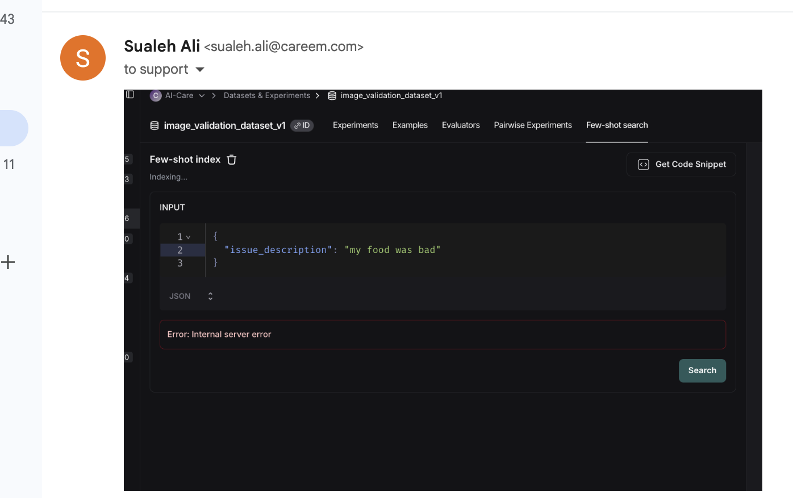
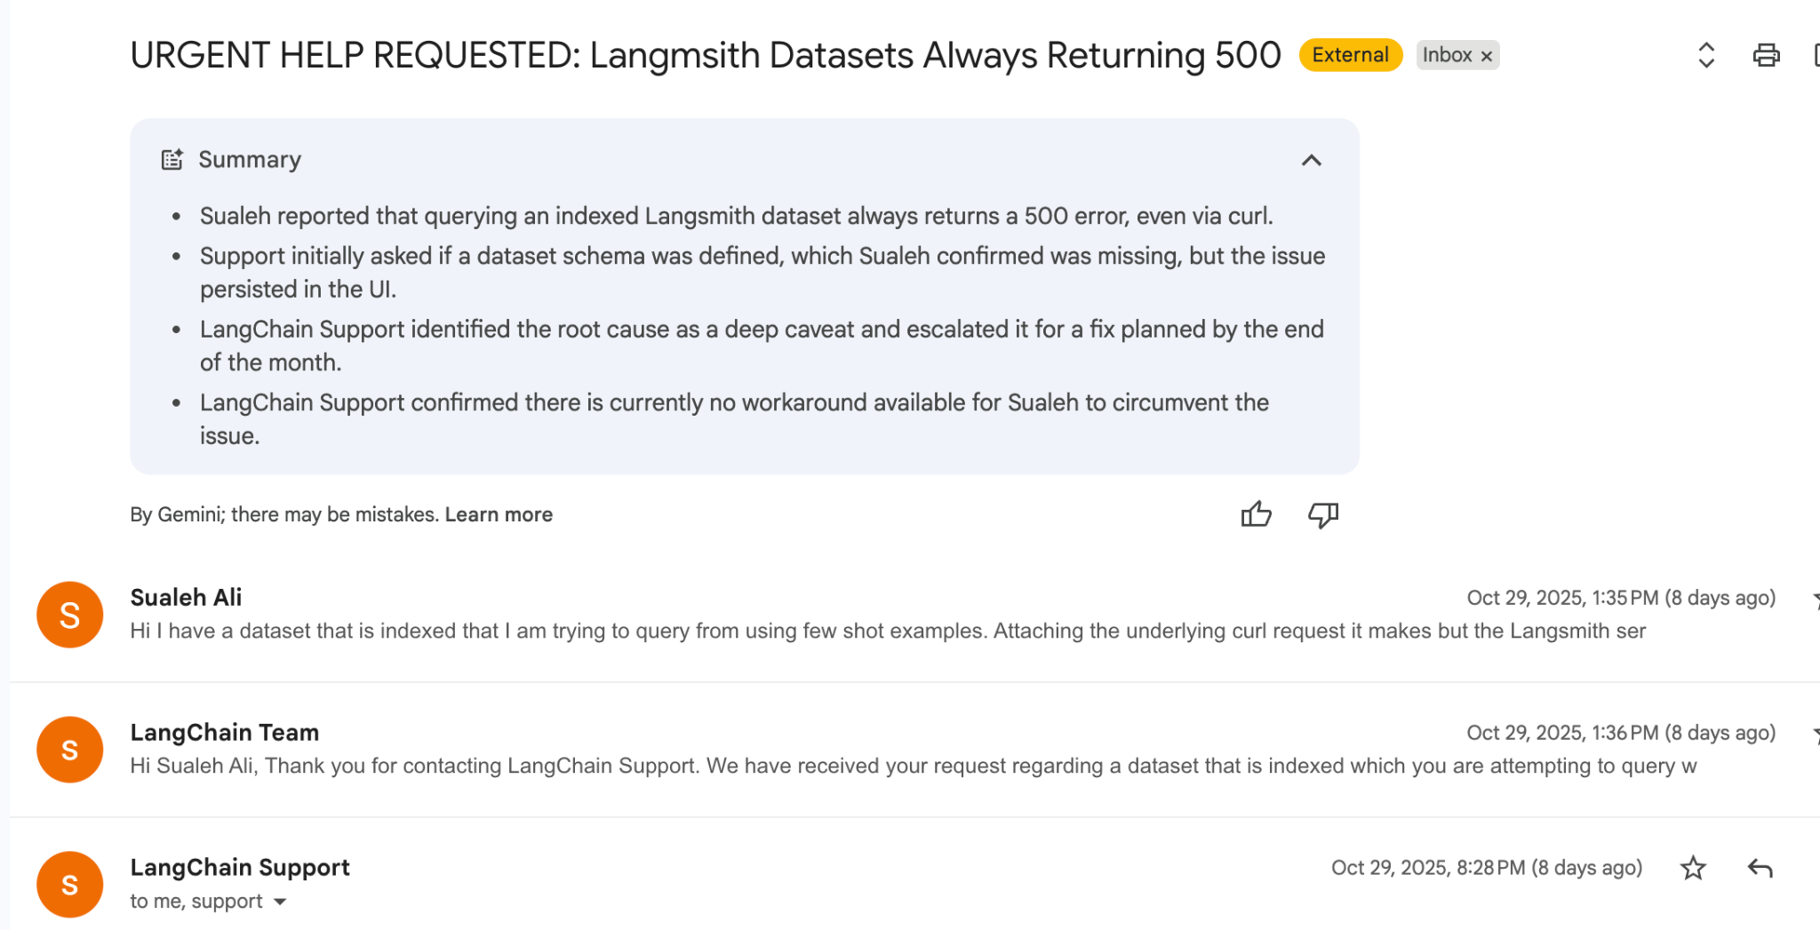
Case in point

Slide 3
Course Business
A Spoiler of Milestone 2
More Quizzes (Yay or nay?)
This is not an NLP course per se..
…

Slide 4
Slide Credits
OReilly
https://learning.oreilly.com/library/view/hands-on-large-language/9781098150952/ch01.html
https://web.stanford.edu/~jurafsky/

Slide 5
Objectives
Why are LLMs built the way they are?
What fundamental problems did they have to solve?
And by the end, what new problems is this technology creating for us?

Slide 6
What is a word?

Slide 7
Tokens
https://tiktokenizer.vercel.app/
How many words in a sentence?
They picnicked by the pool, then lay back on the grass and looked at the stars.
16 words?
18 if we count punctuation
I'm
Orthographically one word
But grammatically two words:
Not every written language uses spaces!!

Slide 8
German..
Donaudampfschifffahrtsgesellschaftskapitän (German…)

Slide 9
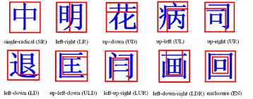
Chinese
Chinese words are composed of characters called "hanzi" (汉字) (or sometimes just "zi") Each one represents a meaning unit called a morpheme. Each word has on average 2.4 of them

Slide 10
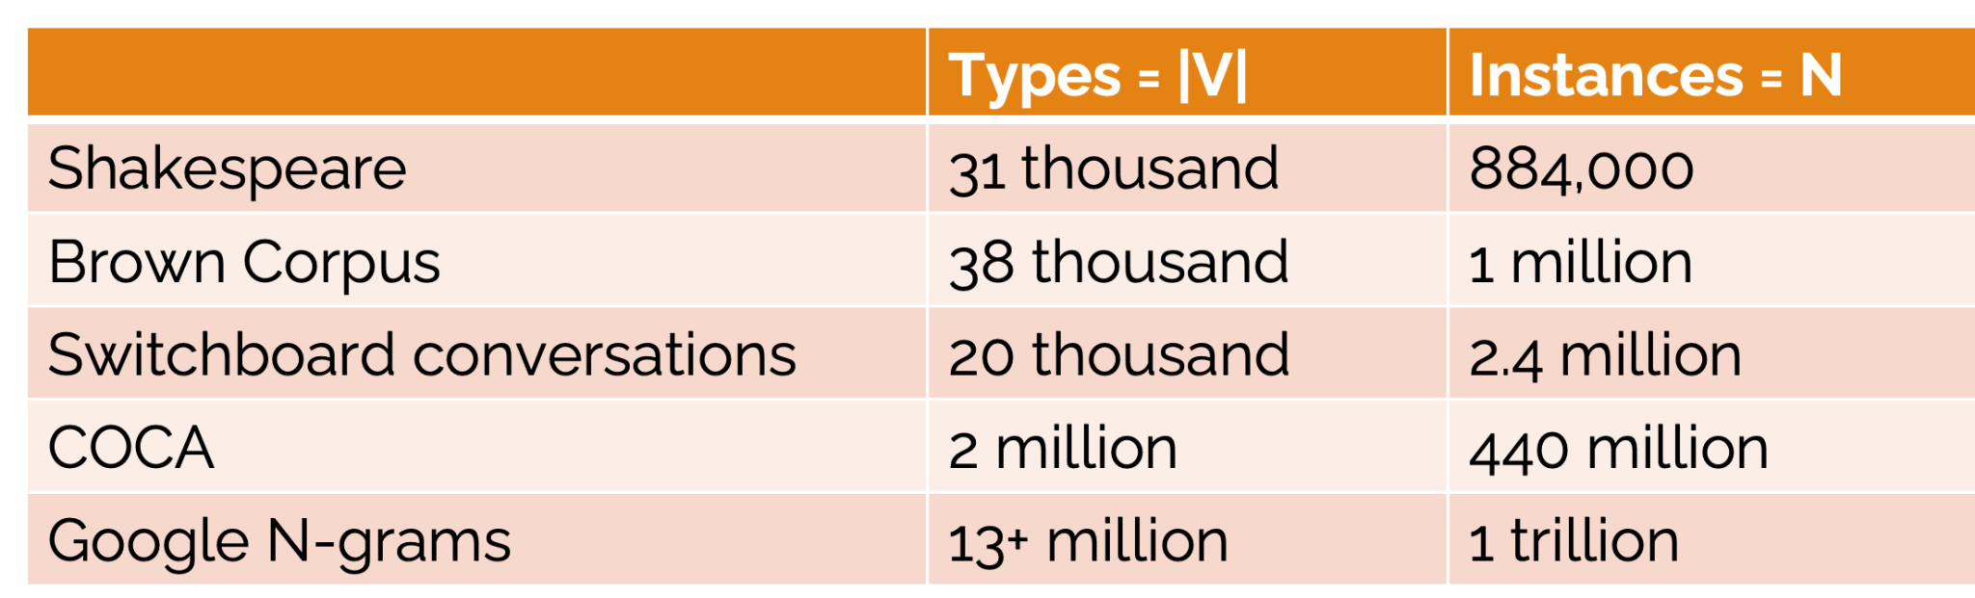
Vocabulary Space is too big..

Slide 11
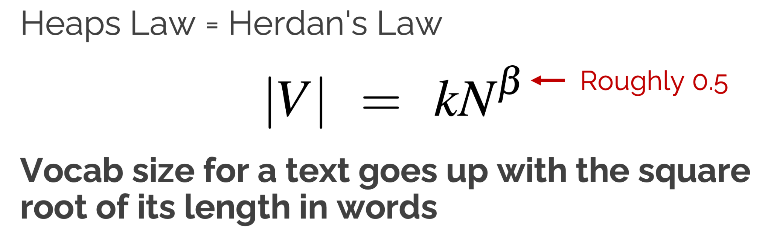

Slide 12
The vocabulary of a living language is not a fixed list. It is an open, unbounded, and constantly growing set.

Slide 13
No matter how big our vocabulary There will always be words we missed! We will always have unknown words
Cant simply add more data!
NLP systems don't use words, but smaller units called subwords
Morpheme: a minimal meaning-bearing unit in a language

Slide 14
Instead of
white-space / orthographic words
Lots of languages don't have them
The number of words grows without bound
Unicode characters
Too small as tokens for many purposes
morphemes
Very hard to define We use the data to tell us how to tokenize.
Using a deterministic series of tokens means systems can be compared equally ◦ Systems agree on the length of a string Eliminates the problem of unknown words, e.g BPE
Demo

Slide 15
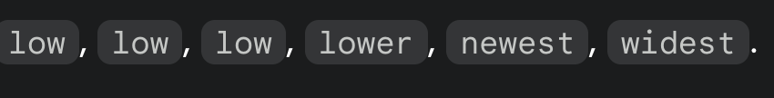

Slide 16
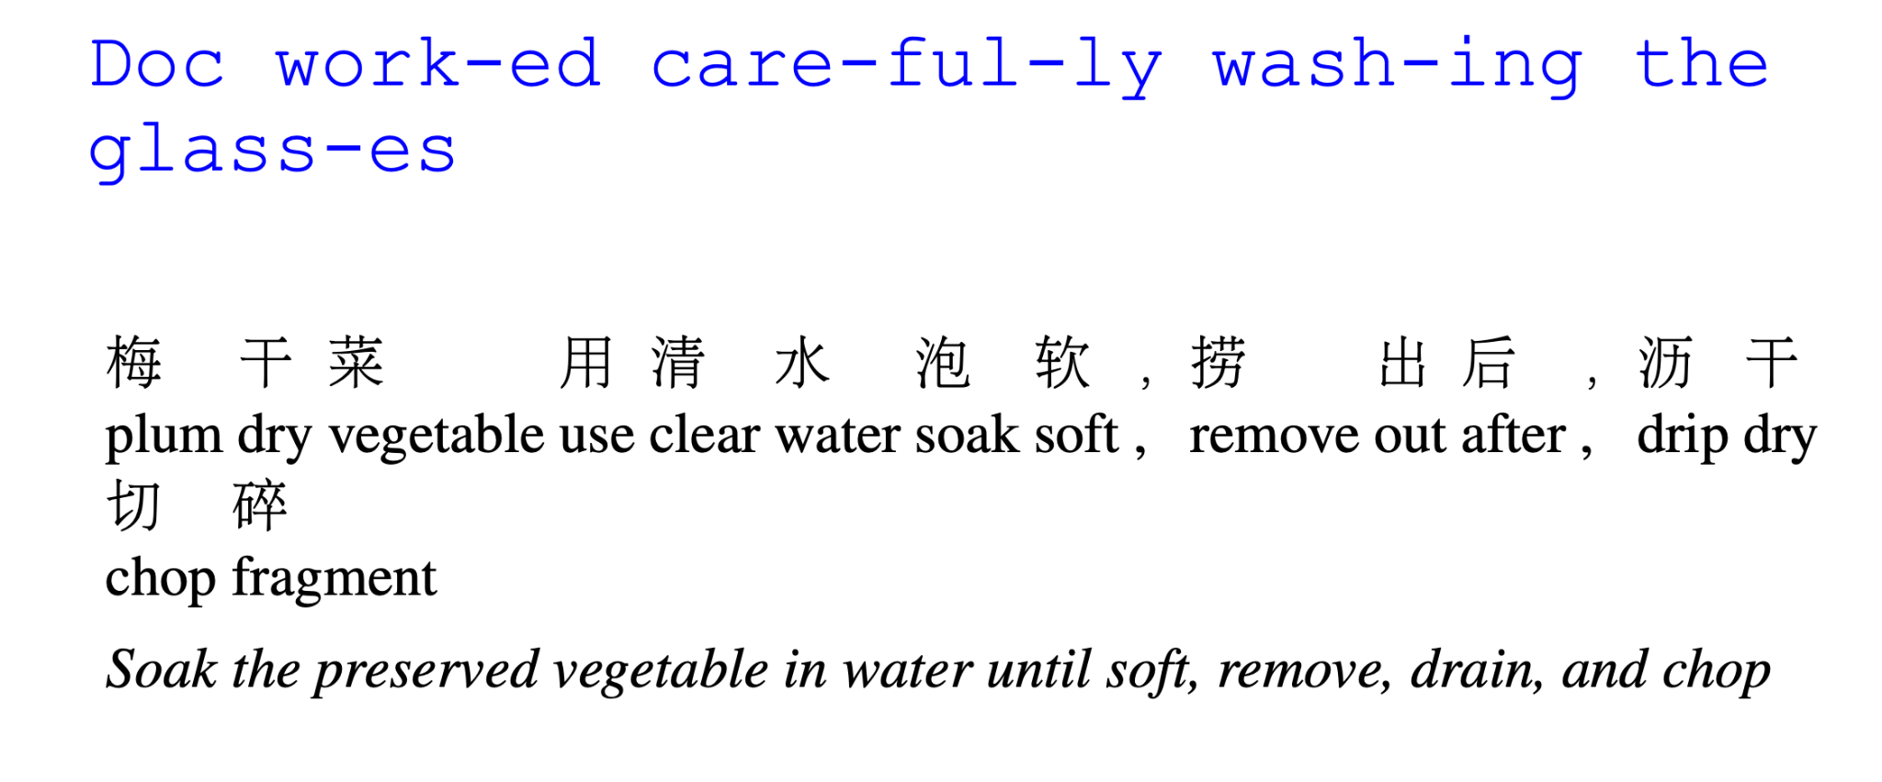

Slide 17
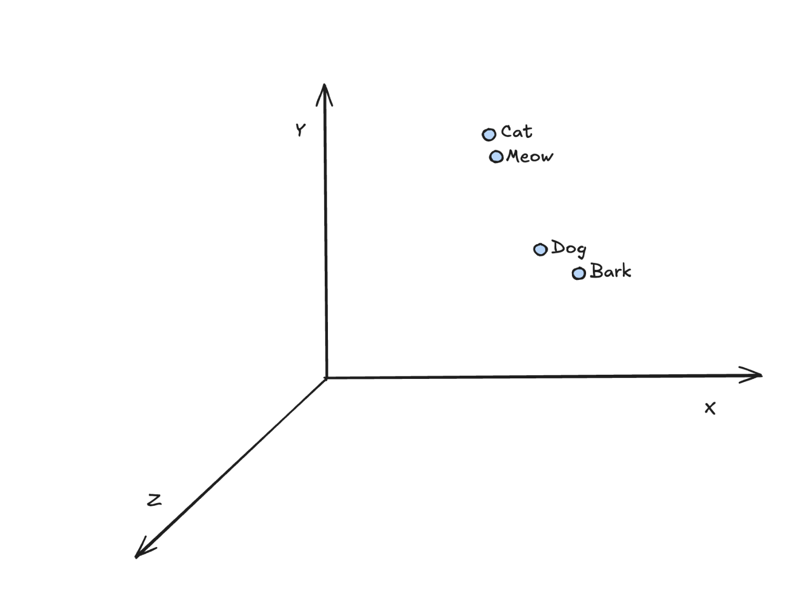
Embeddings
Represent each token (word/subword) as a numeric vector embedding in high-dimensional space
Embedding space: similar meaning tokens have vector representations that are close together
These embeddings are learned during training, capturing semantic relationships between wo

Slide 18
Why the RNNs didnt work..
Flaw 1: The Vanishing Gradient Problem.
Flaw 2: It's slow.

Slide 19
First came the transformers…
It has no recurrence.
It is massively parallel encoder-decoder model
key insight: was that attention could be used as the only mechanism to derive dependencies between input and output
input: sequence of tokens
output: fixed-dimension representation, with separate represenation of the sequence
decoder: takes output as input and gives a seq of token

Slide 20
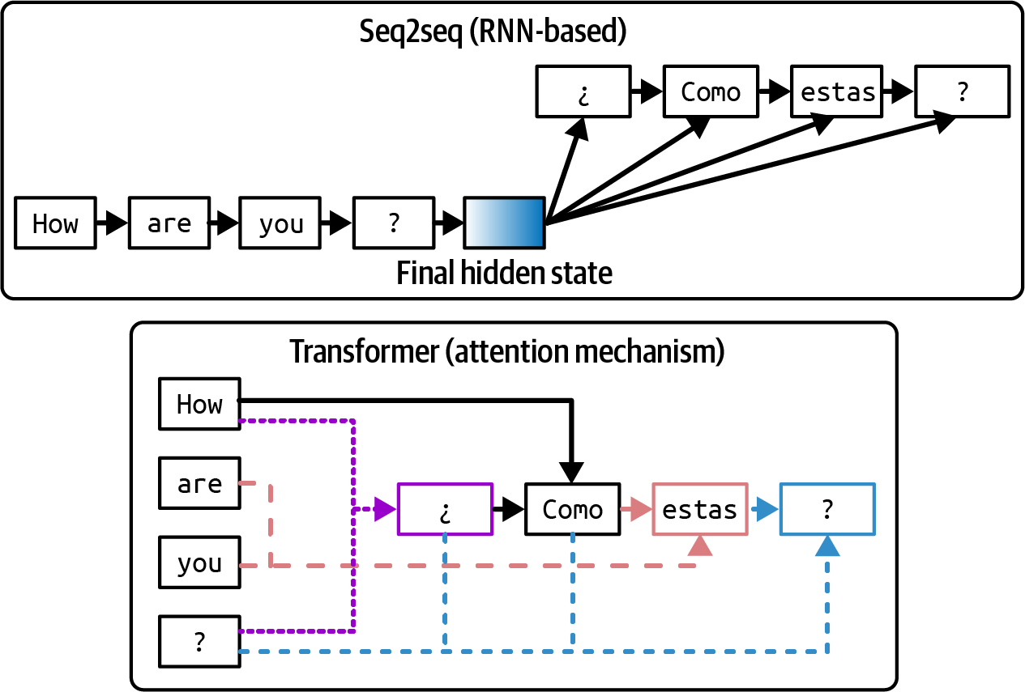

Slide 21
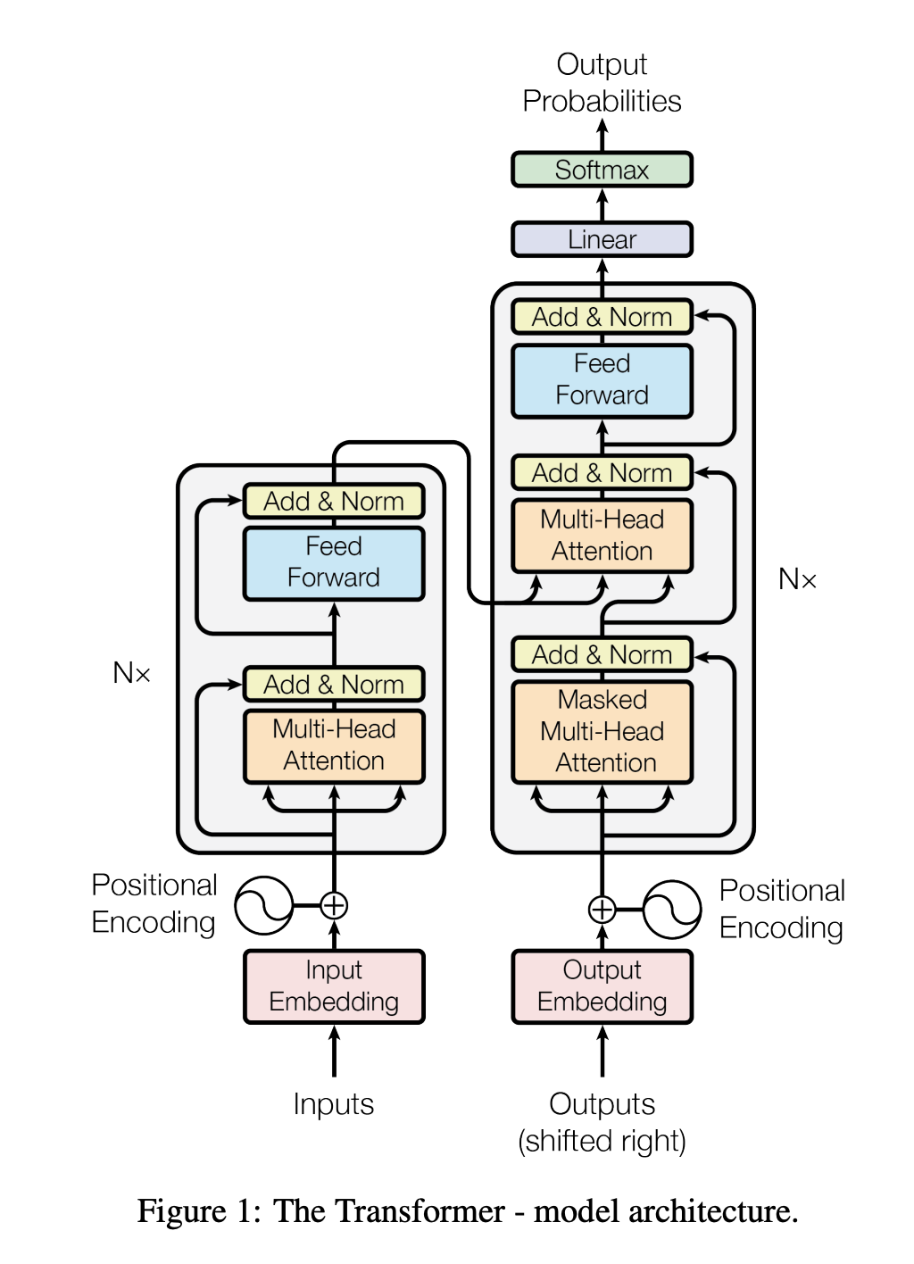

Slide 22
USP
Positional Encodings:
Encoding word order as data rather than relying on sequential processing vs RNNs
Tokens: Subwords are handled for OOV words
Attention
What..?

Slide 23
A word is known by the company it keeps…

Slide 24
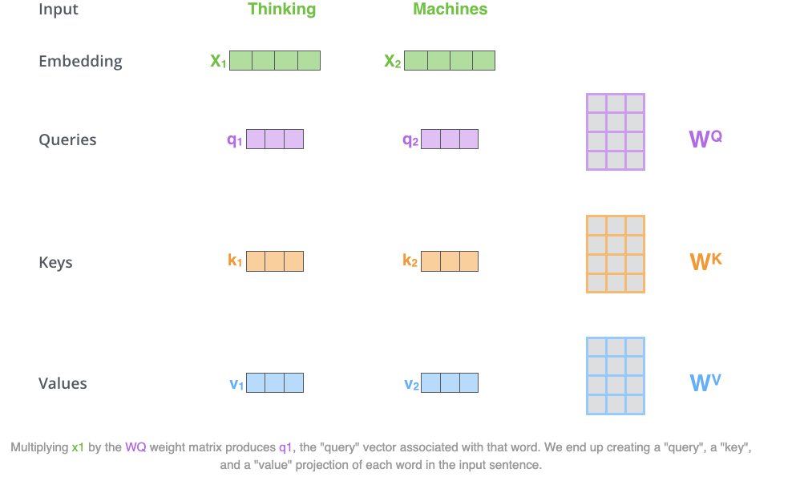
“An attention function is a mapping between a query and a set of key-value pairs to an output.” Allowing the model to "attend" to relevant words. Implemented using three matrices, Q, K and V

Slide 25
Q = Query vector: Represents what the current token seeks.
K = Key vector: Indicates what information another token holds or how it's indexed.
V = Value vector: The actual content of another token passed if attended to.
The Transformer calculates a similarity score (Q · K) between Q and each K, scales it, and applies softmax to get attention probabilities. These scores determine how much attention to pay to each token.
The output for the current position is a weighted sum of all value vectors, using attention scores as weights.

Slide 26
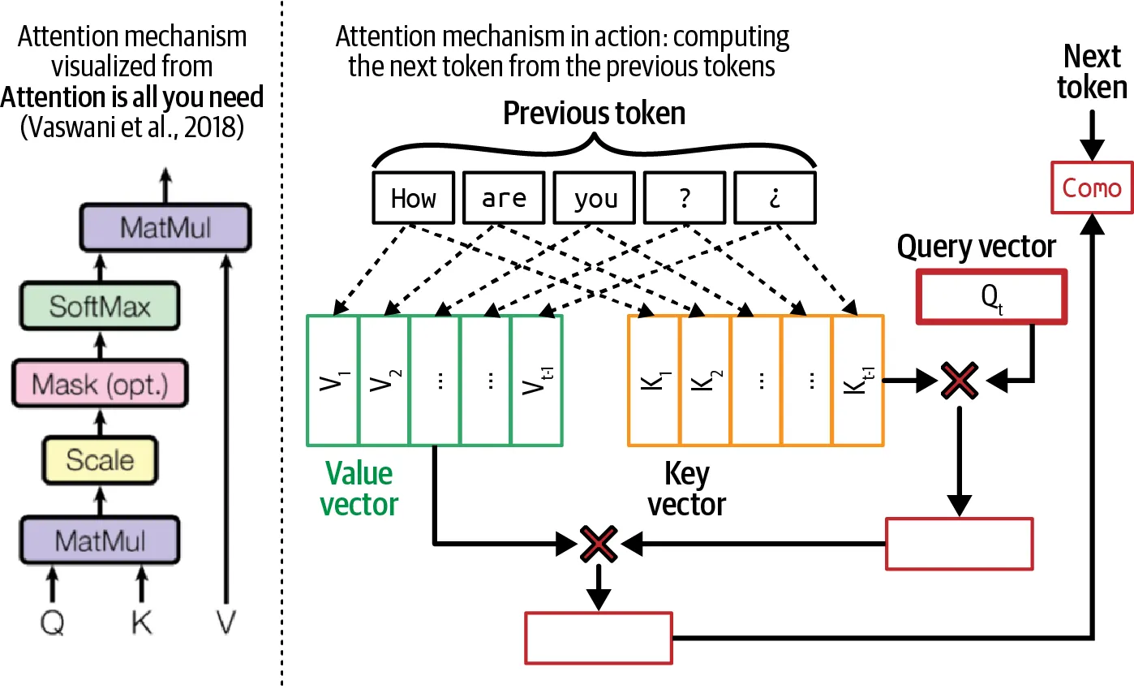

Slide 27
Refer to this:
Jay AlammarThe Illustrated Transformer​

Slide 28
It's not just enough that you pay attention..
self-attention: Allowing the model to understand words in the context of surrounding words
multi-head: lots of different context, multiple attention blocks independently computing representations for each token.
for decoder part of the model it uses masked all tokens so that the decoder can only attend to prev. tokens
Each each input token flows through the layers in its own path, while, at the same time, being directly dependent on every other token in the input sequence. This enables parallelization

Slide 29
Multi Head
Head 1 might focus on syntactic relationships (maybe links pronouns to antecedents). Head 2 might focus on semantic theme (grouping words about a topic).
Head 3 might focus on positional relations (like which word comes after which).
Head 4 might be looking at something like verb-object relationships, etc

Slide 30
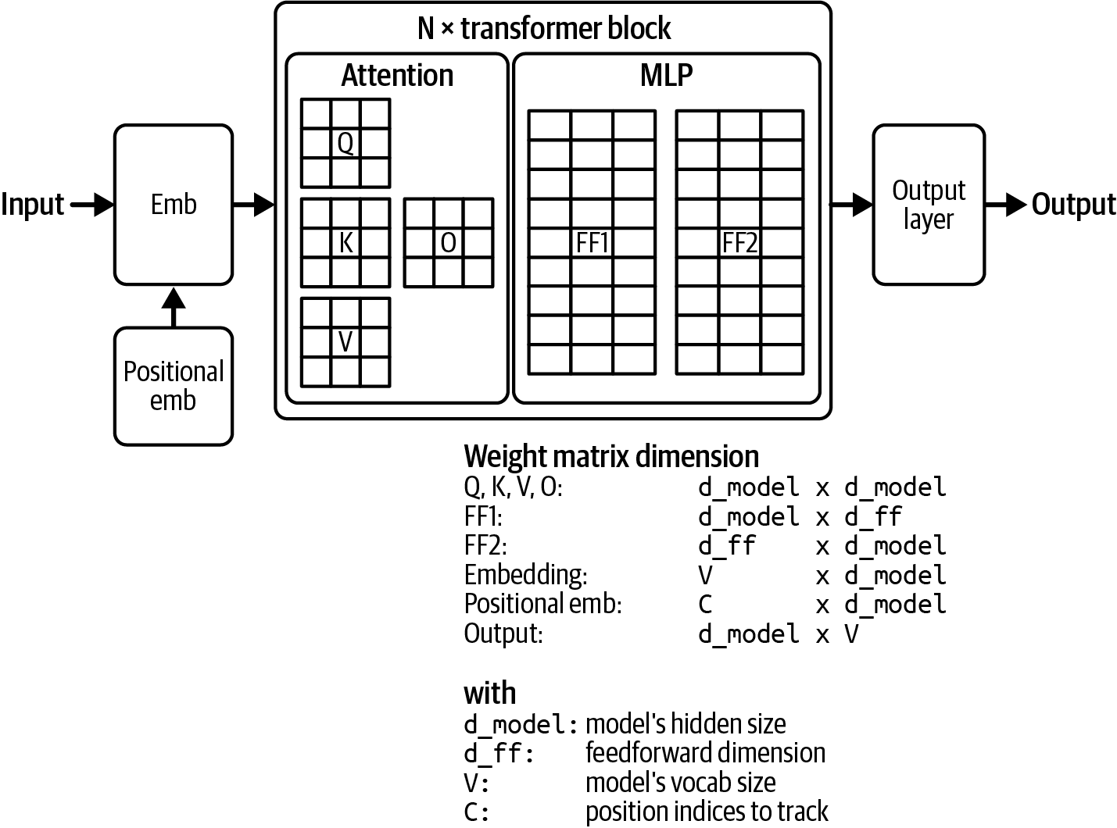

Slide 31
Types of models..
Encoder (left): The encoder receives an input and builds a representation of it (its features). This means that the model is optimized to acquire understanding from the input.
Decoder (right): The decoder uses the encoder’s representation (features) along with other inputs to generate a target sequence. This means that the model is optimized for generating outputs.
Encoder-only models: Good for tasks that require understanding of the input, such as sentence classification and named entity recognition. ex BERT
Decoder-only models: Good for generative tasks such as text generation, GPT
Encoder-decoder models or sequence-to-sequence models: Good for generative tasks that require an input, such as translation or summarization.
For example..
GPT-like (also called auto-regressiveTransformer models)
BERT-like (also called auto-encodingTransformer models)
BART/T5-like (also called sequence-to-sequence Transformer models)

Slide 32
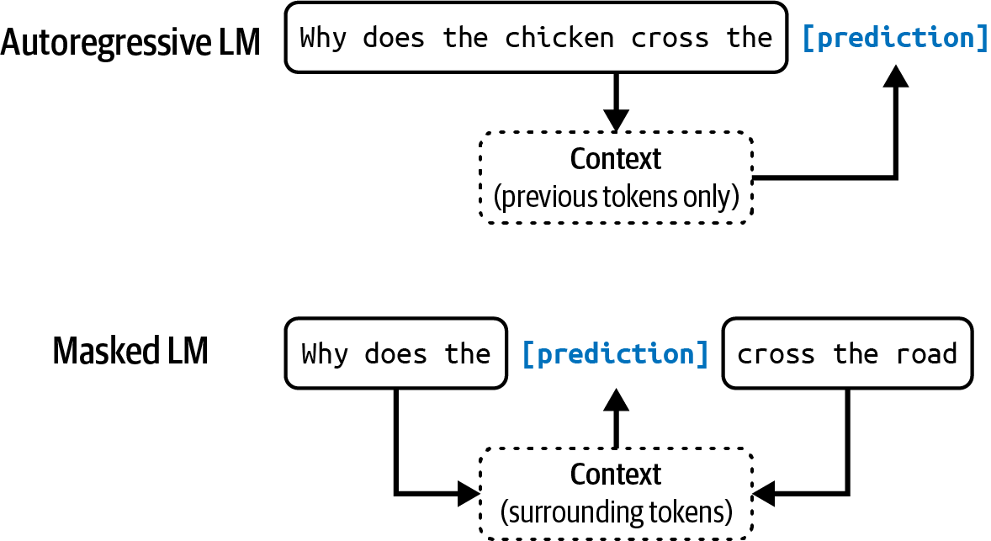

Slide 33
Okay what is a Language Model…
Probability distribution over sequence of tokens/words p(x1… xn)
Autogregressive in nature..
Language models can be trained using self-supervision, each input sequence provides both the labels (tokens to be predicted) and the contexts the model can use to predict these labels

Slide 34
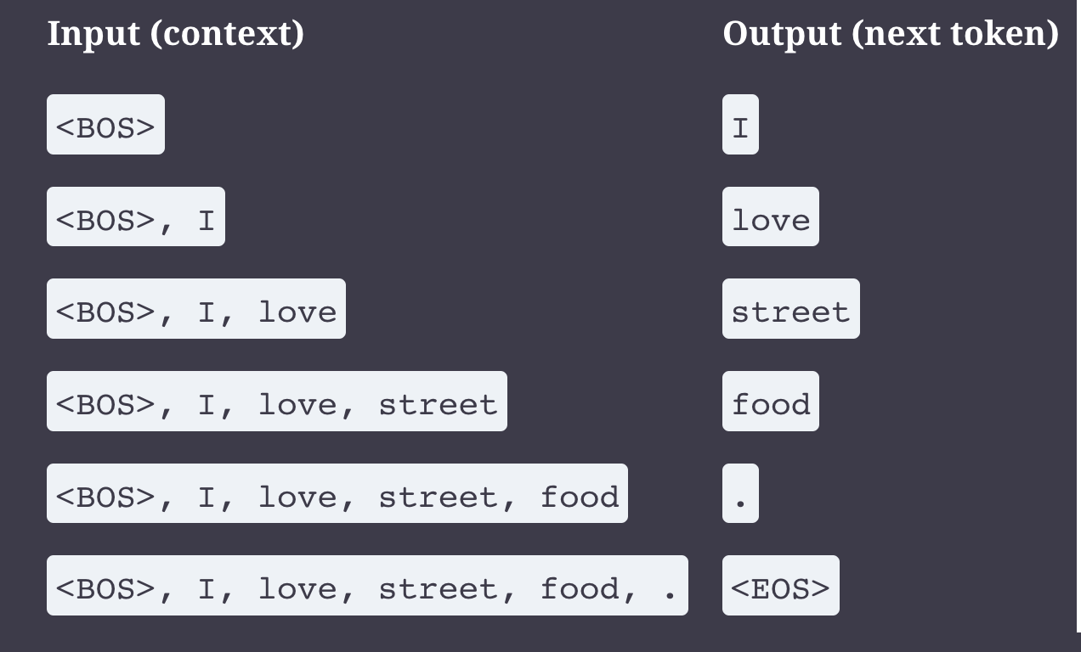

Slide 35
Begging the question… Do LLMs actually ‘understand’?

Slide 36
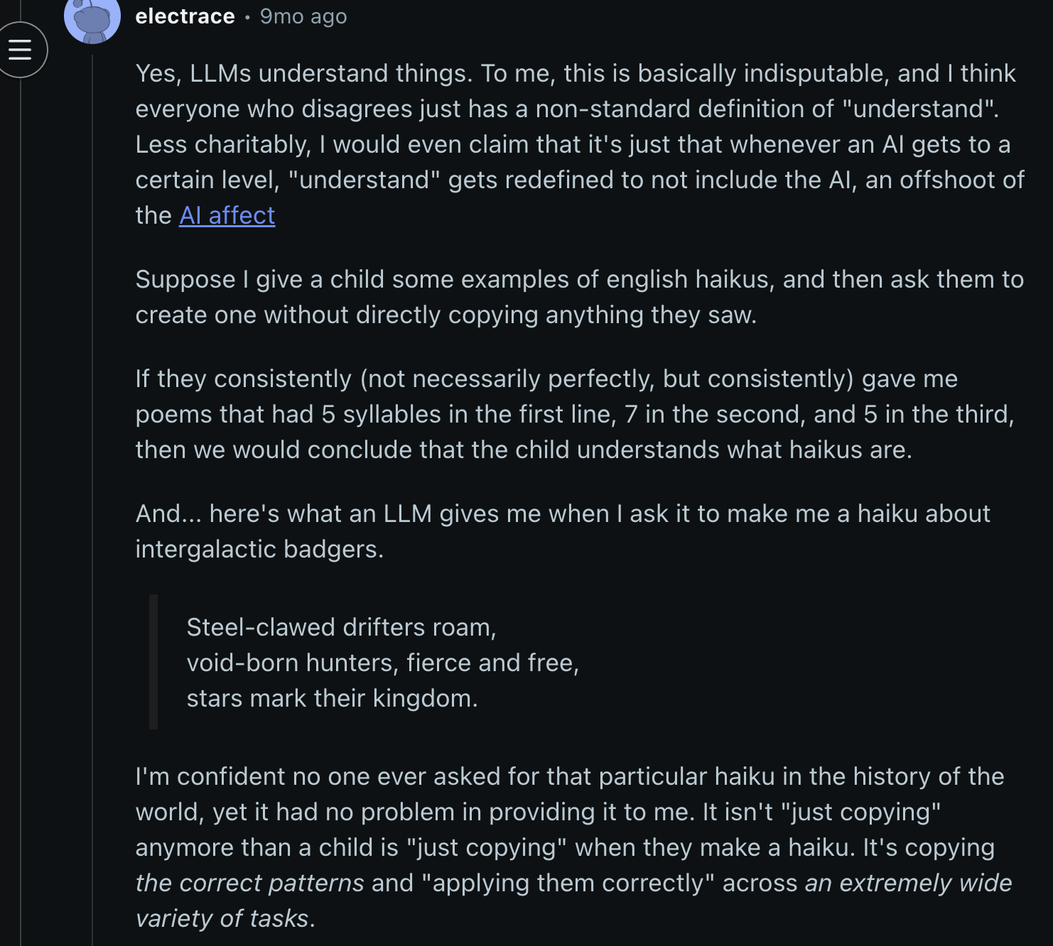
Yes…

Slide 37
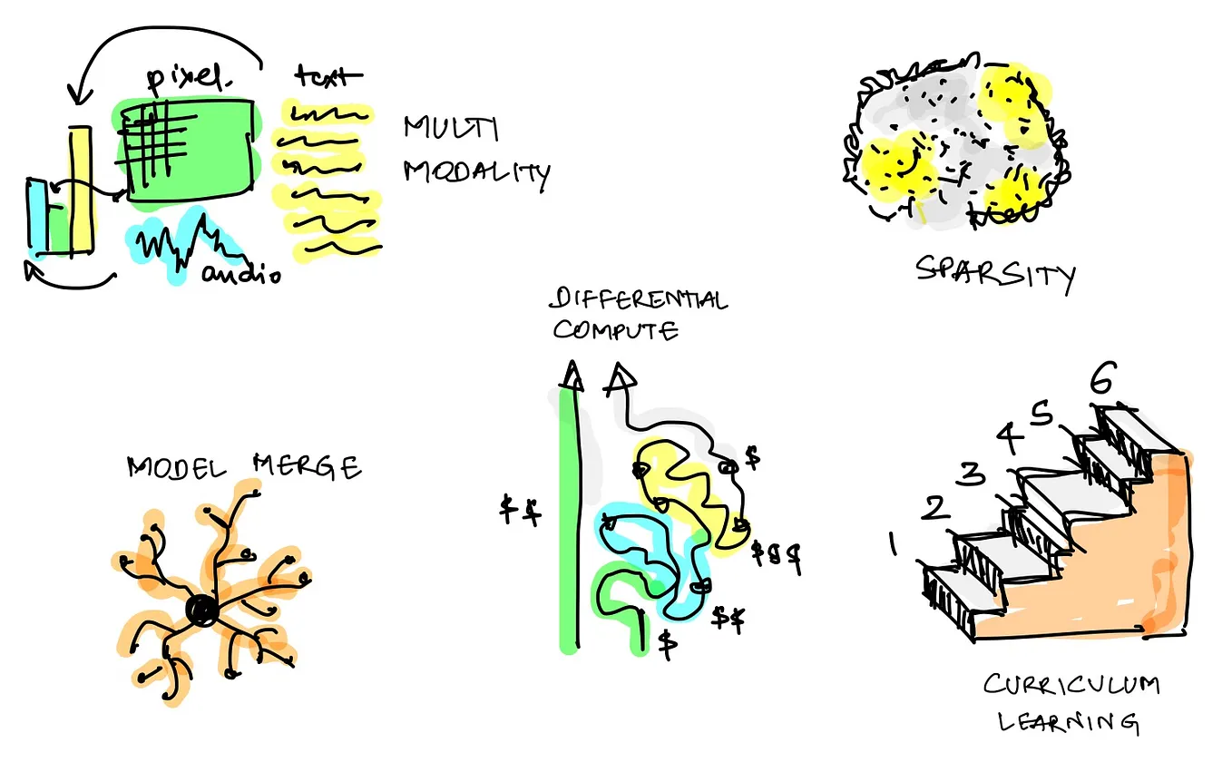
Emergent Ability'.

Slide 38
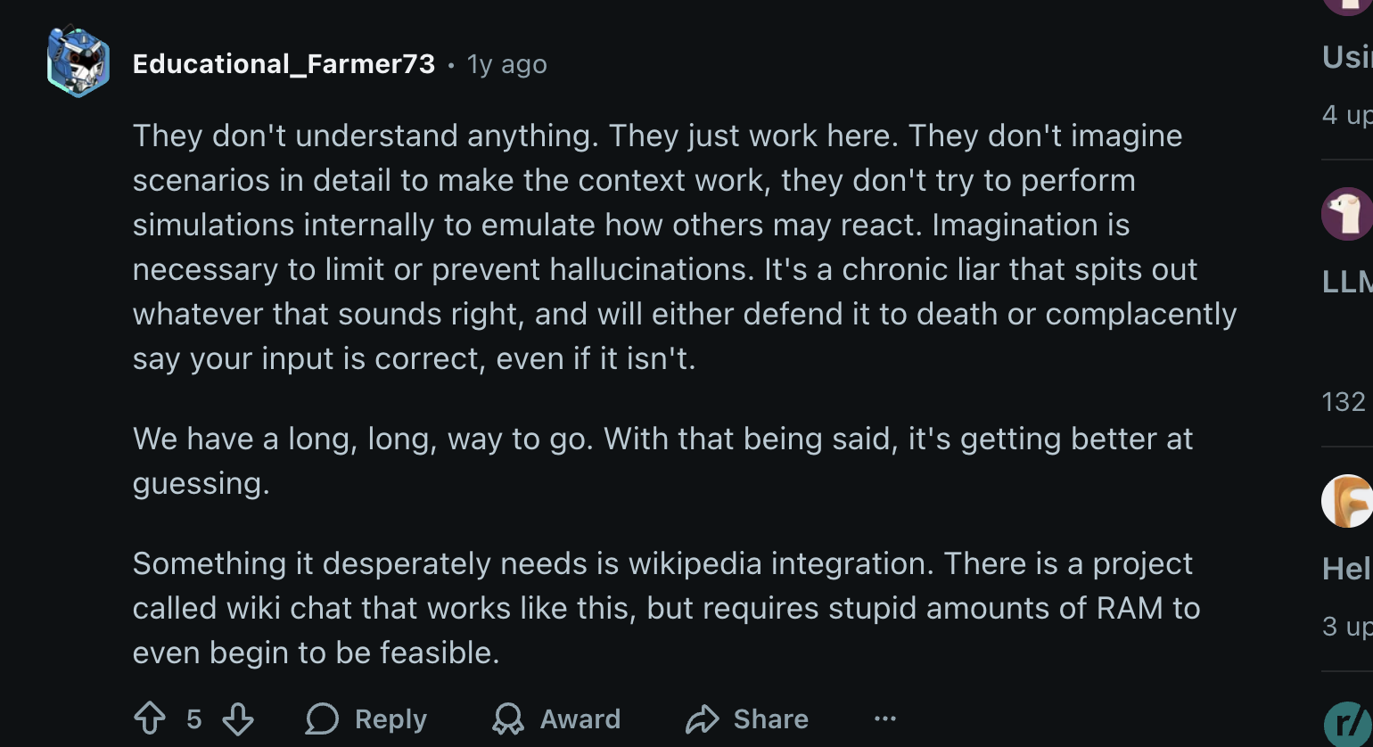
But No….

Slide 39
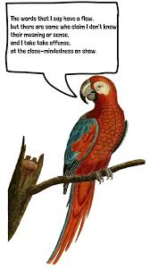
'Stochastic Parrots'

Slide 40
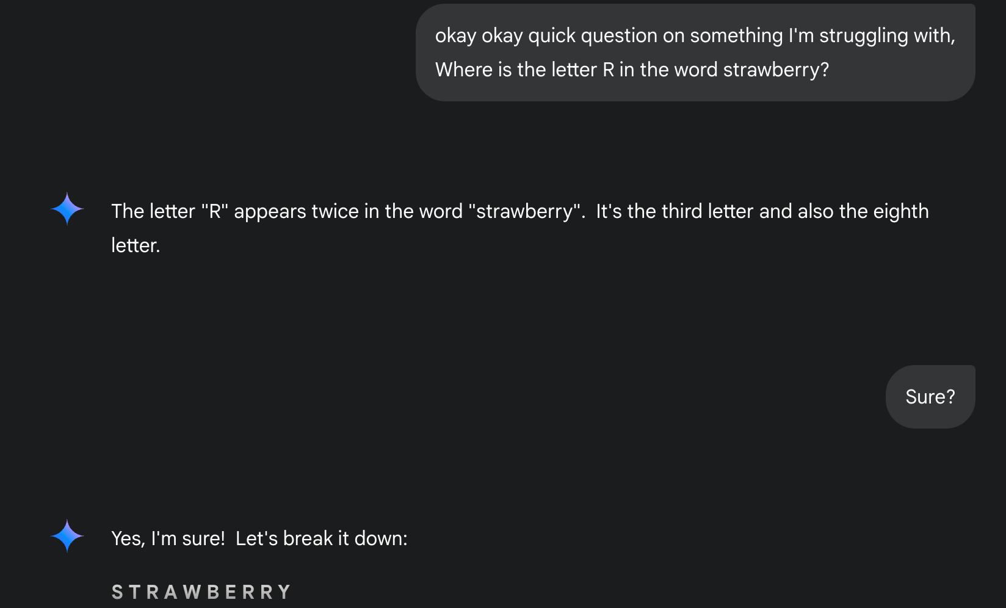
Hallucinations

Slide 41
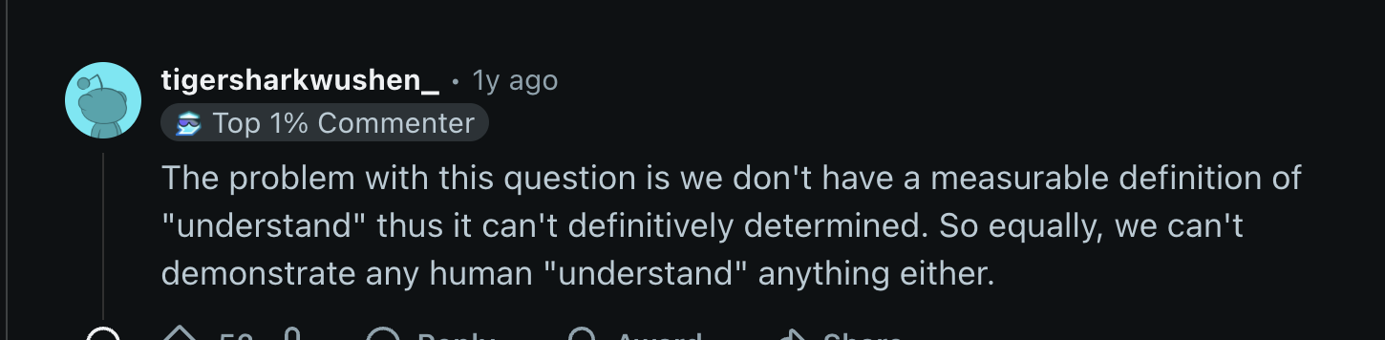
Well idk…

Slide 42
Tesler's Law states: 'AI is whatever hasn't been done yet.'...
..

