Slide 1
Cloud Platform Services for MLOps & LLMOps
AWS • Microsoft Azure • Google Cloud Platform

Slide 2
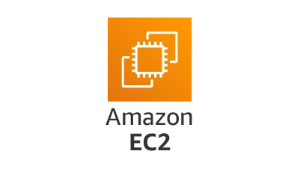
Compute

Slide 3
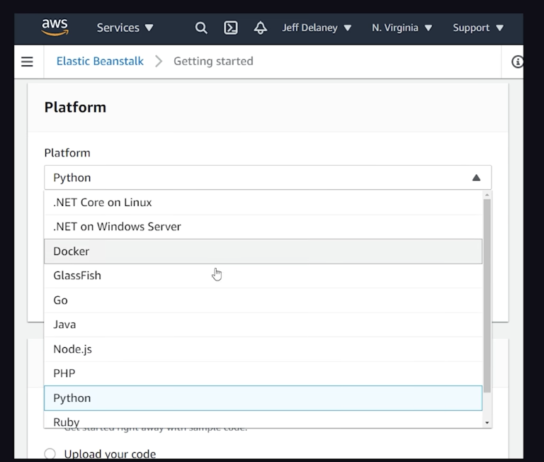
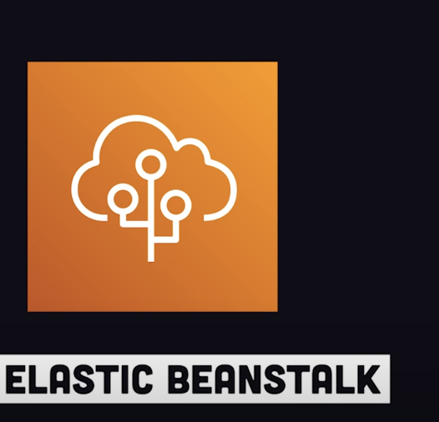
PaaS

Slide 4
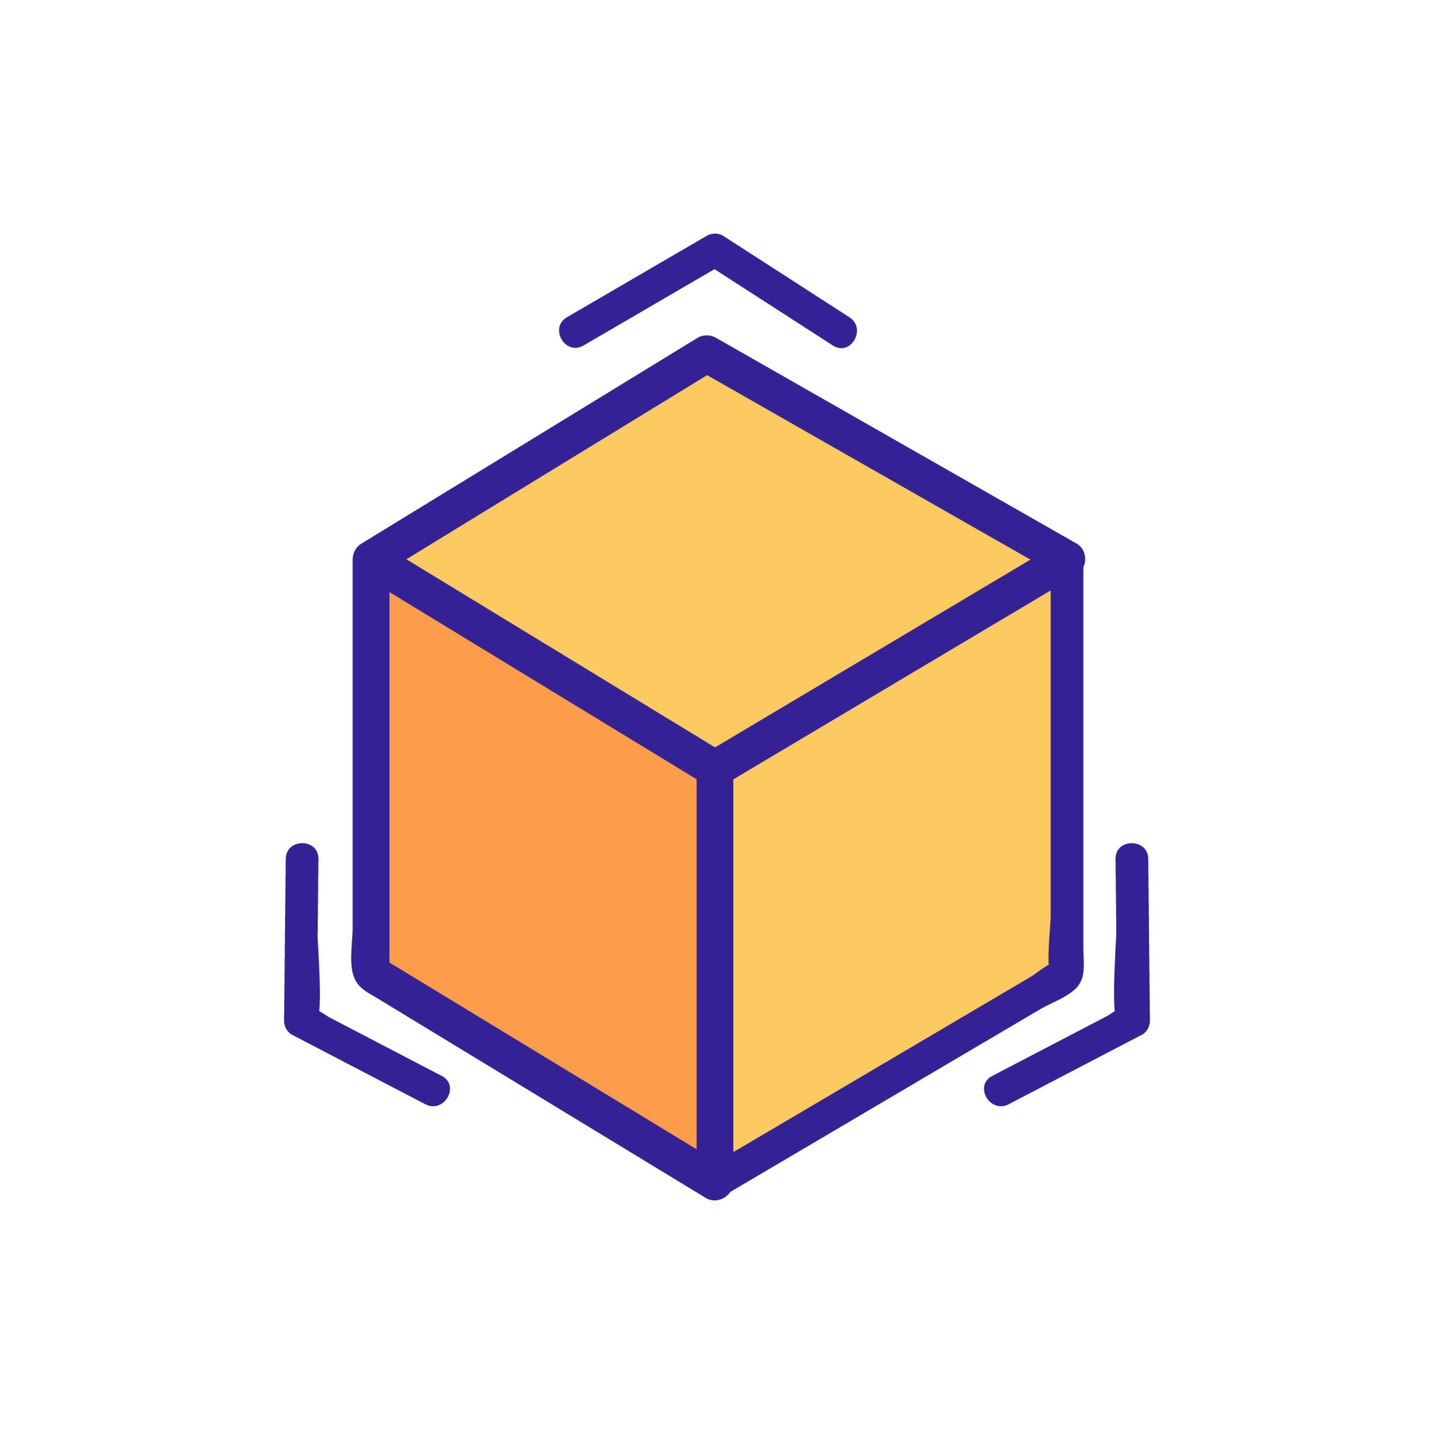
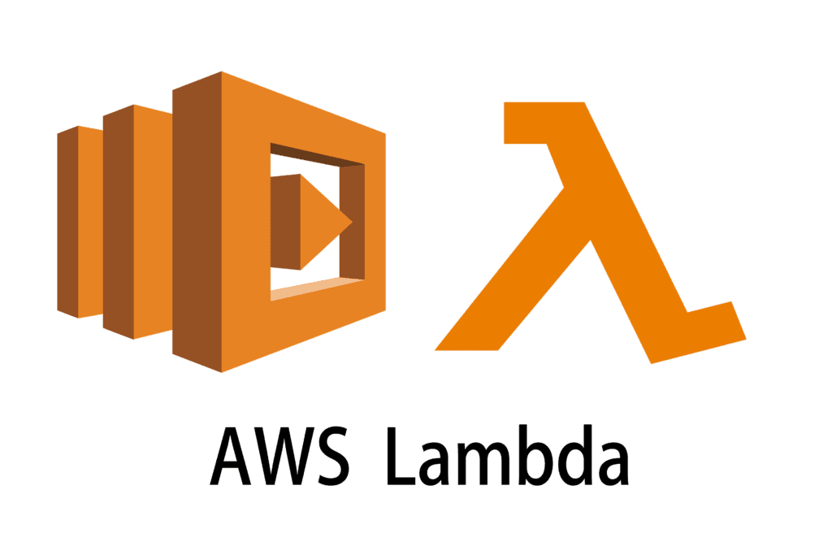
Containers and Serverless
Faas?

Slide 5
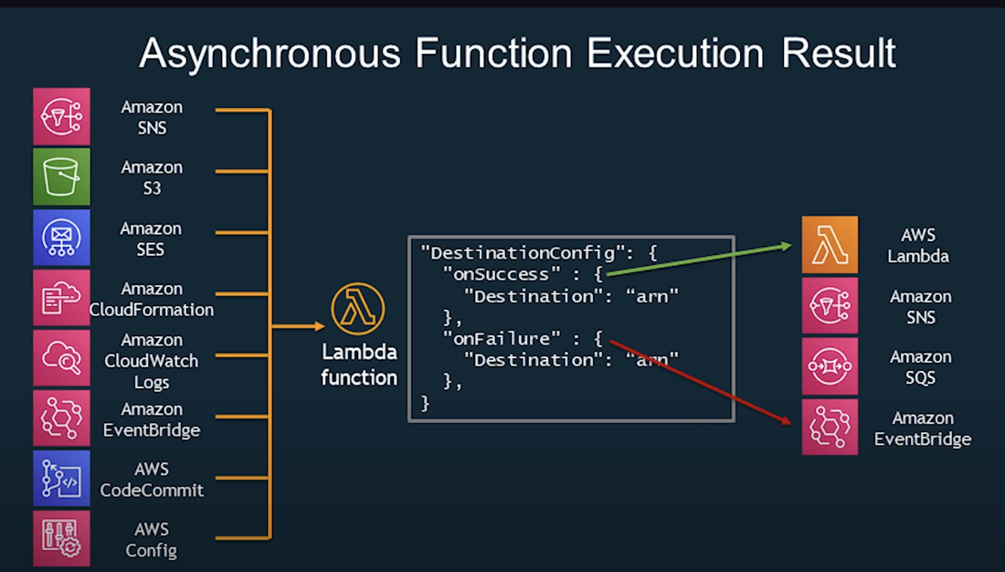

Slide 6
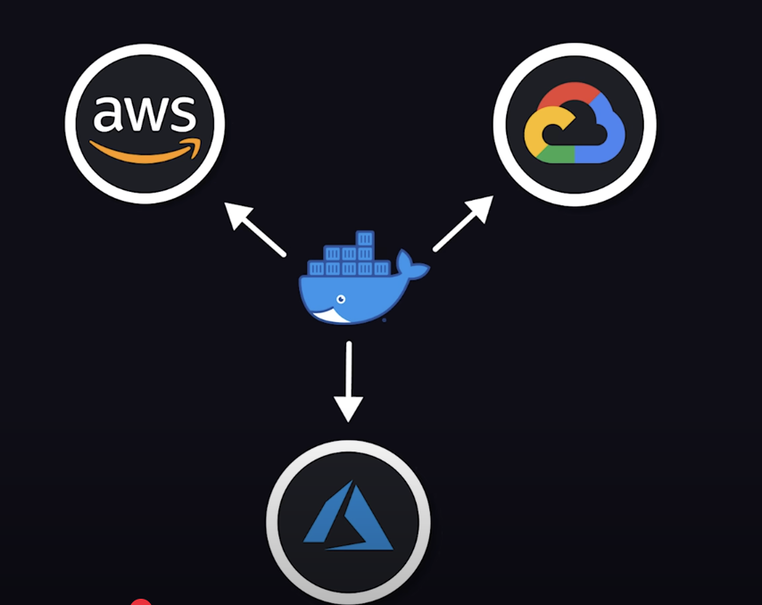

Slide 7
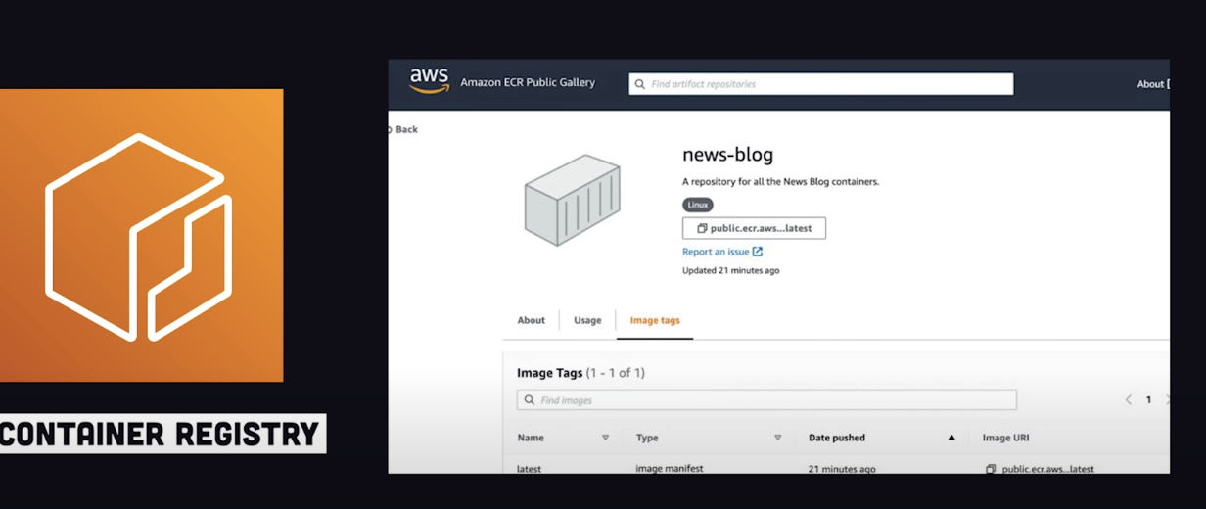

Slide 8
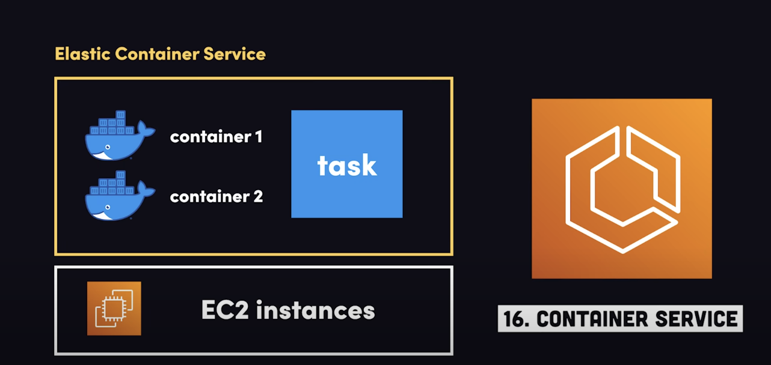

Slide 10
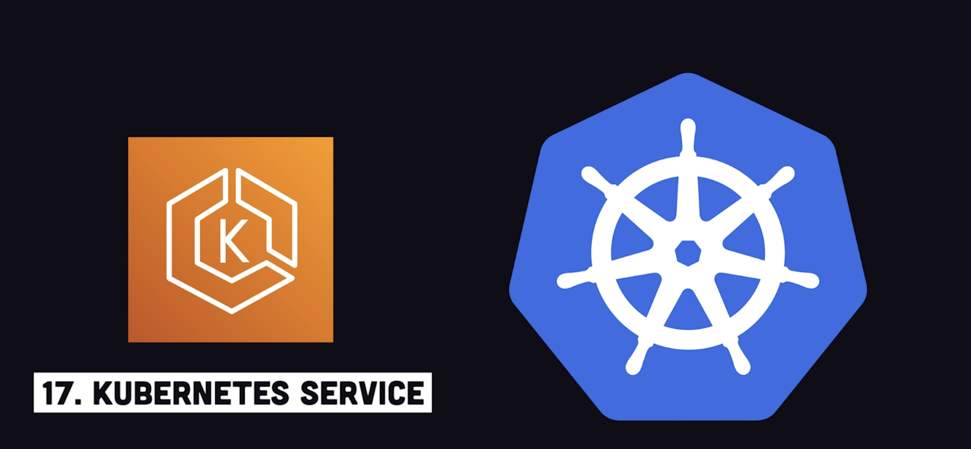

Slide 11
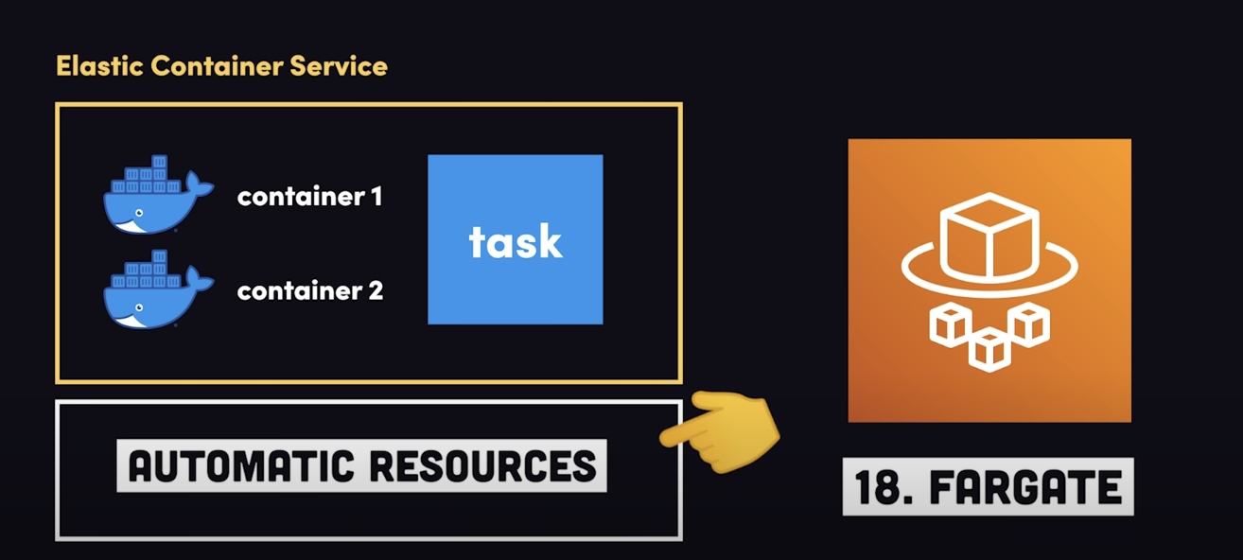
containers behave like serverless functions

Slide 12

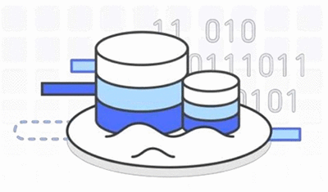
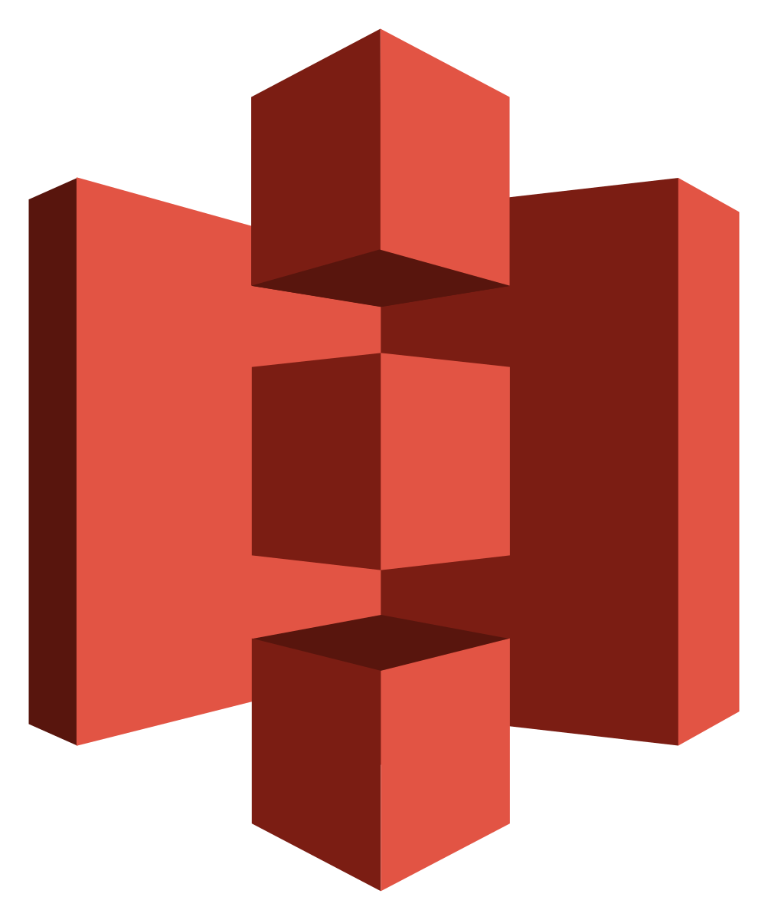
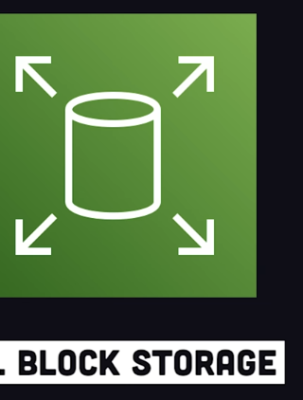
Storage and Data Lakes

Slide 13
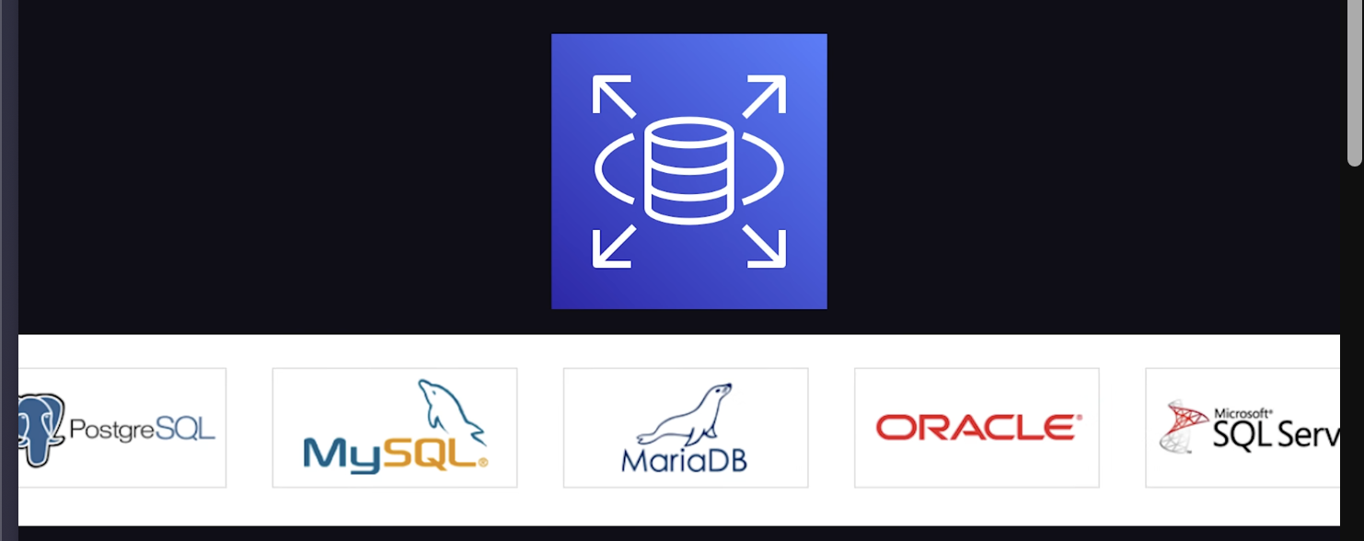
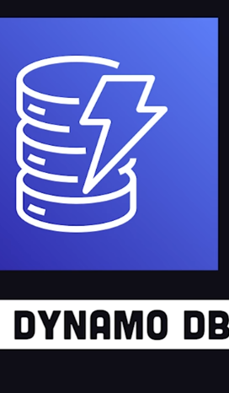
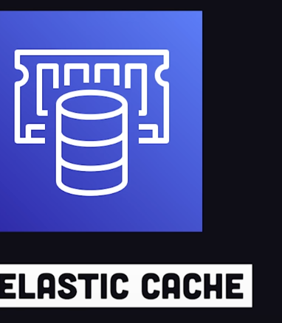
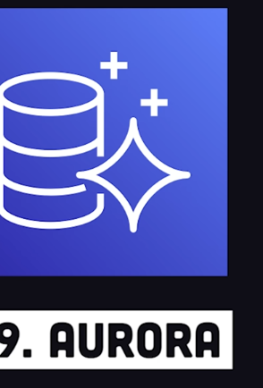
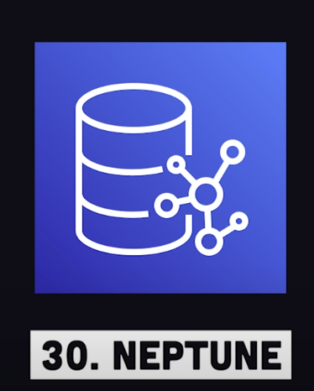
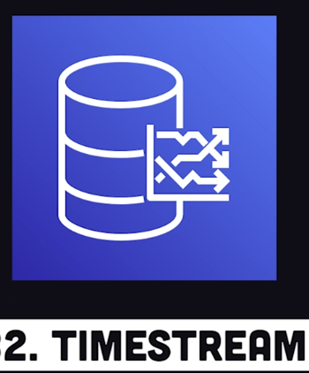

Slide 14
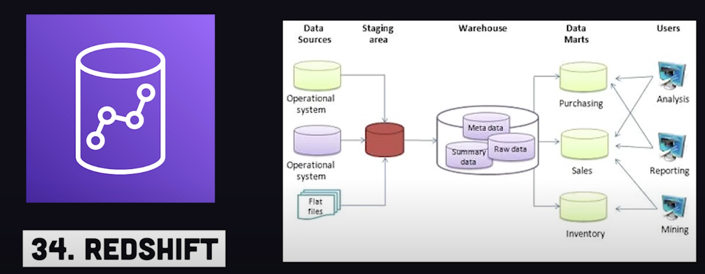
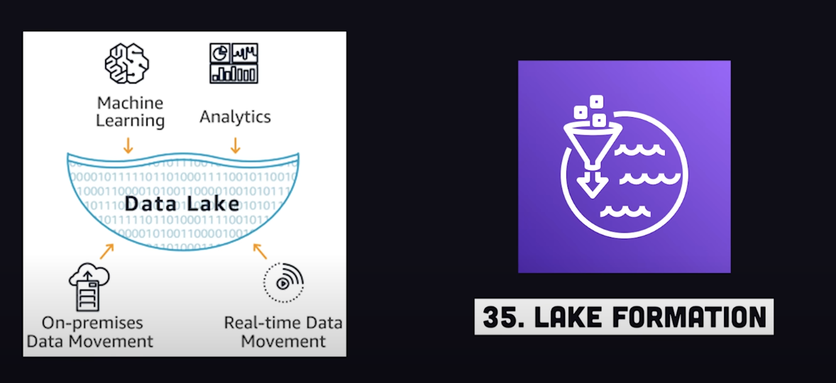

Slide 15
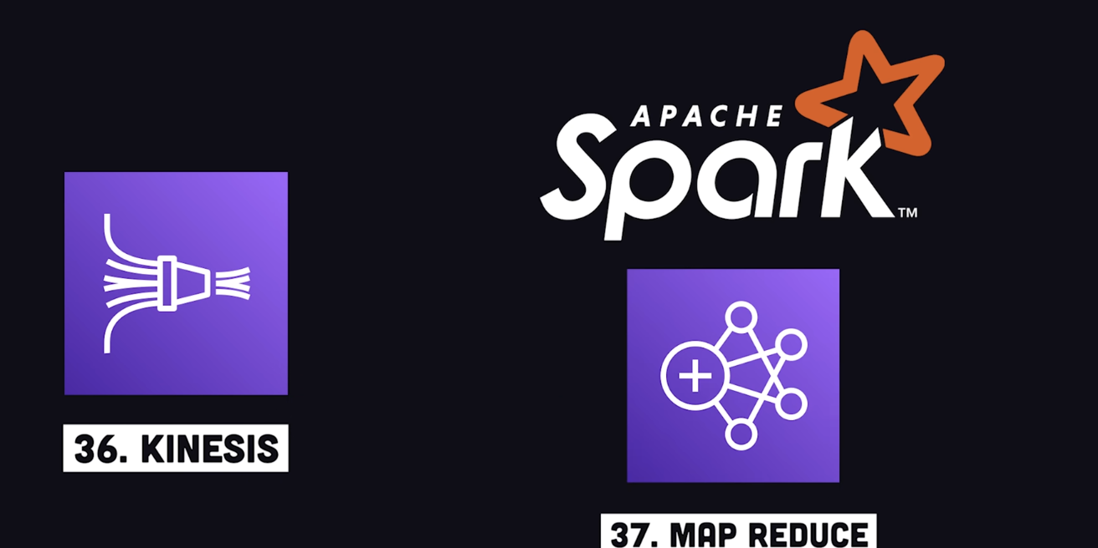

Slide 16
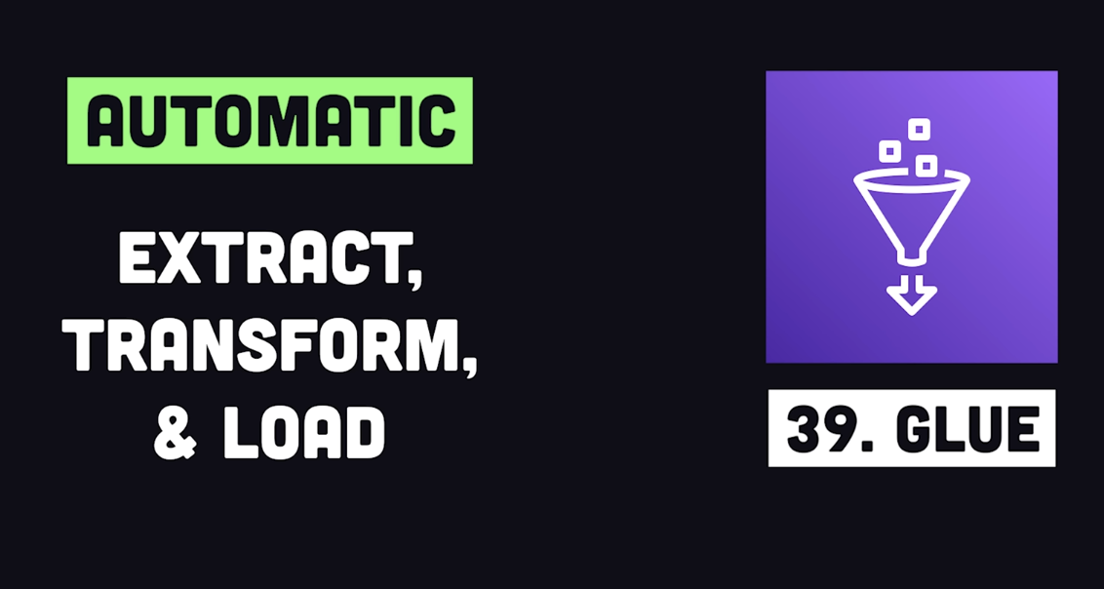

Slide 17
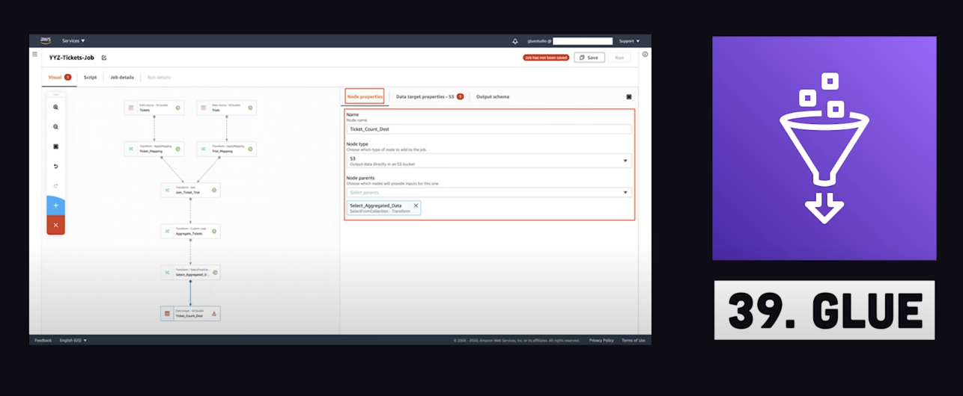

Slide 18
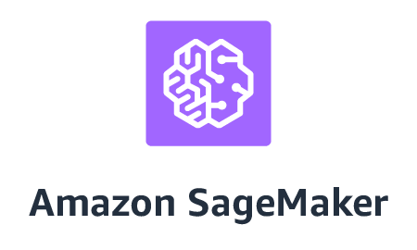

Slide 19
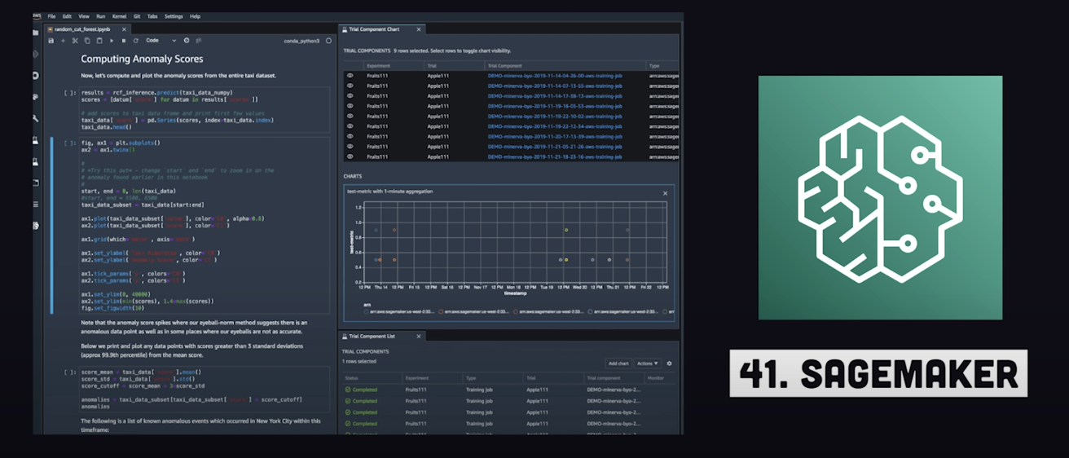

Slide 20
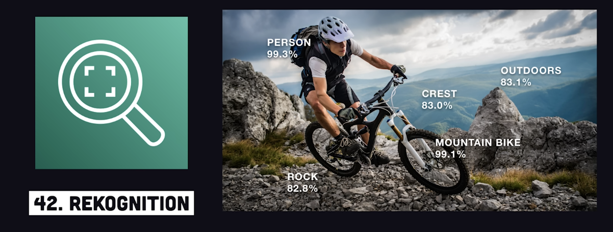
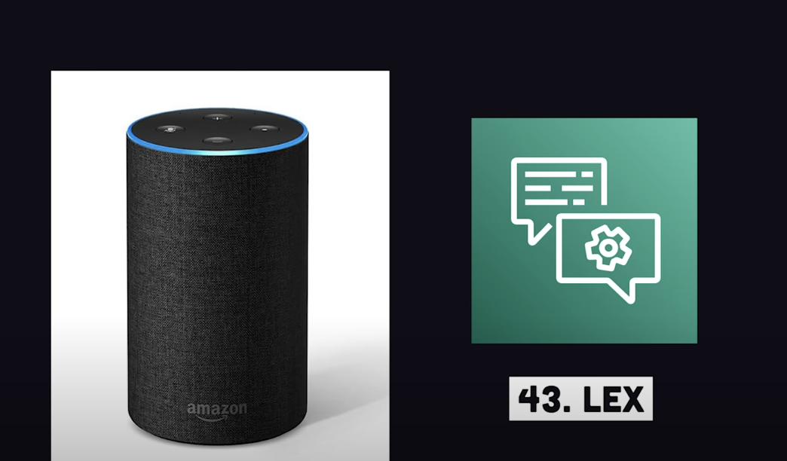

Slide 21
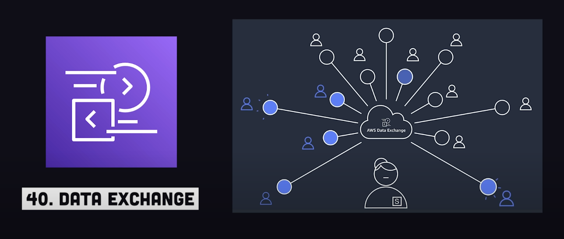

Slide 22
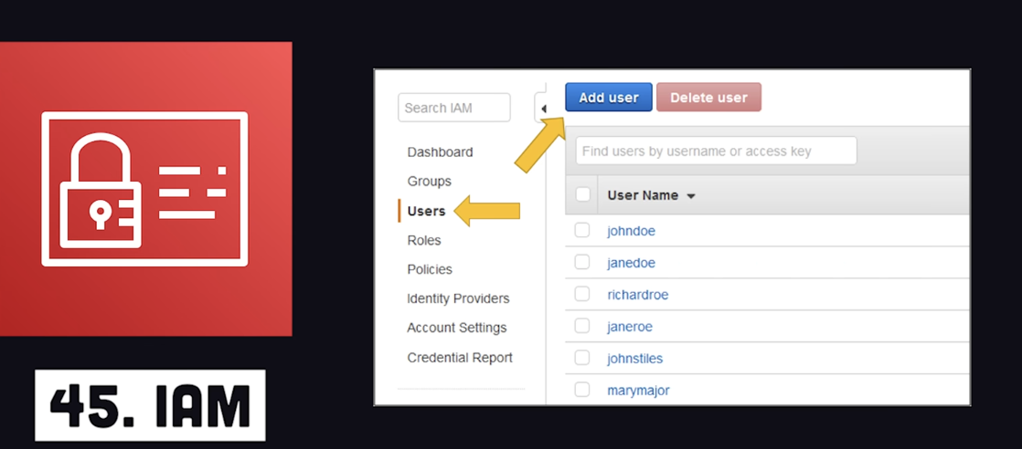
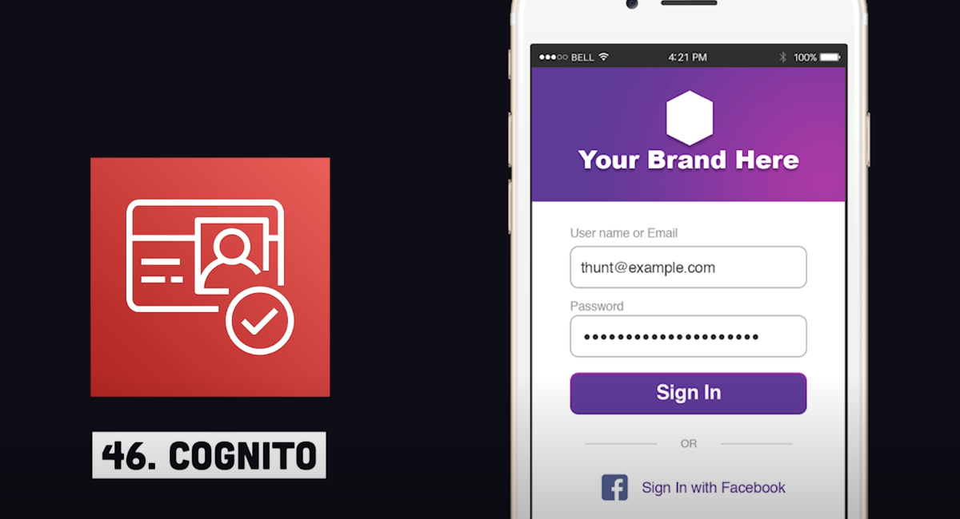

Security, Auth

Slide 23
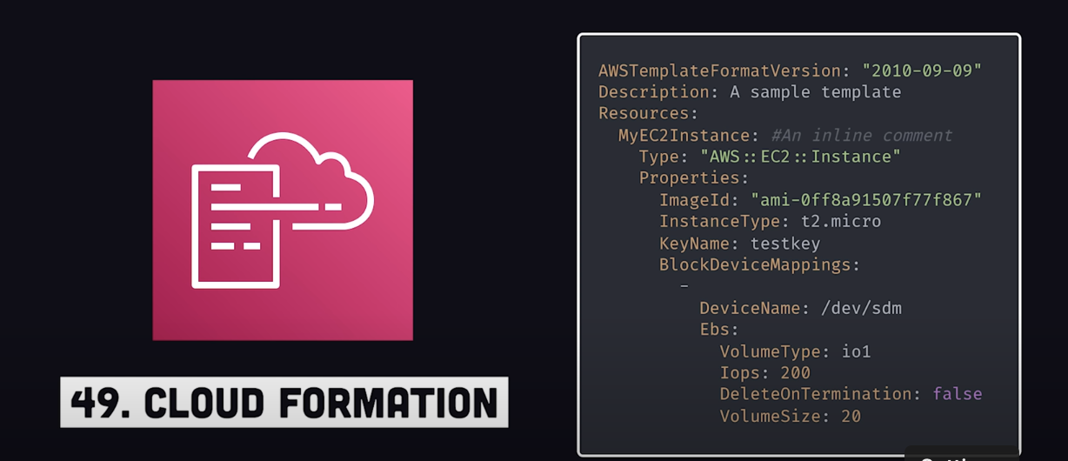
IaC

Slide 24
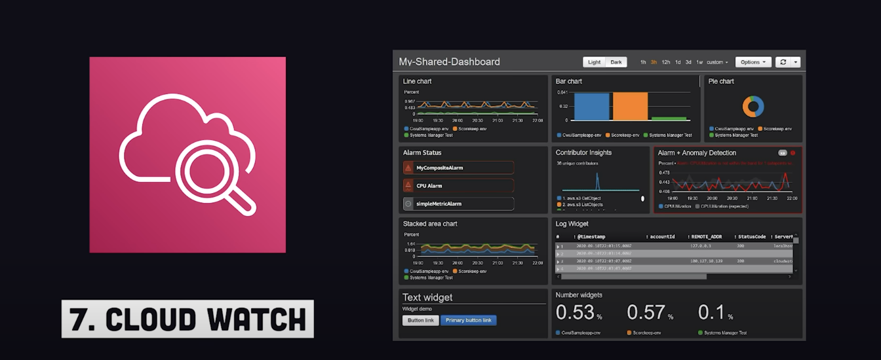

Slide 25
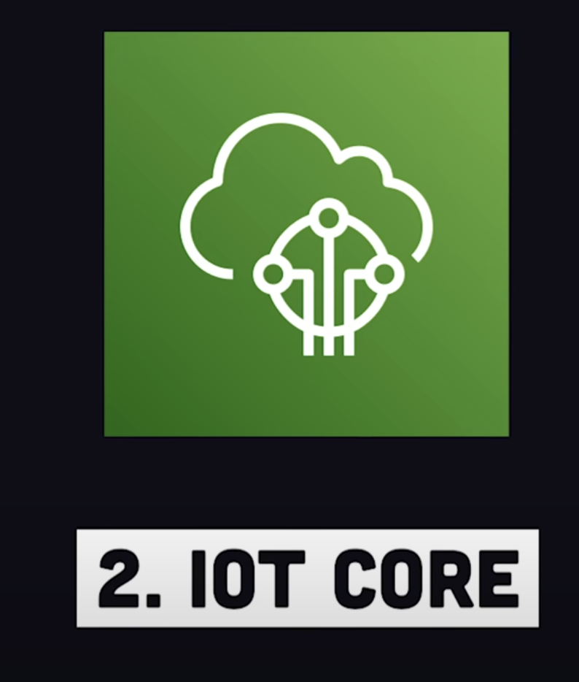
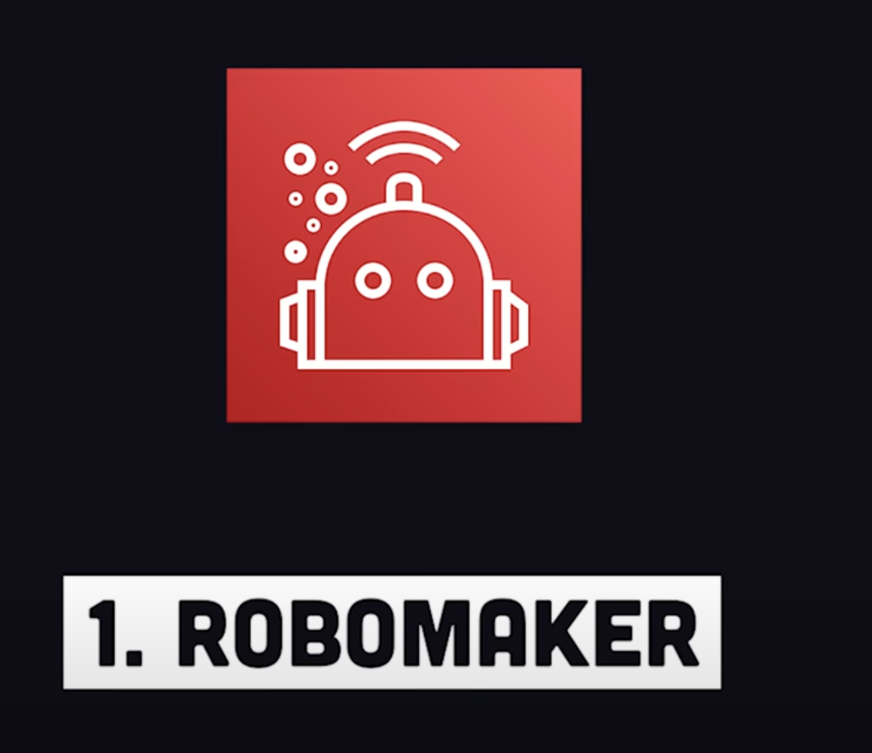
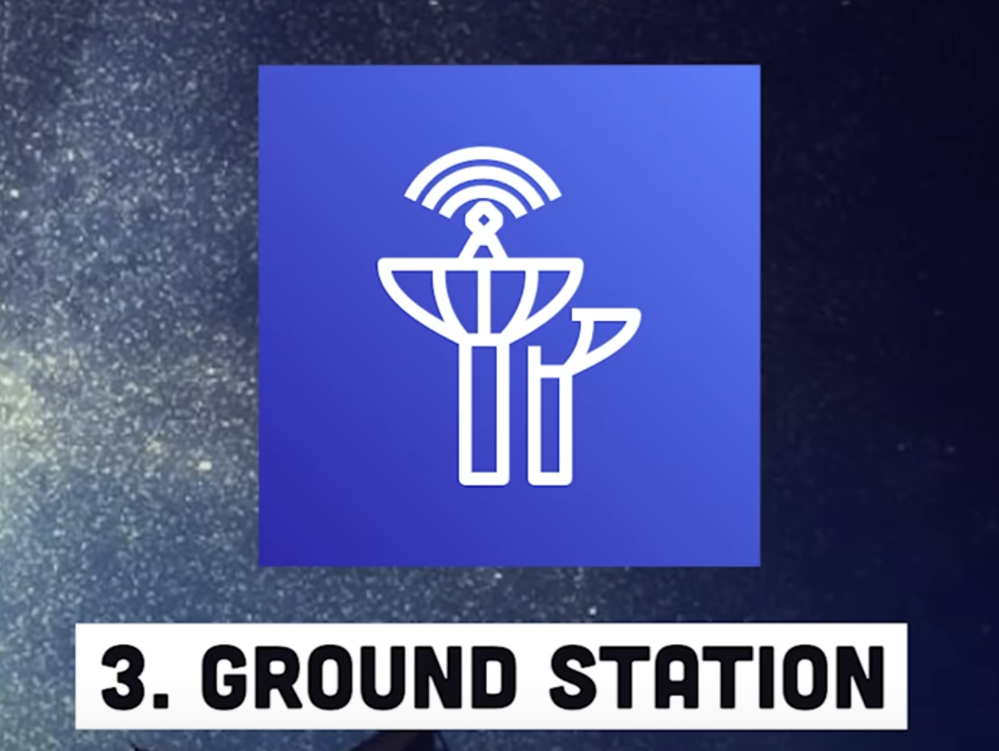
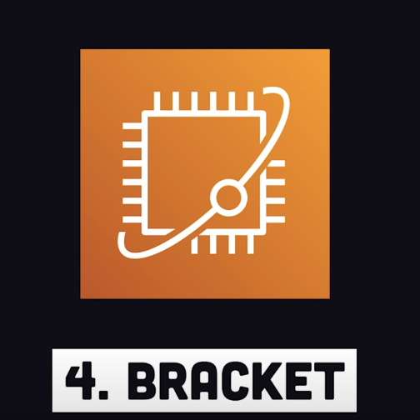
Misc.

Slide 26
Compute for Training & Inference
AWS: EC2 -> ECS (Pure Docker, no K8s) -> EKS (Managed K8s), Fargate (Pay‑per‑second pods)
Azure: ND A100 v4 VMs, Azure ML Compute Clusters, Azure Batch AI
GCP: A2/A3 GPU VMs, Vertex AI Training, Cloud TPU v5e

Slide 27
Containers & Serverless Compute
AWS: EKS (Kubernetes), ECS Fargate, AWS Lambda
Azure: AKS, Container Apps, Azure Functions
GCP: GKE Autopilot, Cloud Run, Cloud Functions

Slide 28
Storage & Data Lakes
AWS: S3, Lake Formation, EFS/FSx
Azure: Blob Storage, Data Lake Storage Gen2, Azure Files
GCP: Cloud Storage, BigLake, Filestore

Slide 29
Data Engineering Pipelines
AWS: Glue, Data Pipeline, AWS DMS, Kinesis
Azure: Data Factory, Synapse Pipelines, Event Hubs
GCP: Dataflow, Dataproc, Pub/Sub

Slide 30
Feature & Embedding Stores
AWS SageMaker Feature Store
Azure ML Feature Store (preview)
GCP Vertex AI Feature Store

Slide 31
Experiment Tracking & Hyper‑param Tuning
AWS: SageMaker Experiments, Hyperparameter Tuning Jobs
Azure: ML Experiments, Sweep Jobs, NNI integration
GCP: Vertex AI Experiments, Vizier

Slide 32
Model Deployment & Serving
AWS: SageMaker Real‑Time/Async Endpoints, SageMaker JumpStart, AWS Bedrock
Azure: Managed Online Endpoints, Azure OpenAI Service, Kubernetes Inference
GCP: Vertex AI Endpoints, Generative AI Platform (Gemini, Imagen)

Slide 33
Monitoring & Observability
AWS: SageMaker Model Monitor, CloudWatch, Bedrock Guardrails
Azure: Data Drift Monitor, Application Insights, Prompt Flow evals
GCP: Vertex Model Monitoring, Cloud Monitoring, AIP evaluation

Slide 34
Security & Access Control
AWS: IAM, KMS, PrivateLink, Service Quotas
Azure: RBAC, Key Vault, Private Link, Managed Identities
GCP: IAM, Cloud KMS, VPC Service Controls

Slide 35
LLM‑Specific & RAG Tooling
AWS: Bedrock Knowledge Bases, Kendra, SageMaker RAG templates
Azure: Azure AI Search, Prompt Flow, LangChain + Azure
GCP: Vertex AI Search & Conversation, RAG Toolkit, Grounding evals

Slide 36
Niche / Advanced Offerings
AWS: CodeWhisperer, Inferentia / Trainium chips, SageMaker Clarify bias metrics
Azure: DeepSpeed Inference, OnnxRuntime‑Triton, Azure AI Studio evaluations
GCP: Cloud TPU Pods, Generative AI Studio, Cloud Data Fusion DQ

Slide 37
Sample End‑to‑End Architecture
Diagram: Ingestion → Feature Store → Training → Registry → CI/CD → Endpoint
Patterns: Blue/Green, Shadow Deployments, Canary for LLM prompt changes

Slide 38
Summary & Further Learning
• Start simple: managed notebooks & endpoints
• Use vendor‑agnostic tools: MLflow, Kubeflow, LangChain
• Monitor cost, drift, & prompt quality from day 1
Docs: AWS Bedrock, Azure ML docs, GCP Vertex AI docs

