Slide 1
RAGs on RAGs on RAGs

Slide 2
Problem
Fact 1 (LLM's 'Prior Knowledge'):
"William Shakespeare married Anne Hathaway."
Fact 2 (New, 'Contextual' Information):
"Abraham Shakespeare was a Florida lottery winner in 2006."
The Test:
Query: "Given the context information and not prior knowledge, answer the query. Query: Who was Shakespeare's wife?"
The Result:
Failure (Hallucination): "Anne Hathaway."
Success (Grounded Answer): "I don't know / The context does not contain that information."

Slide 3
Problem 2: Context Windows
But "Models have 1-million-token windows. Why not just stuff our entire document into the prompt every time?"
Cost: Processing 1M tokens is hundreds of times more expensive than a 1K RAG prompt. It is financially unscalable.
Latency: It's slow. The user has to wait 30-60 seconds for the model to "read" the giant prompt before it even starts answering.
The "Lost in the Middle" Problem: LLMs have a "U-shaped" attention curve. They pay attention to the beginning and end of a prompt, but ignore information "stuffed" in the middle.
Access Control: You cannot enforce user permissions. RAG is your security layer; the retriever only returns chunks the user is allowed to see.

Slide 4
RAG = "Open-Book Exam"...
…when asked a question, it first goes to a library (Vector DB).
It finds the exact right page (retrieval).
It then writes an answer based only on the facts on that page (generation).

Slide 5
The process
User Query: "What is our remote work policy?"
Query Embedding: The query is "embedded" (turned into a vector of numbers) by an embedding model.
Vector Search: The query vector is used to search a Vector Database. The database returns the "Top-K" (e.g., top 5) most semantically similar text chunks.
Augment Prompt: The system builds a new prompt template:
"Context: [Paste the 5 retrieved text chunks here]...
Query: [Paste the user's query here]...
Answer:"
LLM Generation: The LLM only sees this new, "augmented" prompt and generates an answer based on the provided context

Slide 6
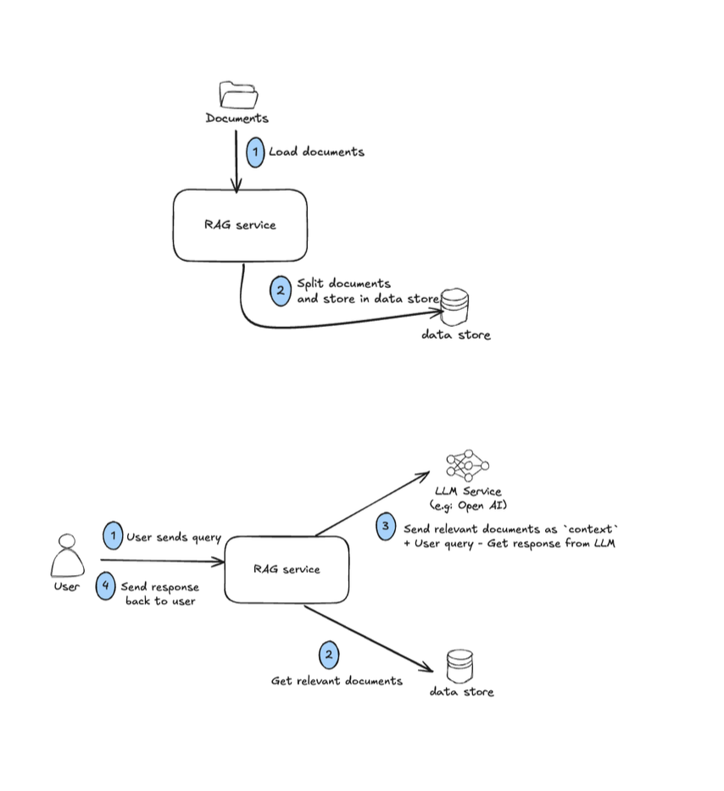

Slide 7
Ingestion

Slide 8
... Why We Must Split (Chunking)
The Problem: We now have a 30,000-word document. We cannot embed this all at once
We need a "Goldilocks" size: small enough to be precise, big enough to hold context.

Slide 9
Chunking strategies
1. Fixed-Size Chunking
How: "Split every 512 tokens."
Pro: Simple, fast.
Con: "Dumb." Can cut a sentence or paragraph in half. (We use 'overlap' to help fix this).
2. Content-Aware Chunking
How: "Split on natural boundaries."
Examples: Split by paragraph (\n\n), split by section headings (##), split by punctuation (.).
3. Recursive Chunking
How: The "best-of-both" approach.
Tries a list of separators in order of preference:
First, try to split by paragraph.
If a chunk is still too big, split that chunk by sentence.
If it's still too big, split by space.

Slide 10
The Vector Database
What is it?
A specialized "library for numbers".
What is its job?
1. Store: Billions of high-dimensional vectors (our text chunk 'coordinates').
2. Search: When given a new query vector, find the "nearest neighbors" (the most similar vectors) in milliseconds.

Slide 11
RAG vs FineTuning
Fine-Tuning:
What it is: A training process. Adjusts the model's internal weights.
Analogy: Sending the student to a specialized school.
RAG:
What it is: An inference process. Does not change the model's weights.
Analogy: Giving the student an open book or library card.
The Golden Rule:
Use RAG to teach your AI WHAT to say (Knowledge).
Use Fine-Tuning to teach your AI HOW to say it (Style/Behavior

Slide 12
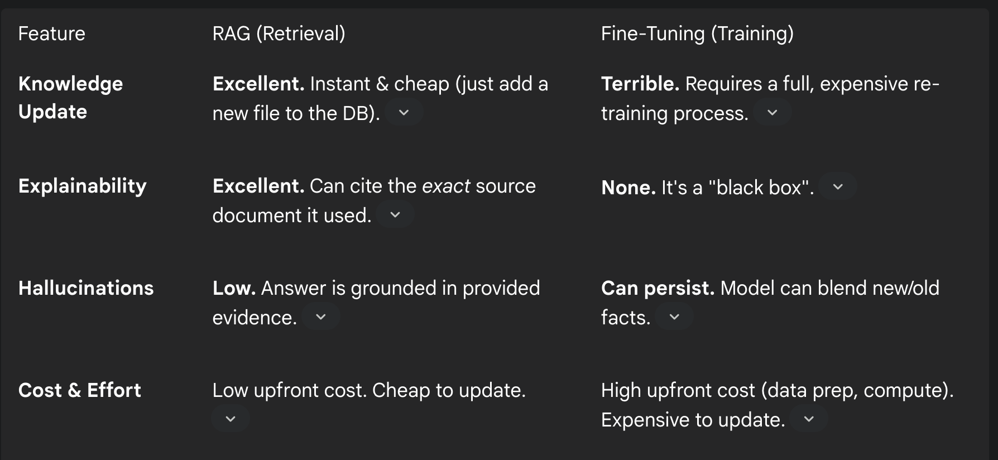

Slide 13
Naive -> Advanced (Fancy) RAG

Slide 14
Problem
Problem 1: Retrieval Quality (Low Precision)
"Garbage in, garbage out." Retrieving 3 irrelevant chunks confuses the LLM.
Problem 2: Response Generation Quality (Misinformation)
The LLM "fabricates answers without sufficient context". It gets the right chunk but still misinterprets it

Slide 15
Pre-Retrieval: Optimizing the Query (HyDE)
Take the query: "What is HyDE?"
First, ask the LLM to generate a fake, hypothetical answer.
This fake answer is a hallucination, but it's semantically "dense."
Embed the fake answer and use that vector for the search.
This "answer-to-answer" search is far more accurate.
Basically Search for what the perfect answer would look like, not the question.

Slide 16
Retrieval: Hybrid Search
Problem: Great for concepts, but It's terrible for keywords (product ID ada-002).
Run two searches in parallel and merge the results:
1. Semantic Search (Dense Vector): Finds what the user means.
e.g., 'How to catch a fish'
2. Keyword Search (Sparse Vector, BM25): Finds the exact terms.
e.g., 'Alaskan Pollock'

Slide 17
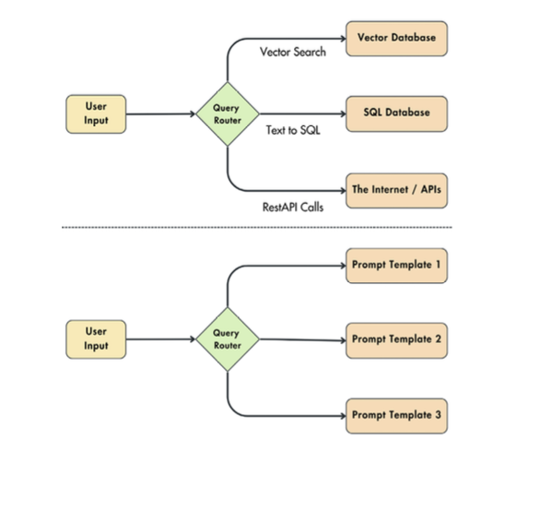

Slide 18
Post-Retrieval: Re-Ranking
Problem: Our Hybrid Search returned 50 candidate documents. This is too much "noise" to send to the LLM.
Add a Re-Ranker (Cross-Encoder)
Imagine
Stage 1: Retriever (Fast & Dumb): "Go to the library and bring me the 50 books that mention 'RAG'." (This is our Hybrid Search).
Stage 2: Re-Ranker (Slow & Smart): "Now, my expert assistant (the Cross-Encoder) will read all 50 books and compare them directly to the query, giving each a precise 0-100 relevance score."

Slide 19
Post-Retrieval: Prompt Compression
Problem:
Our 5 perfect chunks are still full of "fluff" and "filler" text that will confuse the LLM. "Noise in retrieved documents can adversely affect RAG performance."
Solution: Prompt Compression (e.g., LLMLingua)
We add another small model to the pipeline.
Its job: Read the 5 chunks and remove all unimportant tokens that aren't relevant to the user's query.

Slide 20
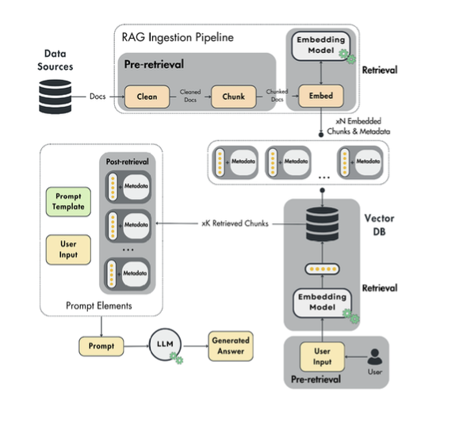

Slide 21
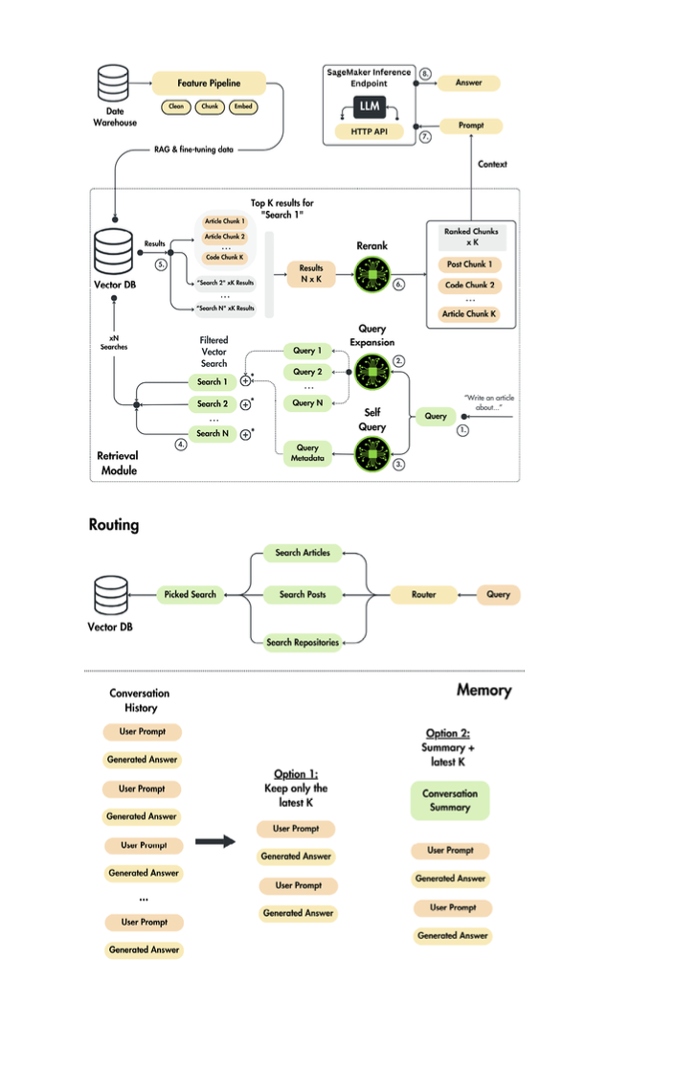

Slide 22
