Slide 1
Emotional Interaction in HCI (2024–2025 Trends)

Slide 2
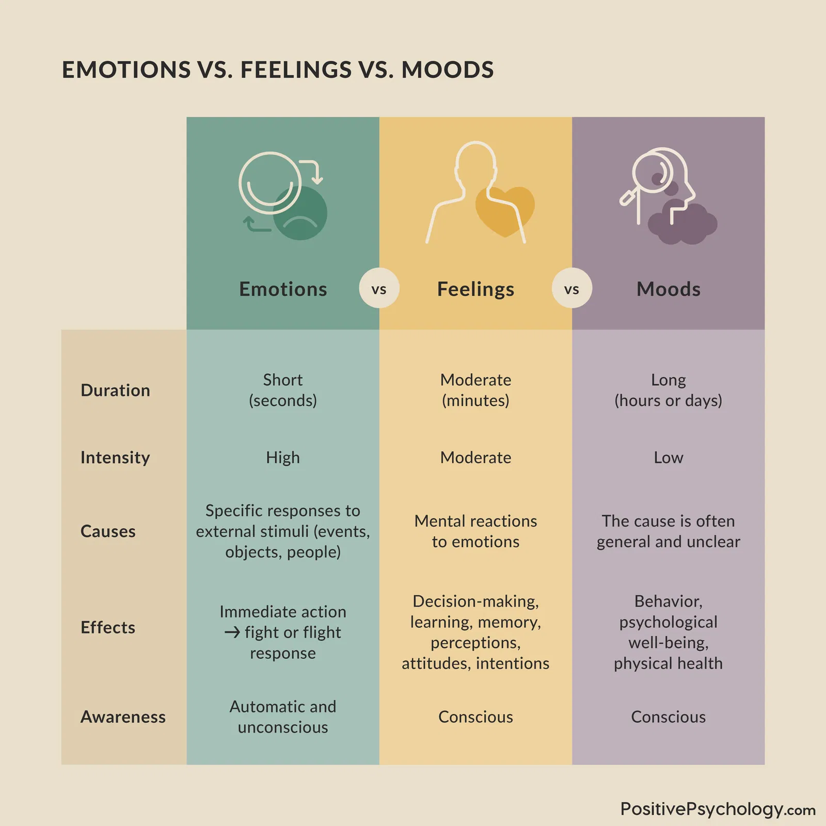
What is Emotional Interaction?
Interaction where systems sense, interpret, or respond to human emotions
Goes beyond affective computing—includes ethics, culture, and user agency
Focus shifting toward supporting rather than regulating emotion

Slide 3
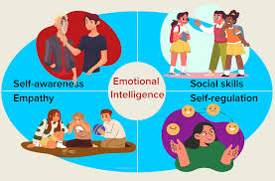
Trend 1: Culture-Aware Emotional Intelligence
Shift from universal emotion models to culturally adaptive ones
Affective–CARA framework: uses knowledge graphs to reduce cultural bias
Relevance: Avoids one-size-fits-all emotional interpretation

Slide 4
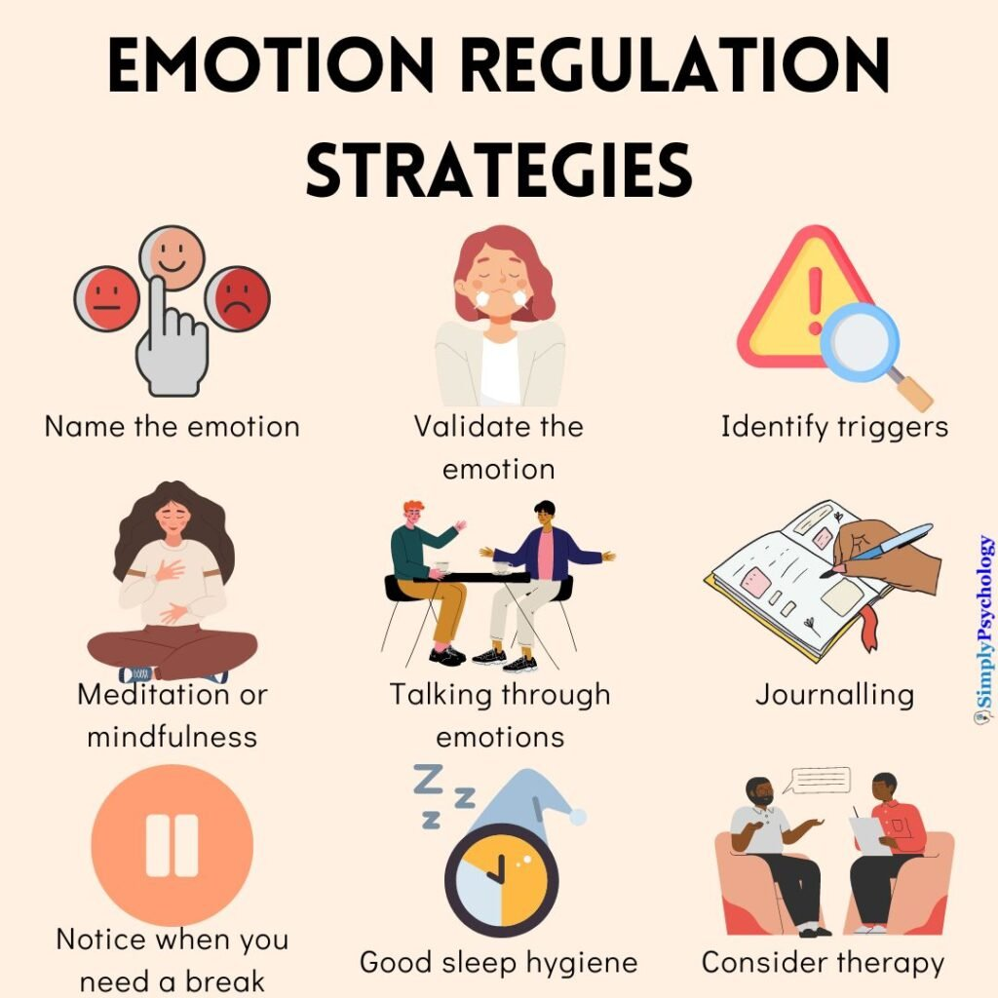
Trend 2: Emotion Support vs Regulation
New research critiques systems that try to 'fix' or control emotions
Focus on supporting emotional expression and agency
Design implication: systems should not impose emotional states on users

Slide 5
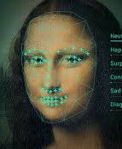
Trend 3: Emotional Output Ethics (R‑CAGE Model)
Guides how AI should express emotion—tone, pacing, intensity
Ethical emphasis on not manipulating user emotions
Useful for designing chatbots, agents, and companions

Slide 6
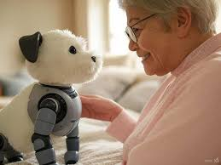
Trend 4: Emotion-Aware Companions
Example: Livia (AR-based emotionally adaptive companion)
Uses multimodal emotion detection and memory compression
Applications in wellness, loneliness, and social support

Slide 7

Trend 5: Immersive Empathic Computing
VR dominates empathic computing research; AR/MR emerging
Dimensional models (valence/arousal) are increasingly used
Strength: high emotional presence; challenge: motion & ethical concerns

Slide 8

Trend 6: Advances in Affective Sensing
Integration of physiological + behavioral signals
Real-time adaptation in interfaces
Applications: wearables, adaptive learning, wellbeing tools

Slide 9
Design Implications for HCI
Emotion-aware systems must respect user agency
Design must include cultural sensitivity
Transparent emotion sensing and output policies

Slide 10
Class Activity Suggestion
Task: Redesign a chatbot to express emotion ethically
Constraint 1: Must follow R‑CAGE output pacing
Constraint 2: Must adapt emotional tone culturally
Deliverable: Storyboard + interaction script

Slide 11
Discussion Questions
Should emotional AI ever try to regulate users' emotions?
How can we ensure systems do not manipulate through emotional output?
What cultural differences must be considered in emotion recognition?

