Slide 1
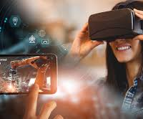
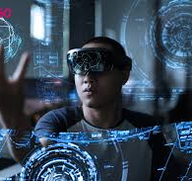
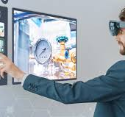
ubiquitous computing
and
augmented realities

Slide 2
ubiquitous computing and augmented realities
ubiquitous computing
filling the real world with computers
virtual and augmented reality
making the real world in a computer!

Slide 3
Challenging HCI Assumptions
What do we imagine when we think of a computer?
“The most profound technologies are those that disappear.”
Weiser
1990’s: this was not our imagined computer!

Slide 4
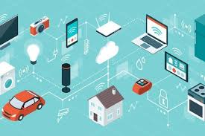

Ubiquitous Computing
Any computing technology that permits human interaction away from a single workstation
Implications for
Technology defining the interactive experience
Applications or uses
Underlying theories of interaction

Slide 5
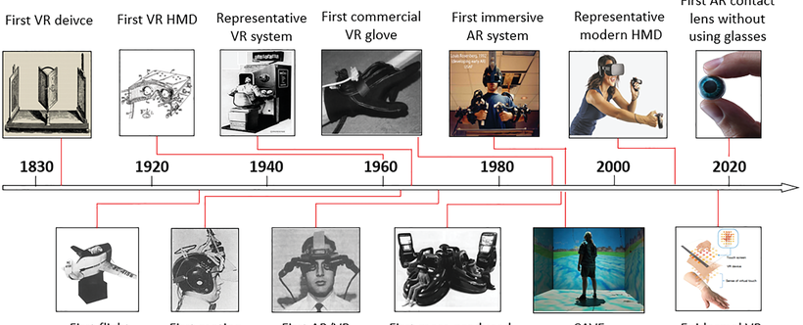
Scales of devices
Weiser proposed
Micro/nano inch
Inch
Foot
Yard
Implications for device size as well as relationship to people

Slide 6
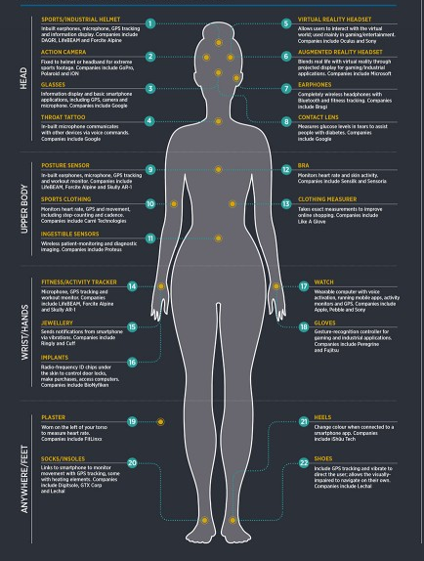
Device scales
Inch
PDAs
Voice Recorders
smart phones
Smart watches
(Sensors)
Individuals own many of them and they can all communicate with each other and environment.

Slide 7
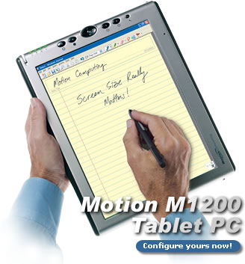
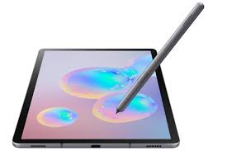
Device scales
Foot
notebooks
tablets
digital paper
Individual owns several but not assumed to be always with them.

Slide 8
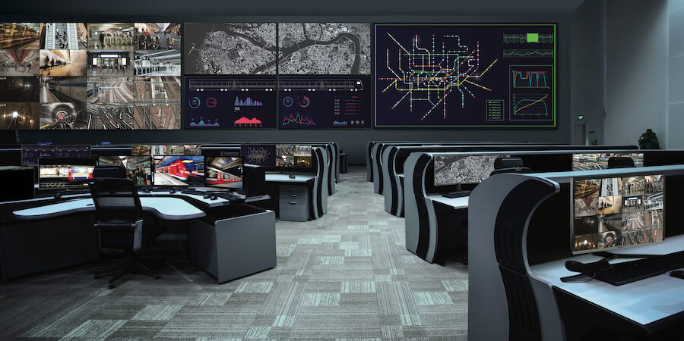
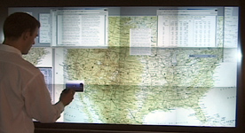
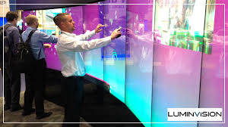
Device scales
Yard
electronic whiteboards
plasma displays
smart bulletin boards
Buildings or institutions own them and lots of people share them.

Slide 9
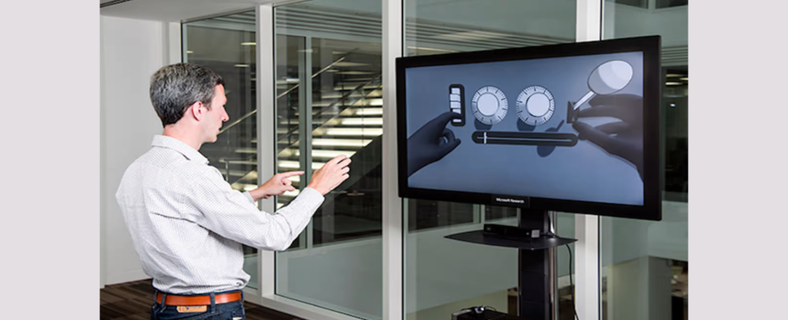
Defining the Interaction Experience
Implicit input
Sensor-based input
Extends traditional explicit input (e.g., keyboard and mouse)
Towards “awareness”
Use of recognition technologies
Introduces ambiguity because recognizers are not perfect

Slide 10
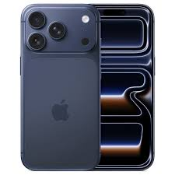
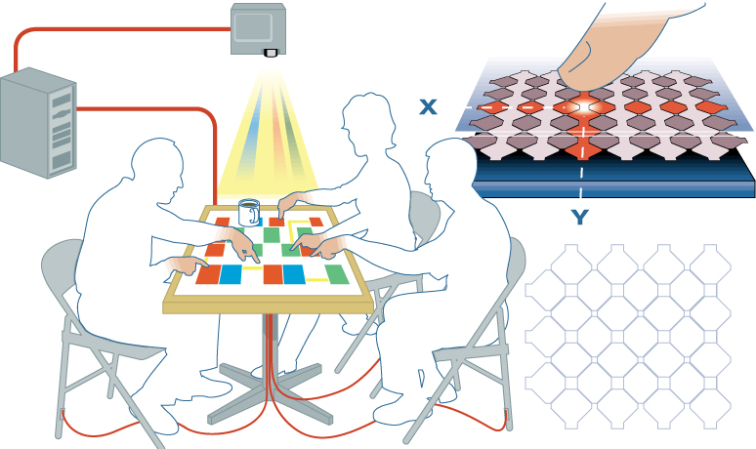
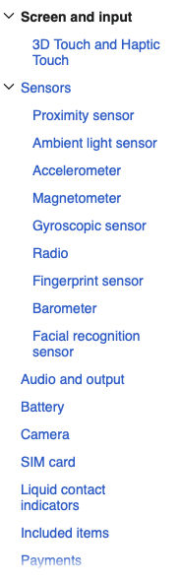
Different Inputs
Capacitive sensing on a table

Slide 11
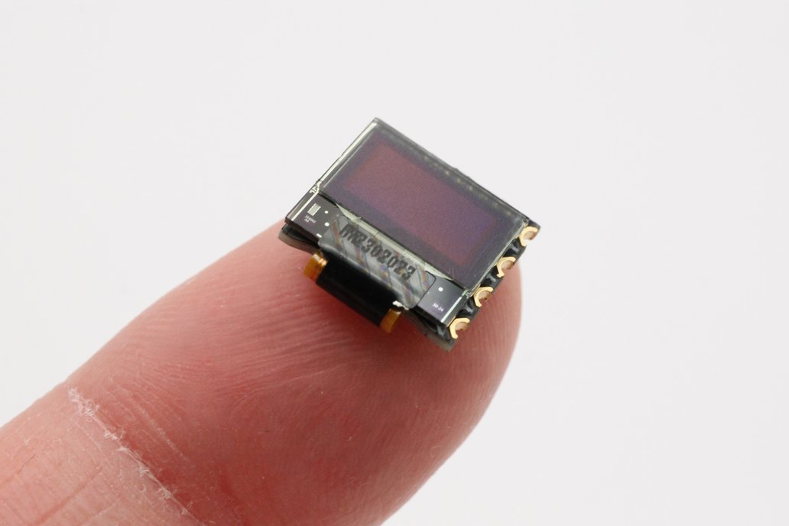
Multi-scale and distributed output
Screens of many sizes
(very) small
(very) large
Distributed in space, but coordinated

Slide 12
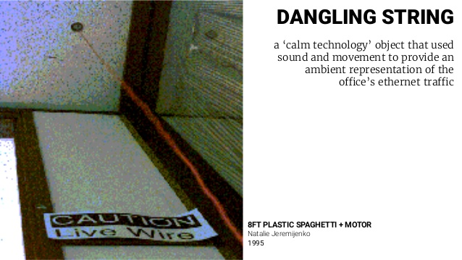
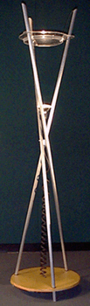
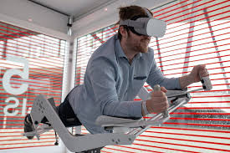
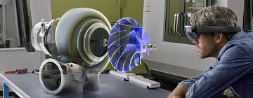
The output experience
More than eye-grabbing raster displays
Ambient: use features of the physical environment to signal information
Peripheral: designed to be in the background
Examples:
The Dangling String
The Water Lamp (shown)

Slide 13
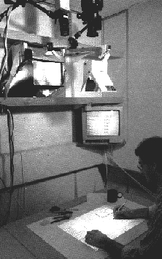
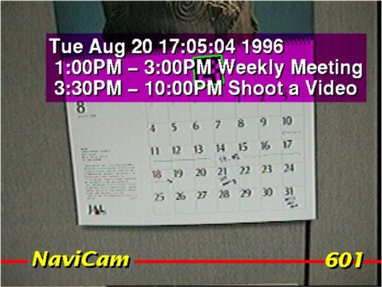
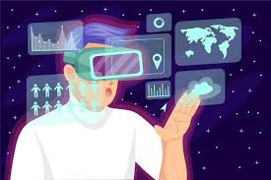
Merging Physical and Digital Worlds
A “digital” desk
How can we remove the barrier?
Actions on physical objects have meaning electronically, and vice versa
Output from electronic world superimposed on physical world
Augmented calendar
Digital + Smart + Augmented

Slide 14
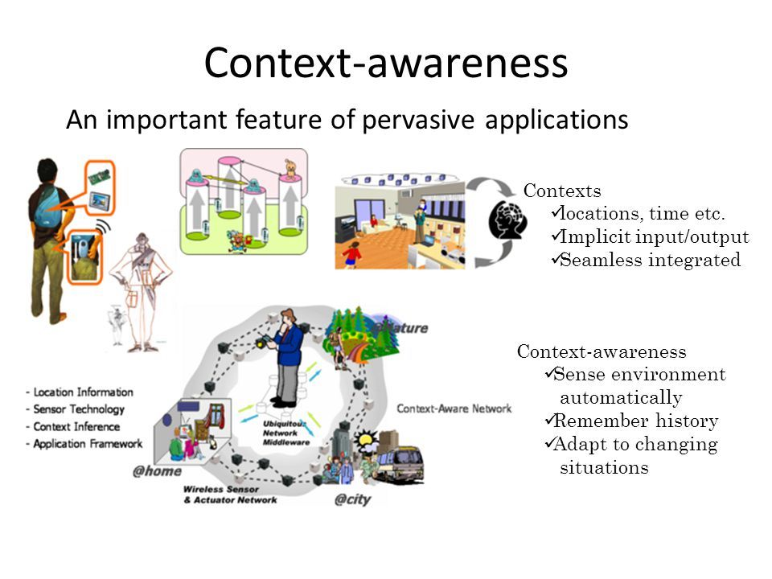
Application Themes
Context-aware computing
Sensed phenomena facilitate easier interaction
Automated capture and access
Live experiences stored for future access
Toward continuous interaction
Everyday activities have no clear begin-end conditions

Slide 15

New Opportunities for Theory
Knowledge in the world
Ubicomp places more emphasis on the physical world
Activity theory
Goals and actions fluidly adjust to physical state of world
Situated action and distributed cognition
Emphasizes improvisational/opportunistic behavior versus planned actions
Ethnography
Deep descriptive understanding of activities in context

Slide 16
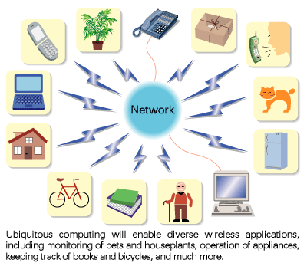
Evaluation Challenges
How can we adapt other HCI techiques to apply to ubicomp settings?
Ubicomp activities not so task-centric
Technologies are so new, it is often hard to get long-term authentic summative evaluation
Metric of success could be very different (playfulness, non-distraction versus efficiency)

Slide 17

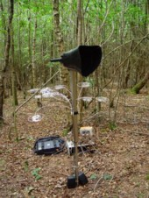
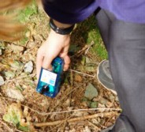
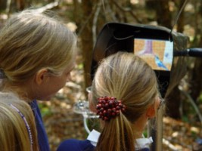
ambient wood
real wood! … filled with electronics
light and moisture meters
recorded with GPRS location
drawn on map later
‘periscope’
shows invisible things
uses RFID
triggered sound

Slide 18
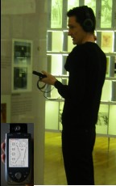
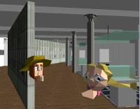
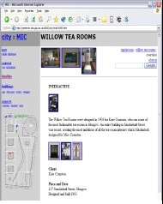
City - shared experience
visitors to Mackintosh Interpretation Centre
some on web, some use VR, some really there
interacting
talk via microphones
‘see’ each other virtually
different places
different modalities
shared experience

Slide 20
virtual and augmented reality
VR - technology & experience
App, web, desktop , and simulators
AR – mixing virtual and real

Slide 21
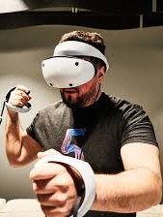
virtual reality technology
headsets allow user to “see” the virtual world
gesture recognition achieved with DataGlove (lycra glove with optical sensors that measure hand and finger positions)
eyegaze allows users to indicate direction with eyes alone
whole body position sensed, walking etc.

Slide 22

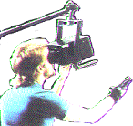

VR headsets
small LED screen for each eye
slightly different angles
3D effect

Slide 23

immersion
VR
computer simulation of the real world
mainly visual, but sound, haptic, gesture too
experience life-like situations
too dangerous, too expensive
see unseen things:
too small, too large, hidden, invisible
e.g. manipulating molecules
the experience
aim is immersion, engagement, interaction

Slide 24
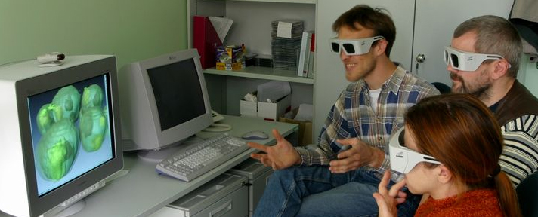
on the desktop
headset VR
expensive, uncomfortbale
desktop VR
use ordinary monitor and PC
cheap and convenient
in games …
and on the web/apps
VRML – virtual reality markup language

Slide 25

VRML … VR on the web
#VRML V1.0 ascii
Separator {
Separator { # for sphere
Material {
emmissiveColor 0 0 1 # blue
}
Sphere { radius 1 }
}
Transform { translation 4 2 0 }
Separator { # for cone
Texture2 {
filename "big_alan.jpg"
}
Cone {
radius 1 # N.B. width=2*radius
height 3
} } }

Slide 26

command and control
scenes projected on walls
realistic environment
hydraulic rams!
real controls
other people
for:
flight simulators
ships
military

Slide 27
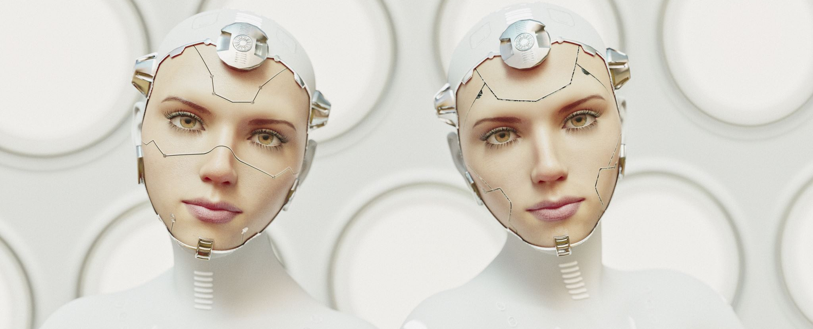
augmented reality (AR)
images projected over the real world
aircraft head-up display
semi-transparent goggles
projecting onto a desktop
types of information
unrelated – e.g. reading email with wearable
related – e.g. virtual objects interacting with world
issues
registration – aligning virtual and real
eye gaze direction

Slide 28
applications of AR
maintenance
overlay instructions
display schematics
examples
photocopier engineers
registration critical arrows point to parts
aircraft wiring looms
registration perhaps too hard, use schematic

Slide 29
applications of VR
simulation
games, military, training
VR holidays
rainforest, safari, surf, ski and moon walk … all from your own armchair
medical
surgery
scans and x-rays used to build model then ‘practice’ operation
force feedback best
phobia treatment
virtual lifts, spiders, etc.

Slide 30
information and data visualisation
VR, 3D and 2D displays
scientific and complex data
interactivity central

Slide 31
scientific and technical data
number of virtual dimensions that are ‘real’
three dimensional space
visualise invisible fields or values
e.g. virtual wind tunnel
two dimensional space
can project data value up from plane
e.g. geographic data
N.B. viewing angle hard for static visualisation
no ‘real’ dimensions
2D/3D histograms, scatter plots, pie charts, etc.

Slide 32
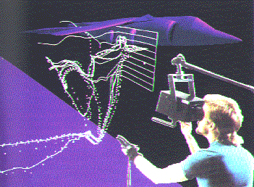
virtual wind tunnel
fluid dynamics to simulate air flow
virtual bubbles used to show movements
‘better’ than real wind tunnel …
no disruption of air flow
cheaper and faster

Slide 33
structured informnation
scientific data – just numbers
information systems … lots of kinds of data
hierarchies
file trees, organisation charts
networks
program flow charts, hypertext structure
free text …
documents, web pages

Slide 34
visualising hiererchy
2D organisation chart
familiar representation
what happens when it gets wide?
managing
director
sales manager
marketing manager
production manager
F. Bloggs
F. Bloggs
A. Jones
R.Carter
K. West
B. Firth
J. Smith
P. Larkin

Slide 35
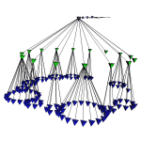
wide hierarchies … use 3D?
managing
director
sales manager
marketing manager
production manager
F. Bloggs
F. Bloggs
A. Jones
R.Carter
K. West
B. Firth
J. Smith
P. Larkin
cone trees (Xerox)
levels become rings
overlap ‘OK’ in 3D

Slide 36
networks in 2D
network or ‘graph’:
nodes – e.g. web pages
links – may be directed or not – e.g. links
planar – can drawn without crossing
non-planar – any 2D layout has crossings
Planar graph
Non-planar graph

Slide 37
time and interactivity
visualising in time
time dimension mapped to space
changing values: sales graphs, distance-time
events: Gantt chart, timelines, historical charts
e.g. Lifelines – visualising medical and court records
using time
data dimension mapped to time
time to itself: fast/slow replay of events
space to time: Visible Human Project
interactivity
change under user control
e.g. influence explorer

Slide 39
between two worlds
ubiquitous computing
computers fill the real world
virtual reality and visualisation
real world represented in the computer
augmented reality, ambient displays …
physical and digital intermingled
maturity
VR and visualisation – commonplace
AR, ubiquity … coming fast!

