Slide 1

Chapter 15
EVALUATION STUDIES:
From Controlled to Natural Settings

Slide 2
Goals
• Explain how to do usability testing
• Outline the basics about conducting experiments
Describe how to do in the wild studies
• Discuss why remote studies maybe needed and how to do remote testing and in-the-wild studies
Notes:
2

Slide 3
Usability testing
Involves testing how people perform on products in controlled settings
The people being tested are observed and the time it takes them to complete a task and the number and kinds of errors they make are recorded
Data is recorded on video and key presses are logged
The data is used to calculate performance times and to identify and explain errors
User satisfaction is evaluated using questionnaires and interviews
Observations about how the product is used in more natural contexts, including in-the wild may be included
Notes:
3

Slide 4
Quantitative measures
Number of participants successfully completing the task
Time to complete the task
Time to complete the task after time away from it
Number and type of errors per task
Number of errors per unit of time
Number of times people navigate to an item such as online help
Number of people making the same or similar errors
Source: Wixon and Wilson, 1997
Notes:
4

Slide 5
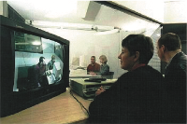
Usability lab with designers watching a user and assistant through a one-way mirror and recording

Slide 6
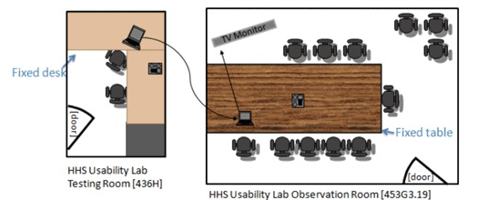
Layout of a usability lab used by US Health & Human Services Dept.
source: https://www.usability.gov/how-to-and-tools/guidance/hhs-usability-lab.html

Slide 7
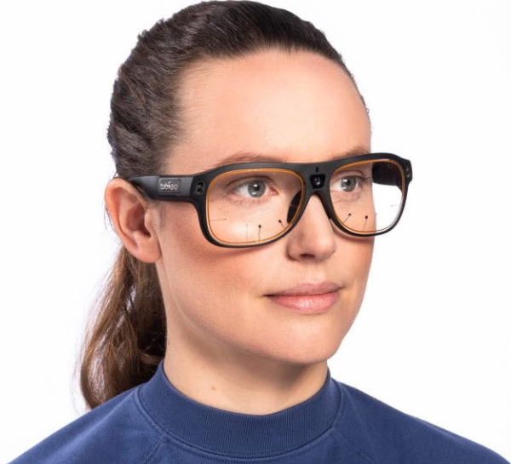
Tobii Glasses Mobile Eye-Tracking System
Source: https://www.tobiipro.com/news-events/on-demand-webinars/ Wearable-eye-tracking-for-research/

Slide 8
Equipment is getting smaller
As more testing is done remotely and in-the- wild, equipment has got smaller
New lightweight models of eye-tracking glasses that look like ordinary glasses
Video and audio recording is often done using mobile phones which produce increasingly good quality with each new model of phone
Replace bulky recording devices and tripods, also more discrete

Slide 9
Remote testing
Participants can carry out tasks in their own environment without an evaluator being present
Zoom, Teams and other digital communications are often used
Testing can be synchronous or asynchronous
Advantage of remote testing, especially asynchronous testing, is that several participants can be tested at the same time in their own environments
Covid-19 pandemic encouraged creative ways of conducting remote testing that was safe
Remote testing may make it easier for people with disabilities to participate
Downside: no one present to help with equipment problems and less personal than co-present testing

Slide 10
Case 1: iPad usability (Budiu & Nielsen, 2010)
Now a classic study – innovative in its day!
Study conducted in two cities: Fremont, CA and Chicago, IL
Tests had to be done quickly, as information was needed by third-party app developers
Also needed to be done secretly so that the competition was not aware of the study before the iPad was launched
Seven participants with over three months experience with iPhones

Slide 11
iPad usability testing procedure
Signed an informed consent form explaining:
What the participant would be asked to do
The length of time needed for the study
The compensation that would be offered for participating
Participants’ right to withdraw from the study at any time
A promise that the person’s identity would not be disclosed
An agreement that the data collected would be confidential and available only to the evaluators
Participants were asked to explore the iPad
Next, they were asked to perform randomly-assigned specified tasks

Slide 12
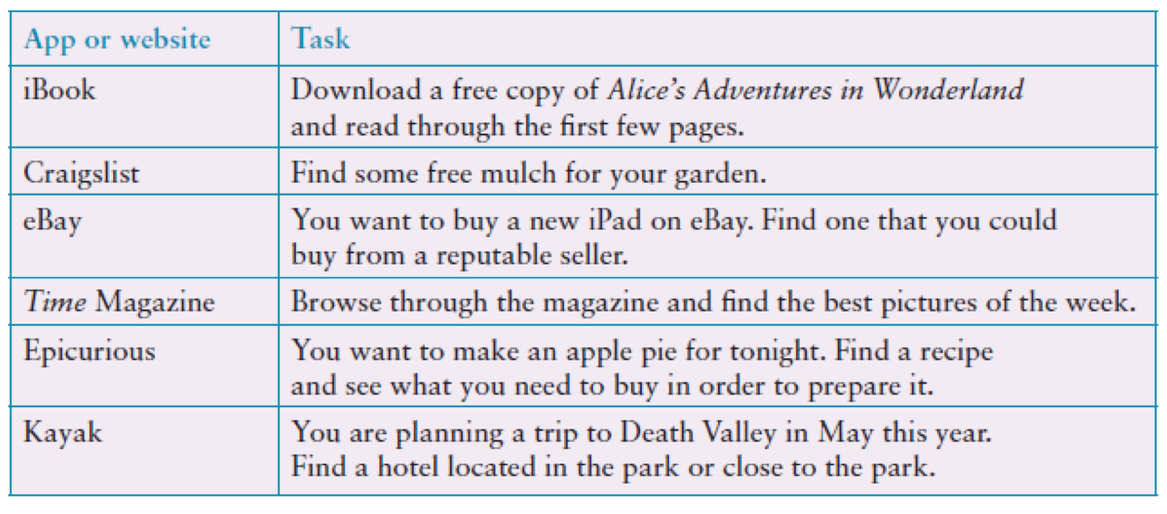
Examples of the tasks used in the iPad evaluation
Adapted from Budiu and Nielsen, 2010
Source: iPad App and Website Usability Study. Used courtesy of the Neilsen Norman Group.

Slide 13
Problems and actions
Examples of problems detected:
Accessing the Web was difficult
Lack of affordance and feedback
Getting lost in an application
Knowing where to tap
Actions by evaluators:
Reported to developers
Made available to public on Neilsen Norman Group.

Slide 14
Problems and actions (continued)
Accessibility for all users is important
Study did not address how iPad would be used in people’s everyday lives
Another study was done a year later to examine this and other issues that there was insufficient time to address in this study

Slide 15
Case 2: Remote testing with extended VR (XR) (Sanni Siltanen et al., 2021)
Study at Krone Corp. (Finland) to examine new immersive experiences in VR
Needed to find ways to test experts and company employees remotely because of Covid-19 pandemic
Also needed a sophisticated setup to test the collaborative XR platforms across multiple locations
Testing was conducted remotely with experts in 8 countries: Finland, India, China, Germany, Indonesia, Malaysia, USA, United Arab Emirates
Some tests in participants premises where special disinfecting routines had to be carried out, other tests were done remotely
Little advice available about how to do remote testing during a pandemic

Slide 16
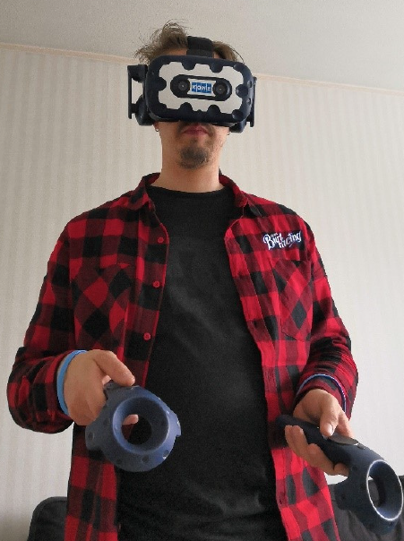
A participant in a test session
Source: Siltanen et al. (2021) MDPI / CC BY 4.0

Slide 17
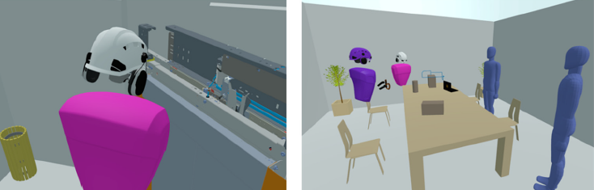
Screenshots from the DesignSpace VR environments
Source: Siltanen et al. (2021) MDPI / CC BY 4.0

Slide 18
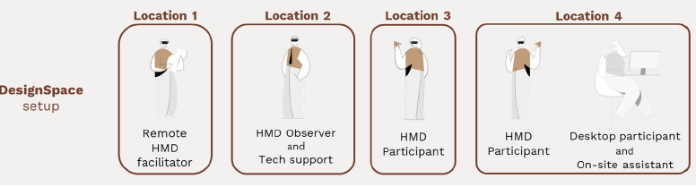
Testing setup used with DesignSpace environments
Source: Siltanen et al. (2021) MDPI / CC BY 4.0

Slide 19
Experiments
Test hypotheses
Predict the relationship between two or more variables
Independent variable is manipulated by the researcher
Dependent variable influenced by the independent variable
Typical experimental designs have one or two independent variables
Validated statistically and replicable
Notes:
19

Slide 20
Experimental designs
Different participants (between participants):
Single group of participants is allocated randomly to the experimental conditions
Same participants (within participants):
All participants participate in both conditions
Matched participants (pairwise design):
Participants are matched in pairs, for example, based on expertise, gender, and so on
Notes:
20

Slide 21
Different, same, matched participant design
Notes:
21

Slide 22
In-the-wild studies
Done in natural settings
“In-the-wild” is a term for prototypes being used freely in natural settings – broader and typically less controlled than traditional field studies
Seek to understand what users do naturally and how technology impacts them
In-the-wild studies are used in product design to:
Identify opportunities for new technology
Determine design requirements
Decide how best to introduce new technology
Evaluate technology in use
Notes:
22

Slide 23
An in-the-wild study of a pain-monitoring device
Monitoring patients’ pain is a known challenge for physicians
Goal of the study was to evaluate the use of a pain-monitoring device for use after ambulatory surgery
Painpad is a keypad device
It was usability tested extensively in the lab before being brought into two hospitals
Goal was to understand how Painpad was used in the natural environment and as part of routines in two UK hospitals.
How pain-monitoring changed with Painpad
Notes:
23

Slide 24
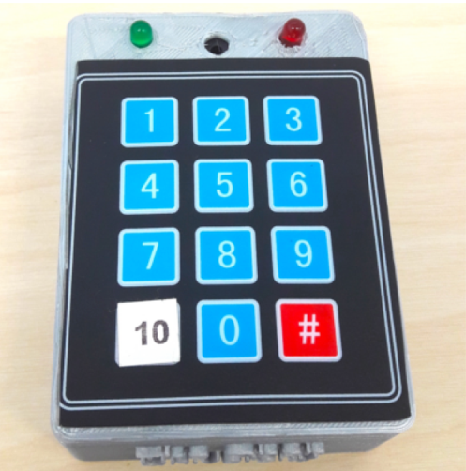
Painpad
A tangible device for inpatient self-logging of pain
Source: Price et al., 2018. Reproduced with permission of ACM Publications.

Slide 25
Data collection and participants
Two studies in two hospitals involving 54 people
13 males, 41 females
Privacy was an important concern
Hospital stay ranged from 1-7 days, mean and median age 64.6, 64.5 years
Patients given Painpad after surgery and prompted to report pain levels every two hours
Nurses also collected scores
All data entered into charts
Patients in one hospital were given a user-satisfaction survey when they left
Also rated Painpad on a 1-5 Likert scale
Notes:
25

Slide 26
Data analysis and presentation
Three types of data were collected:
Satisfaction with Painpad was based on questionnaire responses
Patients’ compliance with the two-hour routine
How data collected from Painpad compared with data collected by nurses
Data showed:
Satisfaction with Painpad 4.63 on Likert scale
Patients’ compliance was mixed: some liked it while others disliked or didn’t notice the prompts
Patients recorded more scores with Painpad than through the nurses

Slide 27
Long-term studies
Some studies involve leaving designs with participants for extended periods so that participants have time to get to know how to use a product in their own setting
Typically these are complex technical products that take time to learn, such as visualization tools
These evaluations often start with an interview and then the product is left with the participant for 2-4 weeks
Data is then collected, often consisting of: structured interviews, daily use diaries, automatic logging of usage
Notes:
27

Slide 28
How many participants is enough for user testing?
The number is a practical issue
Depends on:
Schedule for testing
Availability of participants
Cost of running tests
Typically 5-10 participants if possible
Some experts argue that testing should continue until no new insights are gained
Others suggest that 5 participants is enough to identify any serious problems
Notes:
28

Slide 29
How many participants is enough for other types of evaluation?
Experiments test hypotheses to discover new knowledge by investigating the relationship between two or more variables
The number of participants needed depends on the type of experiment being conducted
It is advisable to consult a statistician before deciding
In-the-wild studies also vary from a few people in a home to a software team to a whole community
Notes:
29

Slide 30
Usability testing and research
Usability Testing
Improve products
Few participants
Results inform design
Usually not completely replicable
Conditions controlled as much as possible
Procedure planned
Results reported to developers
Experiments for Research
Discover knowledge
Often many participants
Results validated statistically
Must be replicable
Strongly controlled conditions
Experimental design
Scientific report to scientific community
Notes:
30

Slide 31
Summary
Usability testing takes place in controlled spaces - usability labs, temporary labs
Usability testing focuses on performance measures - how long and how many errors are made when completing a set of predefined tasks
Indirect observation (video and keystroke logging), user satisfaction questionnaires, and interviews are also collected
Remote testing has been conducted since the early 1990s but it became important during the Covid19 pandemic
Remote testing uses portable equipment - video and audio recording using smart phones, mobile eye-tracking and automated keystroke logging
Notes:
31

Slide 32
Summary (continued)
Long-term studies of several weeks are used to evaluate complex products that participants need time to learn and use in their own work
Experiments test a hypothesis by manipulating certain variables while keeping others constant
The experimenter controls independent variable(s) in order to measure changes in the dependent variable(s)
In-the-wild studies are carried out in natural settings to discover how people interact with technology in the real world
In-the-wild studies involve deployment of prototypes or technologies in natural settings
Sometimes the findings of in-the-wild studies are unexpected, especially for studies that explore how novel technologies are used by participants in their own homes, places of work, or outside
Notes:
32

