Slide 1
Experimental Setups

Slide 2
Techniques for building in usability?
Ethnographic research
Participatory design
Focus group research
Surveys
Walkthroughs
Open and closed card sorting
Paper prototyping
Expert or Heuristic Evaluations
Usability Testing
Follow-up studies

Slide 3
Ethnographic Research
Qualitative method
Observing users where they would use the product
Gather data about target (user, tasks, goals)
Personas, profiles, scenarios, task descriptions

Slide 4
Participatory Design
Users are on board with the design team tapping user’s knowledge, skill set and emotional reactions to design
Workshops are arranged where users, designers, and developers work together on an aspect of design

Slide 5
Focus Group Research
Used at the early stages of a project to evaluate preliminary concepts with rep. users (brain storming sessions)
“Proof of Concept” preview
Paper & pencil drawings, story boards, plastic models are used as tools

Slide 6
Surveys
Used at initial stage of product implementation
Checking preferences of a broad base of users about an existing or potential product
Open ended / closed ended questions
Quantitative data

Slide 7
Walkthroughs
Often used at prototype stage
Explore how user might fare with a product by envisioning user’s route through an early concept or prototype
Used to develop work guides
Participants assume specific roles

Slide 8
Open and closed card sorting
Used to design “findability” of content or functionality
Participants are given cards showing content without titles or categories, and have the users do the naming (open)
Participants use preexisting categories and ask users to sort content or functions into those categories.

Slide 9
Paper Prototyping
Users are shown an aspect of a product on paper and ask questions about it
Expert mockup responses on a graph paper

Slide 10
Expert or Heuristic Evaluations
Review of a product or a system, usually by an expert
“double specialist”

Slide 11
Usability Testing
Techniques to collect empirical data while observing end users using the product
Formal tests as true experiments → confirm/refute specific hypothesis
Iterative cycles of tests → expose usability deficiencies and gradually shaping the product in question

Slide 12
Usability Testing

Slide 13
Why testing? (goals)
Informing Design
Eliminating Design Problems and Frustration
Improving Profitability

Slide 14
Basics of methodology (classical approach)
Hypothesis must be formulated
Randomly chosen participants must be assigned to experimental conditions
Tight controls
Control groups
Sample must be of sufficient size to measure statistically significant differences

Slide 15
Basic Elements of Usability Testing
Development of research questions or test objectives rather than a hypothesis
Use of a representative sample of end users, which may or may not be randomly chosen
Representation of the actual work environment
Observation of the end users who either use or review a representation of the product
Controlled and sometimes extensive interviewing and probing of the participants by the test moderator
Collection of quantitative and qualitative performance and preference measures
Recommendations for improvements to the design of the product

Slide 16
Limitations
Testing is always an artificial situation
Test results do not prove that a product works
Participants are rarely fully representative of the target population
Testing is not always the best technique to use

Slide 17
Types of test
Exploratory (formative)
Assessment (summative)
Validation (verification)
Comparison (integral part of above three)

Slide 18
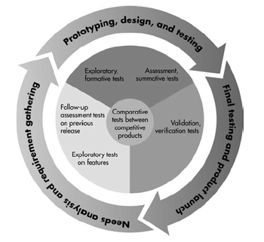

Slide 19
Exploratory or Formative Study
When: Quite early in the development cycle
Objective: to examine the effectiveness of preliminary design
Example: A app designer interested in identifying how well the interface:
Supports users’ tasks within a goal
Communicates the intended workflow
Allows the user to navigate from screen to screen and within a screen

Slide 20
Exploratory or Formative Study(II)
Task-oriented user perspective:
Overall organization of subject matter
Whether to use a graphic or verbal approach
How well does the proposed format support findability
Anticipated points of assistance and messaging
How to address reference information

Slide 21
Exploratory or Formative Study(III)
Typical user-oriented questions:
What do users conceive and think about using the product?
Does the product’s basic functionality have value to the user?
How easily do users make inferences about how to use this user interface, based on their previous experience?
What type of prerequisite information is required to use the product?
Which functions of the product are “walk up and use” and which will probably require either the help of written documentation?
How should the table of contents be organized to accommodate both novice and experienced users?

Slide 22
Exploratory or Formative Study(IV)
Overview of methodology
Prototypes (horizontal representation)
Walk through (vertical representation)

Slide 23
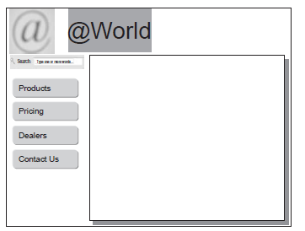
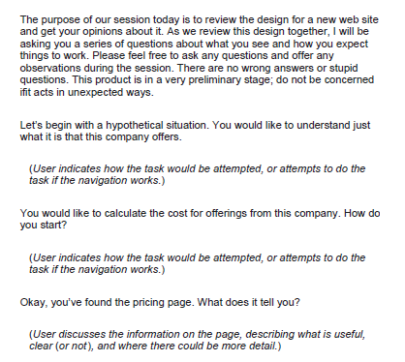

Slide 24
Assessment or Summative Test
When: either early or midway into the product development cycle, usually after the fundamental or high level design.
Objective: to expand the findings of the exploratory test by evaluating usability of lower level operations and aspects of the product.
Example: how well a user can actually perform a full blown realistic task.

Slide 25
Assessment or Summative Test(II)
Methodology:
The user will always perform tasks rather than simply walking through and commenting upon screens, pages and so on.
The test moderator will lessen his or her interaction with the participant because there is less emphasis on thought processes and more on actual behaviors.
Quantitative measures will be collected.

Slide 26
Validation or Verification Test
When Late in deployment cycle
Objective Measure usability of a product against established benchmarks. In case of verification test, to confirm that problems discovered earlier have been removed and new ones have not been introduced.
Example Comparison against established benchmarks.

Slide 27
Validation or Verification Test (II)
Methodology
Prior to test, standards or benchmarks for the tasks are either developed or identified.
Participants are given tasks to perform with either very little or no interaction with the test moderator.
Collection of quantitative data is the central focus, although reasons for substandard performance are identified.

Slide 28
Comparison Test
When not associated with any specific point in the product life cycle.
Objective Used in conjunction of the first three tests. It is used to compare two or more designs.
Example Compare two different interface styles, or the current design of manual, etc.

Slide 29
Comparison Test (ii)
Methodology
The design team is forced to stretch its conceptions of what will work rather than just continuing along in predictable pattern.
During the test, the participant is forced to really consider why one design in better and which aspects make it do so.

