Slide 1
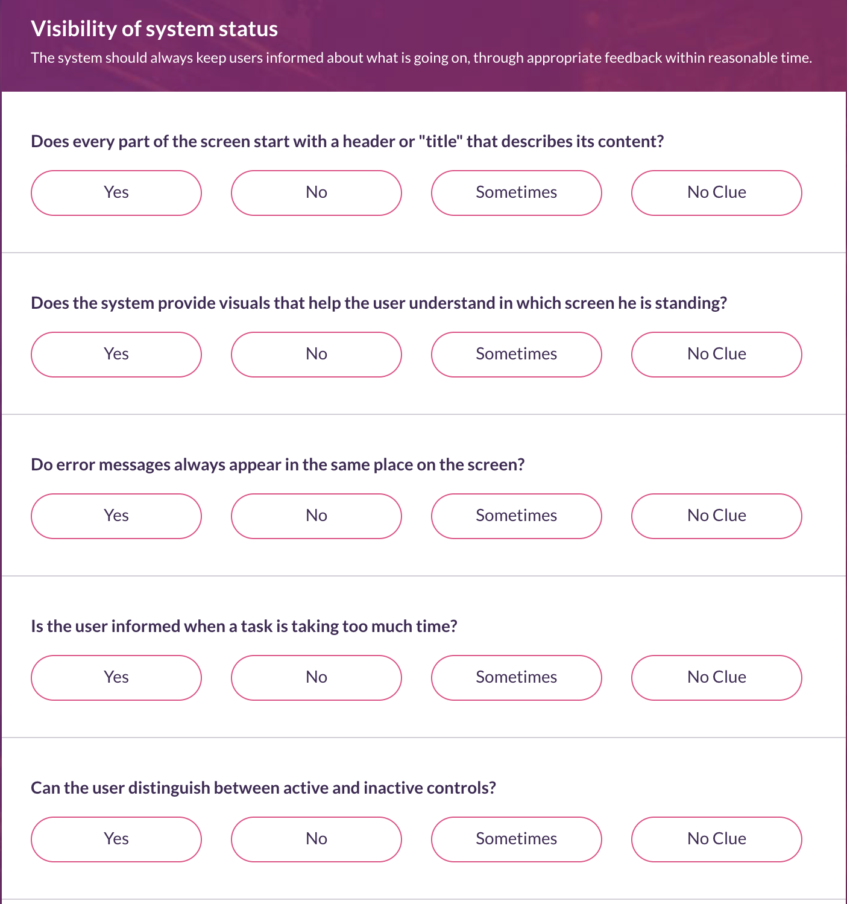

Slide 2
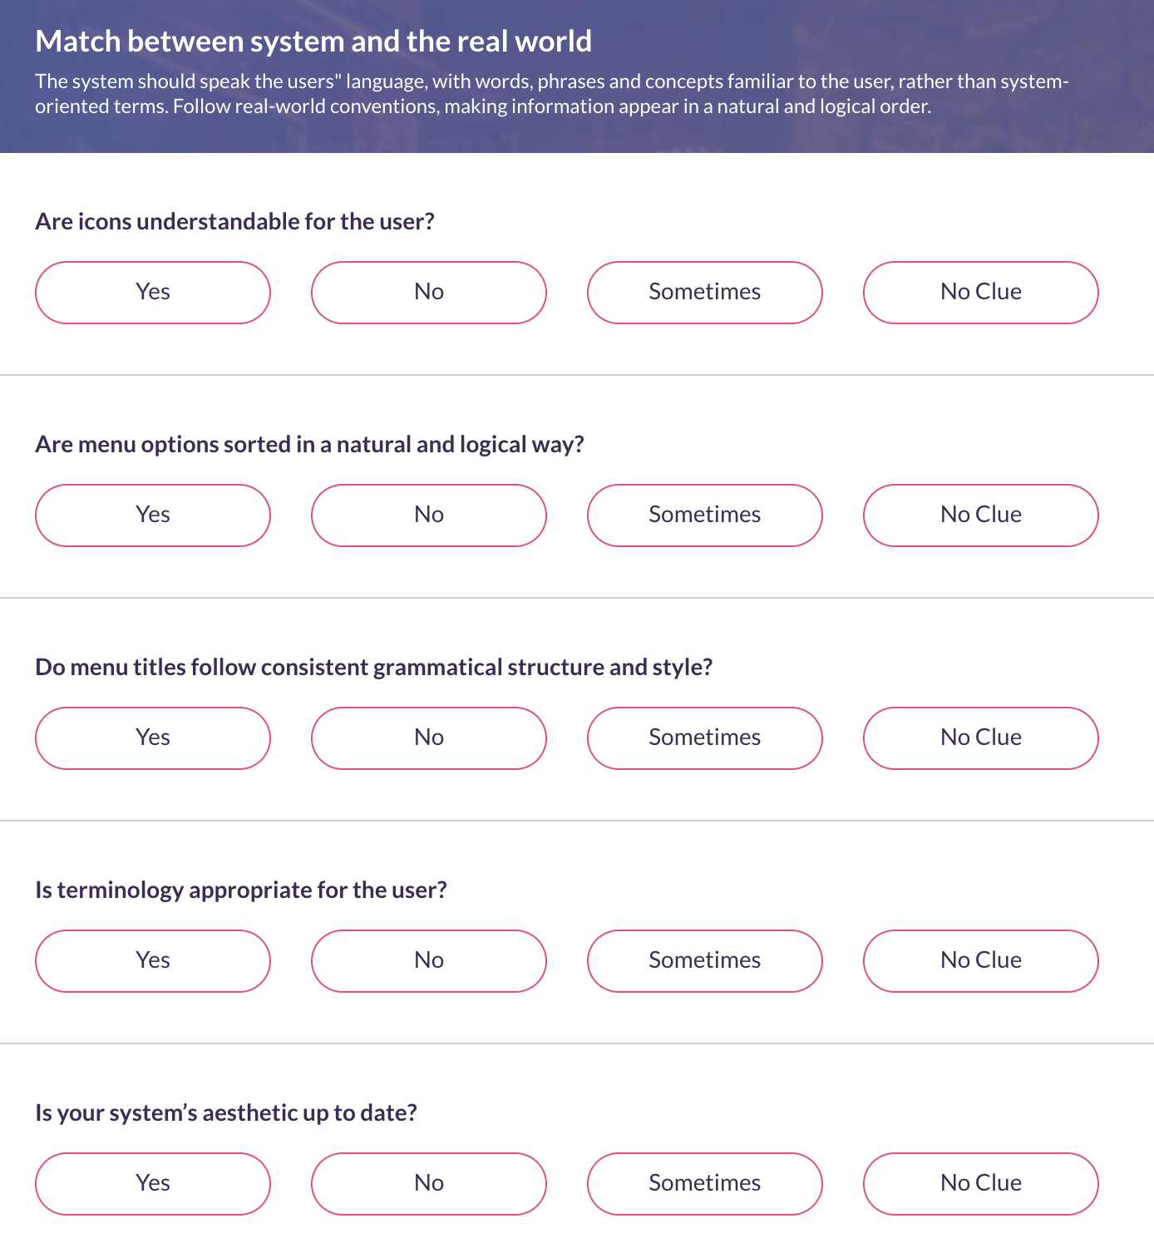

Slide 3
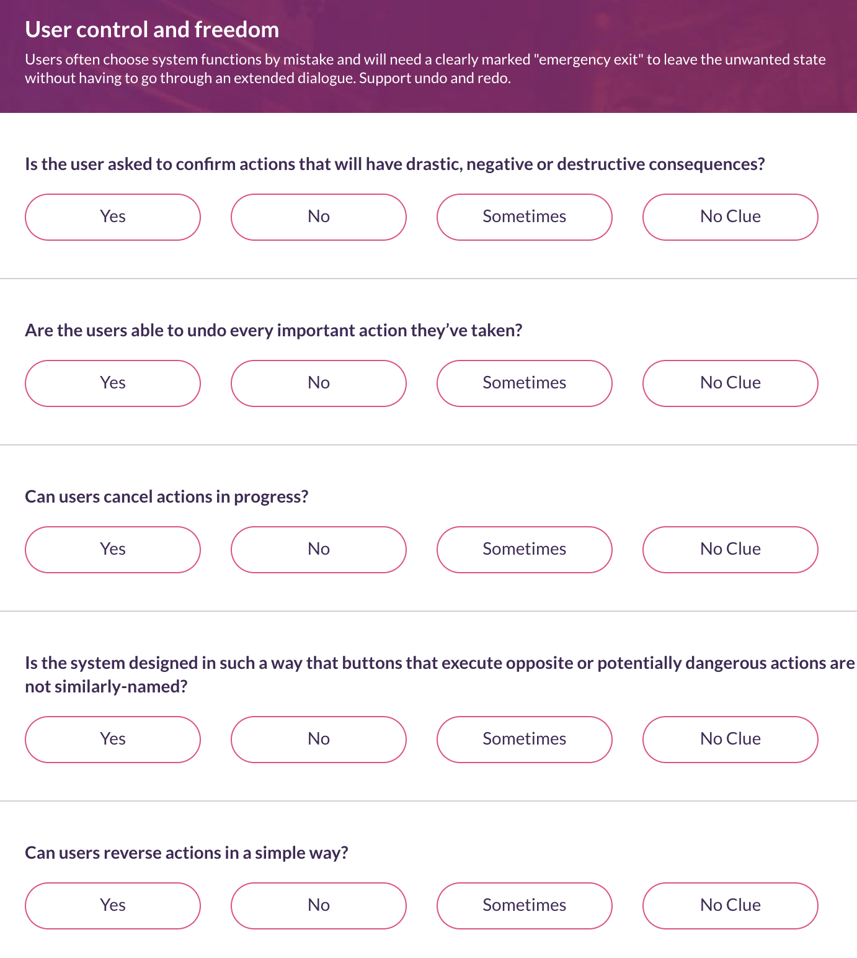

Slide 4
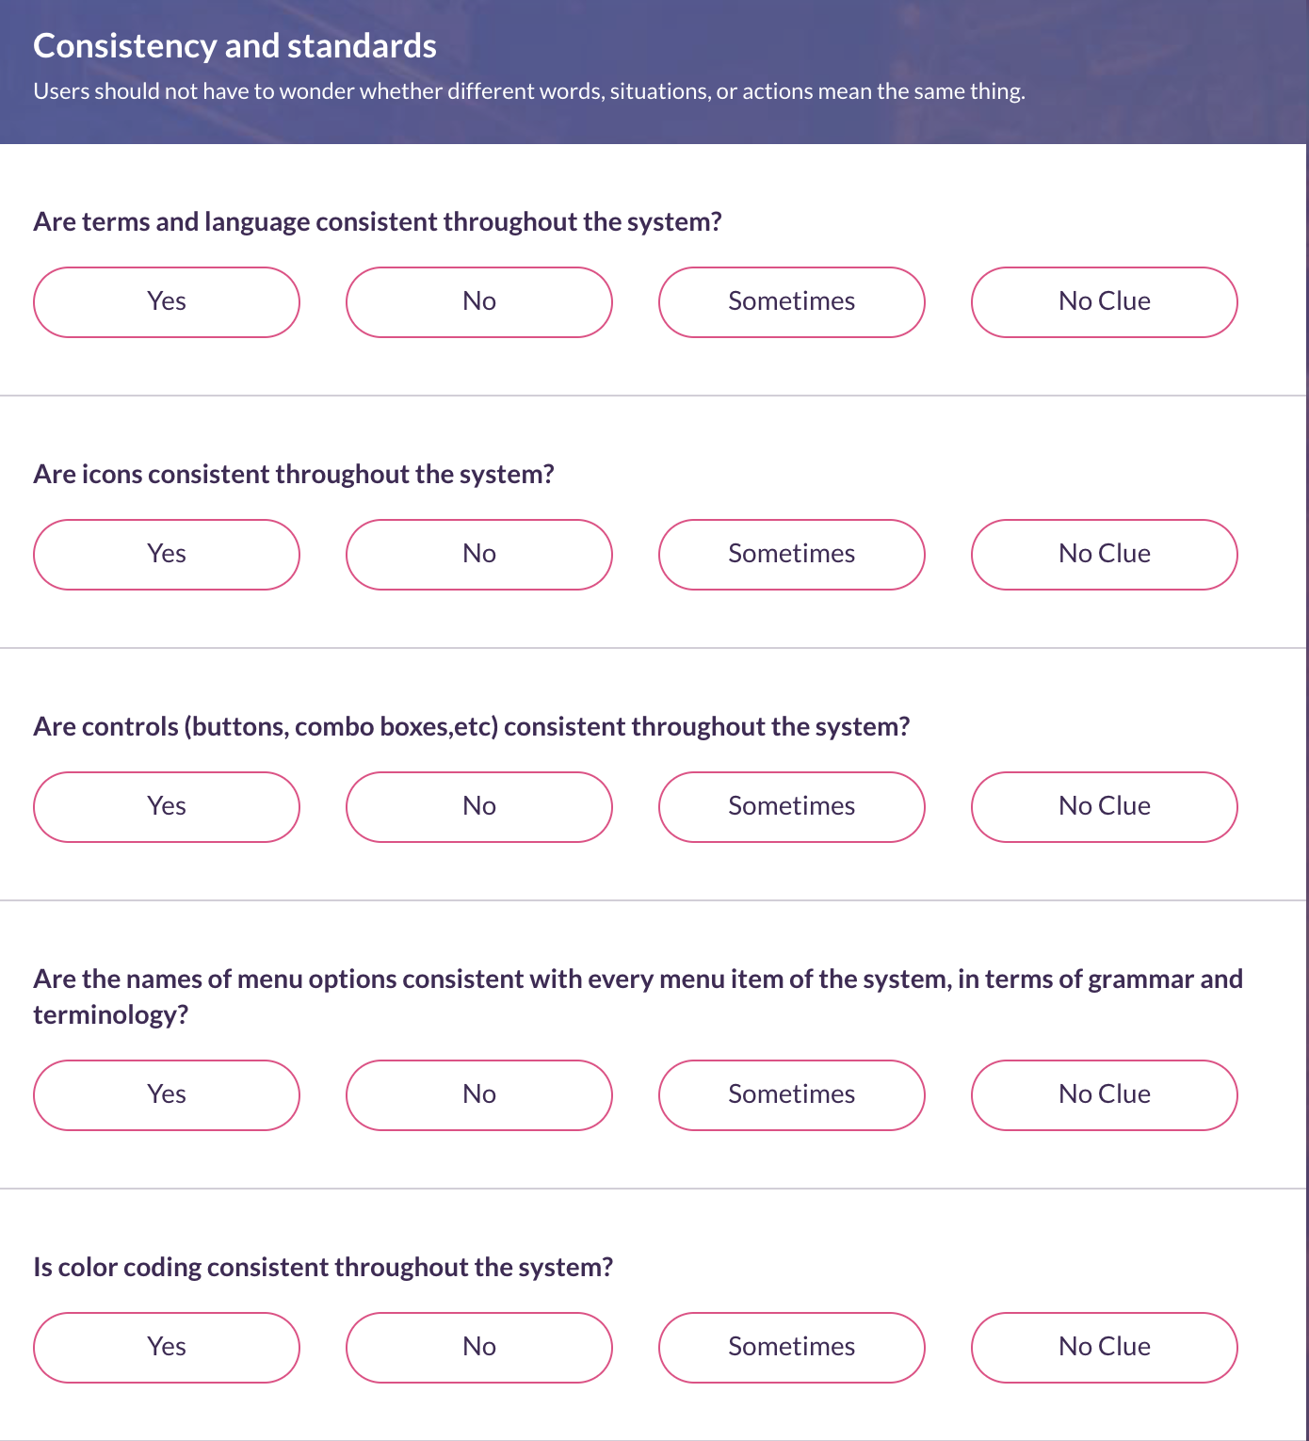

Slide 5
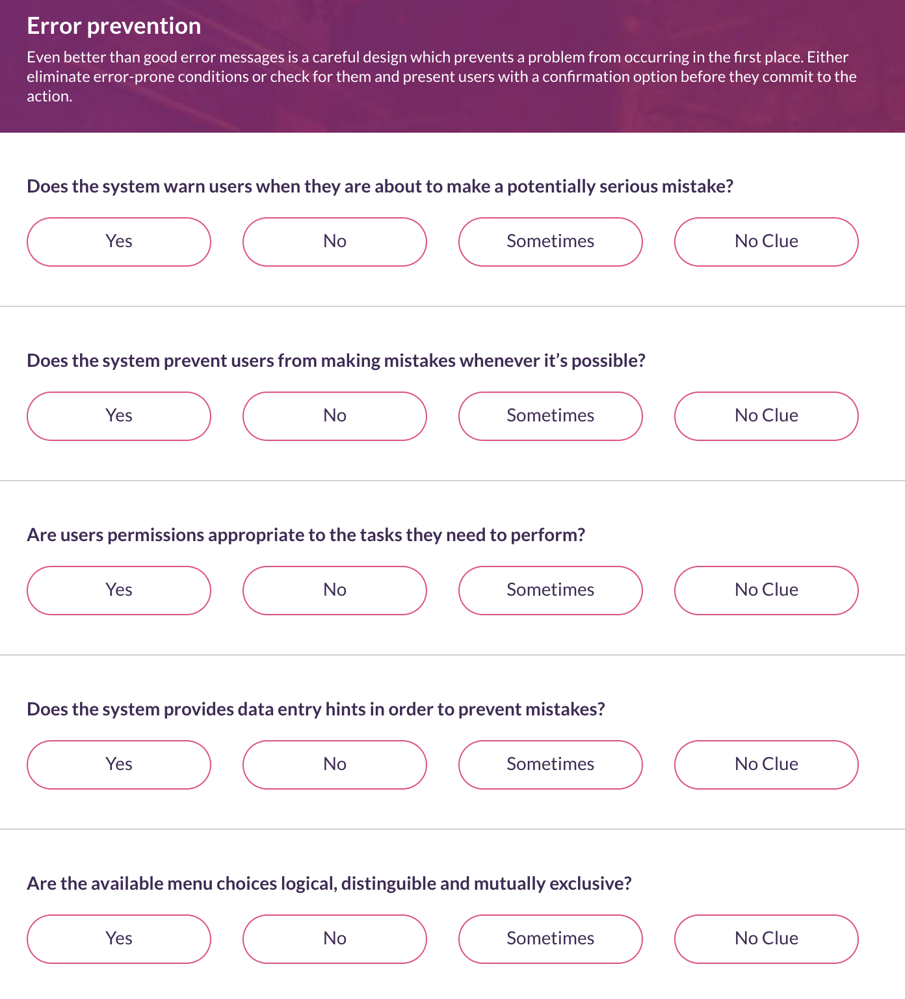

Slide 6
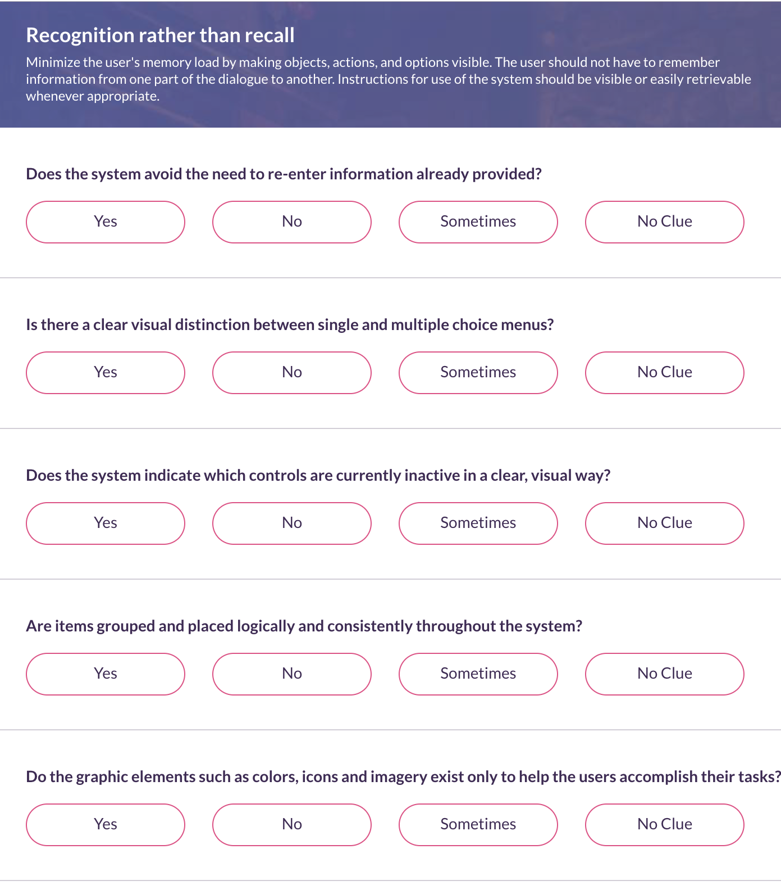

Slide 7
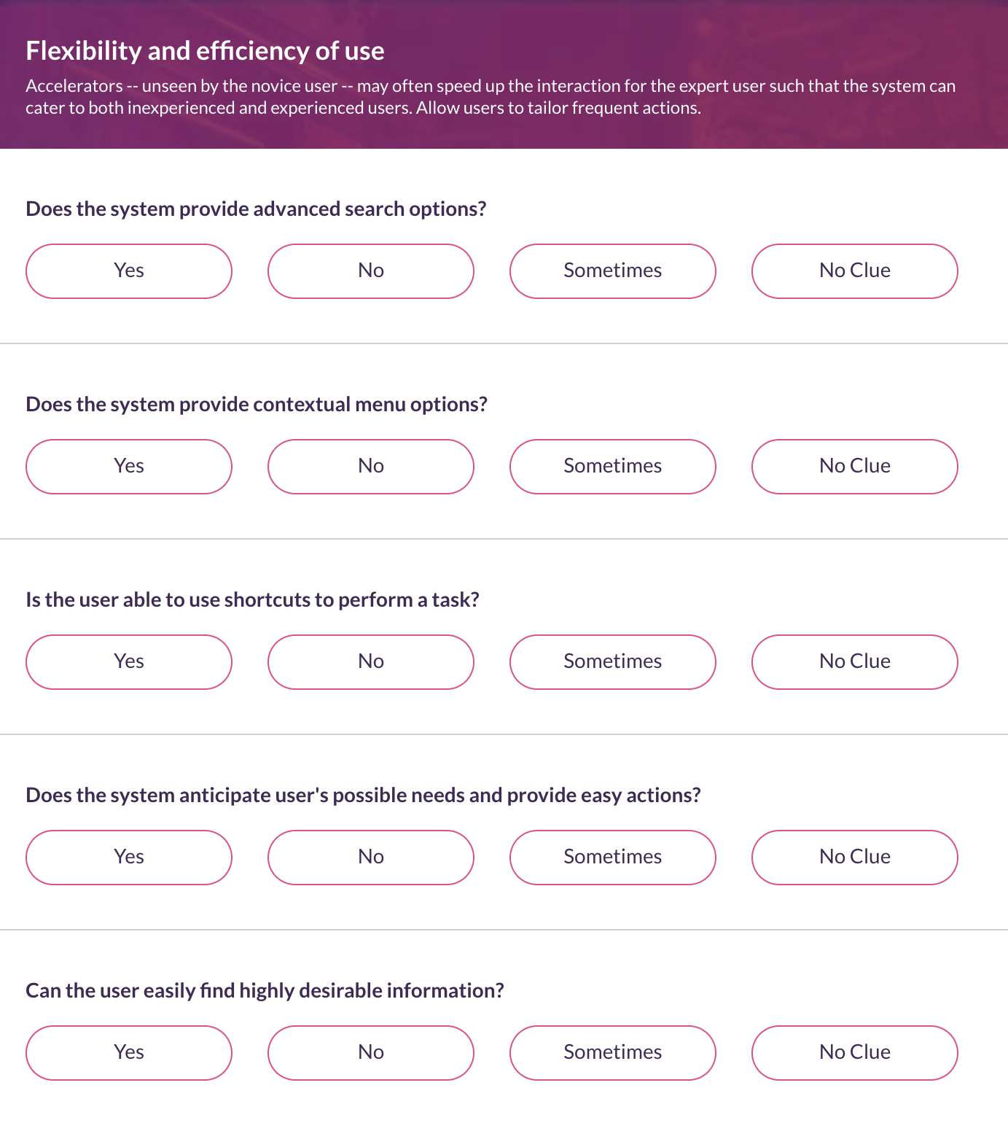

Slide 8
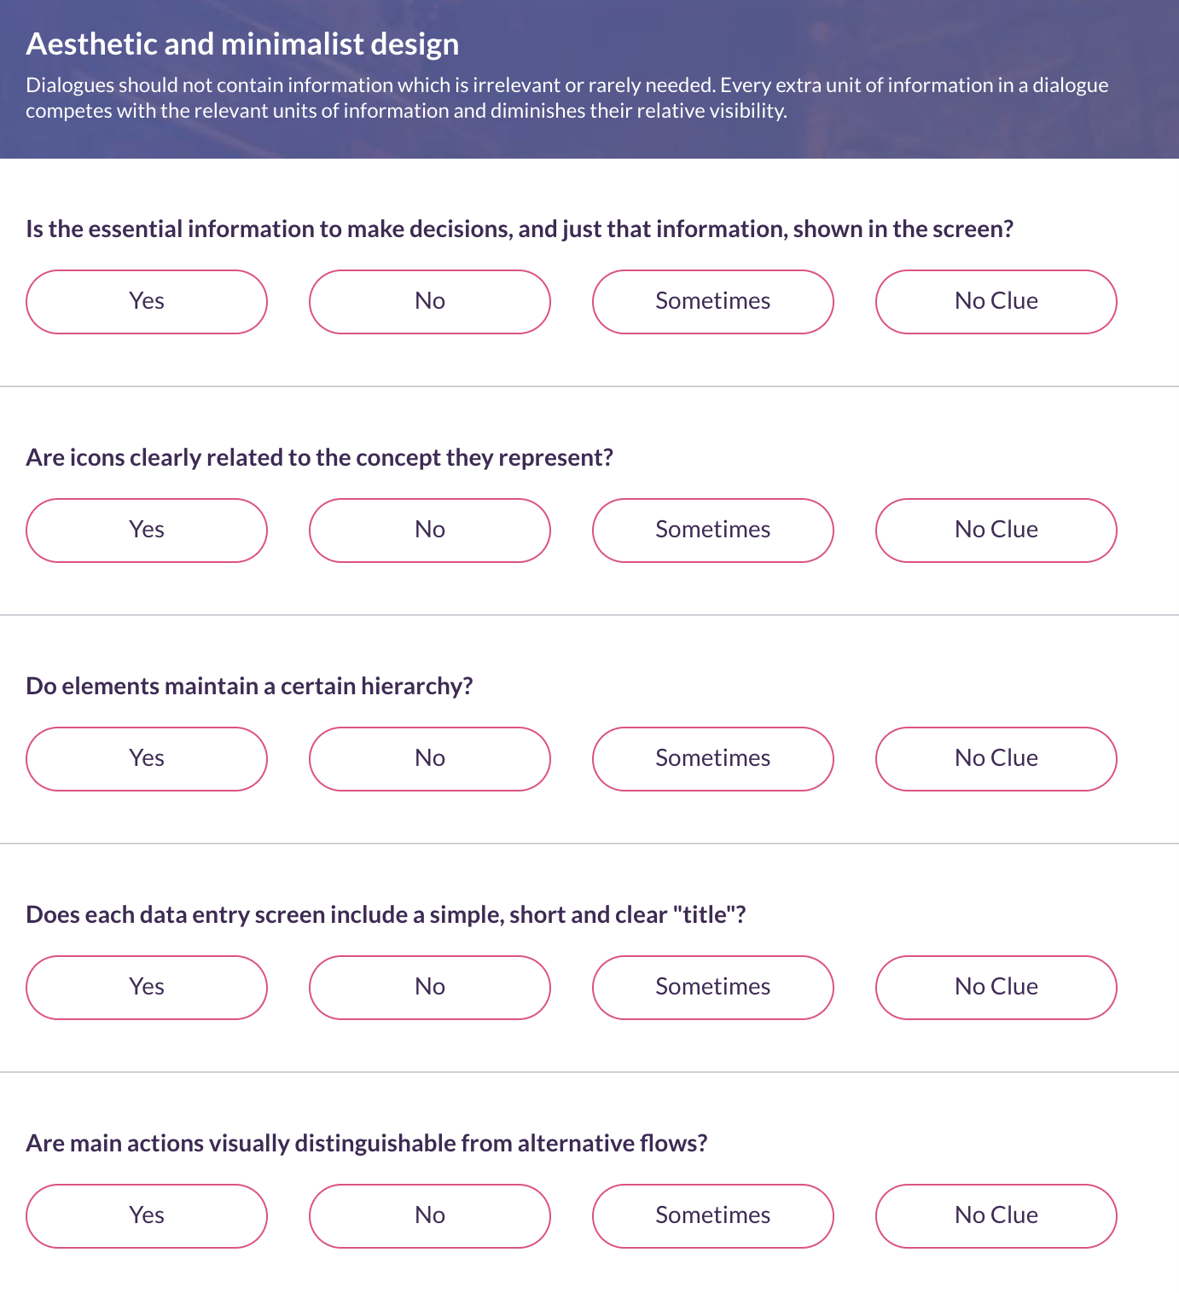

Slide 9
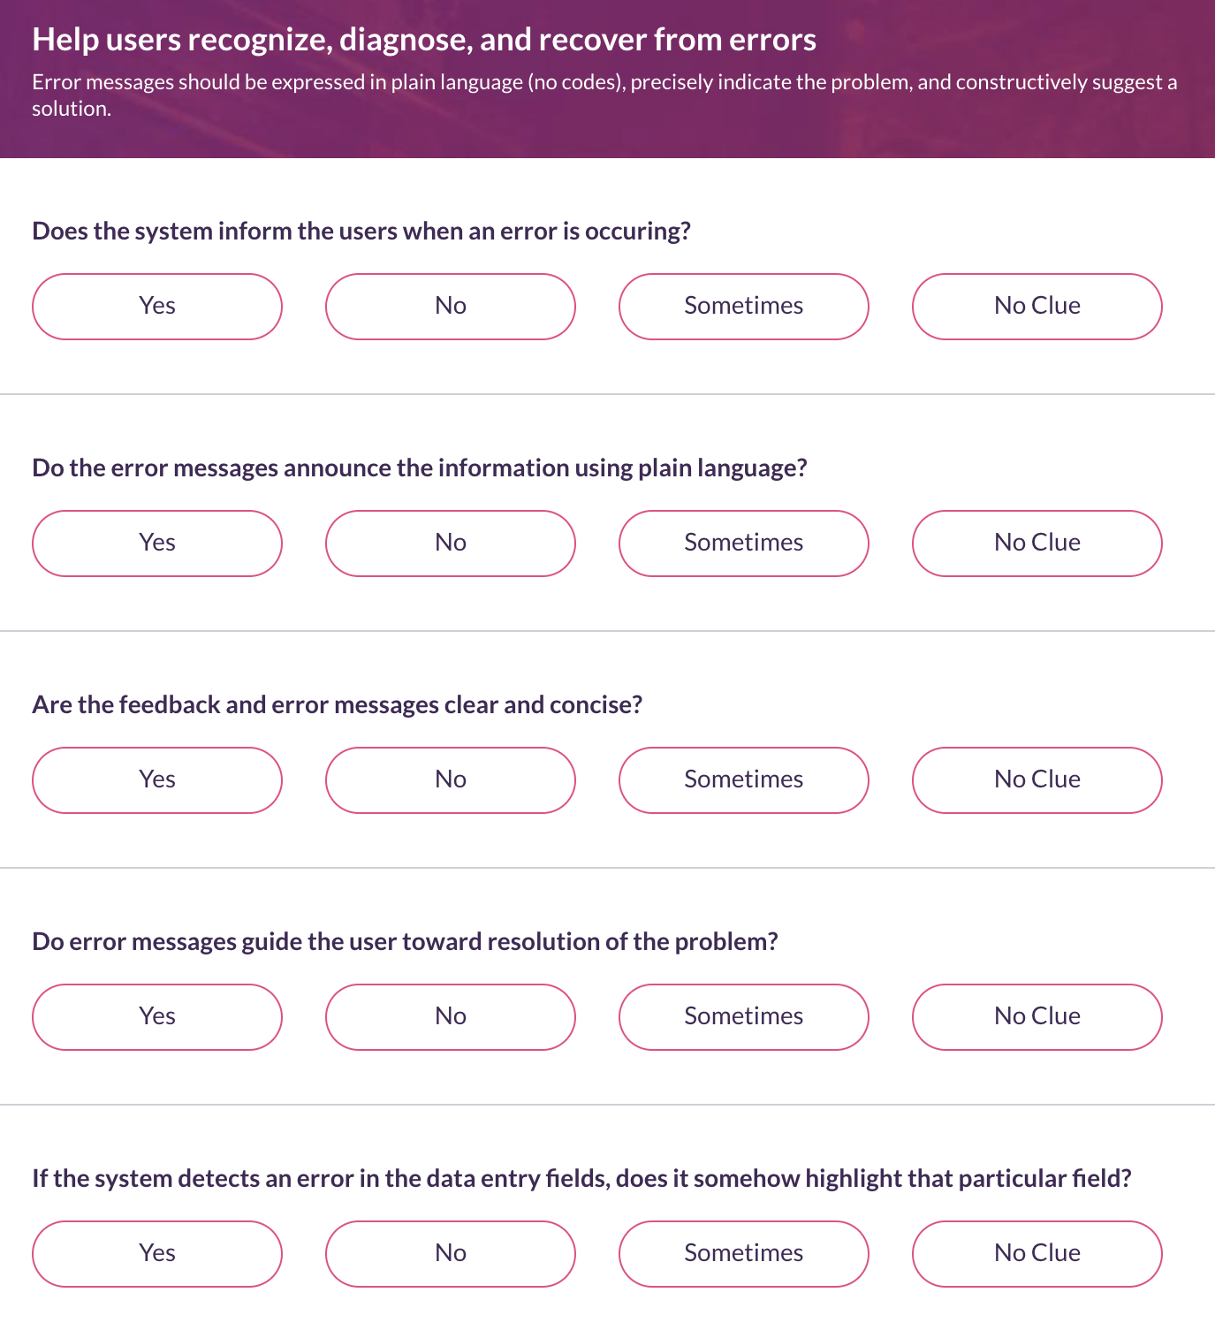

Slide 10


Slide 11
Class exercise
https://bit.ly/3fpF1HA
Using Yango app:
Book a Comfort ride and enter the destination LuckyOne Mall and pickup from IBA Main Campus. Confirm ride and choose payment method as Jazz cash, also enable the traffic display option as well.
Book a courier delivery and add a pick-up time for tomorrow at 10 am, and provide instructions to the rider to bring a 1 kg box for the parcel.
Book a truck for moving furniture with two loaders and enter the date for tomorrow at 5 pm.
Buy at least 5 grocery items from the deal card and pay using the Easypaisa option. Please also apply the Rs 100 Discount Voucher before paying.

