Slide 1
Designs and Evaluations
Week 5
HCI

Slide 2
Design
Technology Myopia
Conceptual Design
Physical Design
Evaluation
Standards
Heuristics

Slide 3

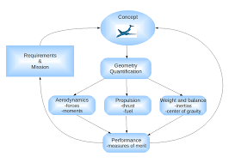
Tech Myopia
Interaction designs must be sensitive to:
Human-human communication
Implicit Knowledge
Non-technical aspects of work
Conceptual Design
Conceptual design involves
Structuring the information space
Creating of alternative solutions
Determining which design concept to pursue

Slide 4
Physical Design
What it will look like
What components it will require
How the screens will be laid out
Standards
Graphical libraries
User interface toolkits
Visual interface builders
Web development tools

Slide 5
Measurements
There are many different approaches to measurement
The traditional measurements are:
Task performance, time performance, and user satisfaction
Those measurements do not accurately measure:
Why people no longer use an interface
Discretionary use for enjoyment (e.g. YouTube)
Emotion and trust

Slide 6
New forms of Measurements
A feeling of community?
Emotion?
Enjoyment?
Physiological measures (EEG, EMG)?
Lower carbon footprint?
Satisfaction from accomplishments in gaming or in virtual worlds?
Ease of use and enjoyment of new forms of technology can be challenging to measure

Slide 7
Triangulation
No data collection method will be perfect
It is important to have multiple researchers, using multiple methods, investigating the same phenomenon
We call this triangulation
One paper ≠ scientific truth
Different researchers, different methods, all coming to the same conclusion, THAT’S when you find consensus

Slide 8
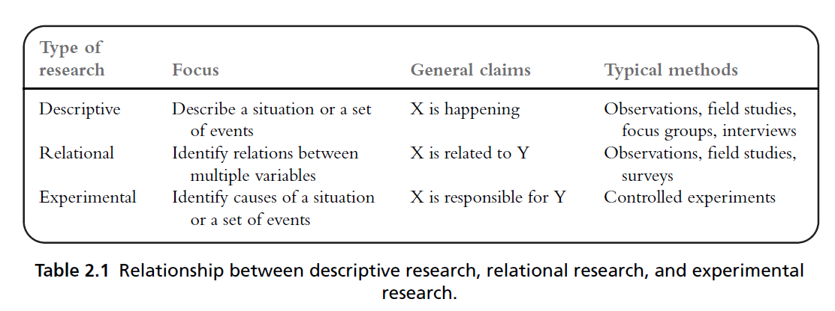
Evaluating Desings
Experimental Research

Slide 9
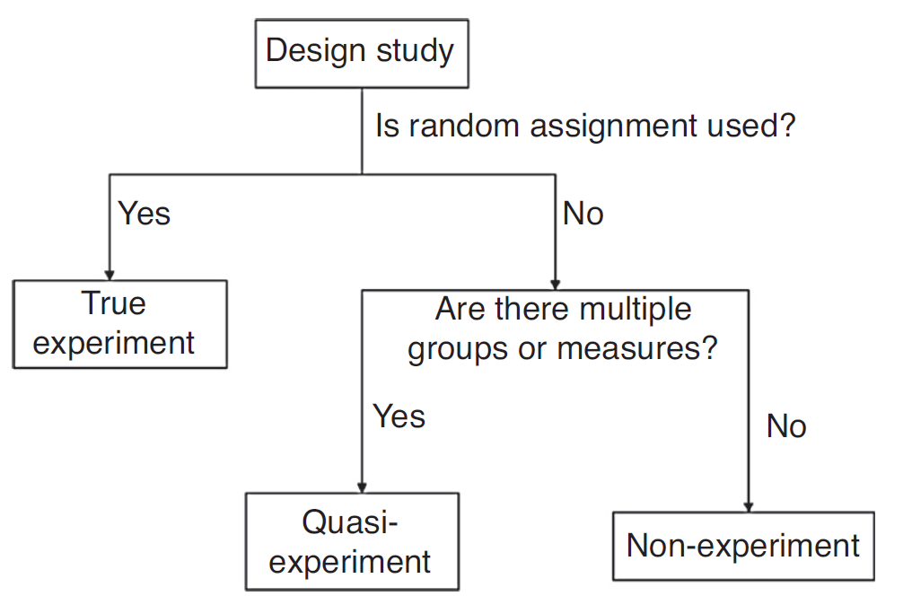
Experimental Design
How many independent variables do we want to investigate in the experiment?
How many different values does each independent variable have?

Slide 10
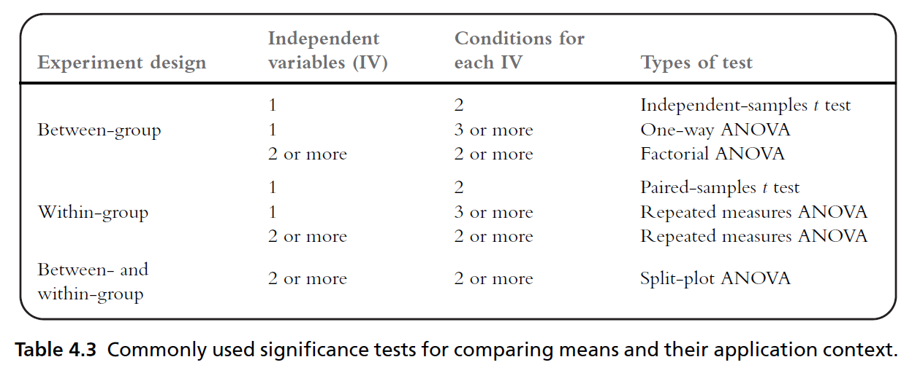
Statistical Analysis
Preparing data for statistical analysis
Descriptive statistics
Comparing means
T tests
Analysis of variance (ANOVA)
Assumptions of t - tests and F - tests
Identifying relationships
Regression
Nonparametric statistical tests

Slide 11

Surveys
Surveys are good at:
getting a large number of responses
Quickly
From a geographically dispersed population
You can capture the “big picture” relatively quickly
If structured random sampling is used, you might be able to make accurate population estimates

Slide 12
Diaries (ethnography)
A diary is a document created by an individual who maintains regular recordings about events in their life, at the time that those events occur
Diaries are useful for recording information that is fluid and changes over time, such as user mood
If recall after-the-fact will be hard, inaccurate, or subject to biases, diaries might be a useful data collection me

Slide 13
Case Studies
in-depth study of a specific instance (or a small number of instances) within a specific real-life context.
Build understanding, generate hypotheses, document behavior that would otherwise be hard to document
Time and labor intensive, but potentially informative
Interviews and Focus Groups
Ethnography

Slide 14
Design rules

Slide 15
Design rules
What is the goal of interaction design?
Designing for maximum usability
Types of design rules
Standards/Guidelines/Principles
Standards and guidelines
Direction for design

Slide 16
Types of design rules
We can classify these rules along two dimensions based on the rule’s authority and generality
By authority, we mean
Rule must be followed in the design or
It is only suggested
By generality, we mean
Rule can be applied to many situations/applications or
It is focused on a limited situations/applications
increasing generality
increasing authority

Slide 17
Types of design rules (contd.)
Standards
Specific design rules
High authority
Low generality (Limited application)
Guidelines
Lower authority
High generality (More general application)
Principles
Abstract design rules
Lower authority
High generality
increasing generality
increasing authority

Slide 18
Golden rules and heuristics
“Broad Brush” design rules
Useful check list for good design
Different collections of design rules includes such as
Shneiderman’s 8 Golden Rules
Norman’s 7 Principles
Nielsen’s 10 Heuristics

Slide 19
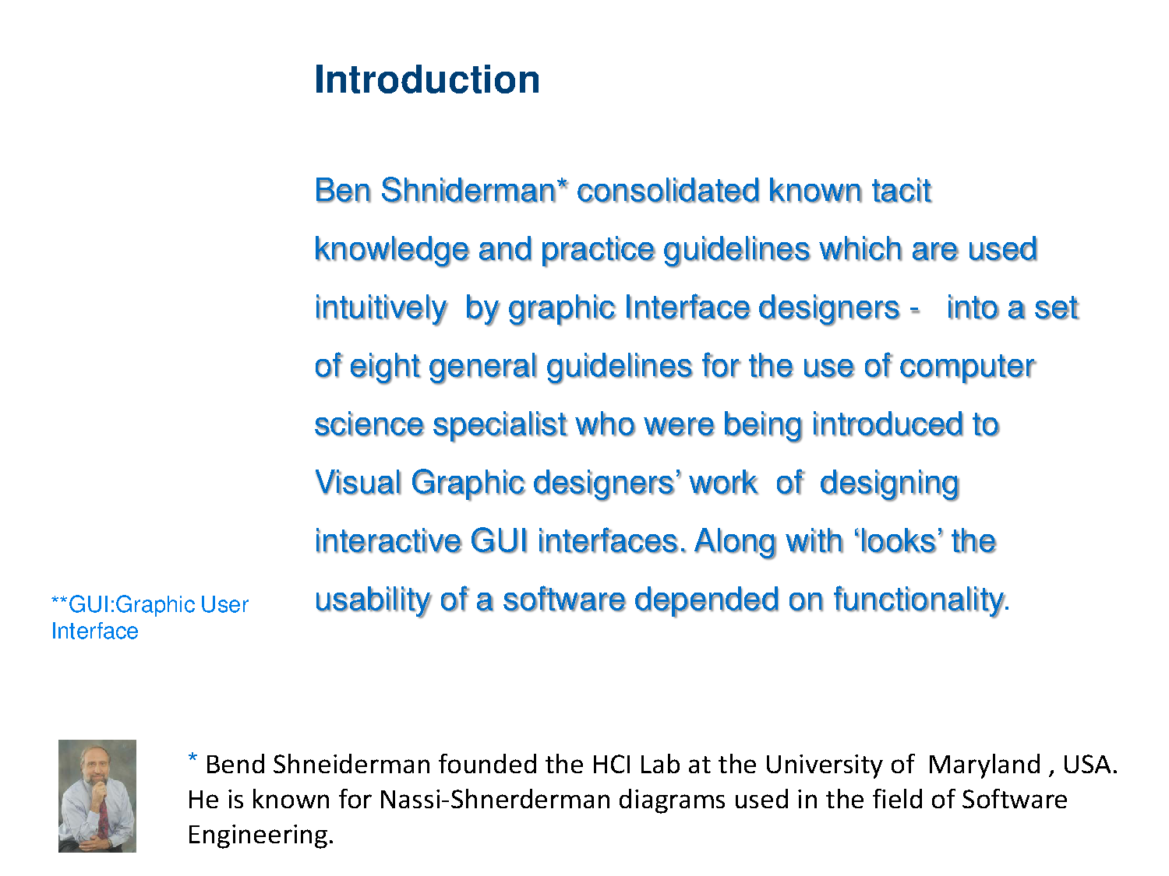
Notes:
https://webdesign.tutsplus.com/articles/8-golden-rules-for-better-interface-design--cms-30886
https://www.interaction-design.org/literature/article/shneiderman-s-eight-golden-rules-will-help-you-design-better-interfaces

Slide 20
Schneiderman's 8 Golden Rules
1. Strive for consistency
2. Cater to Universal Usability (Enable frequent users to use shortcuts)
3. Offer informative feedback
4. Design dialogs to yield closure
5. Offer error prevention and simple error handling
6. Permit easy reversal of actions
7. Support internal locus of control
8. Reduce short-term memory load

Slide 21
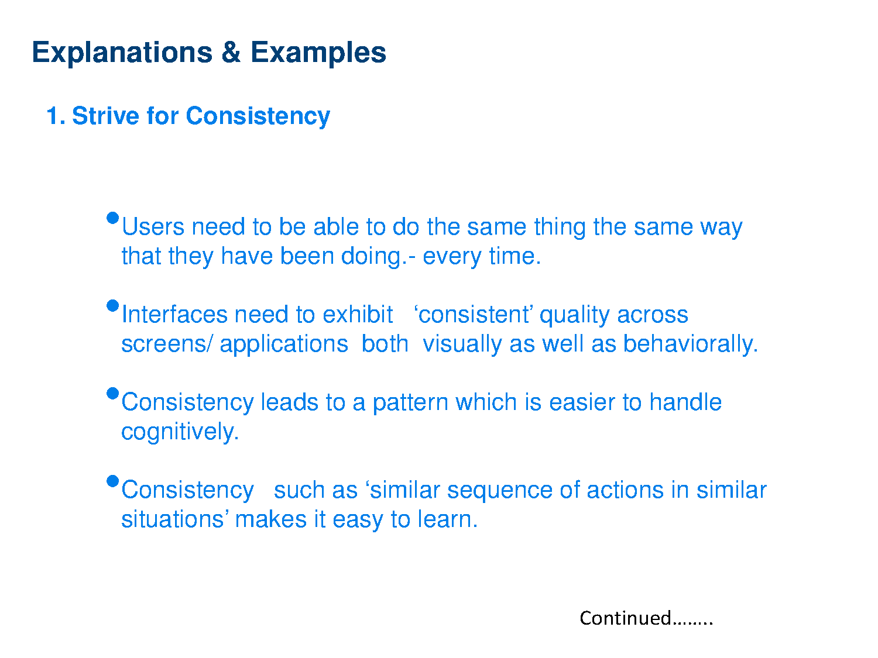

Slide 22
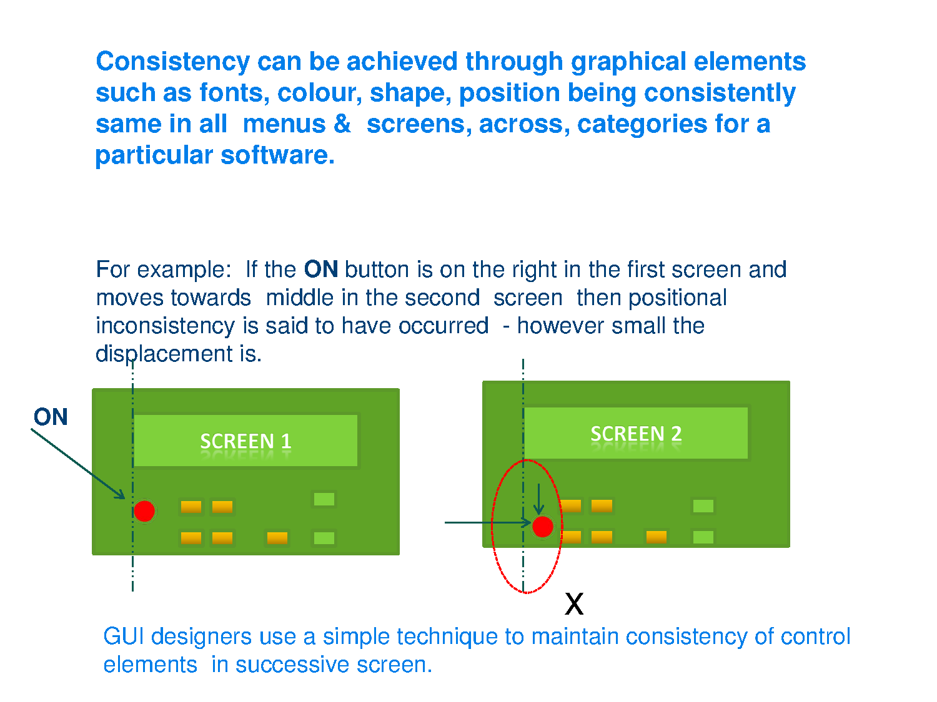

Slide 23
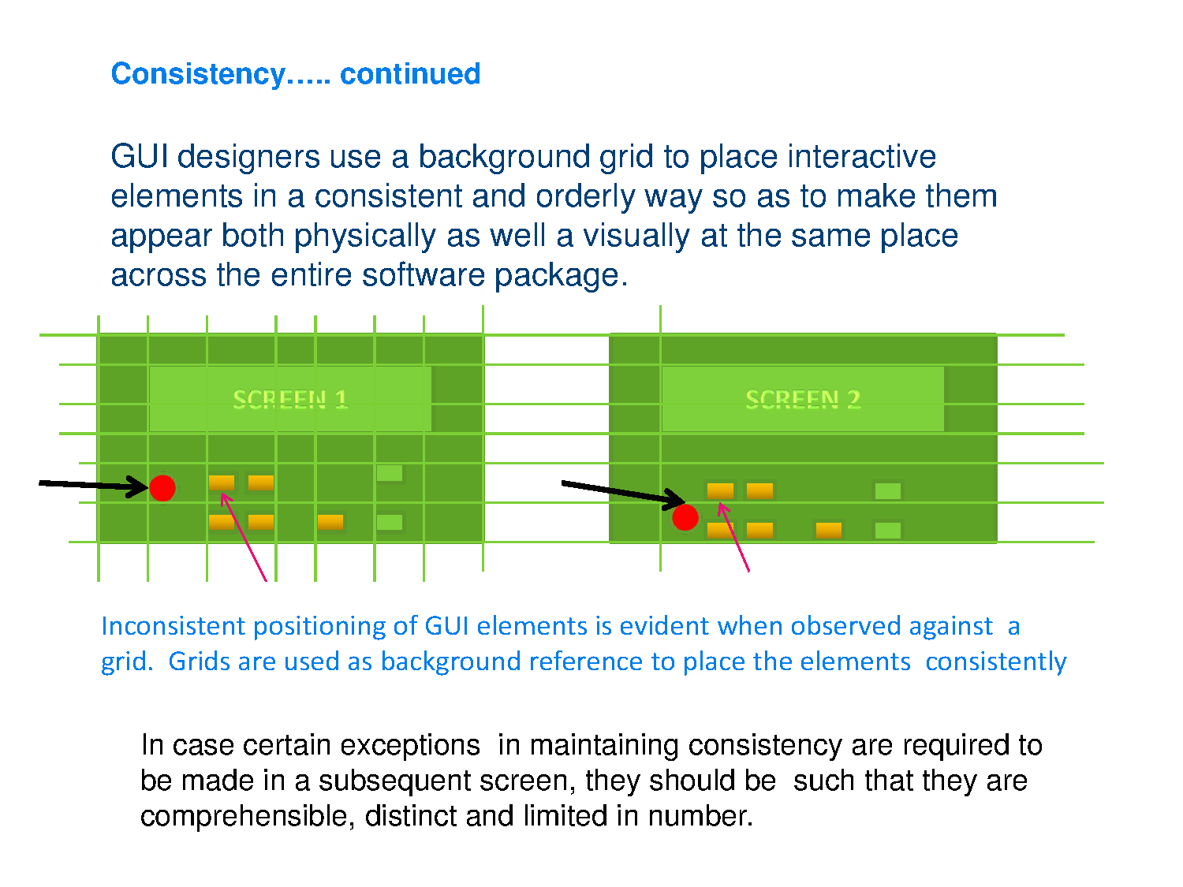

Slide 24
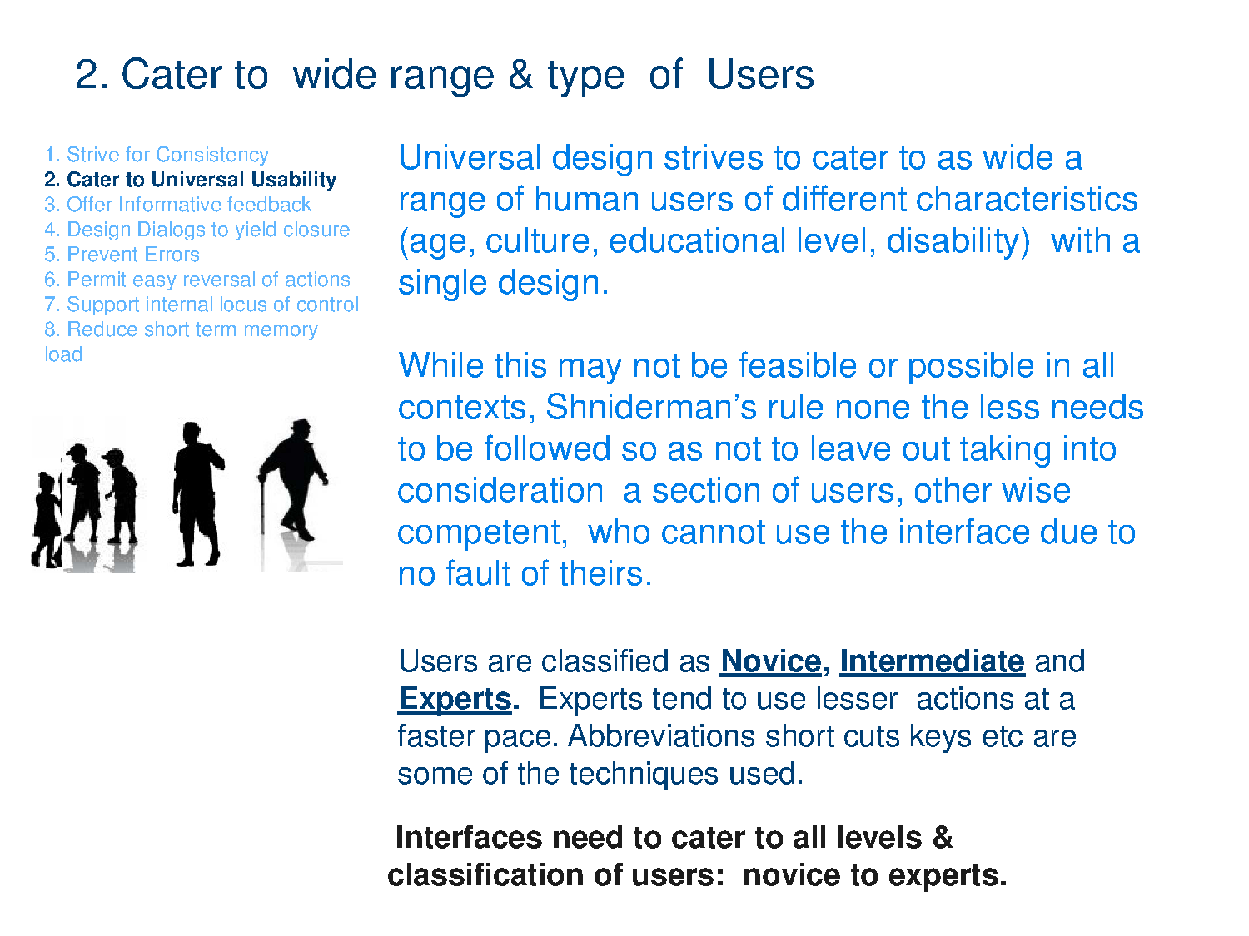

Slide 25
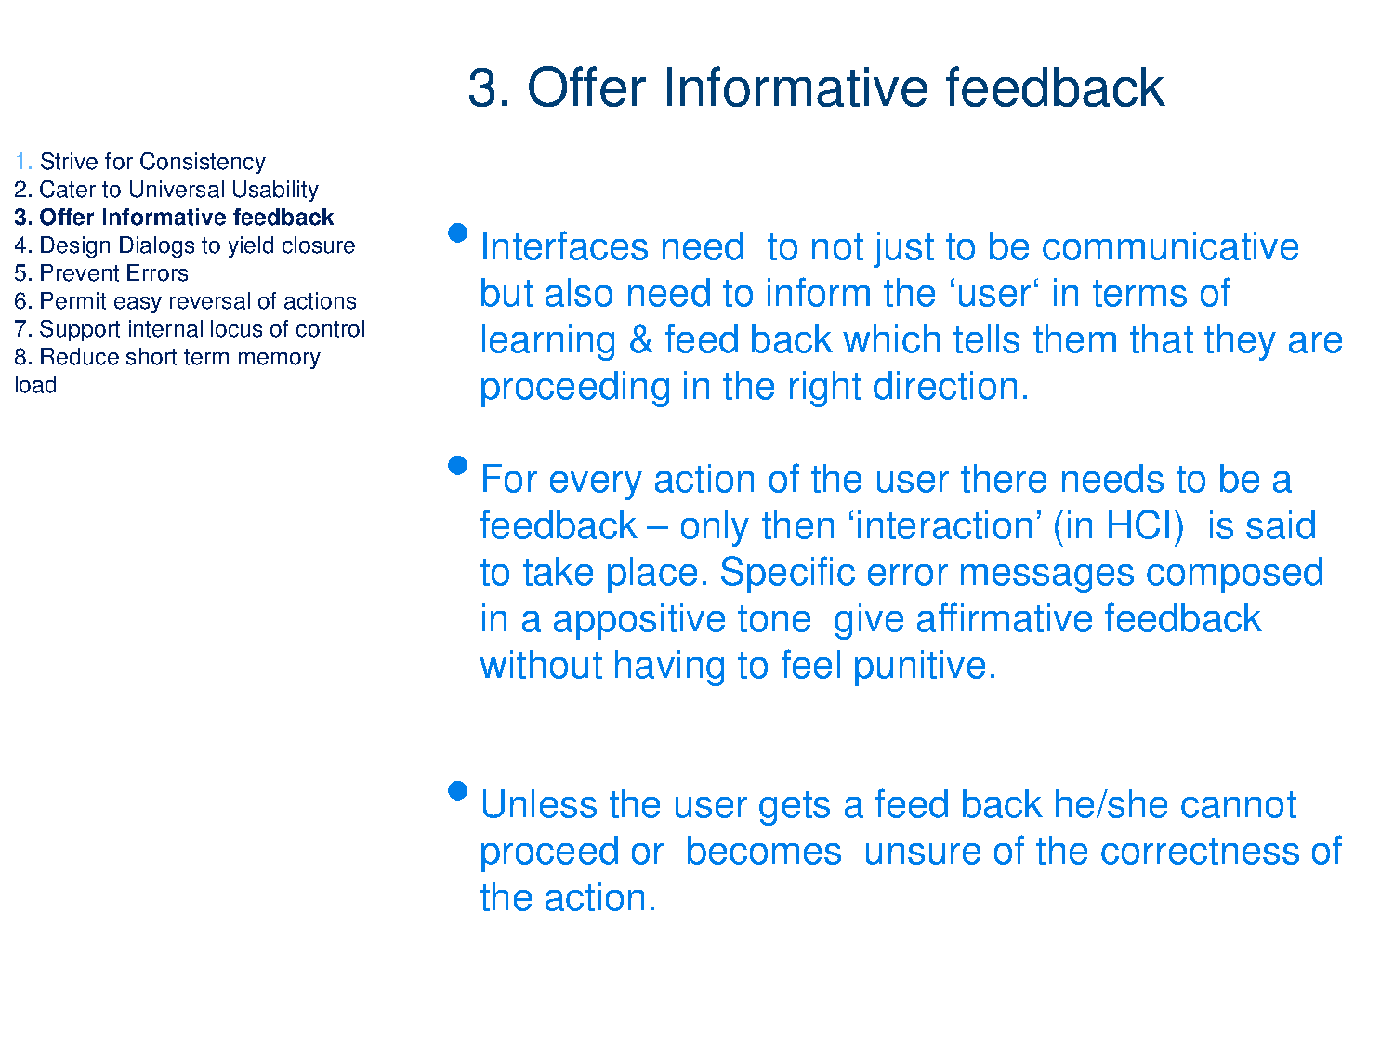

Slide 26
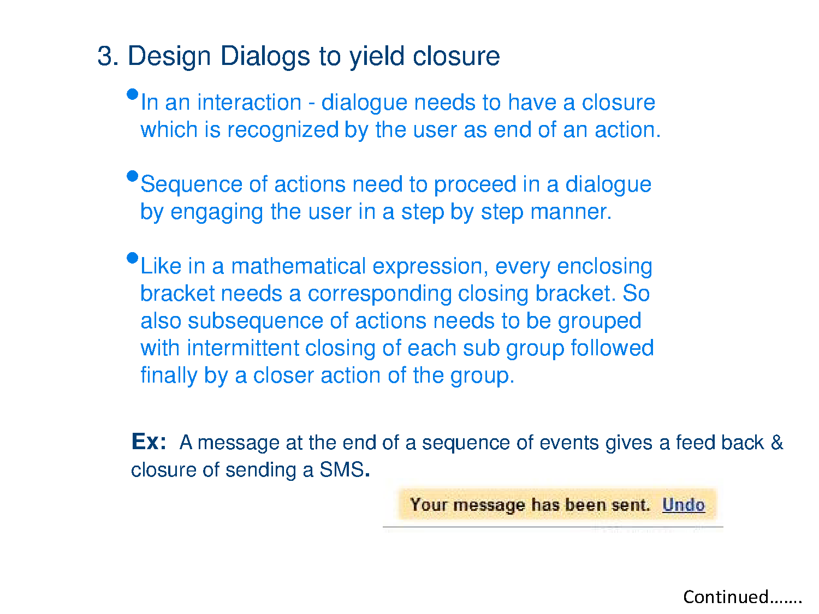
4.

Slide 27
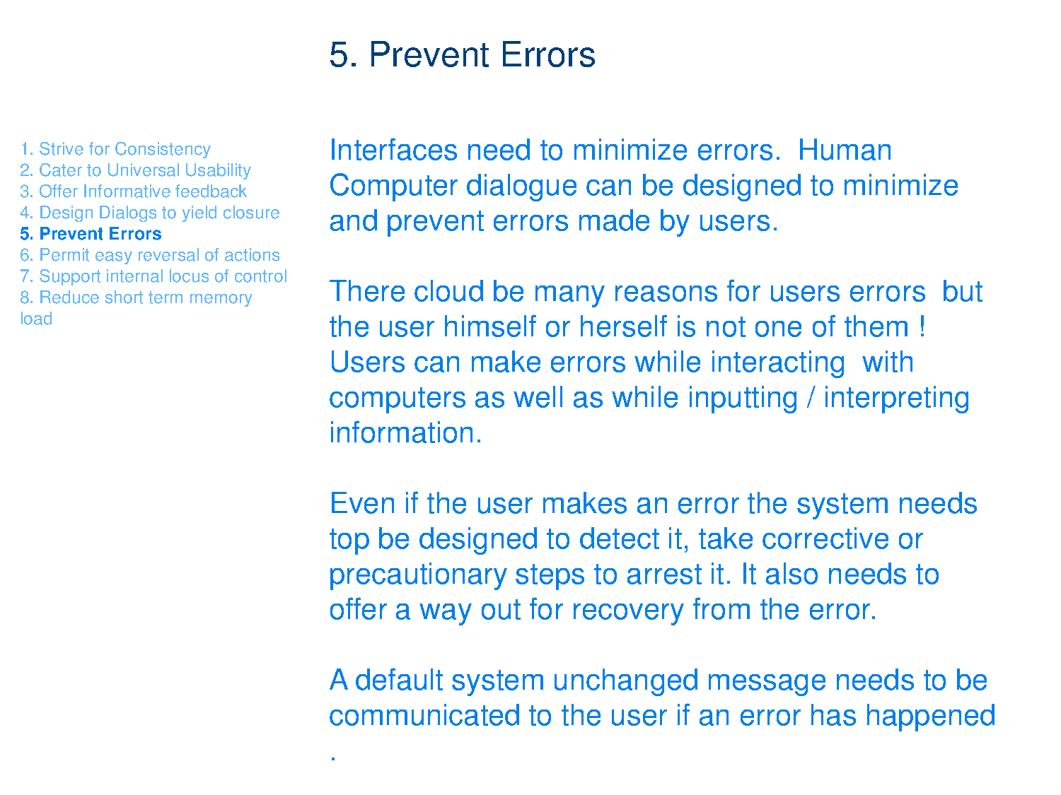

Slide 28
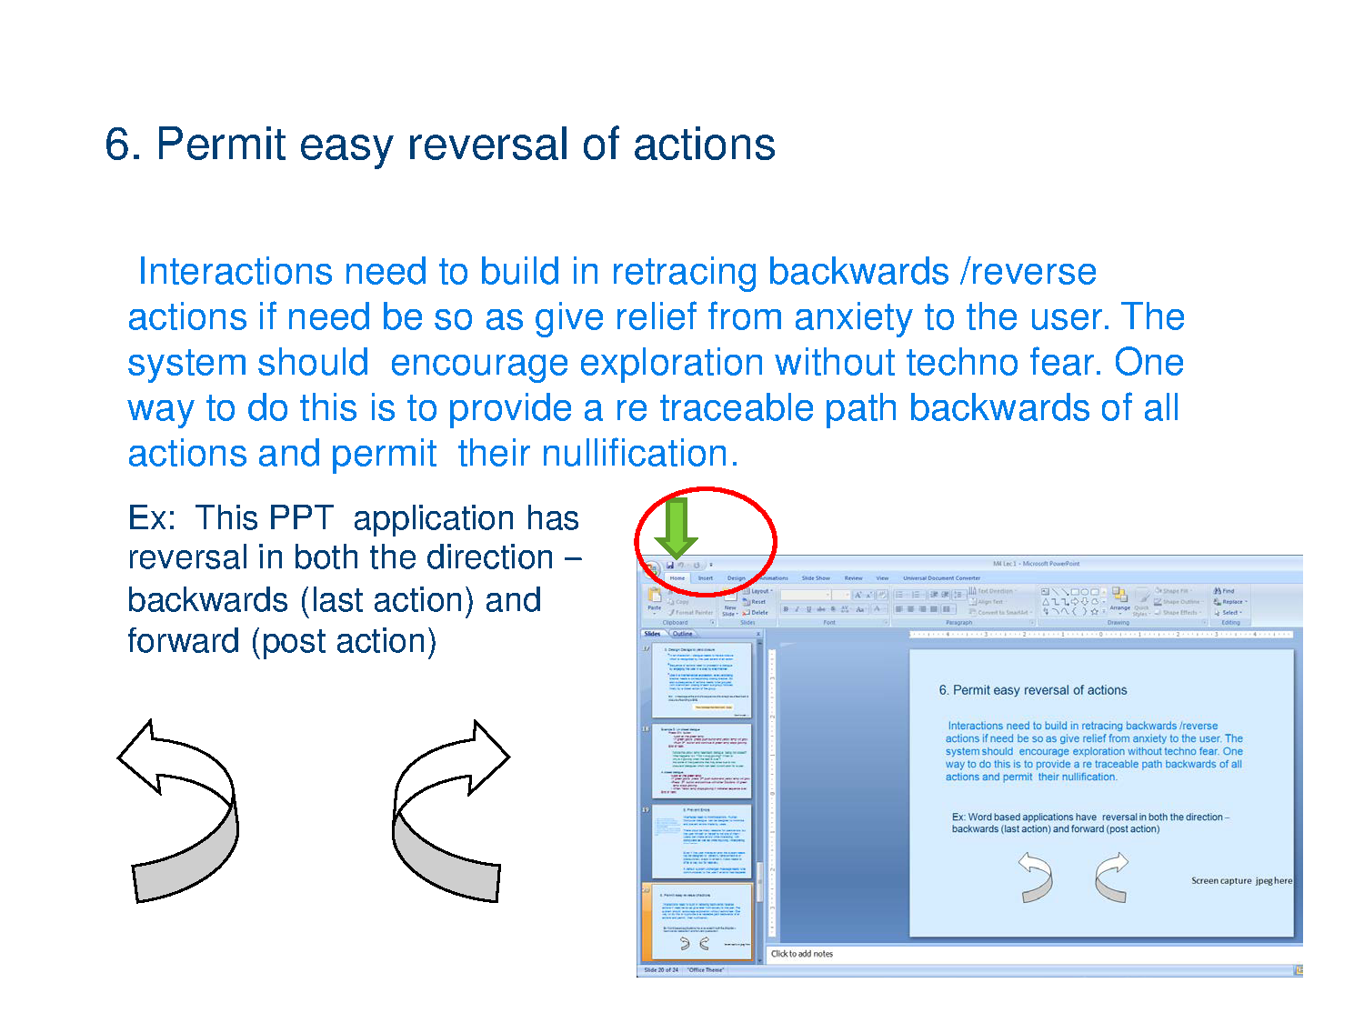

Slide 29
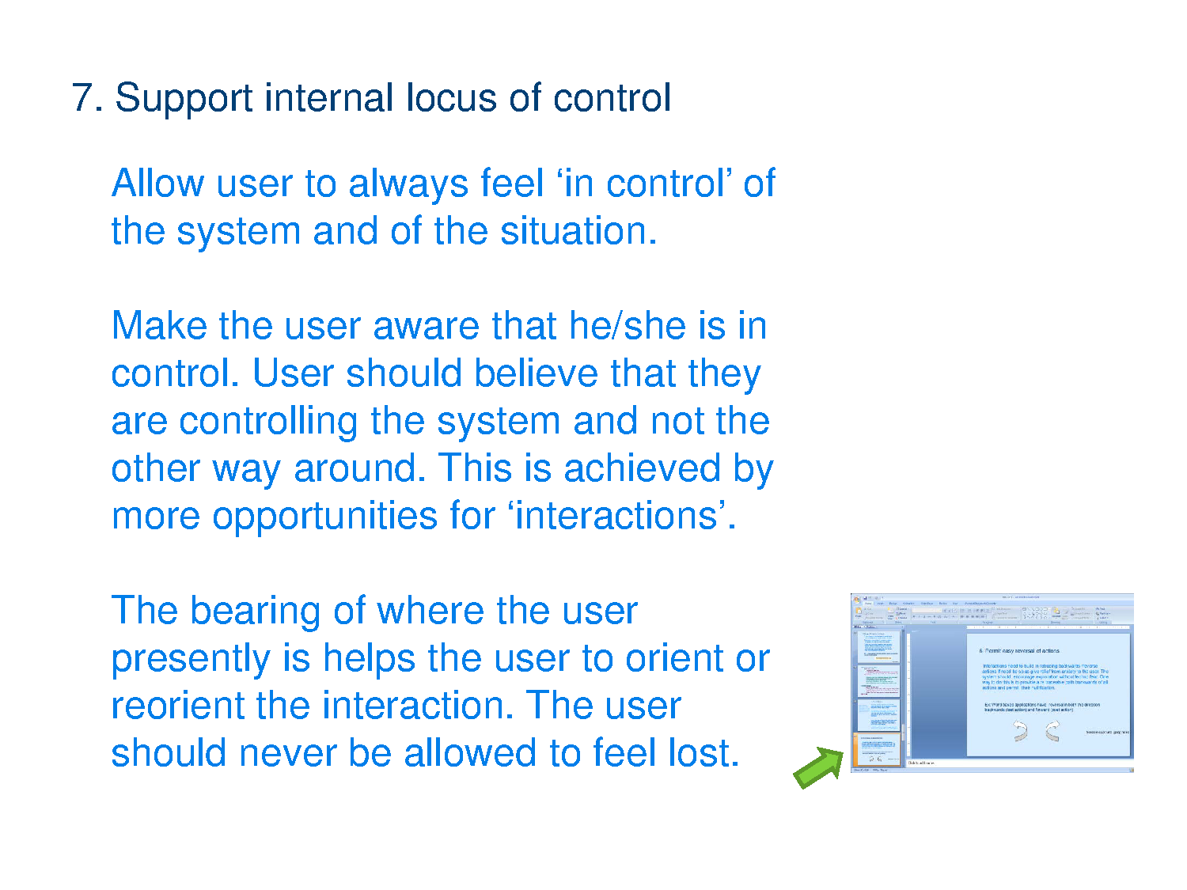

Slide 30
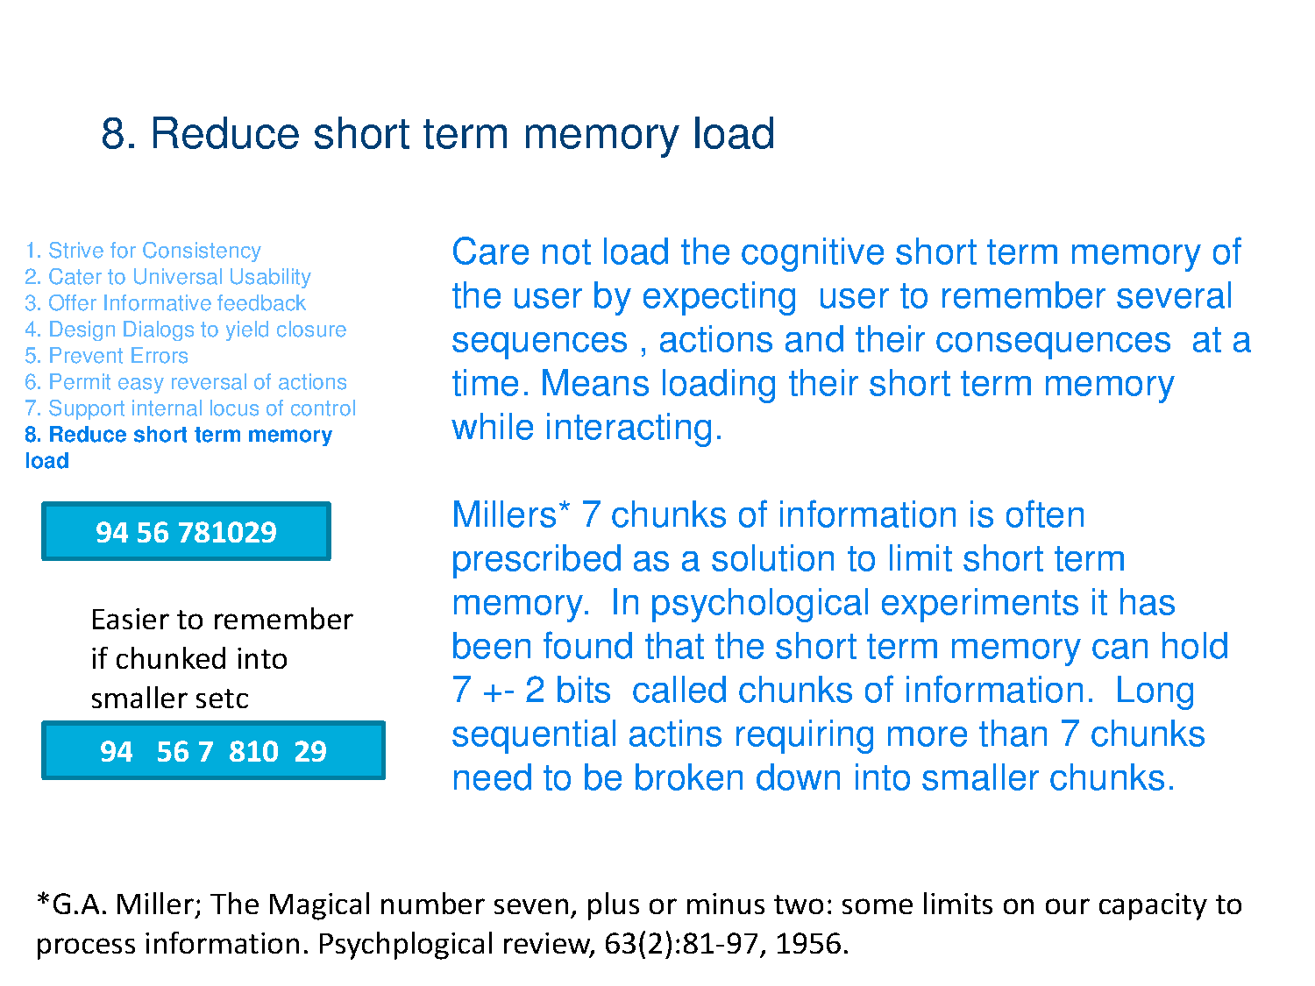

Slide 31
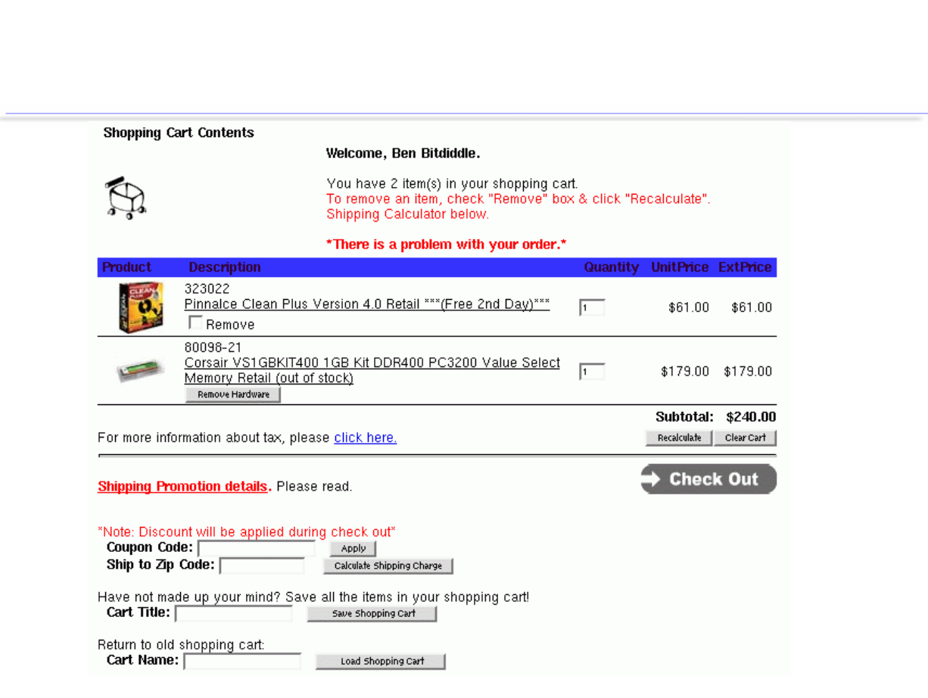

Slide 32
