Slide 1
Navigation Infrastructures

Slide 2
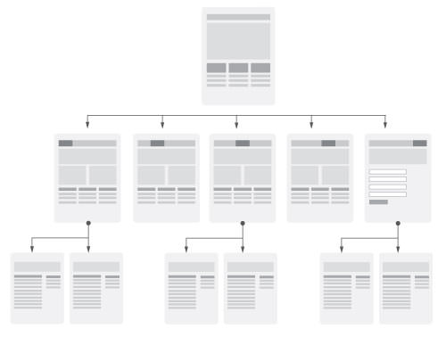
Hierarchical

Slide 3
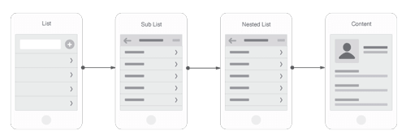
Nested Doll
linear menu pattern that is conventional in mobile web apps. Users incrementally tap or swipe to reveal additional menu options as they traverse up and down through the site map.
Funnelling users from broad overview pages to detail pages helps them hone in on what they’re looking for and focus on content within an individual section. This approach is well suited to small screens, but comes at the expense of easy lateral movement across sections.

Slide 4
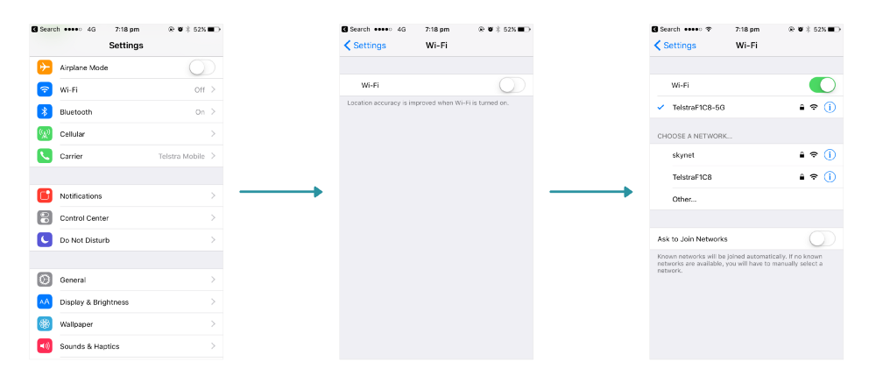

Slide 5
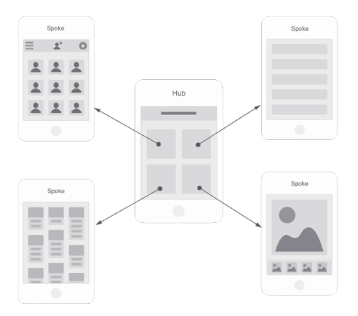
Hub and Spoke
Utilizes a central screen that acts as the launchpad for exploration.
Links point outward to other sections of the website or independent applications, each siloed from the others. ‘
To move from one section to another, you must first jump back to the hub. This home-screen approach eliminates the need for global navigation on each page, making it a popular choice for task-based applications that benefit from focus and minimal distraction.

Slide 6
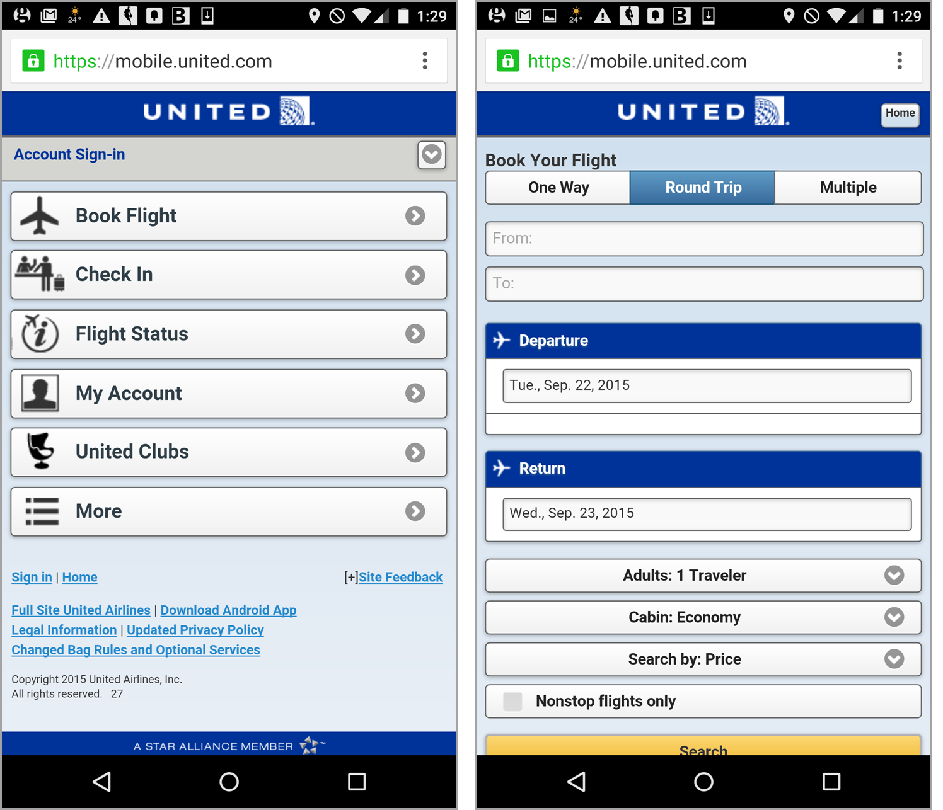

Slide 7
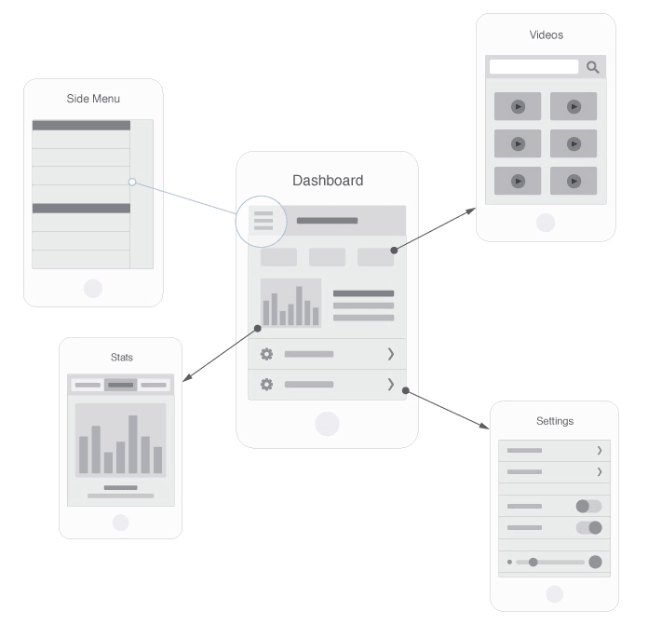
Bento Box
The bento box model is a dashboard-style application that pulls in dynamic components and information.
Most interactions occur in the context of a single multi-purpose screen that unfolds to reveal layers of additional information. This is a popular choice for websites on which users interact with data aggregated from a variety sources.

Slide 8
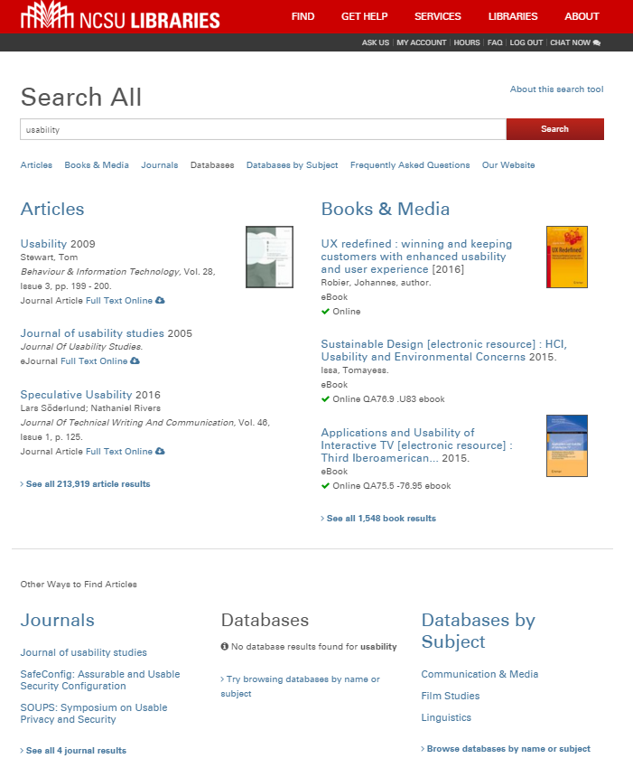

Slide 9
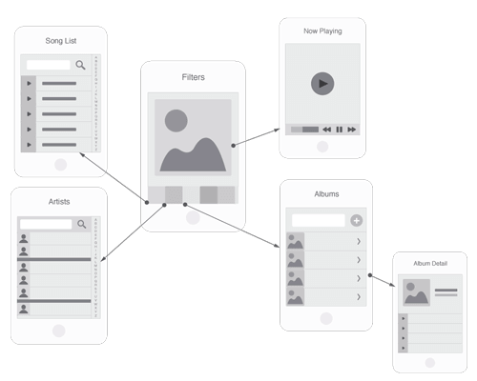
Filtered View
Unlike dashboards, which provide a control center for interacting with a variety of data, filtered view systems deal with a single data set. Information may be explored from multiple perspectives, with a variety of views and sorting options controlled by the user.

Slide 10
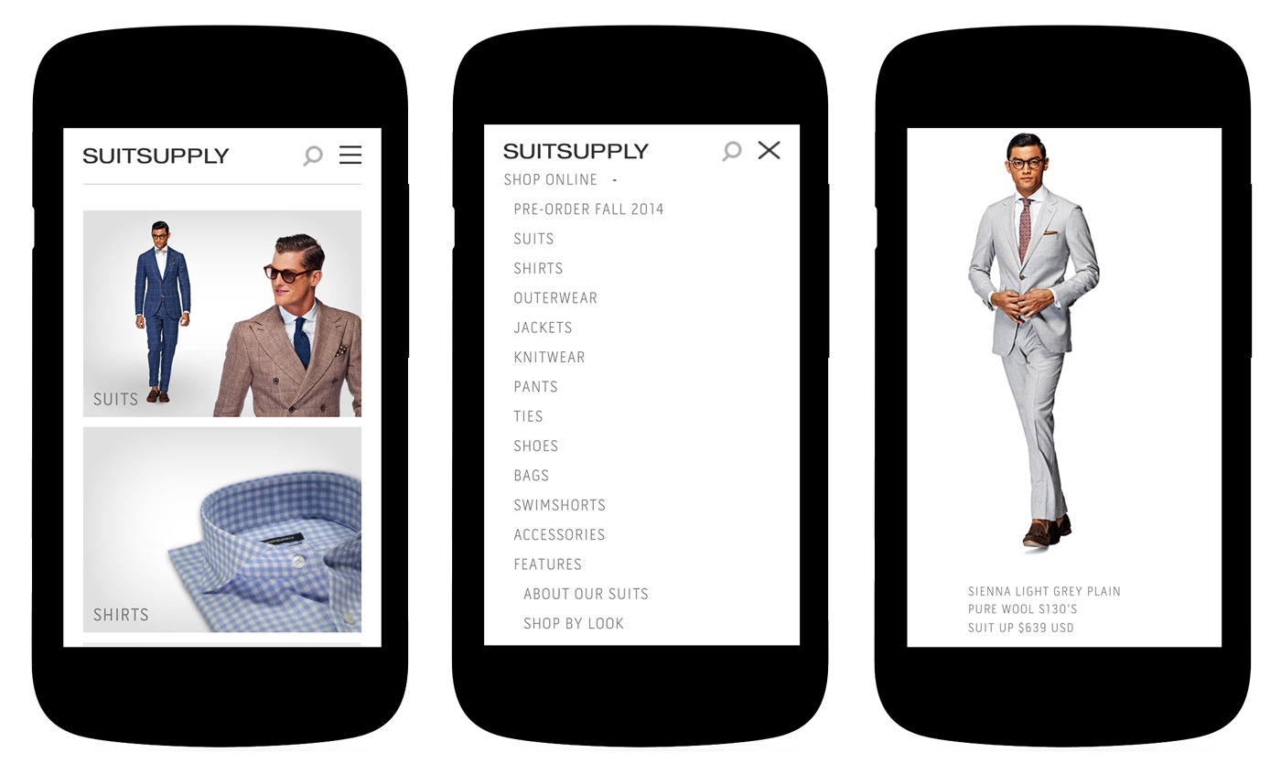

Slide 11
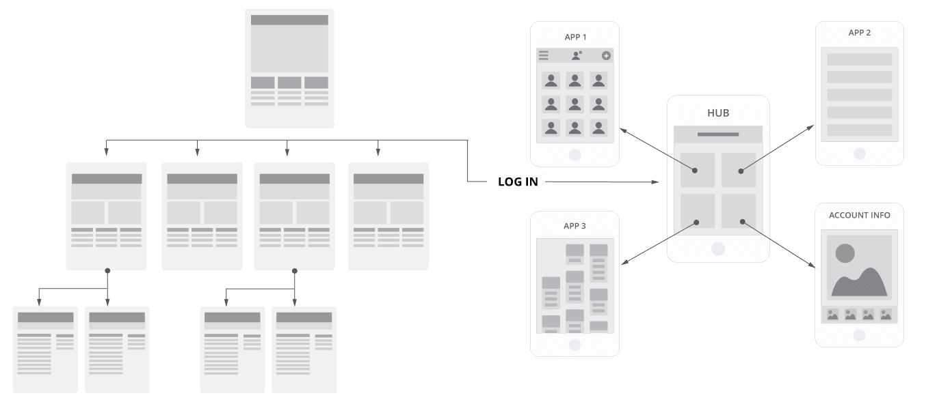
Hybrids

Slide 12
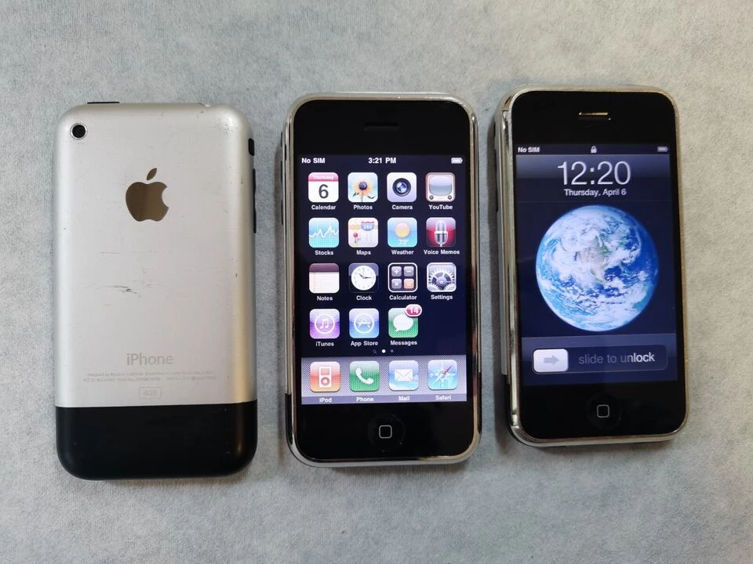
Touch & Gesture-Based Navigation
Multi-touch gestures: Pinch-to-zoom, swipe, drag, flick, rotate (common in smartphones/tablets).
Edge-based gestures: Swiping from screen edges for task switching or hidden menus (Android/iOS navigation).
Air gestures: Hand movements detected without touching the screen (Samsung Air Gestures, Kinect).
3D gestures: Movements in 3D space, tracked by depth sensors or cameras (e.g., Leap Motion, HoloLens).

Slide 13

Voice-Based Navigation
Voice commands: Google Assistant, Siri, Alexa – navigation through speech.
Conversational navigation: Natural language queries for controlling apps or devices.
Multimodal voice + gesture: Combine pointing with a voice command, e.g., “Open this app” while pointing.

Slide 14
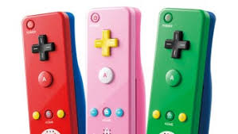
Sensor & Motion-Based Navigation
Tilt/rotation navigation: Gyroscope or accelerometer used to tilt-scroll, rotate to navigate maps, etc.
Shake-to-action: Shake phone to undo, refresh, or trigger functions.
Wearable motion sensing: Smartwatches and fitness bands interpreting wrist flicks or taps.

Slide 15
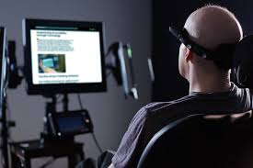
Eye & Gaze Navigation
Eye-tracking: Navigation by looking at UI elements (used in AR/VR headsets, accessibility tech).
Dwell selection: Staring at an icon for a fixed duration to “click.”
Head-tracking navigation: Moving the head instead of eyes to direct focus (HoloLens, VR headsets).

Slide 16
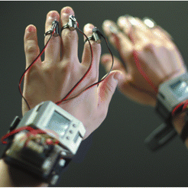
Haptics & Tactile Feedback Navigation
Vibration cues: Guiding users with directional vibrations (e.g., turn left/right in navigation apps).
Surface haptics: Textured or pressure-sensitive screens enabling different navigation feels.
Mid-air haptics: Ultrasonic haptic feedback in AR/VR without touching anything.

Slide 17
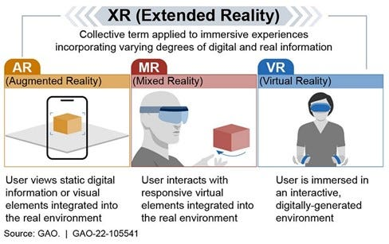
Spatial & Immersive Navigation (AR/VR/MR)
Spatial gestures: Pointing, grabbing, pulling, pushing in 3D environments.
Teleportation: Jumping between locations in VR using controllers or gestures.
Hand-tracking navigation: No controllers – pure hand interaction (Meta Quest, Apple Vision Pro).
Mixed Reality Anchors: Navigating through digital menus “placed” in physical spaces.

Slide 18
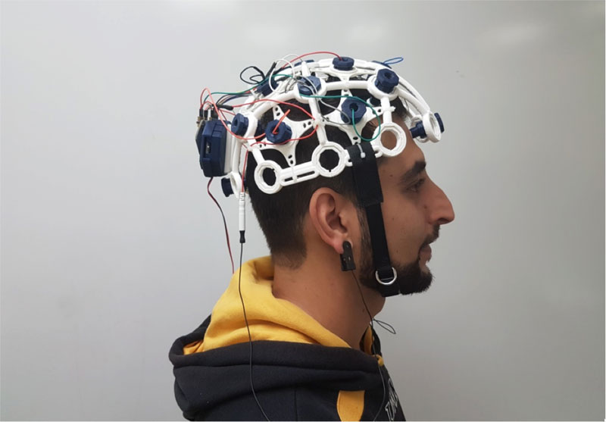
Brain–Computer Interfaces (BCI)
Neural navigation: EEG headbands detect brain signals to control the cursor or select menu options.
Hybrid BCI + gaze/gesture: Combining thought-driven commands with physical input.

Slide 19
Proximity & Context-Aware Navigation
Proximity sensing: Hands hovering above devices to trigger previews or menus.
Context-aware navigation: Device adapts based on environment (e.g., switching modes in dark/light or indoor/outdoor).
Location-based navigation: AR maps overlay directions in real-world view (Google AR Maps, Apple Vision Pro).

Slide 21
Spatial Cues
Landmarks
Logos
Primary Navigation
Bread crumbs
Search
Section Banners
Unique templates or components (slideshows, galleries or event calendars).

Slide 22
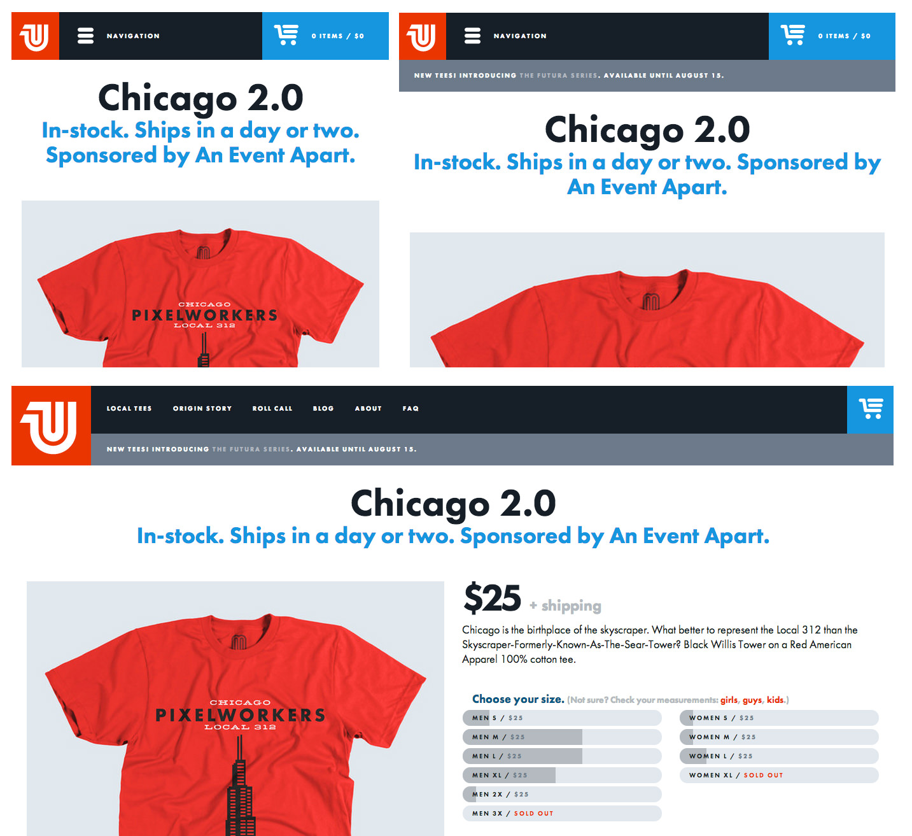
The logo is red in the top left, the navigation is in a black bar along the top, and you can always access the cart from the bright blue button in the top right — no matter which size screen you visit from!

Slide 23
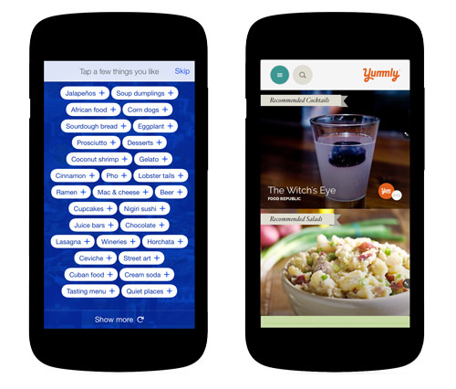
Defining edges of regions
Foursquare’s app (left) packs a lot of tappable items into a small space; clearly defined button boundaries improve scannability and minimize mis-taps. Yummly’s app (right) uses distinct interface edges to define button tap targets and to visually separate the masthead region from the content area and to distinguish between individual recipes.

Slide 24
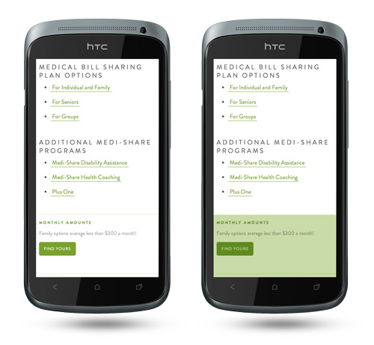
White spaces

Slide 25
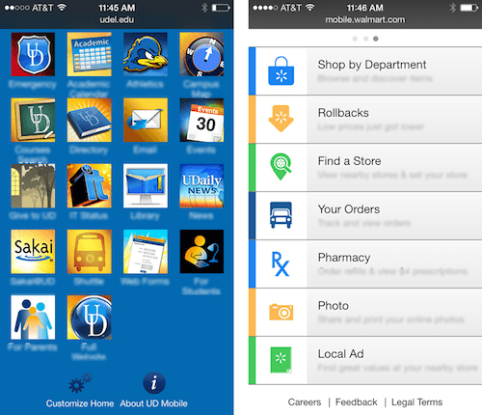
Text labels / Captions

