Slide 1
Question Option Comment (QOC)

Slide 2
How do users log in to the system?
How should users log in to the system?
Username + Password
Passwords are familiar but prone to forgetting and hacking
Biometric (fingerprint/face scan)
Biometrics are convenient but raise privacy concerns and require special hardware
Single Sign-On (Google/Facebook/LinkedIn)
Single Sign-On reduces friction but depends on third-party services
Question
Option
Comment

Slide 3
Navigation in a Mobile App
How should users navigate between the main sections of the app?
Bottom navigation bar
Bottom bar is visible and easy to use, but limited to 4–5 items
Hamburger menu
Hamburger menu hides options and reduces clutter, but decreases discoverability
Swipe gestures
Gestures feel natural but have learnability issues and accessibility problems
Question
Option
Comment

Slide 4
Error Notifications
How should the system notify users about errors?
Pop-up dialog
Pop-ups force attention but interrupt workflow
Inline error message near the field
Inline errors give context but may be overlooked
Notification bar at the top
Notification bar is subtle but less effective for critical errors
Question
Option
Comment

Slide 5
Online Shopping Checkout
How should users confirm their purchase?
One-click checkout
One-click is fast but increases chances of accidental purchase
Multi-step checkout (cart → address → payment → confirm)
Multi-step provides clarity but adds friction
Voice-assisted checkout
Voice checkout is hands-free but not always secure or socially acceptable.
Question
Option
Comment

Slide 6
Feedback Collection
How should the app collect user feedback?
Star rating (1–5)
Star ratings are quick but lack detail
Open-text comment box
Text comments are rich but time-consuming for users
Emoji-based reactions
Emojis are engaging but vague in meaning
Question
Option
Comment

Slide 7
Hierarchical Task Analysis (HTA)

Slide 8
Online Shopping Checkout
Buy a product online
1. Search for product
2.0 Add product to cart
3.0 Proceed to checkout
3.1 Enter shipping details
1.1 Enter keywords in search bar
1.3 Select desired item
1.2 Browse results
3.2 Select payment method
3.3 Confirm Order
4.0 Receive Confirmation

Slide 9
ATM Cash Withdrawal
Insert ATM card
Enter PIN
Select withdrawal option
Enter amount
Collect cash
Collect receipt (optional)
Retrieve card

Slide 10
Ordering food from FoodPanda
1.0 Launch Foodpanda app/website
1.1 Unlock phone / open browser
1.2 Open Foodpanda app / go to website
2.0 Log in / Sign up (if not already logged in)
2.1 Enter phone/email
2.2 Enter password / OTP
2.3 Confirm login
3.0 Select delivery location
3.1 Allow GPS access or manually enter address
3.2 Confirm location on map
4.0 Browse restaurants / food options
4.1 Use search bar (restaurant, cuisine, dish)
4.2 Filter by ratings, price, or offers
4.3 Select restaurant
5.0 Select food items
5.1 Browse menu categories
5.2 Choose dish
5.3 Customize (size, toppings, extras, notes)
5.4 Add to cart
6.0 Review cart
6.1 Check items, quantity, price
6.2 Apply promo code / voucher
6.3 Proceed to checkout
7.0 Provide delivery details
7.1 Confirm delivery address
7.2 Add delivery instructions (optional)
8.0 Make payment
8.1 Choose payment method (Cash / Card / Wallet / Online banking / COD)
8.2 Enter payment details if required
8.3 Confirm payment
9.0 Track order
9.1 See restaurant confirmation
9.2 Follow preparation status
9.3 Track rider location
10.0 Receive delivery
10.1 Meet rider / collect order
10.2 Check items received
10.3 Confirm delivery in app
11.0 Provide feedback
11.1 Rate restaurant & rider
11.2 Write review (optional)

Slide 11
State Transition Network (STN)

Slide 12

STN for attending a course
The basic idea is to define a machine that has a number of states (hence the term finite state machine)

Slide 13
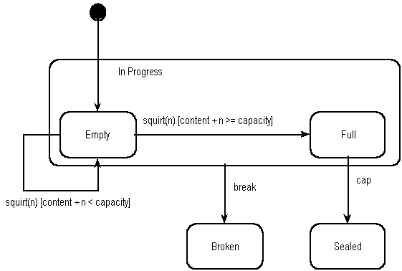
State Transition Diagram of a bottle in a bottling plant.

Slide 14
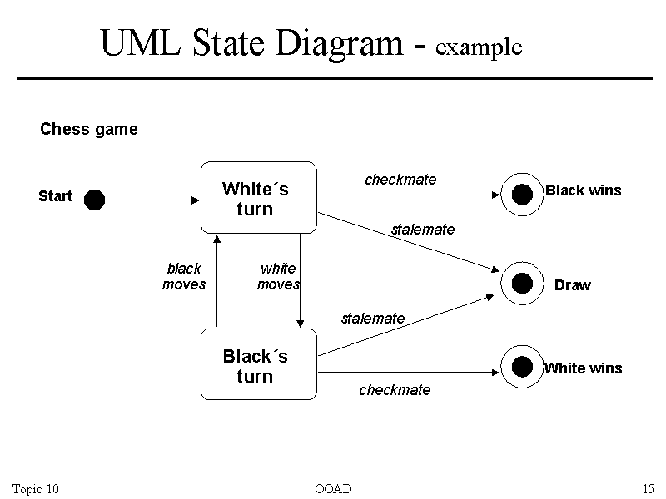
State Transition Diagram of winning a chess game

