Slide 1

Research Methods in Human-Computer Interaction
Chapter 2- Experimental Research

Slide 2
Overview
Types of behavioral research
Research hypotheses
Basics of experimental research
Significance tests
Limitations of experimental research

Slide 3
Types of behavioral research
Descriptive investigations focus on constructing an accurate description of what is happening.
Relational investigations enable the researcher to identify relations between multiple factors. However, relational studies can rarely determine the causal relationship between multiple factors.
Experimental research allows the establishment of a causal relationship.

Slide 4
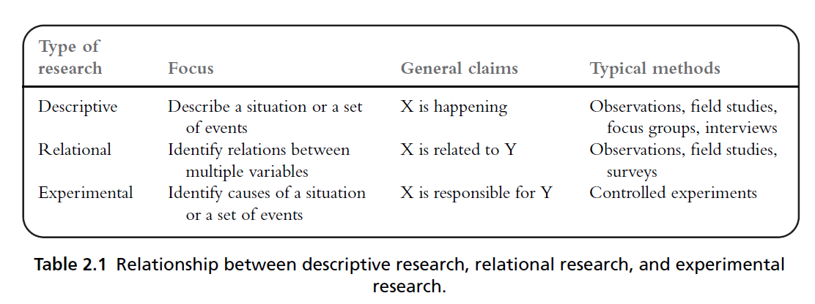
Types of behavioral research

Slide 5
Research hypotheses
An experiment normally starts with a research hypothesis.
A hypothesis is a precise problem statement that can be directly tested through an empirical investigation.
Compared with a theory, a hypothesis is a smaller, more focused statement that can be examined by a single experiment

Slide 6
Types of hypotheses
Null hypothesis: typically states that there is no difference between experimental treatments.
Alternative hypothesis: a statement that is mutually exclusive with the null hypothesis.
The goal of an experiment is to find statistical evidence to refute or nullify the null hypothesis in order to support the alternative hypothesis.
A hypothesis should specify the independent variables and dependent variables.

Slide 7
Research hypotheses
Independent variables (IV) refer to the factors that the researchers are interested in studying or the possible “cause” of the change in the dependent variable.
IV is independent of a participant’s behavior.
IV is usually the treatments or conditions that the researchers can control.
Dependent variables (DV) refer to the outcome or effect that the researchers are interested in.
DV is dependent on a participant’s behavior or the changes in the IVs
DV is usually the outcomes that the researchers need to measure.

Slide 8
Typical independent variables in HCI
Those that relate to technology
Types of technology or device
Types of design
Those that relate to users: age, gender, computer experience, professional domain, education, culture, motivation, mood, and disabilities
Those that relate to context of use:
Physical status
User status
Social status

Slide 9
Typical dependent variables in HCI
Efficiency:
e.g., task completion time, speed
Accuracy:
e.g., error rate
Subjective satisfaction:
e.g., Likert scale ratings
Ease of learning and retention rate
Physical or cognitive demand
e.g., NASA task load index

Slide 10
Components of experiment
Treatments, or conditions: the different techniques, devices, or procedures that we want to compare
Units: the objects to which we apply the experiment treatments. In HCI research, the units are normally human subjects with specific characteristics, such as gender, age, or computing experience
Assignment method: the way in which the experimental units are assigned different treatments.

Slide 11
Randomization
Randomization: the random assignment of treatments to the experimental units or participants
In a totally randomized experiment, no one, including the investigators themselves, is able to predict the condition to which a participant is going to be assigned
Methods of randomization
Preliminary methods
Random table
Software driven randomization

Slide 12
Significance tests
Why do we need significance tests?
When the values of the members of the comparison groups are all known, you can directly compare them and draw a conclusion. No significance test is needed since there is no uncertainty involved.
When the population is large, we can only sample a sub-group of people from the entire population.
Significance tests allow us to determine how confident we are that the results observed from the sampling population can be generalized to the entire population.

Slide 13
Type I and Type II errors
All significance tests are subject to the risk of Type I and Type II errors.
A Type I error (also called an α error or a “false positive”) refers to the mistake of rejecting the null hypothesis when it is true and should not be rejected.
A Type II error (also called a β error or a “false negative”) refers to the mistake of not rejecting the null hypothesis when it is false and should be rejected.

Slide 14
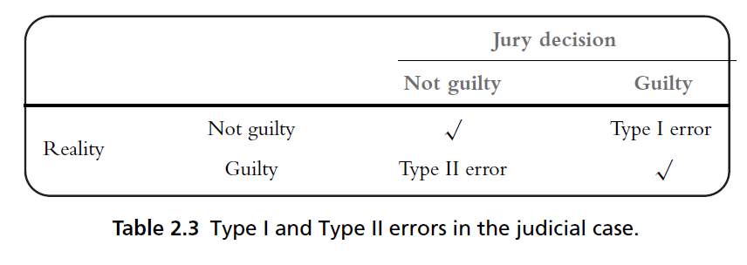
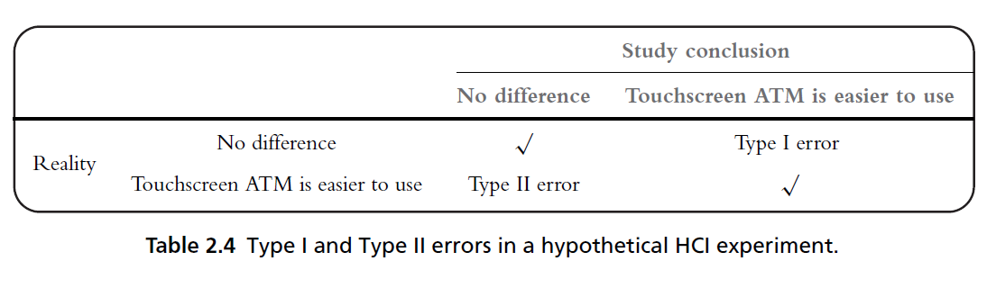
Type I and Type II errors

Slide 15
Type I and Type II errors
It is generally believed that Type I errors are worse than Type II errors.
Statisticians call Type I errors a mistake that involves “gullibility”.
A Type I error may result in a condition worse than the current state.
Type II errors are mistakes that involve “blindness”
A Type II error can cost the opportunity to improve the current state.

Slide 16
Controlling risks of errors
In statistics, the probability of making a Type I error is called alpha (or significance level, p value).
The probability of making a Type II error is called beta.
The statistical power of a test, defined as 1−β, refers to the probability of successfully rejecting a null hypothesis when it is false and should be rejected

Slide 17
Controlling risks of errors
Alpha and beta are interrelated. Under the same conditions, decreasing alpha reduces the chance of making Type I errors but increases the chance of making Type II errors.
In experimental research, it is generally believed that Type I errors are worse than Type II errors.
So a very low p value (0.05) is widely adopted to control the occurrence of Type I errors.

Slide 18
Limitations of Experimental Research
Experimental research requires well-defined, testable hypotheses that consist of a limited number of dependent and independent variables.
Experimental research requires strict control of factors that may influence the dependent variables.
Lab-based experiments may not be a good representation of users’ typical interaction behavior.

Slide 19
End-of-chapter
Summary
Discussion questions
Research design exercise

Slide 20
Research Methods in Human-Computer Interaction
Chapter 3- Experimental Design

Slide 21
Overview
What needs to be considered when designing experiments?
Determining the basic design structure
Investigating a single independent variable
Investigating more than one independent variable
Reliability of experimental results
Experimental procedures

Slide 22
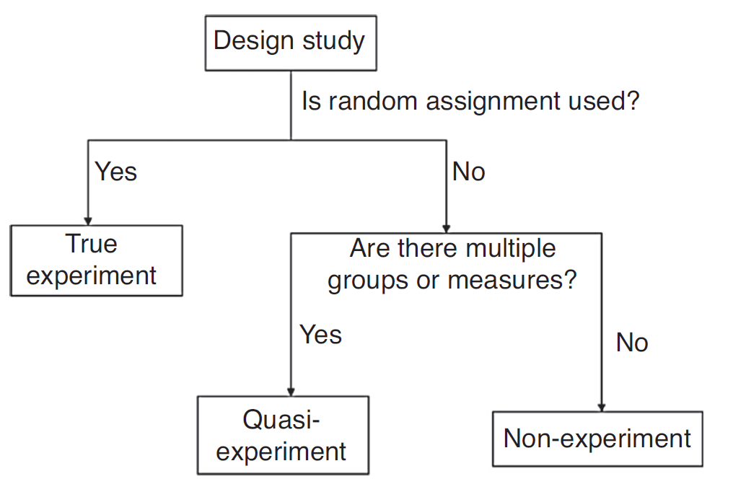
Three groups of studies
Experiments, quasi-experiments, and non-experiments:

Slide 23
Characteristics of true experiments
A true experiment
is normally based on at least on hypothesis
have multiple conditions
The dependent variable can be quantitatively measured
uses statistical significance tests
thrives to remove biases
is replicable

Slide 24
Factors to consider
Research hypothesis
Clearly defined
Appropriate scope
Dependent variables
Easy to measure
Independent variables and conditions
Easy to control

Slide 25
Example
There is no difference between the target selection speed when using a mouse, a touchscreen, or a gesture to select icons of different sizes (small, medium, or large).
Ind var = 2
Conditions = 3 for both variables
Combining two variables will result in (3*3) conditions in the experiment
Dependent Variables?

Slide 26
Basic design structure
Two basic questions:
How many independent variables do we want to investigate in the experiment?
How many different values does each independent variable have?

Slide 27
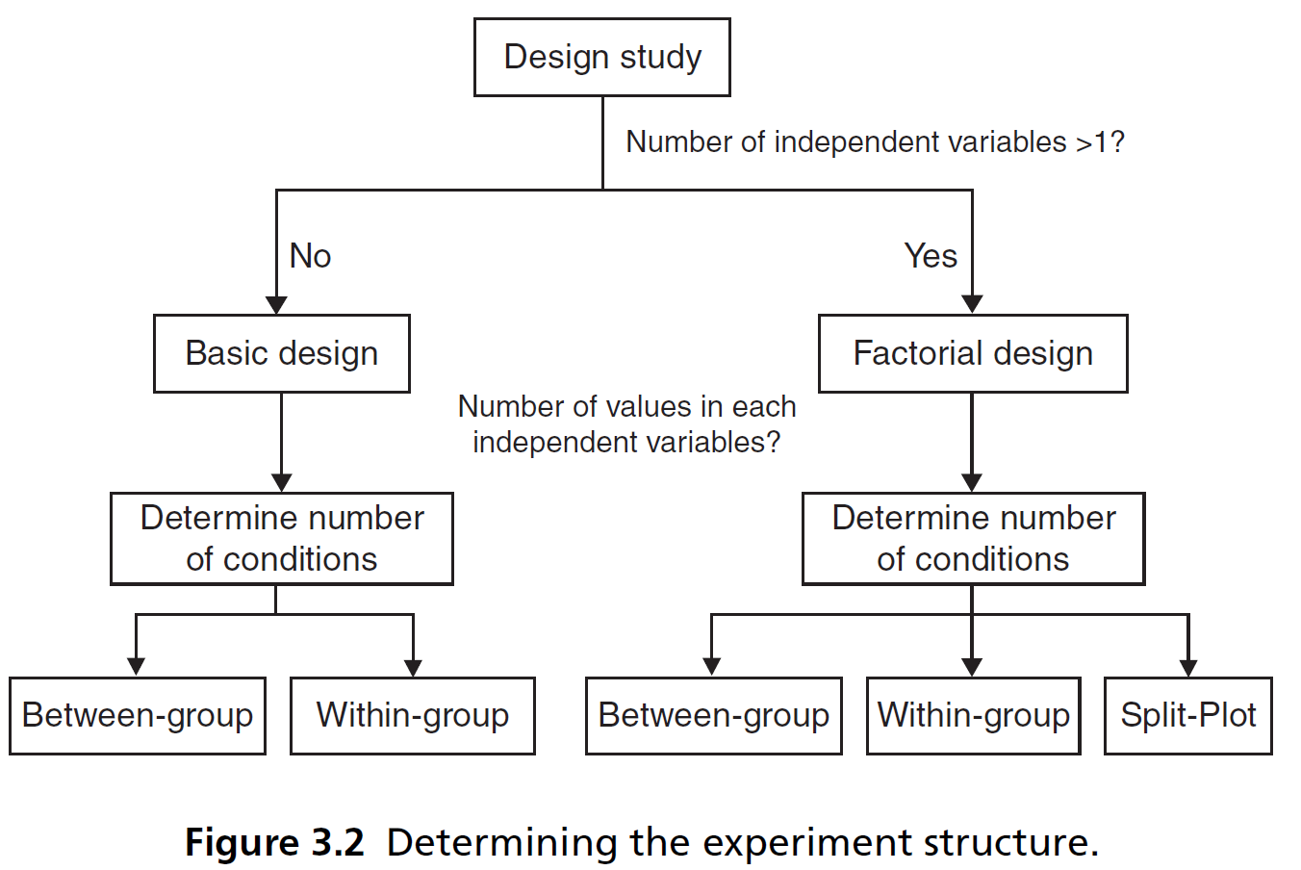
Basic design structure

Slide 28
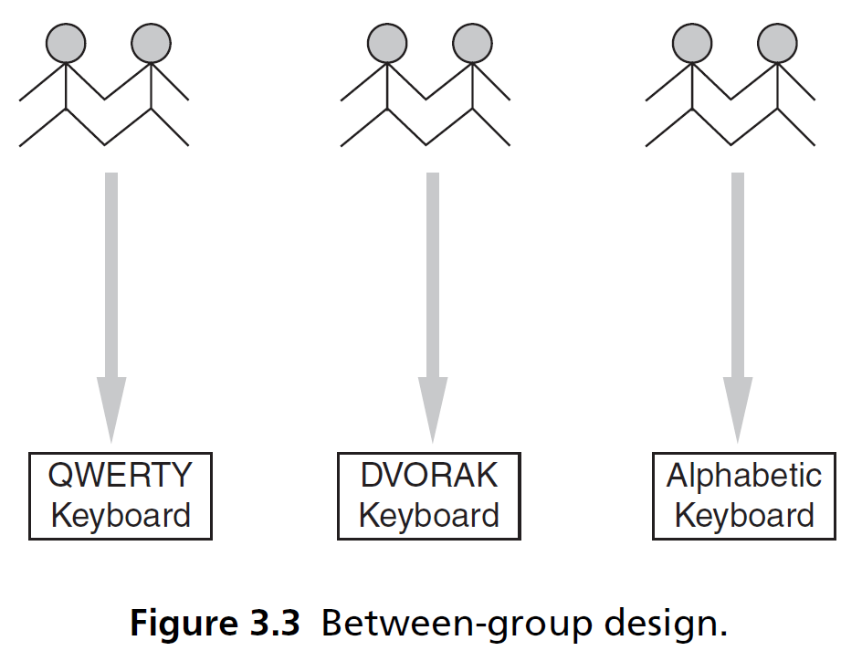
Investigating one independent variable - Between group design
Also called ‘between subject design’
One participant only experience one condition

Slide 29
Between group design
Advantages
Cleaner, better control of learning effect
Requires shorter time for participants
less impact of fatigue and frustration
Disadvantages
Impact of individuals difference
Harder to detect difference between conditions
Require larger sample size

Slide 30
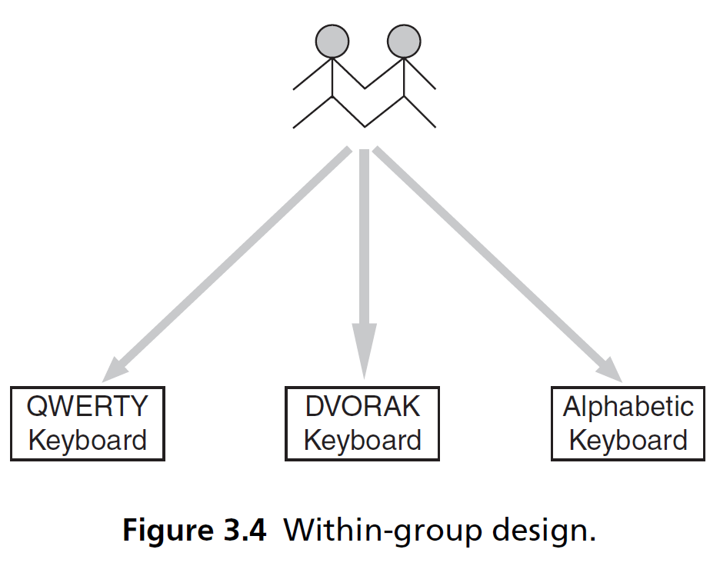
Investigating one independent variable - Between group design
Also called ‘within subject design’
One participant experience multiple conditions

Slide 31
Within-group design
Advantages
Requires smaller sample size
Easy to detect difference between conditions
Disadvantages
Learning effect
Takes longer time
Larger impact of fatigue and frustration

Slide 32
Investigating one independent variable - Between group vs. Within group
Between-group design should be taken when:
Simple tasks
Learning effect has large impact
Within-group design is impossible
Within-group design should be taken when:
Learning effect has small impact
Small participant pool

Slide 33
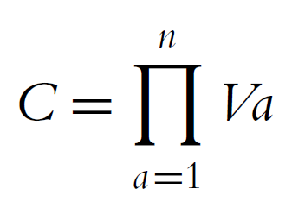
More than one independent variable
Factorial design divides the experiment groups or conditions into multiple subsets according to the independent variables
Can study interaction effects
Number of conditions:

Slide 34
More than one independent variable
Three options of factorial design
Between group design
Within group design
Split-plot design
Split-plot design
Has both a between-group and a within-group component

Slide 35
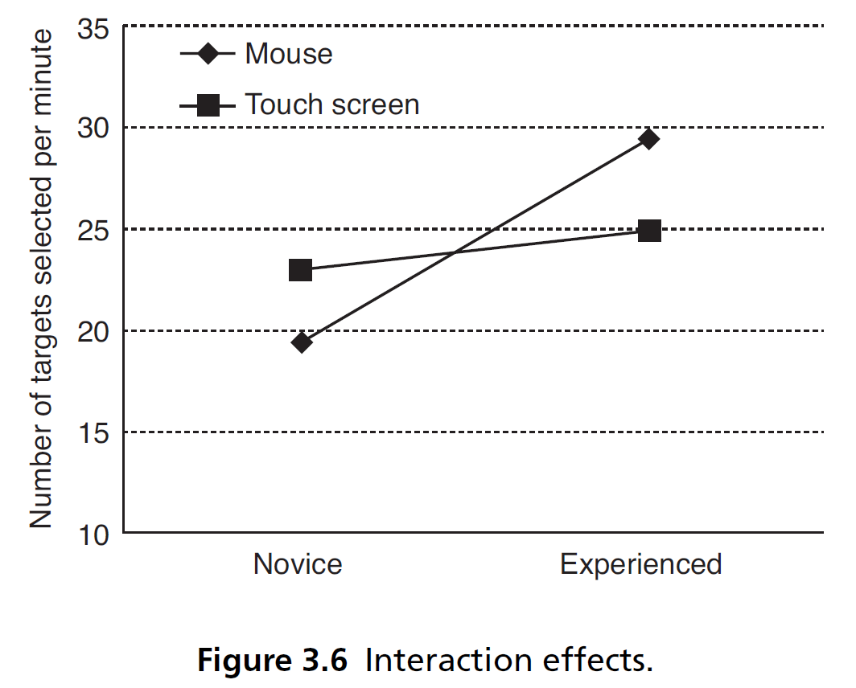
Interaction effect
The differing effect of one independent variable on the dependent variable, depending on the particular level of another independent variable

Slide 36
Reliability of experiments
Random errors
Also called ‘chance errors’ or ‘noises’
Cause variations in both direction
Occur by chance
Can be controlled by a large sample size
Systematic errors
Also called ‘biases’
Always push actual value in the same direction
Can never be offset no matter how large the sample is

Slide 37
Reliability of experiment results
Five major sources of system errors
measurement instruments
experimental procedures
participants
experimenter behavior
the experimental environment

Slide 38
Lifecycle of an experiment
Identify a research hypothesis
Specify the design of the study
Run a pilot study to test the design, the system, and the study instruments
Recruit participants
Run the actual data collection sessions
Analyze the data
Report the results

Slide 39
Experiment session procedure
Ensure the systems or devices being evaluated and the related instruments are ready for the experiment
Greet the participants
Introduce the purpose of the study and the procedures
Get the consent of the participants
Assign the participants to a specific experiment condition according to the pre-defined randomization method

Slide 40
Experiment session procedure
Participants complete training task
Participants complete actual tasks
Participants answer questionnaires (if any)
Debriefing session
Payment (if any)

Slide 41
End-of-chapter
Summary
Discussion questions
Research design exercise

