Slide 1
BASIC DESIGN RULES
HCI-FALL2025 –WEEk8

Slide 2
How can I influence the way a Design is perceived?
Accessibility
80/20 Rule
Affordance
Hick’s law
Fitts’ law
The Golden Ratio
Fibonacci Sequence
Rule of Thirds
Signal-to-Noise Ratio

Slide 3
Accessibility
Designs should be usable by people of diverse abilities, without special adaptation or modification. Also known as barrier-free design and related to universal design and inclusive design.
Four Characters of Accessible Design:
Perceptibility is achieved when everyone can perceive the design, regardless of sensory abilities.
Operability is achieved when everyone can use the design, regardless of physical abilities.
Simplicity is achieved when everyone can easily understand and use the design, regardless of experience, literacy, or concentration level.
Forgiveness is achieved when designs minimize the occurrence and consequences of errors.

Slide 5
80/20 Rule
Approximately 80 percent of the effects generated by any large system are caused by 20 percent of the variables in that system. Also known as Pareto’s Principle, Juran’s Principle, and Vital Few and Trivial Many Rule.
80 percent of a product’s usage involves 20 percent of its features.
80 percent of a town’s traffic is on 20 percent of its roads.
80 percent of a company’s revenue comes from 20 percent of its products.
80 percent of innovation comes from 20 percent of the people.
80 percent of progress comes from 20 percent of the effort.
80 percent of errors are caused by 20 percent of the components.
Useful for focusing resources and, in turn, realizing greater efficiencies in design.
Noncritical functions that are part of the less-important 80 percent should be minimized or removed altogether from the design.

Slide 7
Affordance
A property in which the physical characteristics of an object or environment influence its function.
When the affordance of an object or environment corresponds with its intended function, the design will perform more efficiently and will be easier to use. Conversely, when the affordance of an object or environment conflicts with its intended function, the design will perform less efficiently and be more difficult to use.
Design objects and environments to afford their intended function, and negatively afford improper use.
Mental Models:
To match your users’ mental models, you often have to hide implementation details from them.
To design for mental models, make your product simple, familiar, flexible, and safe. Provide feedback and make it obvious to people what options they have at any given moment.

Slide 8
Figure: 2
Figure: 1
Mental Model
Figure: 4
Figure: 3

Slide 10
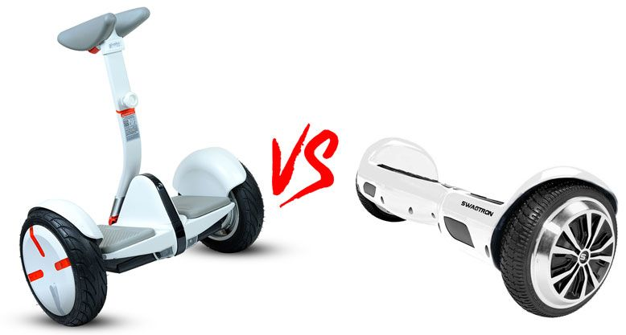

Slide 11
Hick’s Law
The time it takes to make a decision increases as the number of alternatives increases. Time required to make a decision is a function of the number of available options.
The Hick’s Law equation is RT = a + b log2(n), where RT = response time, a = the total time that is not involved with decision making, b = an empirically derived constant based on the cognitive processing time for each option (in this case ≈ 0.155 seconds for humans), n = number of equally probable alternatives.
For example, assume it takes 2 seconds to detect an alarm and understand it’s meaning. Further, assume that pressing one of five buttons will solve the problem caused by the alarm. The time to respond would be RT = (2 sec) + (0.155 sec)(log2 (5)) = 2.36 sec.

Slide 12


Slide 13
Fitts’ Law
The time required to move to a target is a function of the target size and distance to the target.
Fitts’ law equation is MT = a + b log2 (d/s + 1), where: MT = movement time to a target; a = 0.230 sec; b = 0.166 sec; d = distance between pointing device and target; and s = size of the target.
For example, assume the distance between the centre of a screen and an icon of 1” (3 cm) diameter is 6” (15 cm). The time to acquire the icon would be MT = 0.230 sec + 0.166 sec (log2 (6/1 + 1)) = 0.7 sec.
Fitts’ Law is applicable only for rapid, pointing movements, not for more continuous movements, such as writing or drawing. It has been used to predict efficiency of movement for assembly work performed under a microscope, as well as movement of a foot to a car pedal.
Consider Fitts’ Law when designing systems that involve pointing. Make sure that controls are near or large, particularly when rapid movements are required, and accuracy is important.

Slide 17
The Golden Ratio
A ratio within the elements of a form, such as height to width, approximating 0.618.
The golden ratio is the ratio between two segments such that the smaller (bc) segment is to the larger segment (ab) as the larger segment (ab) is to the sum of the two segments (ac), or bc/ab = ab/ac = 0.618
The golden ratio is irrational and can be computed with the equation (√ 5-1)/2. Adding 1 to the golden ratio yields 1.618…, referred to as Phi (o).
The values are used interchangeably to define the golden ratio, as they represent the same basic geometric relationship. Geometric shapes derived from the golden ratio include golden ellipses, golden rectangles, and golden triangles.
A substantial body of research comparing individual preferences for rectangles of various proportions supports a preference based on the golden ratio

Slide 18
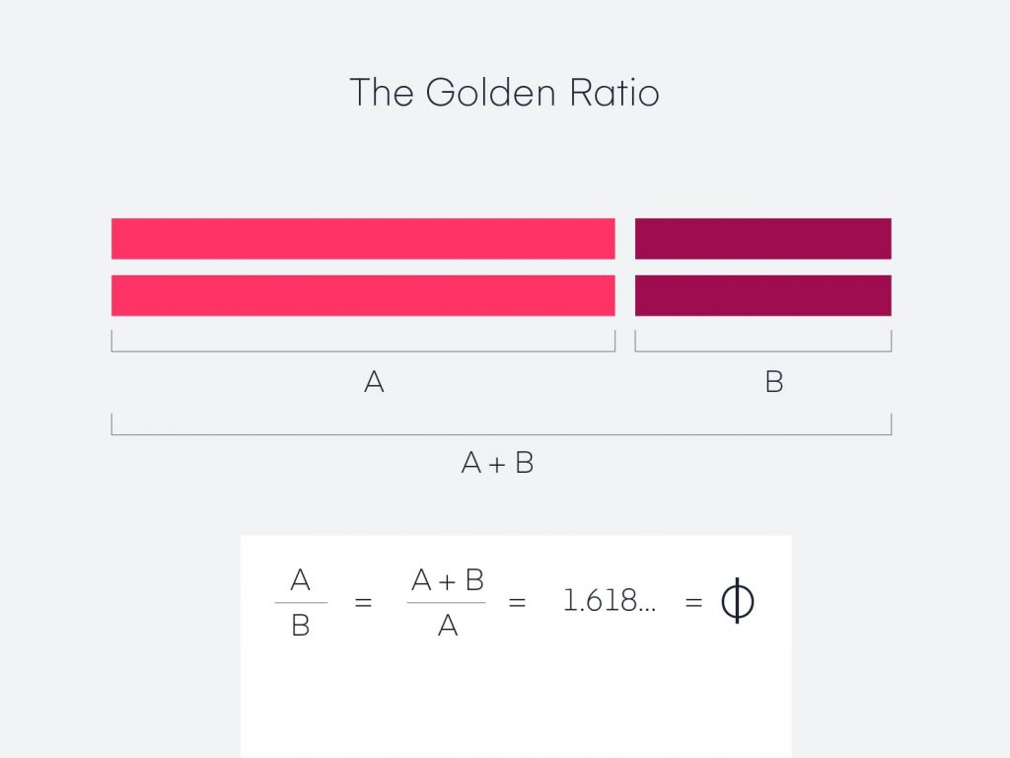
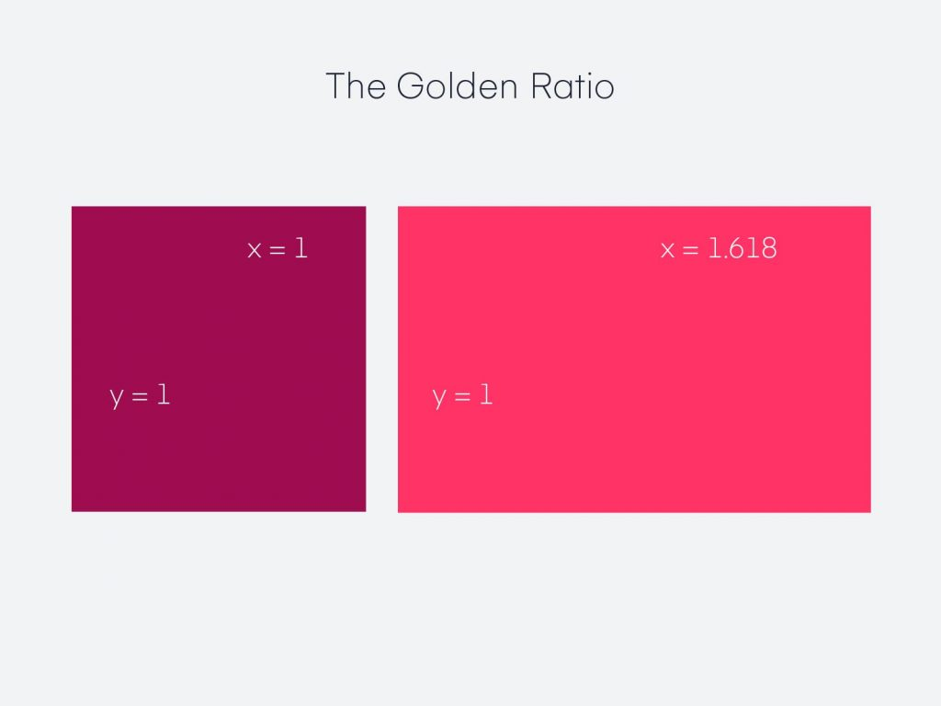
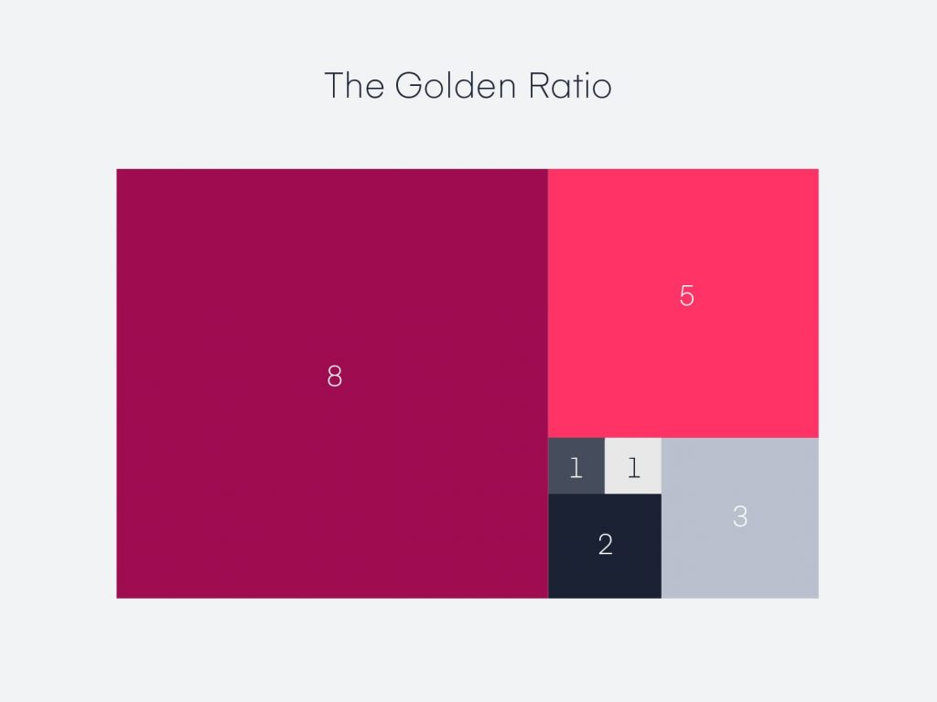

Slide 19
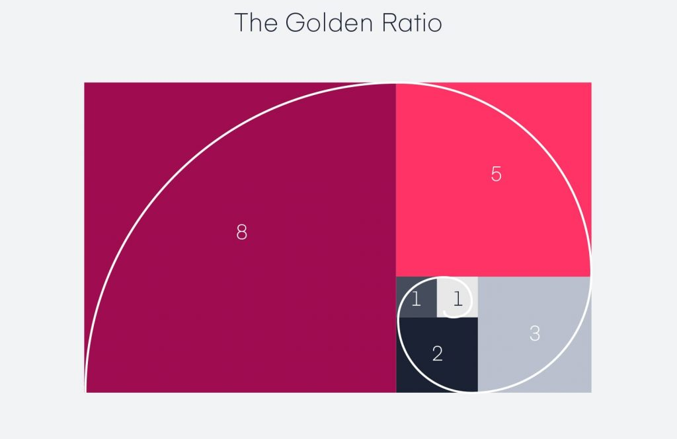
Fibonacci Sequence
A sequence of numbers in which each number is the sum of the preceding two. 1, 1, 2, 3, 5, 8, 13,...
Patterns exhibiting the sequence are commonly found in natural forms, such as the petals of flowers, spirals of galaxies, and bones in the human hand.
Fibonacci sequences are generally used in concert with the golden ratio, a principle to which it is closely related. For example, the division of any two adjacent numbers in a Fibonacci sequence yields an approximation of the golden ratio.

Slide 20
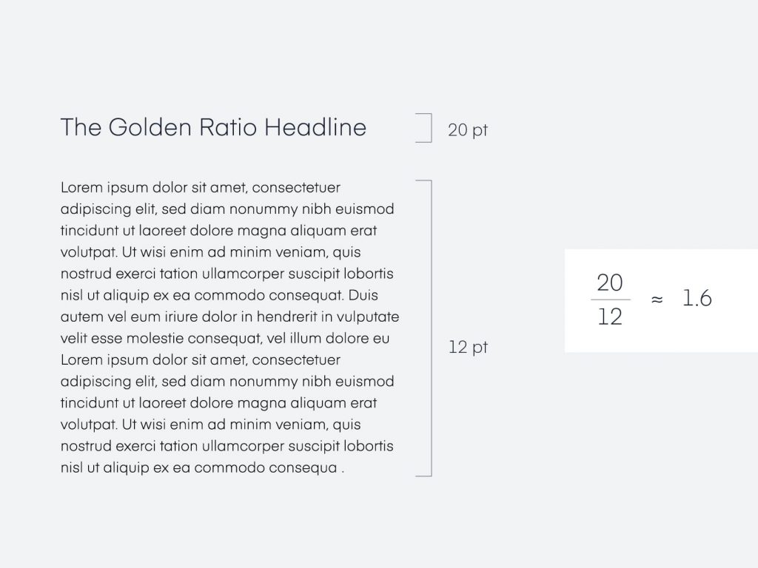
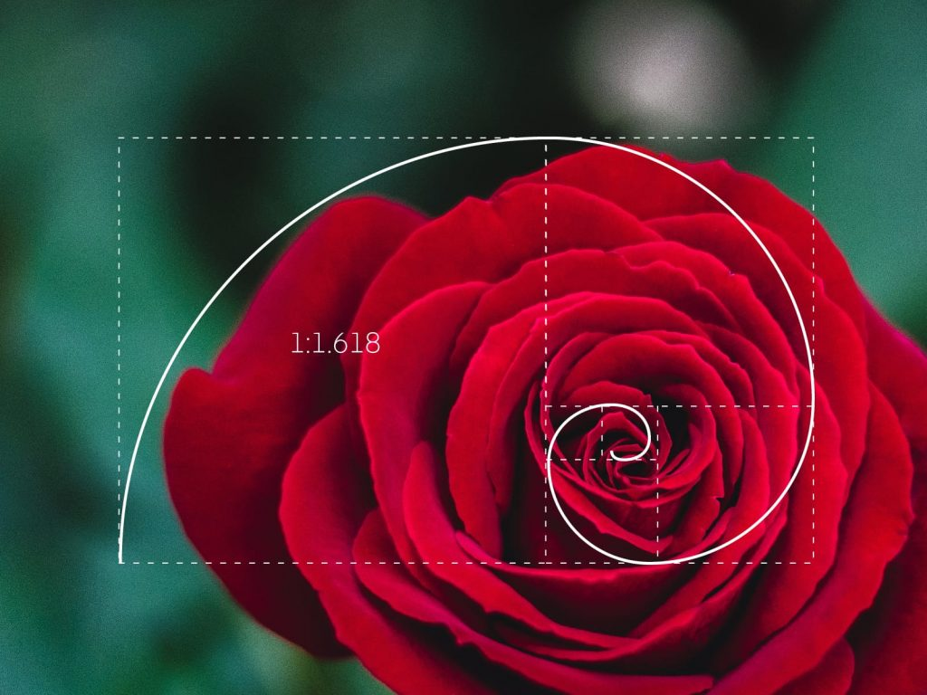

Slide 21
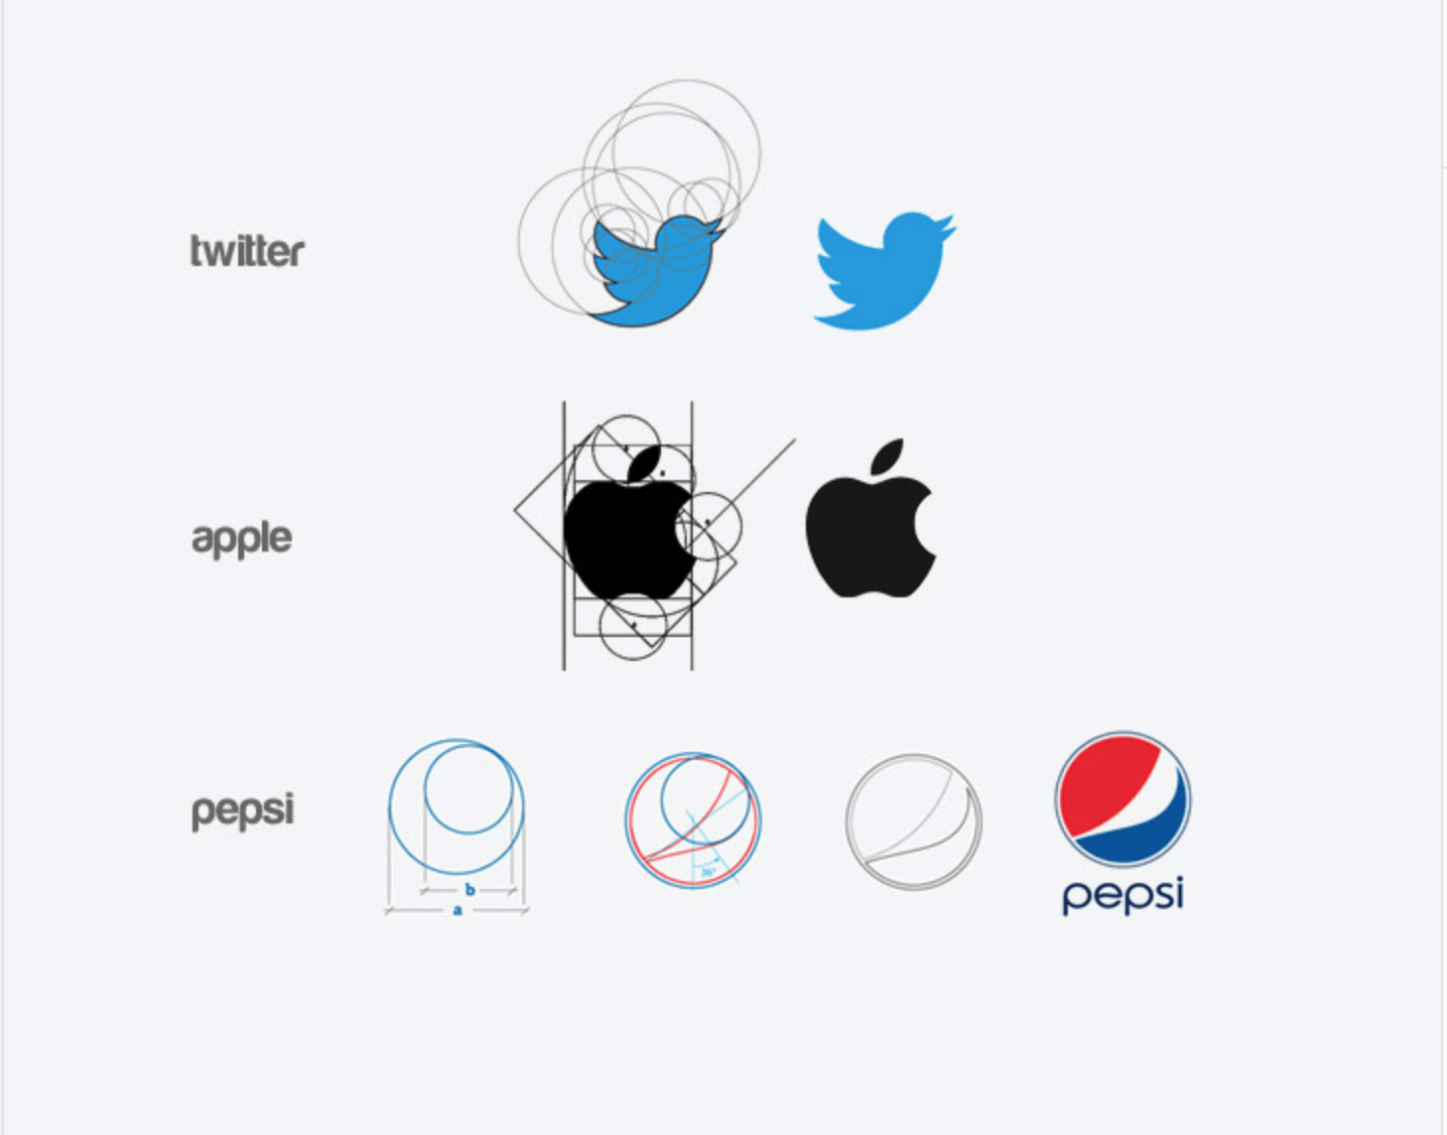
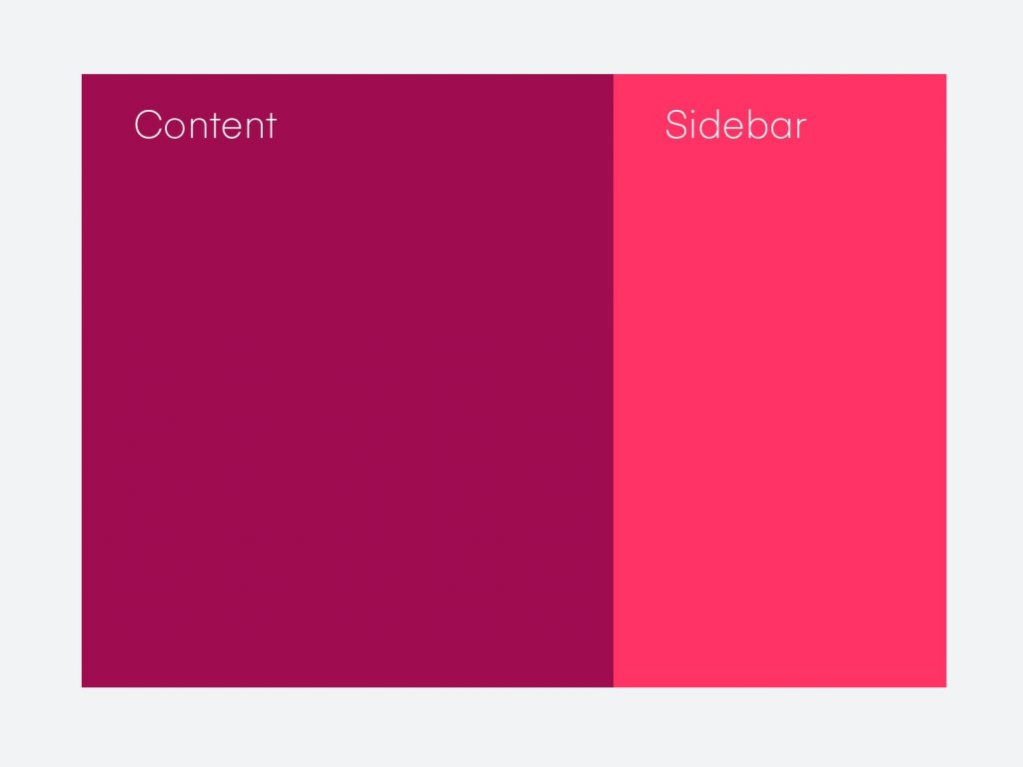

Slide 22
Rule Of Thirds
A technique of composition in which a medium is divided into thirds, creating aesthetic positions for the primary elements of a design.
It is applied by dividing a medium into thirds both vertically and horizontally, creating an invisible grid of nine rectangles and four intersections. The primary element within a design is then positioned on an intersection of the grid.
When the primary element is so strong as to imbalance the composition, consider centring the element rather than using the rule of thirds—especially when the strength of the primary element is reinforced by the surrounding elements or space.

Slide 25
Signal-to-Noise Ratio
The ratio of relevant to irrelevant information in a display. The highest possible signal-to-noise ratio is desirable in design.
Maximizing signal means clearly communicating information with minimal degradation. Signal degradation occurs when information is presented inefficiently: unclear writing, inappropriate graphs, or ambiguous icons and labels. Signal clarity is improved through simple and concise presentation of information. Simple designs incur minimal performance loads, enabling people to better focus on the meaning of the information.
Minimizing noise means removing unnecessary elements and minimizing the expression of necessary elements. It is important to realize that every unnecessary data item, graphic, line, or symbol steals attention away from relevant elements. Such unnecessary elements should be avoided or else eliminated.

