Slide 1
Designing the mobile user experience

Slide 2
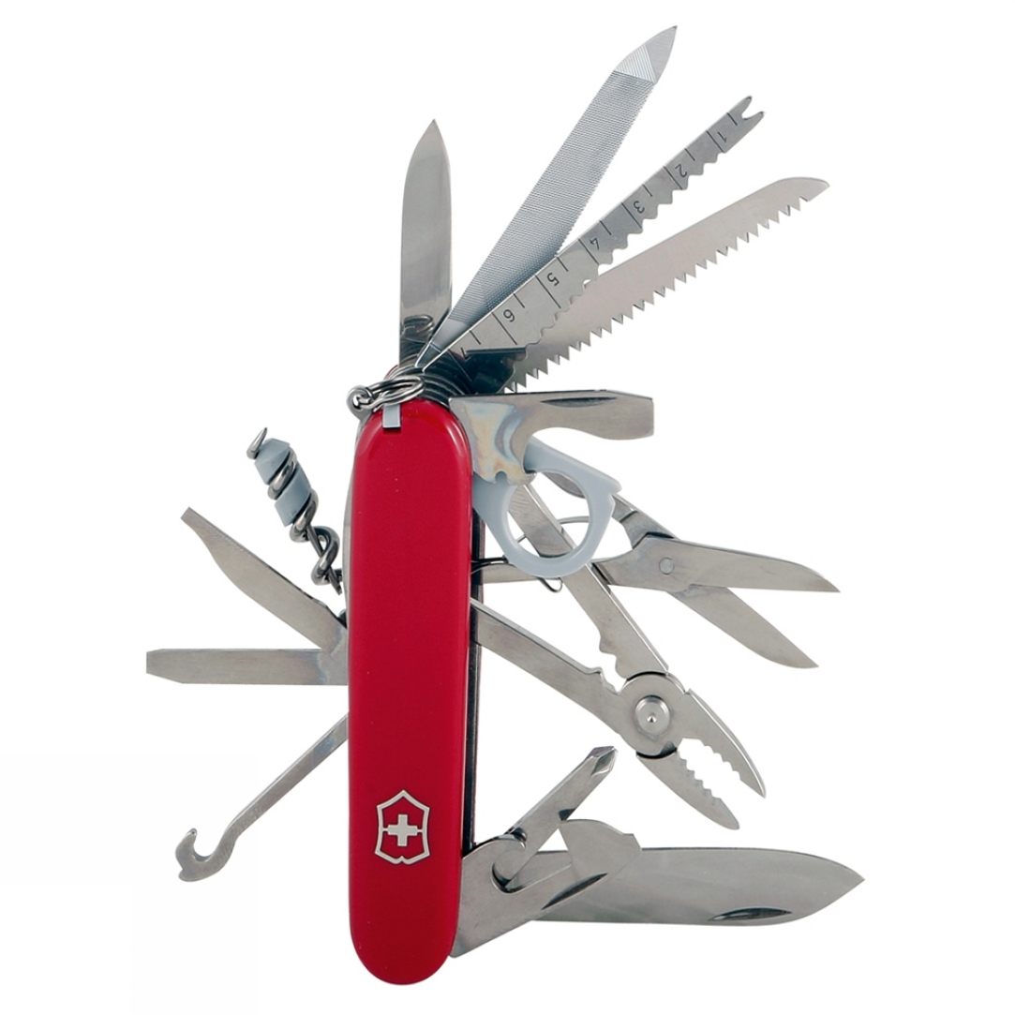
A mobile phone is like:
Quality v/s Quantity
Quality v/s task completion

Slide 3
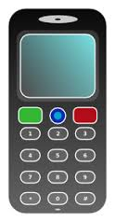
What real consumers think about it?
I don’t have a need for data services on my phone. Just give me
a simple phone that has good reception and battery.’

Slide 4
What is mobile anyhow?
Laptop, Palm, delivery driver data pads, iPods, Gameboy?
Fundamentally, ‘mobile’ refers to the user, and not the device or the application

Slide 5

The Carry Principle
Personal Communication Device (PCD)
Personal. The device generally belongs to only one person, is personally identifiable, and has a messaging address and ongoing service.
Communicative. The device can send and receive messages of various forms and connect with the network in various ways.
Handheld. The device is portable. It can be operated with a single hand, even if two hands or a hand and a surface are more convenient.
Wakable. The device can be awakened quickly by either the user or the network.

Slide 6
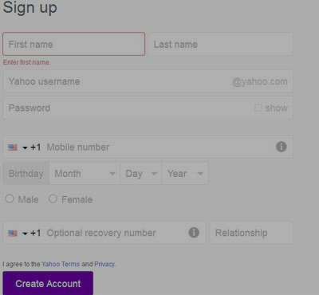
Carry Principle Implications
Form
Features
Device Capabilities
User Interface (Single Window Operation)
Proliferation

Slide 7
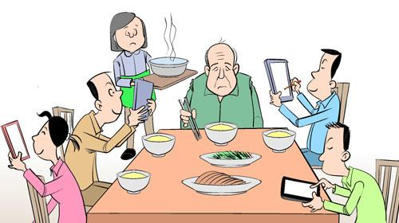
Carry Principle for PCD Users
User availability
Sustained focus
Social behavior

Slide 8
Components of a Mobile App (1/2)
a PCD, with its own use metaphor, browser, application environment, and capabilities
a user, using any of a set of mobile devices, who could be riding a train, sitting in a meeting, sitting in a restaurant, walking down the street, focused on other tasks, or engrossed in the device and application
one or more application platforms, which can include web browsers, application environments, messaging technologies, media environments, and so forth, with new capabilities becoming available regularly
one or more output interfaces with the world outside the mobile device, including screen, speaker, infrared, Bluetooth, local wireless (Wi-Fi), cellular wireless, unique terminal identification

Slide 9
Components of a Mobile App (2/2)
one or more input interfaces with the world outside the mobile device, including (limited) keypad, touchscreen, microphone, camera, RFID chip reader, global position, infrared, Bluetooth, local wireless (Wi-Fi), cellular wireless
optionally a server infrastructure that complements the mobile application and adds information or functionality to the above
interfaces between the application’s servers and other information sources
a network and the corresponding wireless carrier (operator), who enables some of the above technologies, connects the user to the Internet and other users, sells applications and other services, may specify permitted devices, and frequently defines what may and may not be accomplished on the network

Slide 10
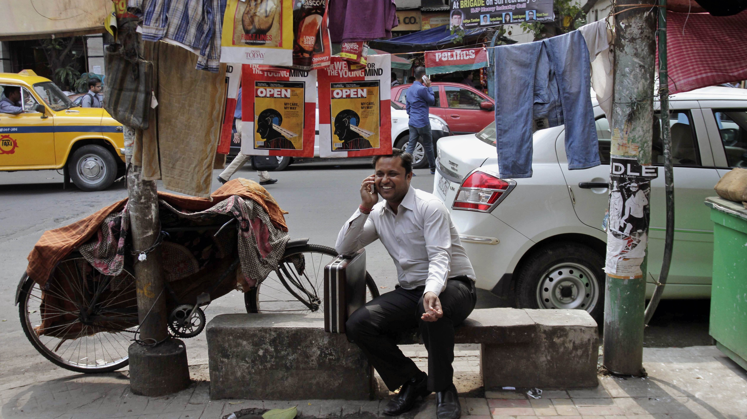
Characteristics of a Mobile User

Slide 11
Characteristics of a Mobile User
Mobile
Interruptible and Easily Distracted
Available
Sociable
Contextual
Identifiable

Slide 12
Contextual
• A calendar application could switch the phone’s ringer to vibrate and intelligently communicate to the caller that the recipient is in a meeting right now. The caller could indicate message urgency – or leave a message or call later – and the recipient could decide whether to accept the call.
• A travel companion application can use the user’s location, the flight number, current flight status, and current traffic conditions to alert the user fifteen minutes before she needs to depart for the airport. The same application could alert meeting attendees when the application owner is going to be later.
• A restaurant coupon application could send coupons at lunchtime when the user is away from home and near restaurants.
Future devices may have acceleration sensors, temperature sensors, fingerprint readers, and any number of other information sources we do not currently imagine.

Slide 13
Groups and Tribes
Voice and Texting
Extending Online Communities
Physical and Mobile Hybrids
Mobiles as Status

Slide 14
Use of Mobile Device
• general-purpose work: multi-purpose devices, likely to be near the user while at work only
• general-purpose entertainment: multi-purpose devices with an entertainment focus, likely to be near the user when entertainment is acceptable
• general-purpose communications and control: multi-purpose, personal devices, used to communicate using voice and text as well as control things like home automation or finances
• targeted: devices intended for one or a very small number of tasks, with forms varying with their purpose.

Slide 15
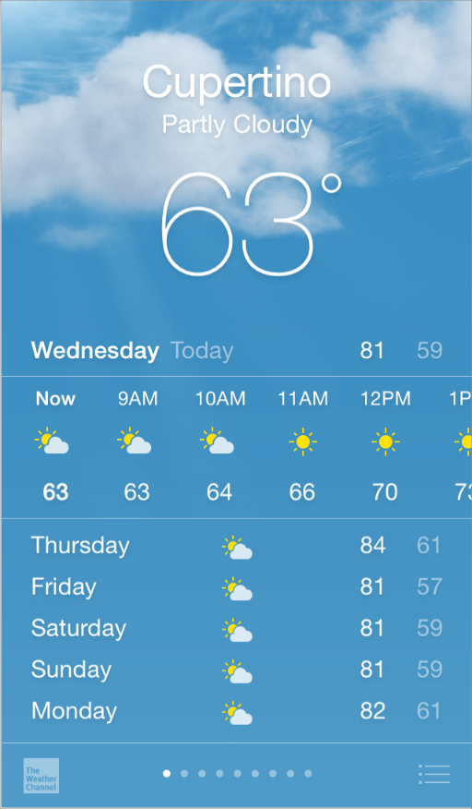
iOS
Deference. The UI helps people understand and interact with the content, but never competes with it.
Clarity. Text is legible at every size, icons are precise and lucid, adornments are subtle and appropriate, and a sharpened focus on functionality motivates the design.
Depth. Visual layers and realistic motion impart vitality and heighten people’s delight and understanding.
https://developer.apple.com/library/ios/documentation/UserExperience/Conceptual/MobileHIG/index.htm

Slide 16
iOS Step1
First, look past the UI to the app’s core functionality and affirm its relevance.
Next, use the themes of iOS to inform the design of the UI and the user experience. Add details and embellishments with care and never gratuitously.
Finally, be sure to design your UI to adapt to various devices and modes so that users can enjoy your app in as many contexts as possible.
Throughout the process, be prepared to defy precedent, question assumptions, and let a focus on content and functionality motivate every design decision

Slide 17
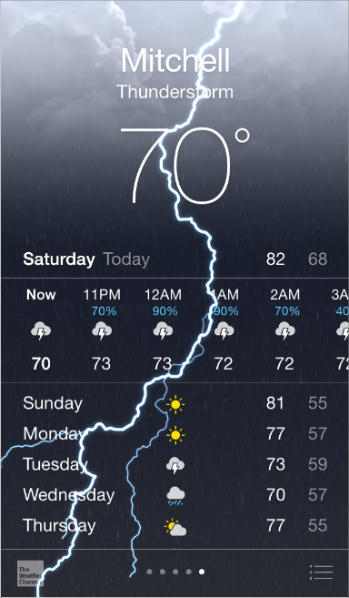
Step 2
Take advantage of full screen

Slide 18
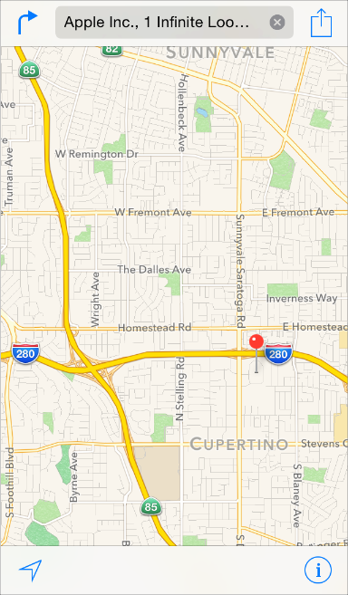
Reconsider visual indicators of physicality and realism

Slide 19
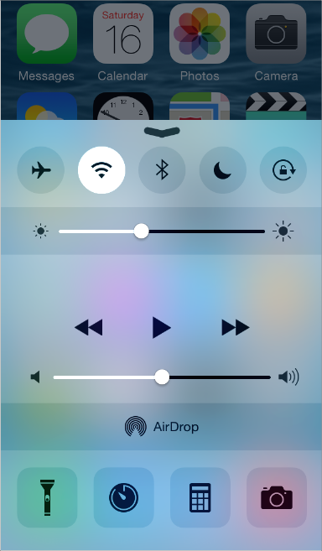
Translucent UI elements hint at the content behind them.

Slide 20
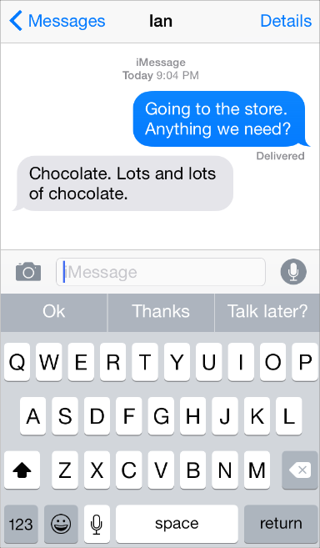
Use plenty of negative (white) space

Slide 21
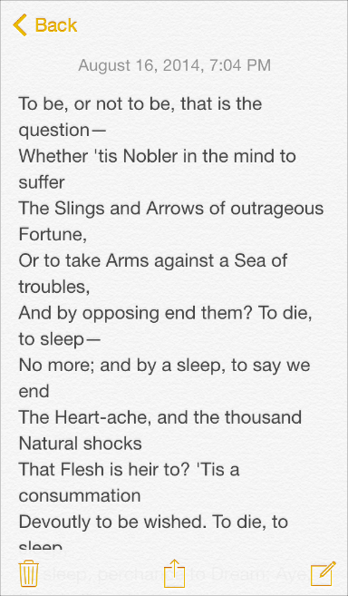
Let color simplify the UI

Slide 22
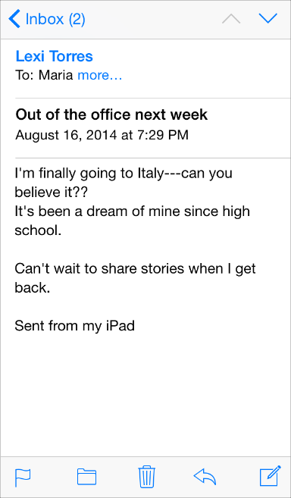
Ensure legibility by using the system font

Slide 23
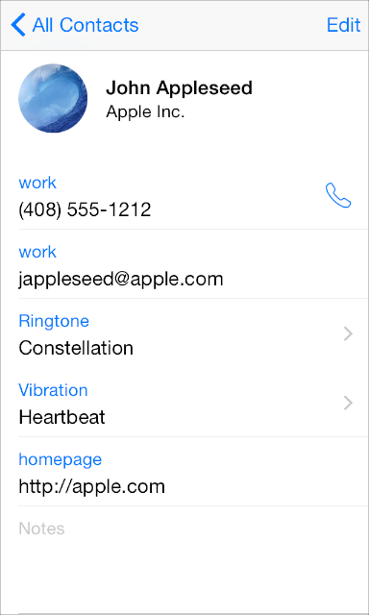
Embrace borderless buttons

Slide 24
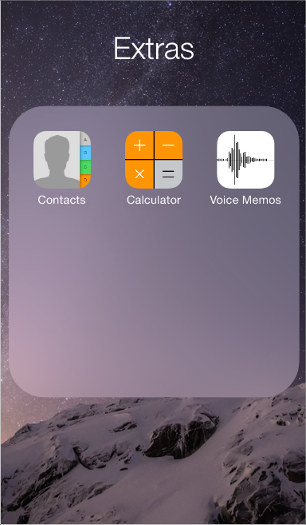
By using a translucent background and appearing to float above the Home screen, folders separate their content from the rest of the screen.

Slide 25
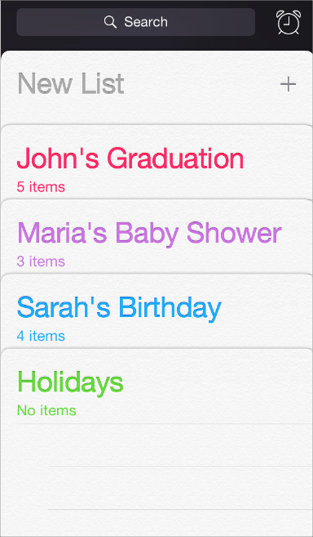
Reminders displays lists in layers, as shown here. When users work with one list, the other lists are collected together at the bottom of the screen.

Slide 26
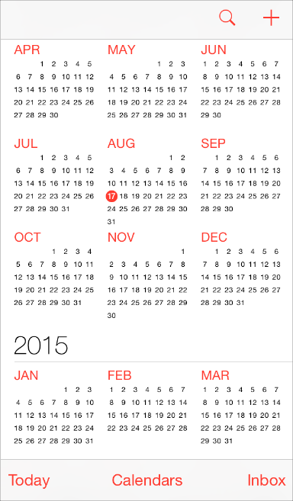
Calendar uses enhanced transitions to give users a sense of hierarchy and depth as they move between viewing years, months, and days. In the scrolling year view shown here, users can instantly see today’s date and perform other calendar tasks.

Slide 27
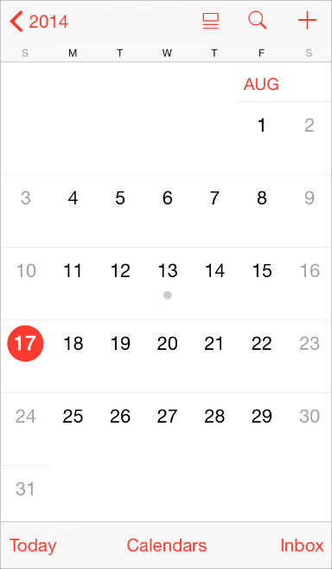
When users select a month, the year view zooms in and reveals the month view. Today’s date remains highlighted and the year appears in the back button, so users know exactly where they are, where they came from, and how to get back.

Slide 28
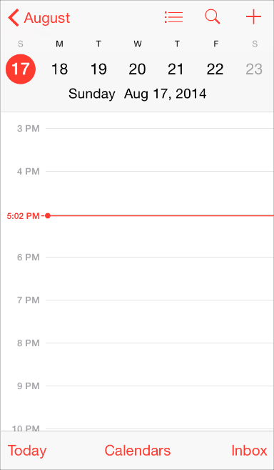
A similar transition happens when users select a day: The month view appears to split apart, pushing the current week to the top of the screen and revealing the hourly view of the selected day. With each transition, Calendar reinforces the hierarchical relationship between years, months, and days.

