Slide 1
Prototyping
Week 2
HCI Fall 2025

Slide 2
User Interface Prototyping
Development of highly interactive software system with graphical user interfaces (GUI) has become increasingly common and acceptance of such a system depends highly on the quality of GUI.
Prototyping is an excellent means of generating ideas about how the GUI can be designed and it helps to evaluate quality of solution at an early stage.

Slide 3
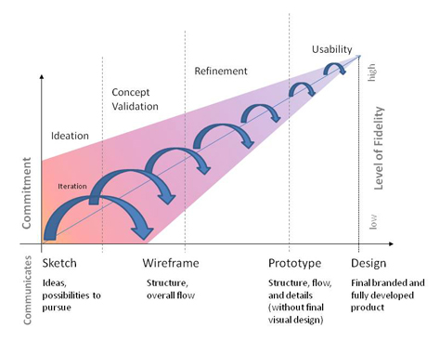
The Sketch to Design Continuum

Slide 4
Sketch
In the context of design, sketching is rapid, freehand drawing that we do with no intention of its becoming a finished product.
In fact, many times, sketching is only a foundation upon which we can overlay our actual design work.
Thus, sketching is a tool that supports the process of making, not the actual design itself.
Unfortunately, it’s all too easy to forget this fact in our quest to get to an end product.
Notes:
Sketching and design emerged during the medieval period, so these concepts are nothing new. However, what I believe many people forget is that the intention of sketching is to separate design from the process of making.

Slide 5
Wireframes
A wireframe, in comparison, is a basic visual guide we use to suggest the structure of a Web site, as well as the relationships between its pages.
Wireframes come long before we do any visual design.
A wireframe’s purpose is to communicate and explore the concepts that come out of sketching—that is, those concepts you actually want to pursue further during user interface design.
Wire framing lets us outline a Web site’s basic, overall structure and flow and helps us explore divergent ideas from our sketches.

Slide 6
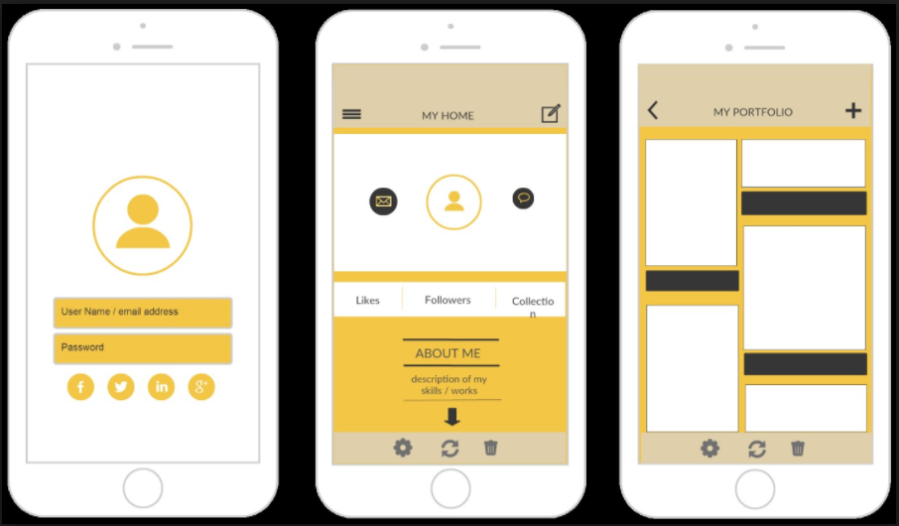

Slide 7
Prototyping
A prototype is an expression of design intent.
Prototyping allows designers to present their designs and see them in action. In the context of digital products, a prototype is a simulation of the final interaction between the user and the interface.
Depending on what a product team needs a prototype to do, it can simulate an entire app or just a single interaction.
Notes:
As we iterate our wireframes and get clarity on requirements and constraints, some of our ideas naturally fall away. It is at this stage I would say a real prototype exists. Our designs are still not final, but we have defined a set of ideas we know can actually be pursued, and we begin to refine and exemplify them. We may invest some light coding in them to achieve a degree of interactivity, but a prototype is still a communication tool and artifact.

Slide 8
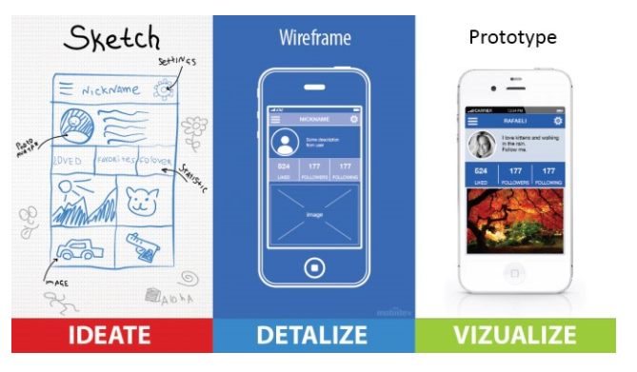

Slide 9
What is fidelity?
Prototypes don’t necessarily look like final products — they can have different fidelity.
The fidelity of a prototype refers to how it conveys the look-and-feel of the final product (basically, its level of detail and realism).
Fidelity can vary in the areas of:
Visual design
Content
Interactivity
.

Slide 10
What is fidelity?
There are many types of prototypes, ranging anywhere between these two extremes:
Low-Fidelity
High-Fidelity
Product teams choose a prototype’s fidelity based on the goals of prototyping, completeness of design, and available resources.

Slide 11
Low-Fidelity Prototyping
Low-fidelity prototypes are often paper-based and do not allow user interactions. They range from a series of hand-drawn mock-ups to printouts.
Low-fidelity prototypes uses a medium which is unlike the final medium, e.g. paper, cardboard, sketches and storyboard.
It is quick, cheap and easily changed.
An additional advantage to this approach is that when using rough sketches, users may feel more comfortable suggesting changes.
Notes:
Low-fidelity prototyping is generally limited function, limited interaction prototyping effort.
They are constructed to depict concepts, design alternatives and screen layouts. They are intended to demonstrate general look and feel of the interface.
They are created to educate , communicate and inform, but not to train, test or serve as a basis for which to code.
Low fidelity prototyping is used early in the design cycle to show general conceptual approaches without much investment in development.

Slide 12
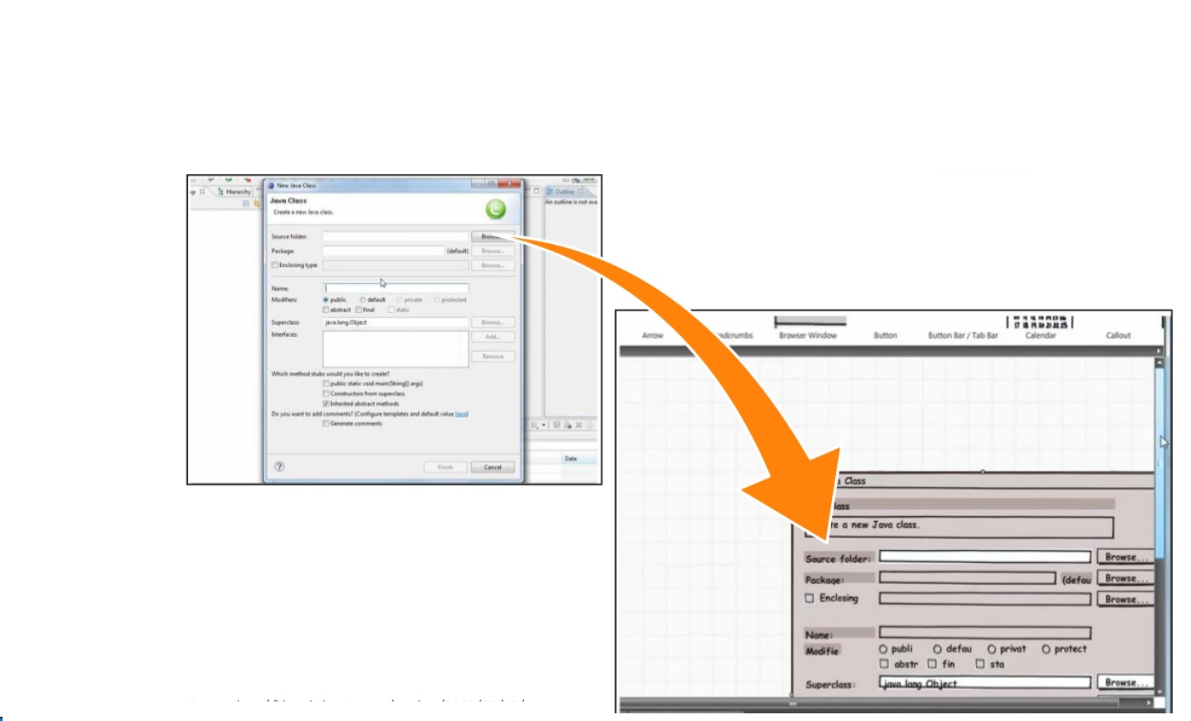

Slide 13
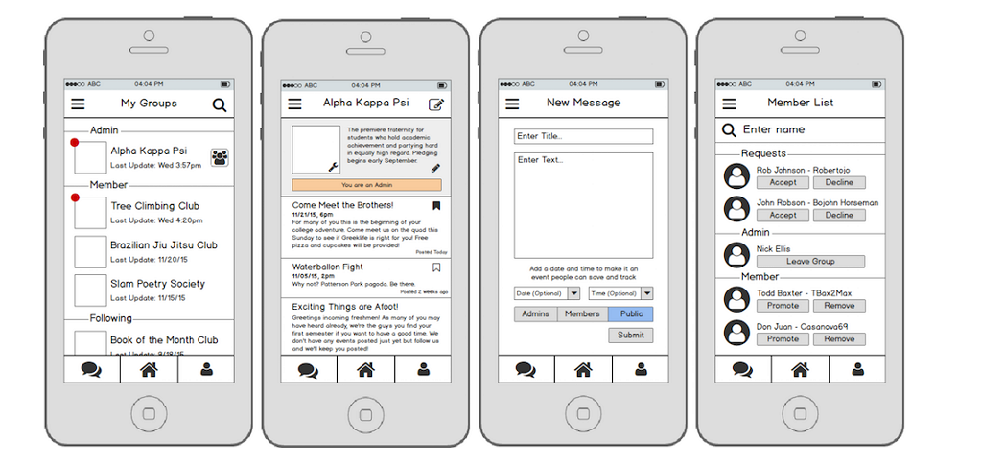

Slide 14
Storyboarding
Often used with scenarios, bringing more detail, and a chance to role play
It is a series of sketches showing how a user might progress through a task using the device
Used early in design

Slide 15
High-Fidelity Prototyping
High-fidelity prototypes are computer-based, and usually allow realistic (mouse-keyboard) user interactions.
It represent the core functionality of the products user interface.
High fidelity prototypes are fully interactive systems.
Users can enter data in entry fields, respond to messages, select icon to open windows and interact with user interface as if it were a real system.

Slide 16
High-Fidelity Prototyping
High-fidelity prototypes take you as close as possible to a true representation of the user interface.
High-fidelity prototypes are assumed to be much more effective in collecting true human performance data (e.g., time to complete a task), and in demonstrating actual products to clients, management, and others.

Slide 17
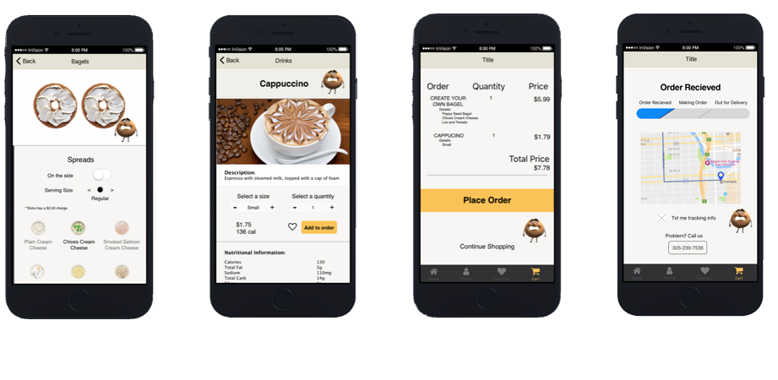

Slide 18
Advantages & Disadvantages Low-Fidelity
Advantages
Low-fidelity representations, such as sketches, differ from the final product in interaction design, visual appearance, and/or level of details. The method is quick & cheap which encourage iterative design idea tryouts between/during usability tests.
Quick Low-fidelity tests allows designers and users to focus on high-level interaction design and information architecture, rather than on details or visual style.
Disadvantages
Users might judge a low-fidelity prototype as unprofessional.
While Low-fidelity prototypes allow spontaneous changes for exploring interactions, they also sacrifice some realism.
Limitations in navigation and flow while a control person has to “make the interaction”.
Notes:
Low-Fi prototypes : differs from final prod. In interaction, visual appearance, level of details. And while the method id quick and easy it encourage to try alternative designs.
Allows designers to focus on high-level interaction design and information architecture rather than on details or visual style.
…

Slide 19
Advantages & Disadvantages High-Fidelity
Advantages
High-fidelity prototypes offer more realistic interactions than low-fidelity.
Better at conveying the range of design possibilities.
User-driven.
Disadvantages
High-fidelity prototyping may make designers reluctant to change designs and less likely to fully explore the design space.
Take a long to build and requires skill.
Reviewers and testers tend to comment on surface aspects rather than content.

Slide 20
Conclusion
Low-fidelity prototypes have big advantages in cost and ease of iteration, and allow designers to focus on interaction design and information architecture rather than aesthetic details.
Prototyping on paper eases testing of alternative design and enables testing in a more exploratory, dynamic way.
Computer prototypes allow automatic recording of user tests, can be distributed electronically, and can help document the design process.
What kind of prototype method to choose is not a simple decision. Do combine and apply several techniques might be a good idea.

Slide 21
Interactive Prototyping Tools
Modern tools such as Figma, Adobe XD, Sketch, and InVision allow designers to create interactive prototypes. These tools enable live collaboration, developer handoff, and seamless updates across teams.
Example: Figma enables multiple designers to work on the same prototype in real-time, similar to Google Docs.

Slide 22
AI-Assisted Prototyping
AI-powered tools can generate wireframes and design layouts directly from text prompts, speeding up the design process.
Examples:
- Galileo AI: Generates UI designs from plain English descriptions.
- Uizard: Converts hand-drawn sketches into editable digital prototypes.

Slide 23
Code-Linked Prototypes
Some tools now export production-ready code from prototypes, bridging the gap between design and development.
Examples:
- Framer: Allows designers to create interactive prototypes that can be directly used in production.
- FlutterFlow: Generates Flutter code from visual designs.

Slide 24
Voice & Conversational Prototyping
Prototyping has expanded beyond GUIs into voice interfaces and conversational flows.
Examples:
- Voiceflow: Prototypes Alexa and Google Assistant apps.
- Botmock: Designs and tests chatbot interactions before development.

Slide 25
AR/VR & Spatial Prototyping
Immersive prototyping enables design for augmented and virtual reality experiences.
Examples:
- Adobe Aero: Creates AR experiences without coding.
- ShapesXR: Prototyping tool for VR collaboration and spatial design.

Slide 26
Remote Usability Testing
Remote testing platforms integrate directly with prototypes to gather user feedback.
Examples:
- Maze: Connects with Figma and InVision for usability tests.
- UserTesting: Provides video feedback from real users.

Slide 27
Analytics-Integrated Prototyping
Some platforms provide analytics within prototypes, including heatmaps, click-tracking, and journey maps.
Example: Hotjar and FullStory integrate with prototypes to visualize user behavior.

Slide 28
Accessibility & Inclusivity
Accessibility-first design ensures products can be used by everyone, including those with disabilities.
Examples:
- Stark plugin for Figma: Checks color contrast and accessibility compliance.
- Axe DevTools: Tests prototypes for screen reader compatibility.

Slide 29
Future of Prototyping
Prototyping is evolving into smart, collaborative, and AI-powered simulations that closely mirror real-world use. This reduces development costs, speeds up iteration, and enhances user satisfaction.
Example: Combining AI tools like Galileo with testing platforms like Maze provides an end-to-end design validation workflow.

