Slide 1
Project: Create Resume Zahra Arabi – Ali Samavati Dr.Jahanshahi winter 2021

Slide 2
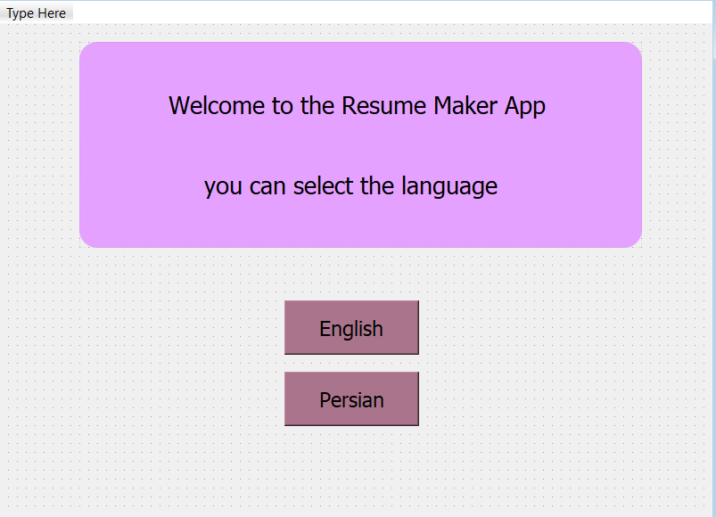
Creating UI

Slide 3
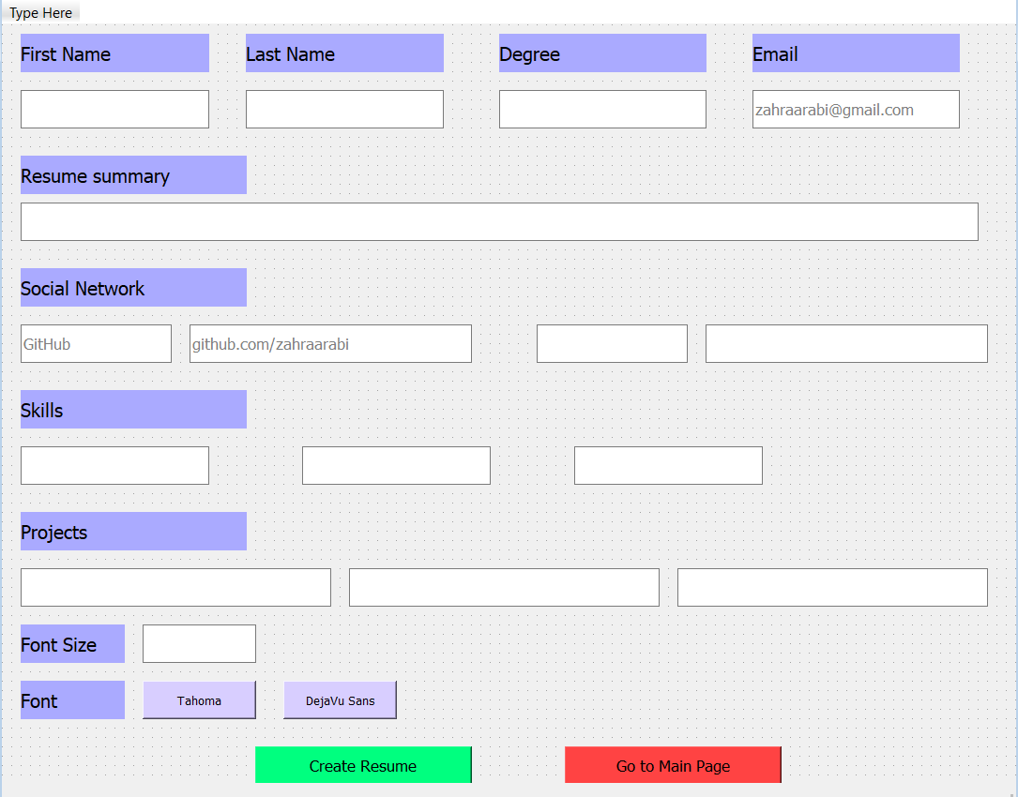
Creating UI

Slide 4
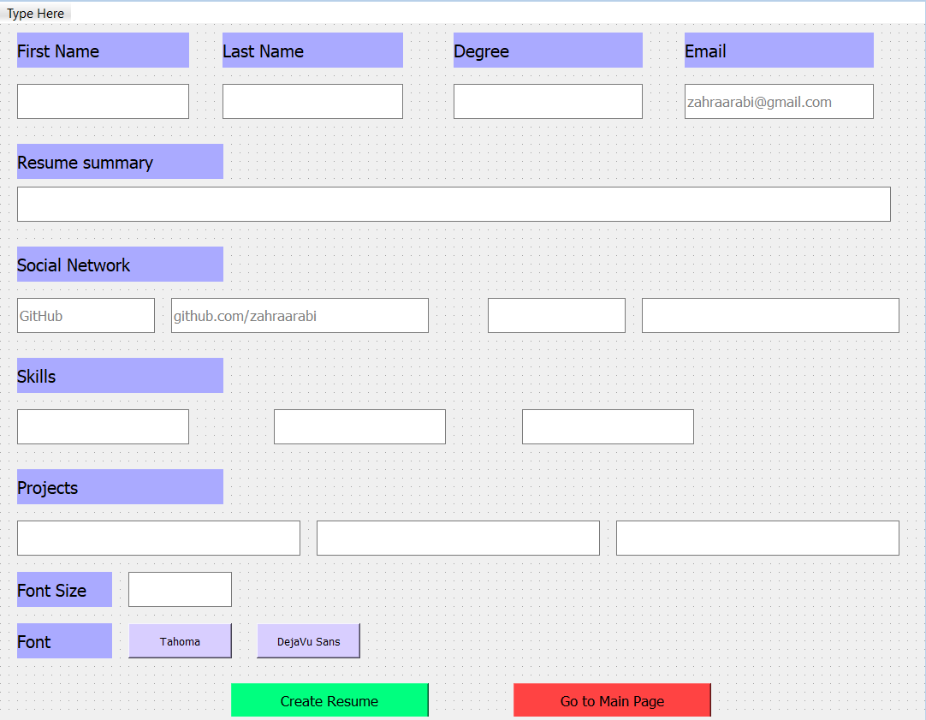
Creating UI

Slide 5
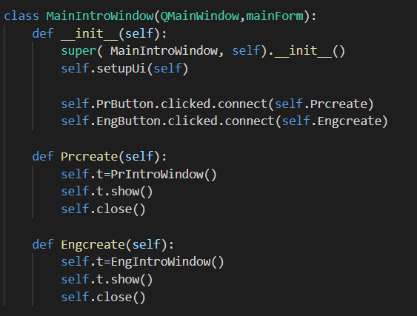
MainWindow

Slide 6
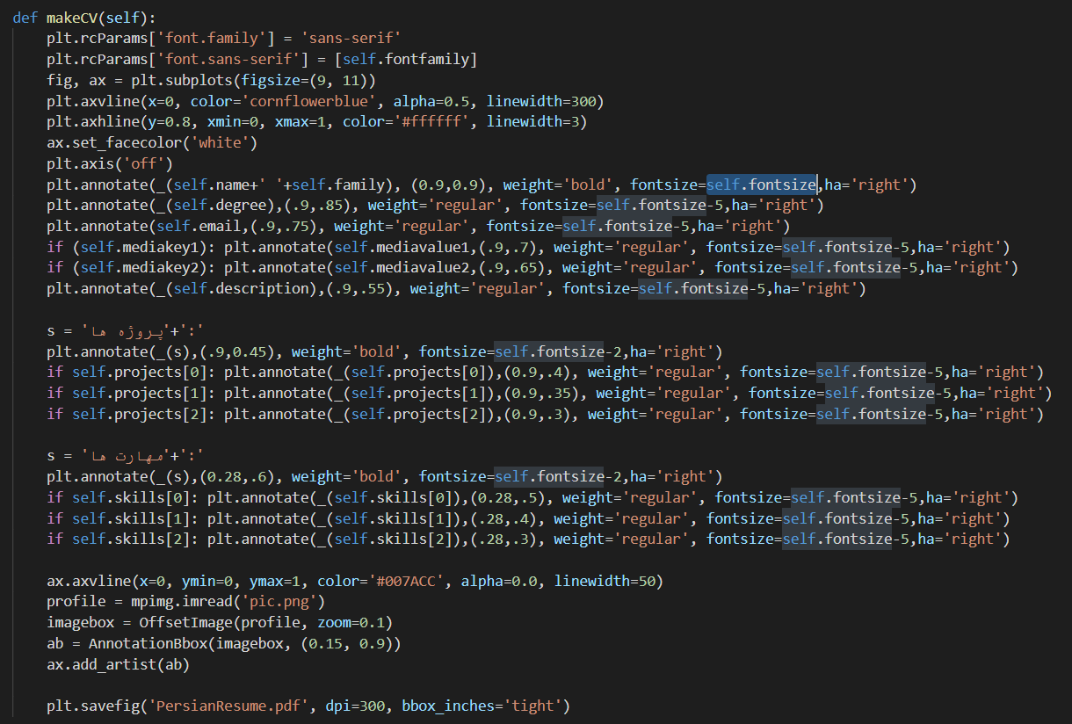
PersianWindow

Slide 7
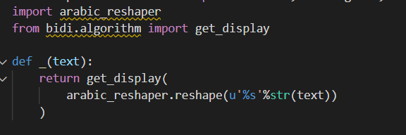
Persian Font

Slide 8
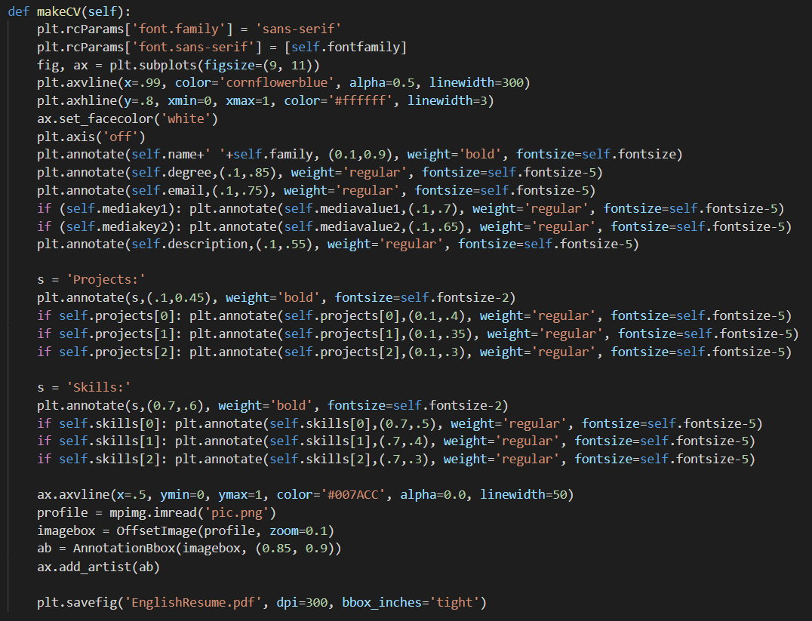
EnglishWindow

Slide 9
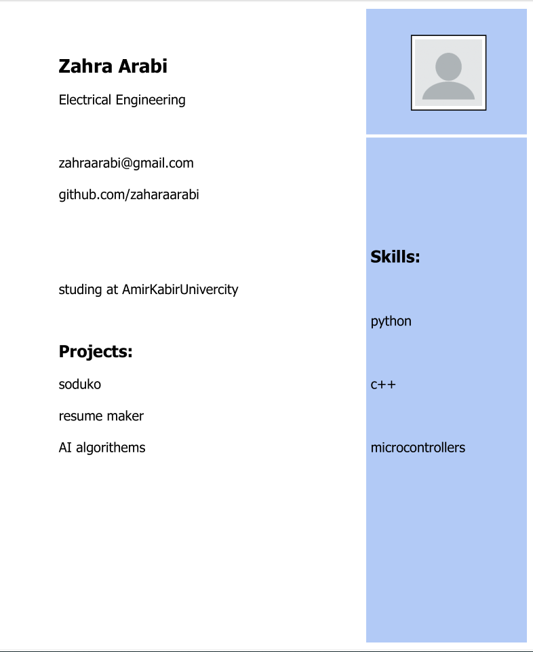
Output

Slide 10
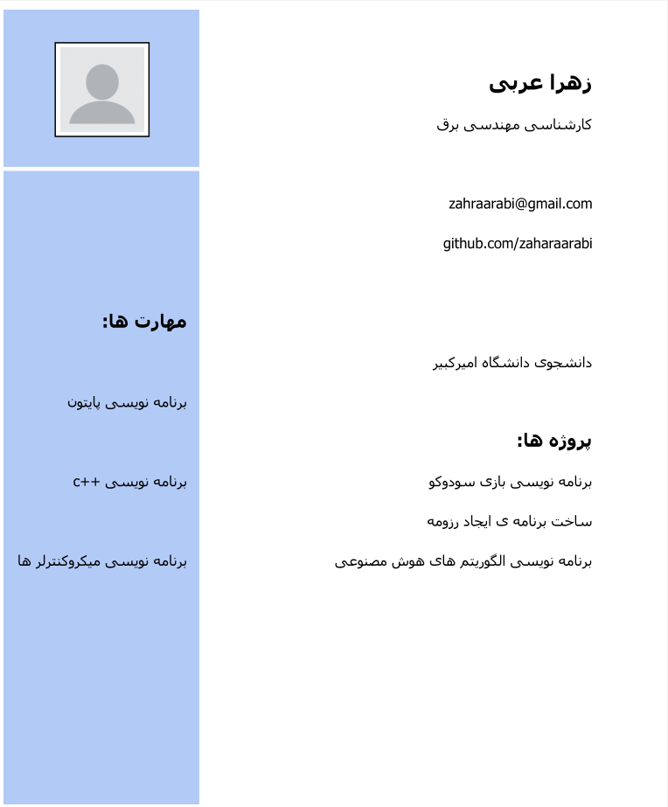
Output

