Slide 1

Cloud Native Curriculum for Diverse Student Cohorts
Zara Ahmad-Post
University of Arizona

Slide 2
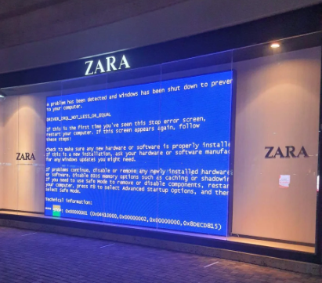


About Me
Zara Ahmad-Post
Adjunct Faculty, Cloud Computing
@ University of Arizona
Senior Security Data Scientist
@ DigitalOcean
Founder, Director of R&D
@ Z Collective

Slide 3
What this talk is about
A new graduate-level class at the University of Arizona, Foundations of Cloud Computing
Curriculum design, assignment framing, and engaging industry to support students
Notes:
I revamped a grad-level class on cloud computing at U of A.
I'm going to share how I structured the curriculum around my students needs
How we engaged with industry to support students

Slide 4

What you’ll leave with
Specific ways to support University students studying cloud computing
Curriculum overview
Sample lectures, assignments, supplemental material, and resources
Ideas of how the industry & community can help students succeed

Slide 5
Cloud Computing Curriculum in U.S. Universities
Many universities teach cloud computing with a focus on the engineering behind cloud platforms
Virtualization
Data center optimization
Students often graduate without a working understanding of how to use modern cloud primitives

Slide 6
Cloud Computing Curriculum in U.S. Universities
Instructors face significant challenges when designing curriculum that is both accessible and hands-on:
Affordability
Student prerequisites & varying education backgrounds
Challenge vs. manageability for students

Slide 7
Student Populations
Diverse academic experiences
Different professional backgrounds
Pandemic-era learning
Multi-cultural
Intergenerational

Slide 8
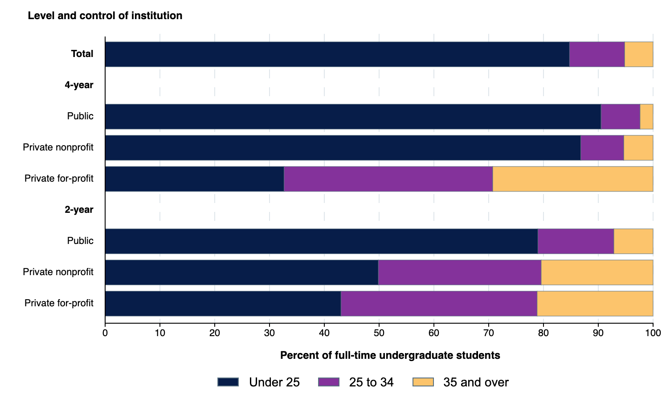
Student Demographics
Although 18 to 25-year-olds make up the majority of undergraduate college enrollment, a substantial number of learners are ages 25+
Source: U.S. Department of Education
Undergraduate student enrollment, by age group and type of institution

Slide 9
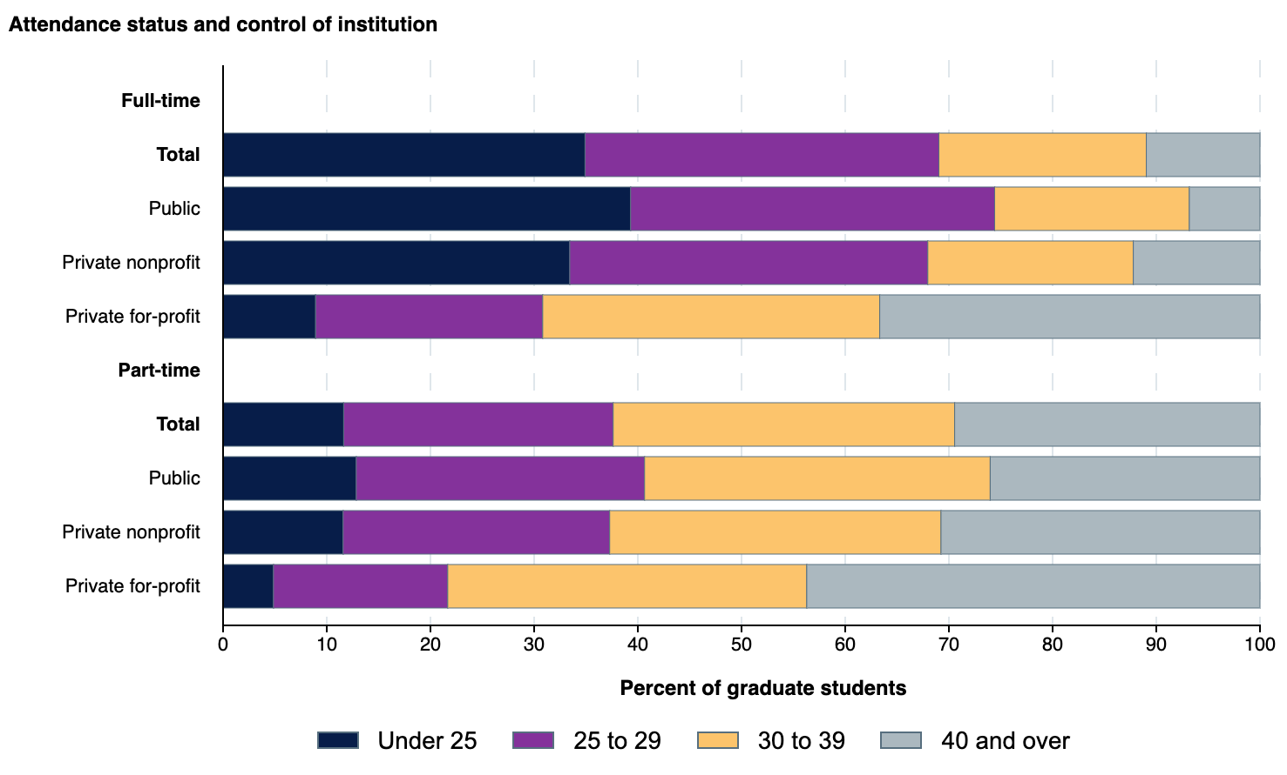
Student Demographics
The proportion of learners who are over the age of 25 is significantly higher for graduate students.
Different generations will bring unique backgrounds and perspectives and have preferred learning modalities.
Source: U.S. Department of Education
Graduate student enrollment, by age group and type of institution
Notes:
Serving a multi-generational cohort requires offering content in multiple formats: lectures, readings, short and long-form video, in-class and take-home assignments. Etc.

Slide 10
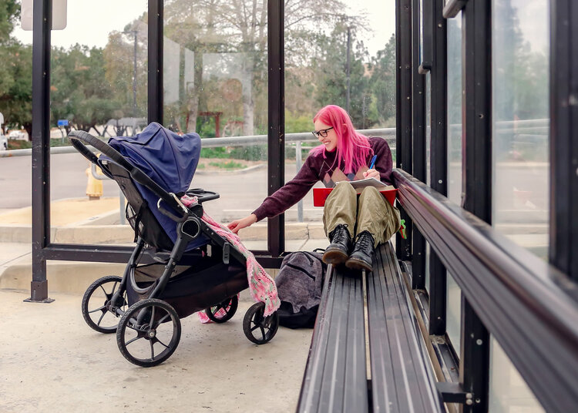
Student Demographics
1 in 4
1 in 3
undergraduate students are parents
graduate students are parents
Source: National Public Radio

Slide 11
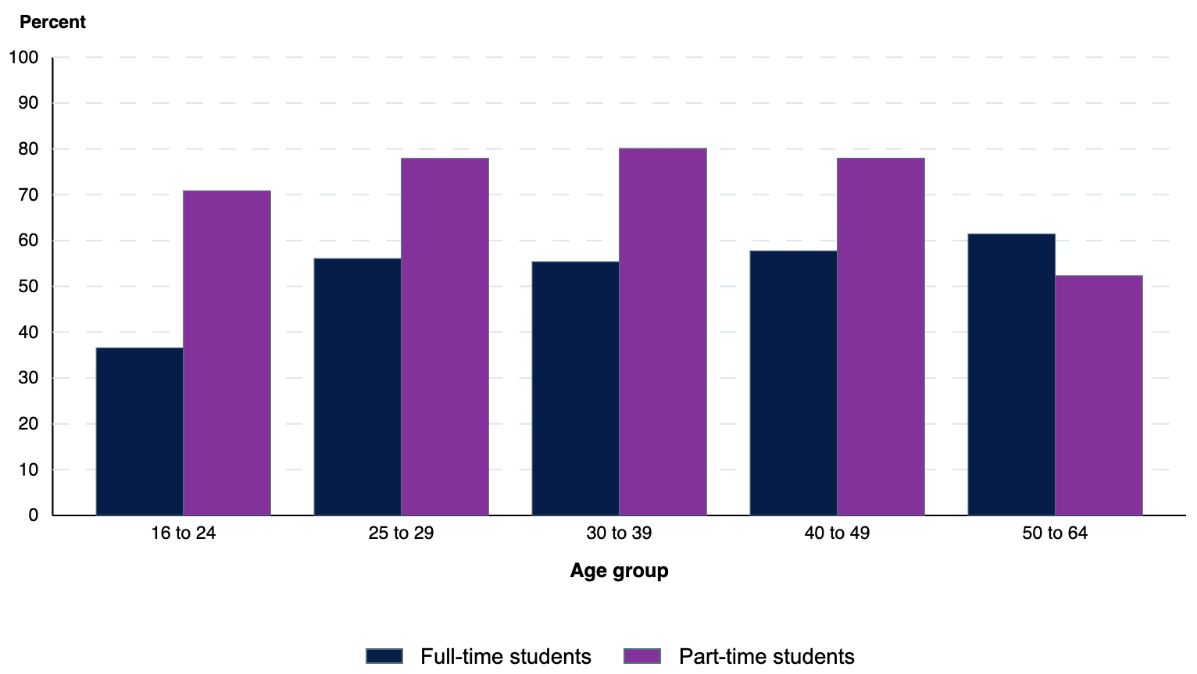
Student Demographics
70%
Overall % of college students who work while enrolled
Percent of undergraduate students who were employed, by age group and attendance status: 2020
Source: U.S. Department of Commerce

Slide 12
Student Population Overview
Students are busier than ever
They come to class with varying technical & professional fluency
Education affordability is a top concern

Slide 13
Cloud Native Learning Student Support
Challenges and Opportunities

Slide 14
Challenges in Cloud Native Learning: Cost
Classroom assignments and cloud labs that utilize modern cloud primitives can cost $$$
Making mistakes in cloud computing is expensive
Students are already working while in school to make ends meet

Slide 15
GitHub Student Developer Pack
What is the GitHub Student Pack?
A multi-vendor, credit or subscription-based package of free or reduced-cost tooling and services for student developers
Cloud credits in GitHub Student pack :
DigitalOcean
$200 in platform credit for 1 year
Azure
Free access to 25+ Microsoft Azure cloud services for 1 year
$100 in Azure credit
Heroku
$13 USD per month for 24 months
Funding is insufficient when students need to use cloud resources for multiple semesters/classes
Notes:
Students can burn through $200 credits in a week due to inexperience

Slide 16
Other Training Resources
AWS Educate
Doesn’t provide direct credits for cloud projects outside of the AWS Educate labs
Google Cloud Skills Boost
Doesn’t provide direct credits for cloud projects outside of the GCP Skills Boost environment
Introductory-level certification costs:
AWS
Cloud Practitioner: 100 USD
AI Practitioner: 100 USD
GCP
Cloud Digital Leader: 99 USD
Azure
Azure Fundamentals: 99 USD

Slide 17
Free Tier Resources (Always Free) as of November 2024
Resource | AWS Free Tier | GCP Free Tier | Azure Free Tier
Compute | 1M Lambda Requests/ month | 1 ec2-micro VM per month 2M Cloud Run invocations/month 28 hours/day F1 App Engine 9 hours/day B1 App Engine | 10 web, mobile, API apps w 1GB storage, 1 hour/day 1M Azure Functions requests 180,000vCPU seconds Container Apps
Database | 25GB DynamoDB 25 hours/month Simple DB | 1GB Firestore storage/project 50,000 reads, 20,000 writes, 20,000 deletes/day/project | 32GB Azure SQL 1,000 Cosmos DB request units/second, 25GB storage
Containers | - | .5GB Artifact Registry storage/month | 1 registry w/ 100GB storage, 10 webhooks Service Fabric
Network | 1TB CloudFront data transfer out 1,000 Route53 CIDR blocks/month |  | 100GB outbound data transfer PrivateLink
Storage | - | 5GB regional storage 5,000 Class A Ops/month 50,000 Class B ops/month only in us-east1, us-west1, us-central1 | 10GB LRS Storage, 10GB LRS or GRS write & retrieve, 100 reads
Notes:
It’s challenging to work around these limitations when creating assignments

Slide 18


Opportunities
Stronger relationships between Clouds and Universities
DigitalOcean & University of Arizona partnership
DigitalOcean fully funding the University of Arizona’s Cloud Computing course this semester
Notes:
Also free introductory certifications from the hyperscalers???

Slide 19
Challenges in Cloud-Native Learning: Pre-requisites
What prerequisites should students have?
Students may have taken foundational classes during pandemic-era remote learning
Students may take these classes at the same time as a cloud computing class
Prerequisites may not have been defined at the department level
Notes:
Prerequisites: Databases, networking, programming background

Slide 20
Opportunities
Supplemental materials are key
Examples:
How to generate an SSH key
Short video walk-throughs demonstrating the same concept on different clouds
Introduction to the OSI model
Work with other instructors to make cloud learning a part of each class

Slide 21
More Considerations
International students in the United States
High pressure to find work post-graduation due to immigration status
Opportunities: Focus on portfolio pieces
Language barriers
Opportunities: Record lectures and enable transcriptions for learners whose first language is not English
Reflect on the language we use in Cloud Native (e.g., “Cattle not pets”)
Notes:
How can cloud-native curriculum not only set them apart via their skillsets on LinkedIn but also by adding to their professional presence?

Slide 22
Curriculum Design & Overview

Slide 23
Curriculum Design
3 Units:
Unit 1: cloud-enabled/cloud-hosted
Unit 2: cloud-native primitives
Unit 3: MLOps
Assignments are either resume-building or have dual-use in other classes:
Launch a Jupyter server on a droplet, access interface via SSH tunneling (IaaS)
Create a static resume website and host using App Platform (PaaS)
Build static code/container scanning pipelines (Security, CI/CD)
Notes:
The course is structured around projects that students can either add to their resumes or use in other classes:

Slide 24
Curriculum Overview: Unit 1
Cloud Enabled/ Cloud Hosted (IaaS)
The “Why” won’t be clear for learners who jump directly into cloud native
Teaching “lift & shift” helps to bridge existing academic work with cloud computing concepts
Very little time for repetition in one semester
Assignments built around containers, VMs, CLIs, networking
Notes:
Feeling the pain of some of “lift & shift” can help students gain deeper understanding of why modern design principles are beneficial
Very little time for repetition in one semester, so try to start with building in repetition early

Slide 25
Unit 1 Lectures
Lecture 1: What is the Cloud?
Lecture 2: What is Computing?
Lecture 3: Hypervisors and Virtual Machines
Lecture 4: Containers
Lecture 5: Cloud Storage
Lecture 6: Cloud Database Fundamentals
Lecture 7: Network Day 1
Lecture 8: Network Day 2
Lecture 9: Unit 1 Review

Slide 26
Curriculum Overview: Unit 2
Cloud-Native
Teach cloud primitives as counter examples to challenges faced when doing cloud-enabled/cloud-hosted
More and more abstraction
Be transparent! Yeah, this is so far removed from running things on-prem…
Assignments focused on PaaS, serverless, IaC, JAMstack
Notes:
Cloud-Native
Teach cloud primitives as counter examples to challenges faced when doing cloud-enabled/cloud-hosted
Having only had a couple of weeks with cloud-hosted/ cloud-enabled, learning cloud-native can be a bit of whiplash.
Here’s all this cool stuff you learned now we are never going to do it that way again
More and more abstraction
Be transparent! Yeah, this is so far removed from running things on-prem…
Assignments focused on:
PaaS
Serverless
IaC
JAMstack

Slide 27
Unit 2 Lectures
Lecture 10: Introduction to Cloud Native
Lecture 11: Compute (PaaS)
Lecture 12: Microservices
Lecture 13: Infrastructure as Code
Lecture 14: Kubernetes Day 1
Lecture 15: Kubernetes Day 2
Lecture 16: Code Walk-through
Lecture 17: Observability
Lecture 18: Cloud Security Day 1
Lecture 19: Cloud Security Day 2
Lecture 20: Unit 2 Review

Slide 28
Curriculum Overview: Unit 3
Unit 3: MLOps
Machine learning lifecycle
MLOps & LLMOps
Cloud architecture reviews
Assignments focused on MLflow, Kubeflow
Notes:
Unit 3: MLOps
My students all either take or took 1 introductory ML class before/during my class
Try to use that external knowledge to tie the cloud class into what they’re learning in other classes
One assignment is to run a notebook on a VM and access it using SSH tunneling (set it up as a playground anytime they run out of memory or compute on their local machines during their ML class)
Assignments focused on:
MLFlow,

Slide 29
Sample Curriculum: Unit 3
Lecture 21: Introduction to MLOps
Lecture 22: Cloud Architecture Decisions for MLOps
Lecture 23: LLMOps & Introduction to Kubeflow
Lecture 24: Common Cloud Architectural Patterns
Lecture 25: Unit 3 Review

Slide 30
Curriculum Design: Group Project
Group project implements an end-to-end ML service
Uses resources from every unit
Compute, Storage, DB, Networking, Containers
Serverless, DBaaS, Microservices, CI/CD (code scanning, image scanning, GHA, etc.)
MLOps
New cloud primitives around LLMOps can be student-driven if they want to dive deeper
Notes:
Group project encourages students to use resources they learn throughout the class to implement an end-to-end ML service
Data collection/storage, preprocessing, model training/retraining, model persistence, model deployment, inferencing endpoint
Opportunity for each student to bring their unique technological/professional strengths to the project
Use elements from every unit
Compute, Storage, DB, Networking, Containers
Serverless, DBaaS, Microservices, CI/CD (code scanning, image scanning via GHA, etc.)
MLOps
New cloud primitives around LLMOps can be student-driven if they want to dive deeper
Allow flexibility!

Slide 31
Building the Curriculum Around Student Stress Cycles

Slide 32
Student Stress Cycle
September
Homesickness
Imposter Syndrome
Missing foods, events, holidays from home
Financial challenges begin
October
Loneliness develops
FAFSA filing date opens
Job search stress for December grads
Time management
Illness increases
November
Academic pressure mounts
Incidence of depression and anxiety increase
Spring Semester decision making
December
Anxiety, fear, guilt increase as final exams approach
Pre-holiday depression
Financial strain
Confidence-building assignments*
Transparency around financial implications of the class
Portfolio assignments focused on job & internship search
Earlier mid-term exams
Invite conversations about Spring semester plans
Regular check-ins about progress toward end-of-semester projects
Notes:
Source: https://studentsuccess.arizona.edu/news/timely-resources-october-stressors-students

Slide 33
Student Stress Cycle
March
Midterms
Anxiety around securing internships & jobs
Decrease in motivation after spring break
April
Anxiety rises as classes end and work is due
May
Summer job decisions, papers, exams, vacation, relationships
Students without support system concerned about stability or resources until they return in the fall
Concerns grow for students looking for work or internships
Fall semester course registration
Confidence-building assignments*
Re-centering activities/ inverted classroom lectures
Invite conversations about post-graduation plans
Regular check-ins about progress toward end-of-semester project
Connect students with summer support
Volunteering opportunities
Notes:
Source: https://studentsuccess.arizona.edu/news/timely-resources-october-stressors-students

Slide 34
Student Stress Cycle
Flexibility is key
Students are still learning fundamental application code debugging skills
Add in debugging containers, pipelines, runtimes, …
Open deadlines (assignment deadlines never close) can help to alleviate stress
Notes:
Open deadlines (assignment deadlines never close) can help to remove the (sometimes extreme) stress of debugging against an arbitrary deadline

Slide 35
Promoting Engagement & Community
Slack citizenship extra credit
Asking questions
Answering questions
Engaging in threads
Initiating thoughtful discussions
Community citizenship extra credit
Organizing a Hacktober event on campus
Attending & submitting CFPs for conferences (even if not selected to speak)
Engaging in or starting student clubs

Slide 36
Promoting Engagement & Community
Have students co-create community guidelines
Starting Points
No “feigning surprise”
As best as you can, avoid words like “easy”, “trivial”, “basic”, etc.

Slide 37
Promoting Engagement & Community
Psychological safety
Thank students for giving their hard work!!
Small group discussions in-class
Trustworthiness & transparency
Articulate how each assignment relates to the course objectives
Create “definition of done” for assignments
Peer support and mutual self-help
Emphasize peer support to foster community
Slack question/answering
Shared decision making
Pre-course surveys
Mid-semester surveys
Build a sense of purpose
Participation in Open Source
Participation/ attendance at conferences
Polls in Slack
Source: Inside Higher Ed

Slide 38
Mistakes I’ve Made
Overall course difficulty:
First year:
Pre-requirements not enforced
Avg grade on midterm was C-
Second year:
Pre-requirements enforced
Class is maybe too easy??
Assignments:
First few assignments were not sufficiently tested (Windows)
Not enough creativity to minimize debugging
Not enough focus on portfolio projects early in the semester so that students can use them for job applications

Slide 39
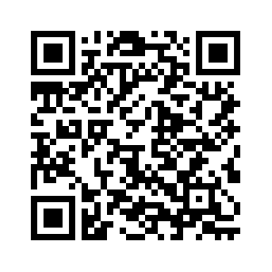
Resources
Course resources are available in GitHub
Curriculum Overview
Sample lectures (slides & recordings)
Sample assignments
Sample supplementary materials
Helpful resources for instructors from Univeristy of Arizona student success staff
https://github.com/z-collective-io/cloud-computing-curriculum

Slide 40
Thank You!!
Get in Touch or Collaborate!
Interviews , stories, deep dives
Industry engagement
zahmadpost@arizona.edu
zara@zcollective.io
zahmadpost@digitalocean.com

Slide 41
References
U.S. Department of Education, National Center for Education Statistics, Integrated Postsecondary Education Data System (IPEDS), Spring 2021, Fall Enrollment component. See Digest of Education Statistics 2022, table 303.50.
Marcus, J. (2024, April 18). College is hard enough- try doing it while raising kids. National Public Radio. https://www.npr.org/2024/04/18/1243709966/college-student-parents-child-care-costs
U.S. Department of Commerce, Census Bureau, Current Population Survey (CPS), October, 2020. See Digest of Education Statistics 2021, table 503.40.
Imad, M. (2020, June 2). Leveraging the Neuroscience of Now. Inside Higher Ed. https://www.insidehighered.com/advice/2020/06/03/seven-recommendations-helping-students-thrive-times-trauma

Slide 42
Promoting Engagement & Community
Inverted classroom
Students watch lectures and read/watch supplemental materials before class
Use class time to walk through assignments, work in small groups
Growth Mindset
STEM & overall education experiences among students vary significantly
Instructors and students are coming to the classroom with traditions passed down to them that might not serve them.
Start from 0 and build to 100, don’t start from 100 and subtract to 0.
Notes:
Skate videos lol

