Slide 1
HW6
12.30

Slide 2
T1
PUSH A, PUSH B, POP, PUSH C, PUSH D, POP, PUSH E, POP, POP, PUSH F
(a) What does the stack contain after the PUSH F?
A AB A AC ACD AC ACE AC A AF
(b) At which point does the stack contain the most elements?
PUSH D
PUSH E
(c)As for queue
A AB B BC BCD CD CDE DE E EF

Slide 3
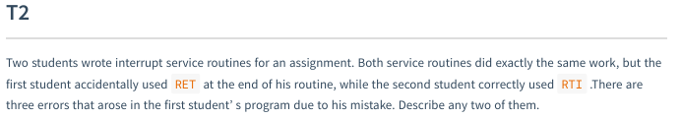
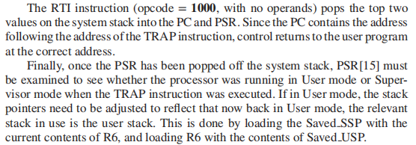
T2
RET:JMP R7

Slide 4
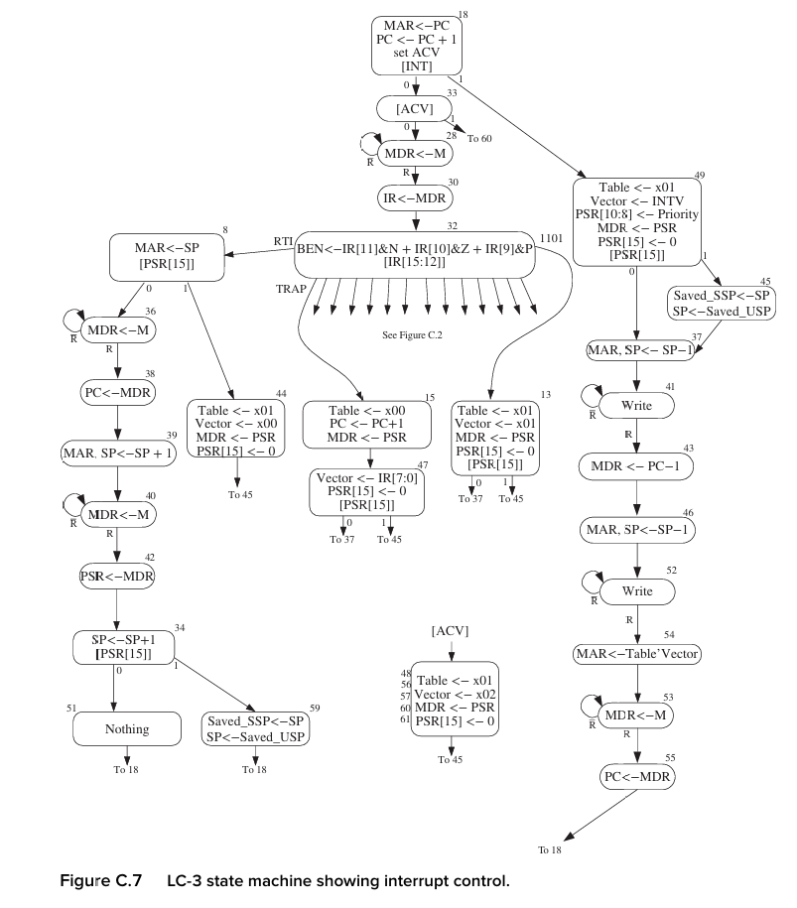
T2

Slide 5
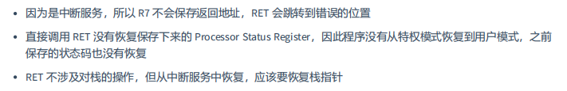
T2

Slide 6
T3
(a) What problem could occur if a program does not check the ready bit of the KBSR before reading the KBDR?
程序可能反复读取同一个字符
(b) What problem is likely to occur if the keyborad hardware does not check the KBSR before writing to the KBDR?
KBDR 存的数据可能还没有被读取，用户输入字符可能丢失
What problem could occur if the display hardware does not check the DSR before writing to the DDR?
display hardware 并不会写入 DDR
what about a program does not check the DSR before writing to the DDR?

Slide 7
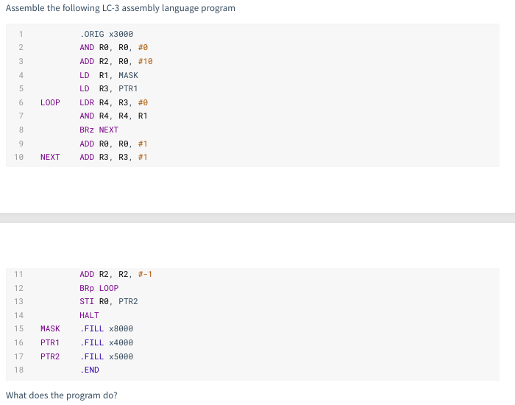
T4
统计 x4000 开始的十个数据中首位为1（负数）的个数，存在地址 x5000 处
主要看MASK x8000
和AND 操作。

Slide 8
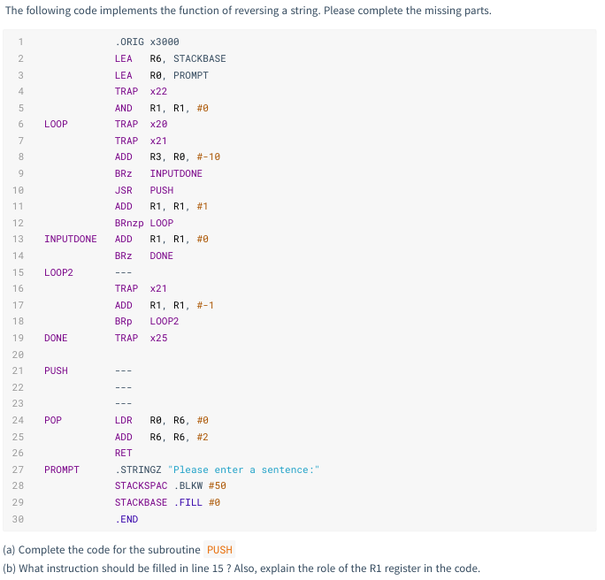
T5
(a)参考POP：LDR换STR，+2换-2：
ADD R6, R6, #-2
STR R0, R6, #0
(b)先入后出反向输出字符串：JSR POP
R1 寄存的作用是记录输入字符串的长度，便于后续逆序输出

Slide 9
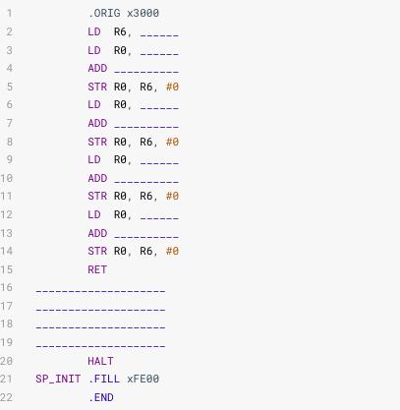
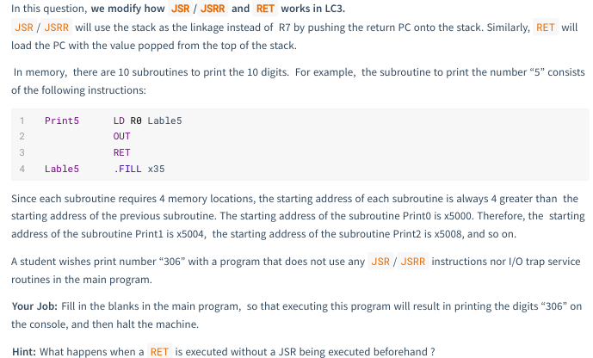
T6

Slide 10
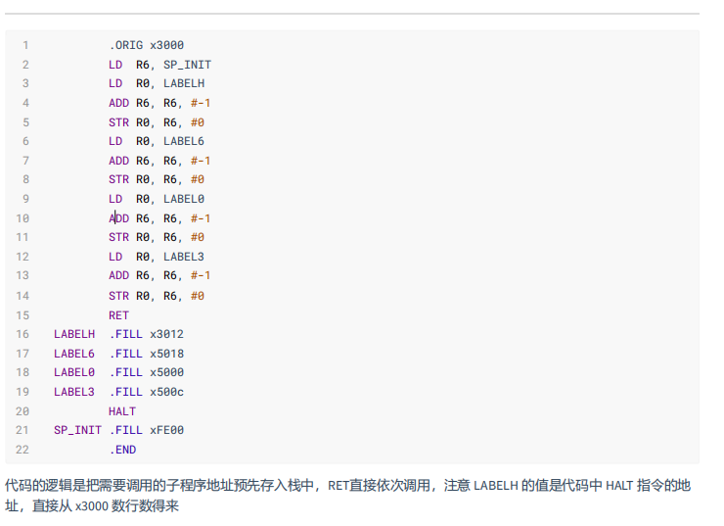
T6

Slide 11
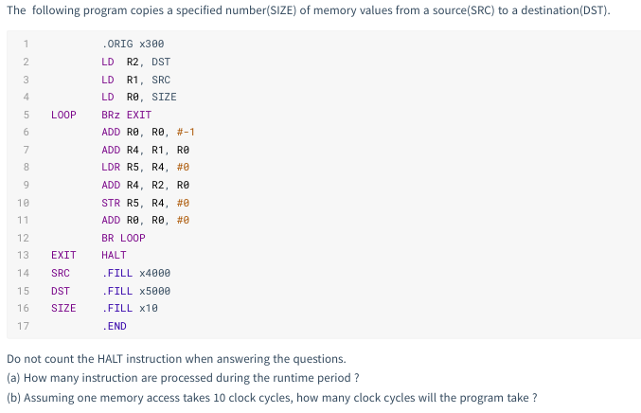
T7
(a)3*1 + (16+1)+7*16=132

Slide 12
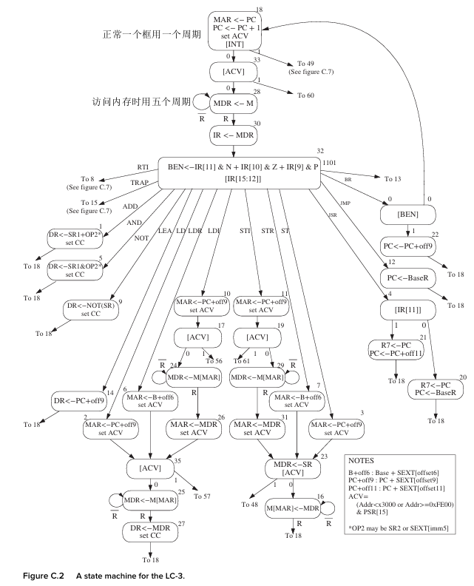
T7
（b）计算指令的周期：数框框，内存访问（R）*10，否则*1

Slide 13
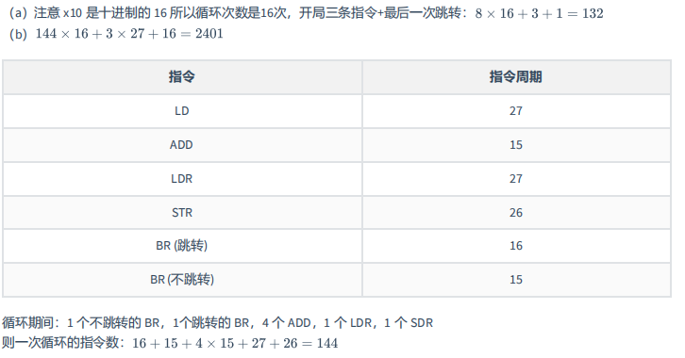
T7

