Slide 1



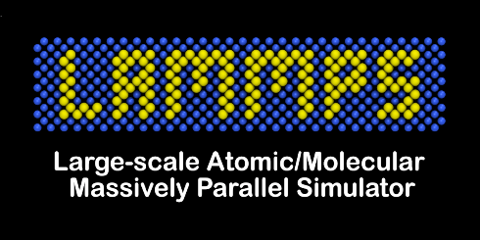

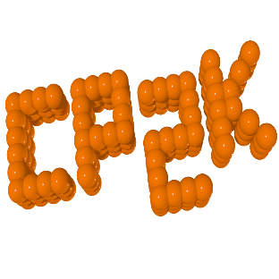

Yet another MD simulation software
Functionality
Ease-of-use
Extendability
Performance
GROMACS
LAMMPS
OpenMM
Notes:
Thermodynamic properties are essential for chemical engineering design
Experimental properties are only available for a small portion of compounds

Slide 2
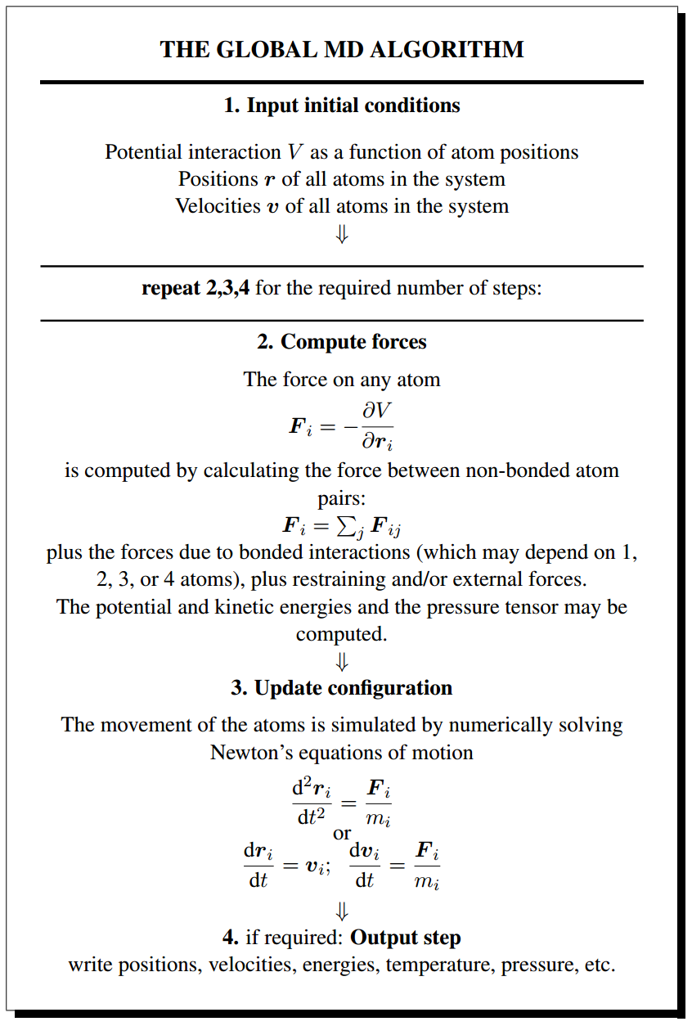
A rough description of MD
System definition
Particles and masses
Potential function
Boundary conditions
Integration
Temperature control
Pressure control
Constraints
Enhanced sampling
Output
Thermodynamic quantities
Trajectory

Slide 3
Terminologies
LAMMPS
pair_style
read_data
pair_coeff
fix nvt npt ...
fix shake spring ...
compute msd ...
thermo
dump
run
Simulation
System
Periodic Box Vectors
“Force”
(potential, barostat...)
Integrator
(Langevin, NH...)
Platform
(CPU, CUDA...)
Reporters
State Reporter
Trajectory Reporter
Particle
Topology
(elements, residues)
Context
(modify simulation data)
State
(retrieve simulation data)
OpenMM
box
atom
bond_style
angle_style
pair_style
fix
fix nve
fix nvt
fix npt
gpu
intel
thermo
dump

Slide 4
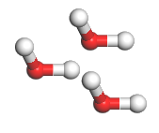

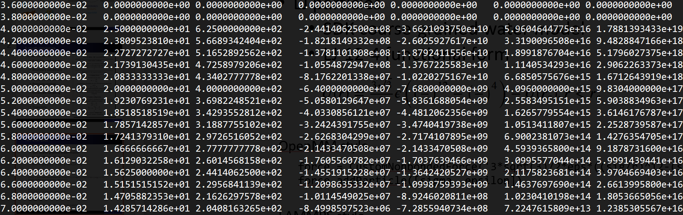


Example 1 - LJ particles with non-LJ-12-6 function
SDK coarse-grained water model
LJ-12-4 functional form
A coarse-grained water particle
GROMACS style
vdw_type user
a table file with thousands lines of numbers
LAMMPS style
What if another model with LJ-12-8-6-4 function
pair_style mie/cut
pair_coeff * * epsilon sigma 12 4
OpenMM style
force = CustomNonbondedForce('3*sqrt(3)/2*eps*((sig/r)^12-(sig/r)^4)')
force.addParticle([sigma, epsilon])

Slide 5
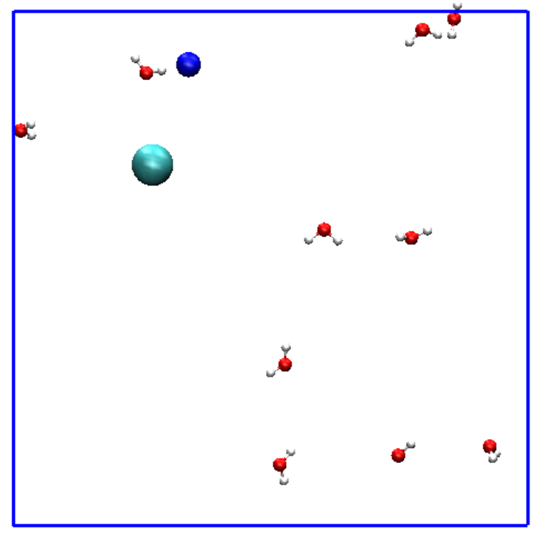
Example 2 - NaCl ion pair in atomistic water solution
How to apply extra constraints
Tether the Na+ ion at the center of the box
Control the distance between Na+ and Cl- ions
OpenMM code
CustomExternalForce('k*((x-x0)^2+(y-y0)^2+(z-z0)^2)')
Equivalent LAMMPS fix
fix spring tether ....
OpenMM code
CustomBondForce('k*(r-r0)^2')
Equivalent LAMMPS fix
fix spring couple ....

Slide 6
Links
https://github.com/openmm/openmm
http://openmm.org/
http://docs.openmm.org/latest/userguide/index.html
http://docs.openmm.org/latest/api-python/index.html

