Slide 1
n₀
n₂
n₁
θ₁
φ₁
φ₀

Slide 2
n₀
n₂
n₁
φ₀
φ₁
θ₀
β

Slide 3
n₀
n₂
n₁
φ₀
θ₁
φ₁
θ₀
β

Slide 4
n₀
n₂
n₁
θ₁
φ₁
θ₂
β
θ₀

Slide 5
x
n_{clad}
z
n_{core}
y

Slide 6
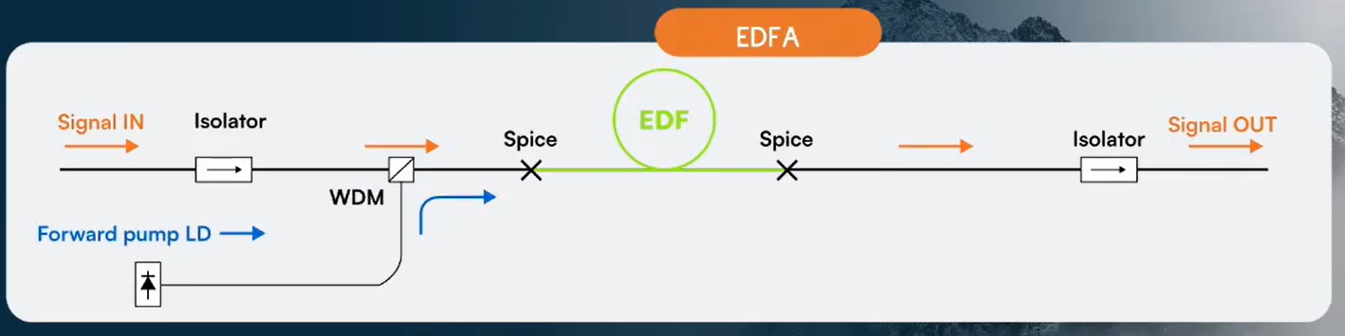
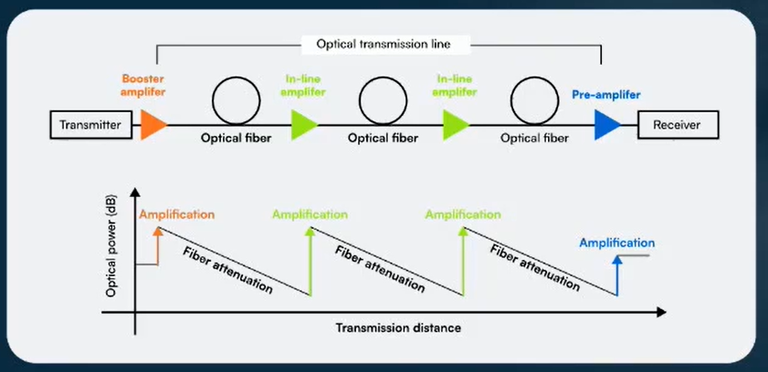
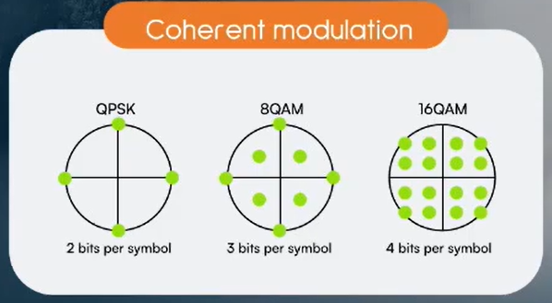

Slide 7
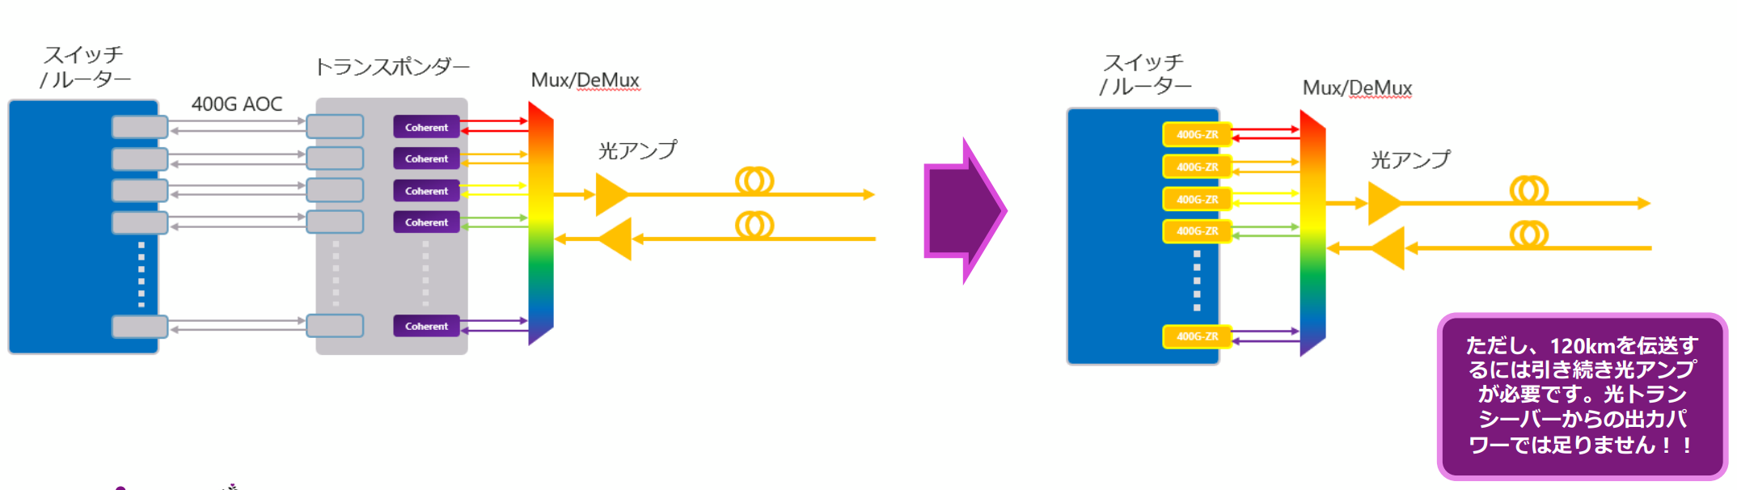
400G-ZR/ZR+とは？

Slide 8
x
n_{clad}
z
n_{core}
y
Bragg gratings length

Slide 9
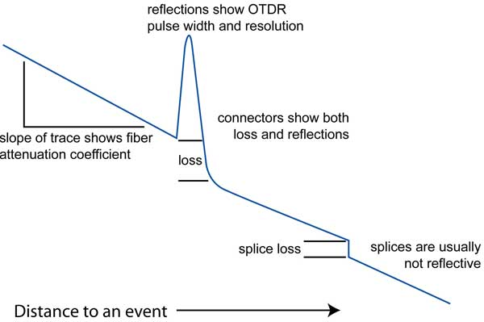

Slide 10
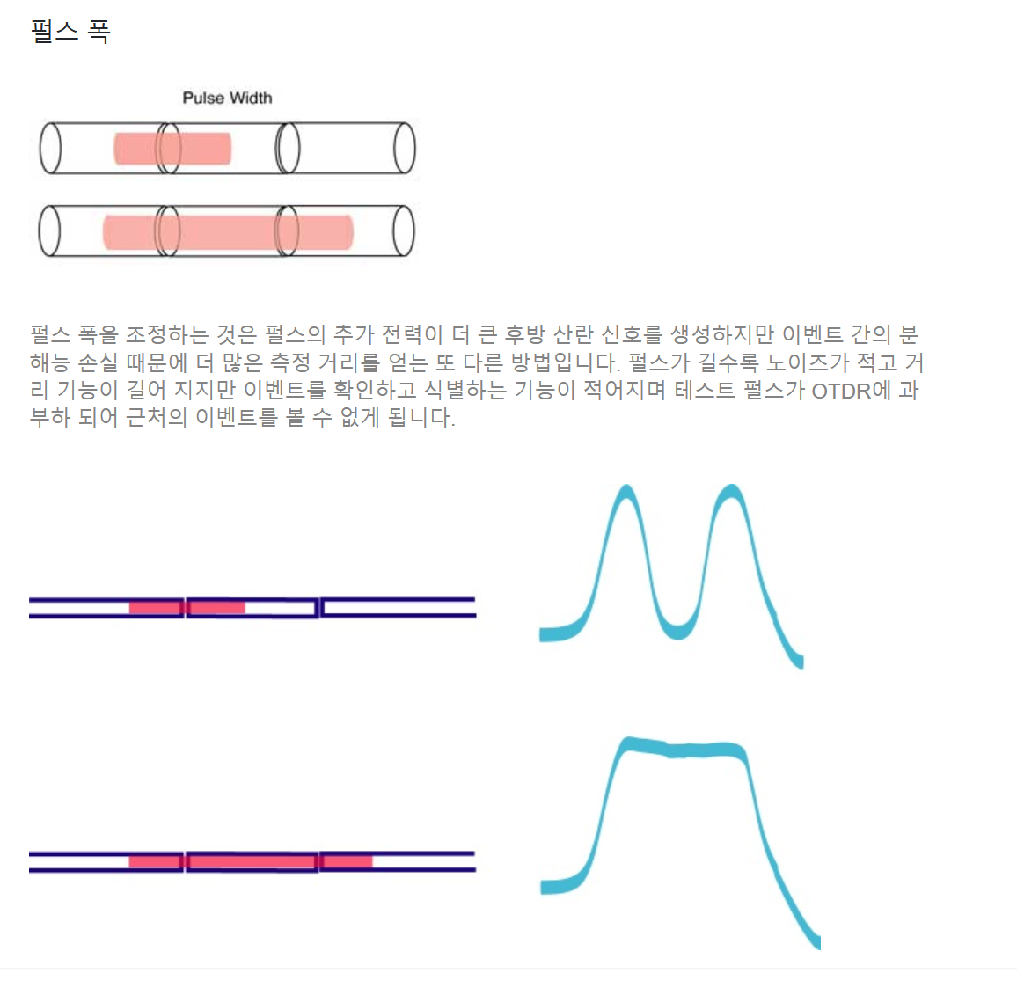
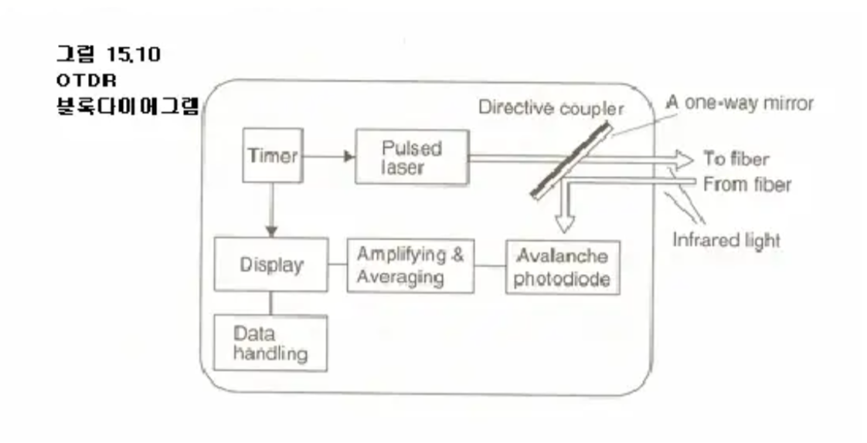

Slide 11




x
x
Look at from this perspective
y
$$k_{r}$$
$$θ$$
y
z
$$θ$$
$$β$$
z

Slide 12


x
$$E_{TE}$$
y
$$θ$$
z

Slide 13









$$k_{2ω}$$
$$Optic axis c$$
$$θ_{0}$$
$$d$$
$${\hat{e}}_{z}$$
$${\hat{e}}_{y}$$
$${\hat{e}}_{x}$$
$$k_{ω}$$
Surface normal = ${\hat{e}}_{z}$

Slide 14












$$k_{2ω}$$
$$Optic axis c$$
$$θ$$
$$d$$
$$γ_{2}^{′}$$
$$γ_{1}^{′}$$
$${\hat{e}}_{z}$$
$${\hat{e}}_{y}$$
$${\hat{e}}_{x}$$
$$k_{2,ω}$$
$$k_{1,ω}$$
Surface normal = ${\hat{e}}_{z}$

