Slide 1
Optimizing
Project Management Using Graph Theory
CS 5002 Final Project
Qiuying Zhuo & Zhiwei Zhou
2023.04

Slide 2
Agenda
Team Background
Graphs Theory @ Project Management
Questions and Hypothesis
Existing Theory: Critical Path Method (CPM)
Promotional Event Challenges
Python Based Analysis
Output and Interpretation
Reflections and Future Directions

Slide 3



1. Team Background
Drawings, lots of drawings…
Zhiwei's Background:
Architectural Designer
Design Documents Phasing
Building Permits
Construction Administration
Qiuying's Background:
Investment Banker
IPO & MA projects
Cross-team and Cross-company Coordination
Time is $$$$

Slide 4
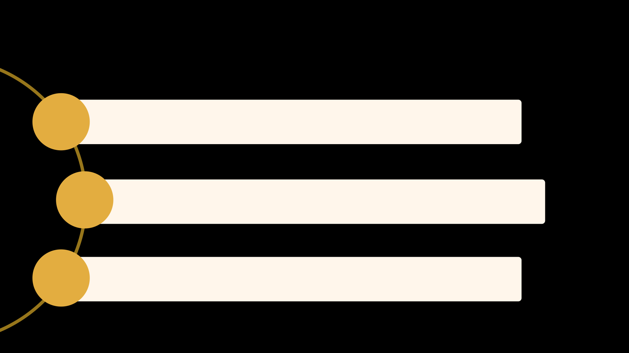
2. Graphs Theory @ Project Management
Project Management as a common task for both of us in our previous jobs
Explore the way to promote Project Management by using Discrete Math
Benefits: Make project Delivery on time, within budget, and with the desired quality

Slide 5

3. Questions and Hypothesis
1. How can Graph Theory be applied to optimize DAG-type projects, especially those time-sensitive ones, in various industries?
2. What is the earliest completion time for the project, and how can it be found?
3. Which activities can be delayed, and by how long, without affecting the minimum completion time?

Slide 6

4. Existing Theory: Critical Path Method (CPM)
Core Theory to Apply:
Critical Path Method (CPM)
The critical path and its relation to graph theory
Incorporating graph theory in project management
Finding the longest path
(the critical path)

Slide 7



5. Promotional Event Challenges
The event is super super
super urgent! Pls finish it
in 30 days!!!
Item | Description | Days
A | Plan the event (Event Coordinator) | 5
B | Select products (Purchaser) | 4
C | Design promotional materials (Graphic Designer) | 8
D | Coordinate with suppliers (Purchaser) | 5
E | Prepare email content (Marketing) | 4
F | Print promotional materials (Printer) | 4
G | Assemble email campaign (Marketing) | 3
H | Distribute promotional materials | 3
I | Launch email campaign (Marketing) | 1
J | Execute promotional event (Retail Staff) | 2
OMG! In total
it takes 39 days!
Another mission impossible!

Slide 8

5. Promotional Event Challenges (Cont.)
Item | Description | Days | Preceding Works
A | Plan the event (Event Coordinator) | 5
B | Select products (Purchaser) | 4
C | Design promotional materials (Graphic Designer) | 8 | A, B
D | Coordinate with suppliers (Purchaser) | 5 | C
E | Prepare email content (Marketing) | 4 | C
F | Print promotional materials (Printer) | 4 | D, E
G | Assemble email campaign (Marketing) | 3 | C
H | Distribute promotional materials | 3 | F, G
I | Launch email campaign (Marketing) | 1 | G
J | Execute promotional event (Retail Staff) | 2 | H, I
Opportunities to optimize?
Parallelization
Breaking down tasks
Task dependencies?

Slide 9
6. Python Based Analysis
Step 1: Process input data (CSV)
Step 2: Represent the Directed Acyclical Graph using NetworkX
Step 3: Find the critical path / the longest path
Step 4: Format and plot using Matplotlib
Step 5: Generate summarized message

Slide 10
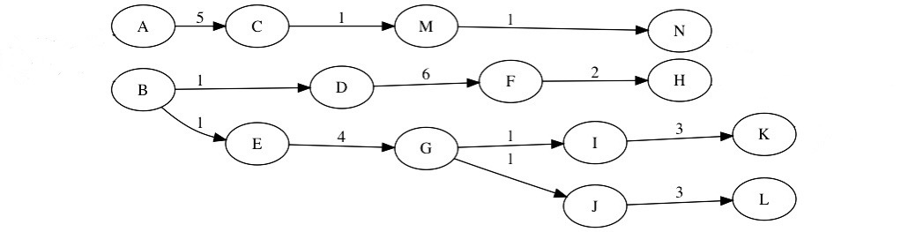
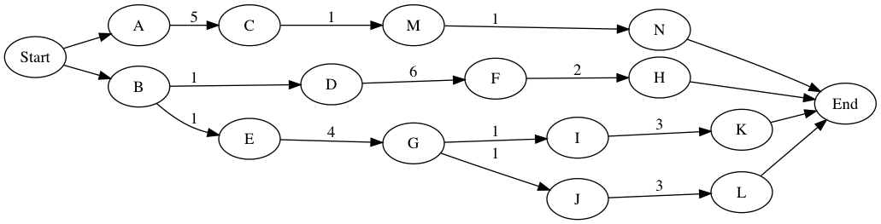
6. Python Based Analysis: Highlight
Issues
A project might start with several parallel projects
A project might end with several parallel projects
Solution
Adding virtual start and end nodes
Ensuring the start and end point is unique
Figures are extracted and adapted from What is the 'critical path' when drawing an activity-on-node network diagram that doesn't converge?

Slide 11

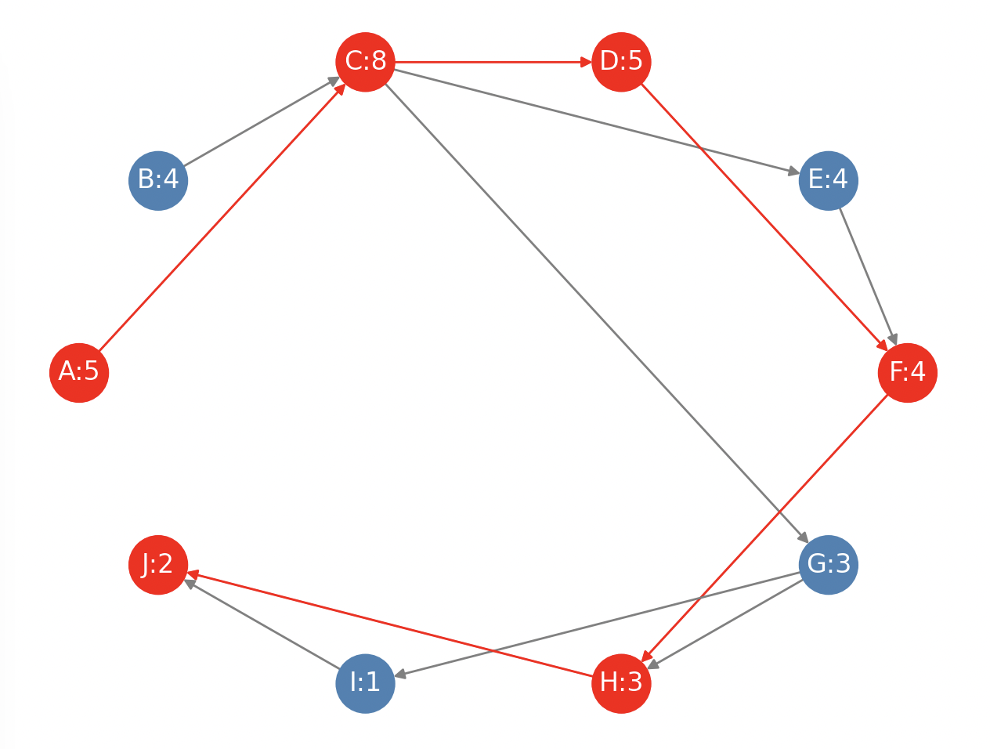
7. Output and Interpretation
SUMMARY
The critical path consists of the following tasks:
1. A: Plan the event (Event Coordinator) (5 days)
2. C: Design promotional materials (Graphic Designer) (8 days)
3. D: Coordinate with suppliers (Purchaser) (5 days)
4. F: Print promotional materials (Printer) (4 days)
5. H: Distribute promotional materials (Retail Staff) (3 days)
6. J: Execute promotional event (Retail Staff) (2 days)
The total duration of the critical path is 27 days.
REFERENCE
The tasks NOT on the critical path are:
B: Select products (Purchaser) (4 days)
E: Prepare email content (Marketing) (4 days)
G: Assemble email campaign (Marketing) (3 days)
I: Launch email campaign (Marketing) (1 days)

Slide 12
7. Output and Interpretation (Cont.)
Project completion possible within 30-day deadline
Non-critical tasks with scheduling flexibility
Inform decisions on resource allocation and task prioritization
Critical path total duration: 27 days

Slide 13
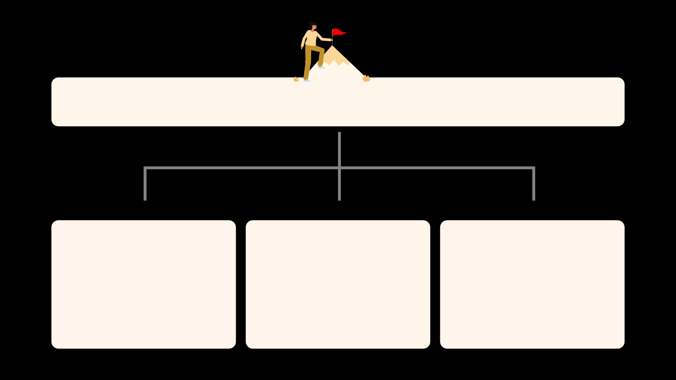



8. Reflections and Future Directions
Benefits for Project Management and beyond
Things to improve
Future Development Directions

Slide 14

9. References
The ABCs of the Critical Path Method from Harvard Business Review
Building DAGs / Directed Acyclic Graphs with Python from MungingData
What is the "critical path" when drawing an activity-on-node network diagram that doesn't converge
Notebook 2.2- Weighted and directed graphs
HiLite.me to insert code snippet in the word document
Customizing NetworkX Graphs by Aren Carpenter

Slide 15
THE END
THANKS
Graph Theory
is so cool ; )

