Slide 1
Optimizing
Project Management Using Graph Theory
CS 5002 Final Project
Qiuying Zhuo & Zhiwei Zhou
2023.04

Slide 2
CONTENT
1. Team Background
2. Graphs Theory @ Project Management
3. Questions and Hypothesis
4. Existing Theory: Critical Path Method (CPM)
5. Python Based Analysis: Example of a Promotional Event
6. Analysis: Interpretation of the Output
7. Conclusion: Reflections and Future Directions
8. References

Slide 3
01
1. Team Background

Slide 4



1. Team Background
Drawings, lots of drawings…
Zhiwei's Background:
Architectural Designer
Design Documents Phasing
Building Permits
Construction Administration
Qiuying's Background:
Investment Banker
IPO & MA projects
Cross-team and Cross-company Coordination
Time is $$$$

Slide 5
02
2. Graphs Theory @ Project Management

Slide 6
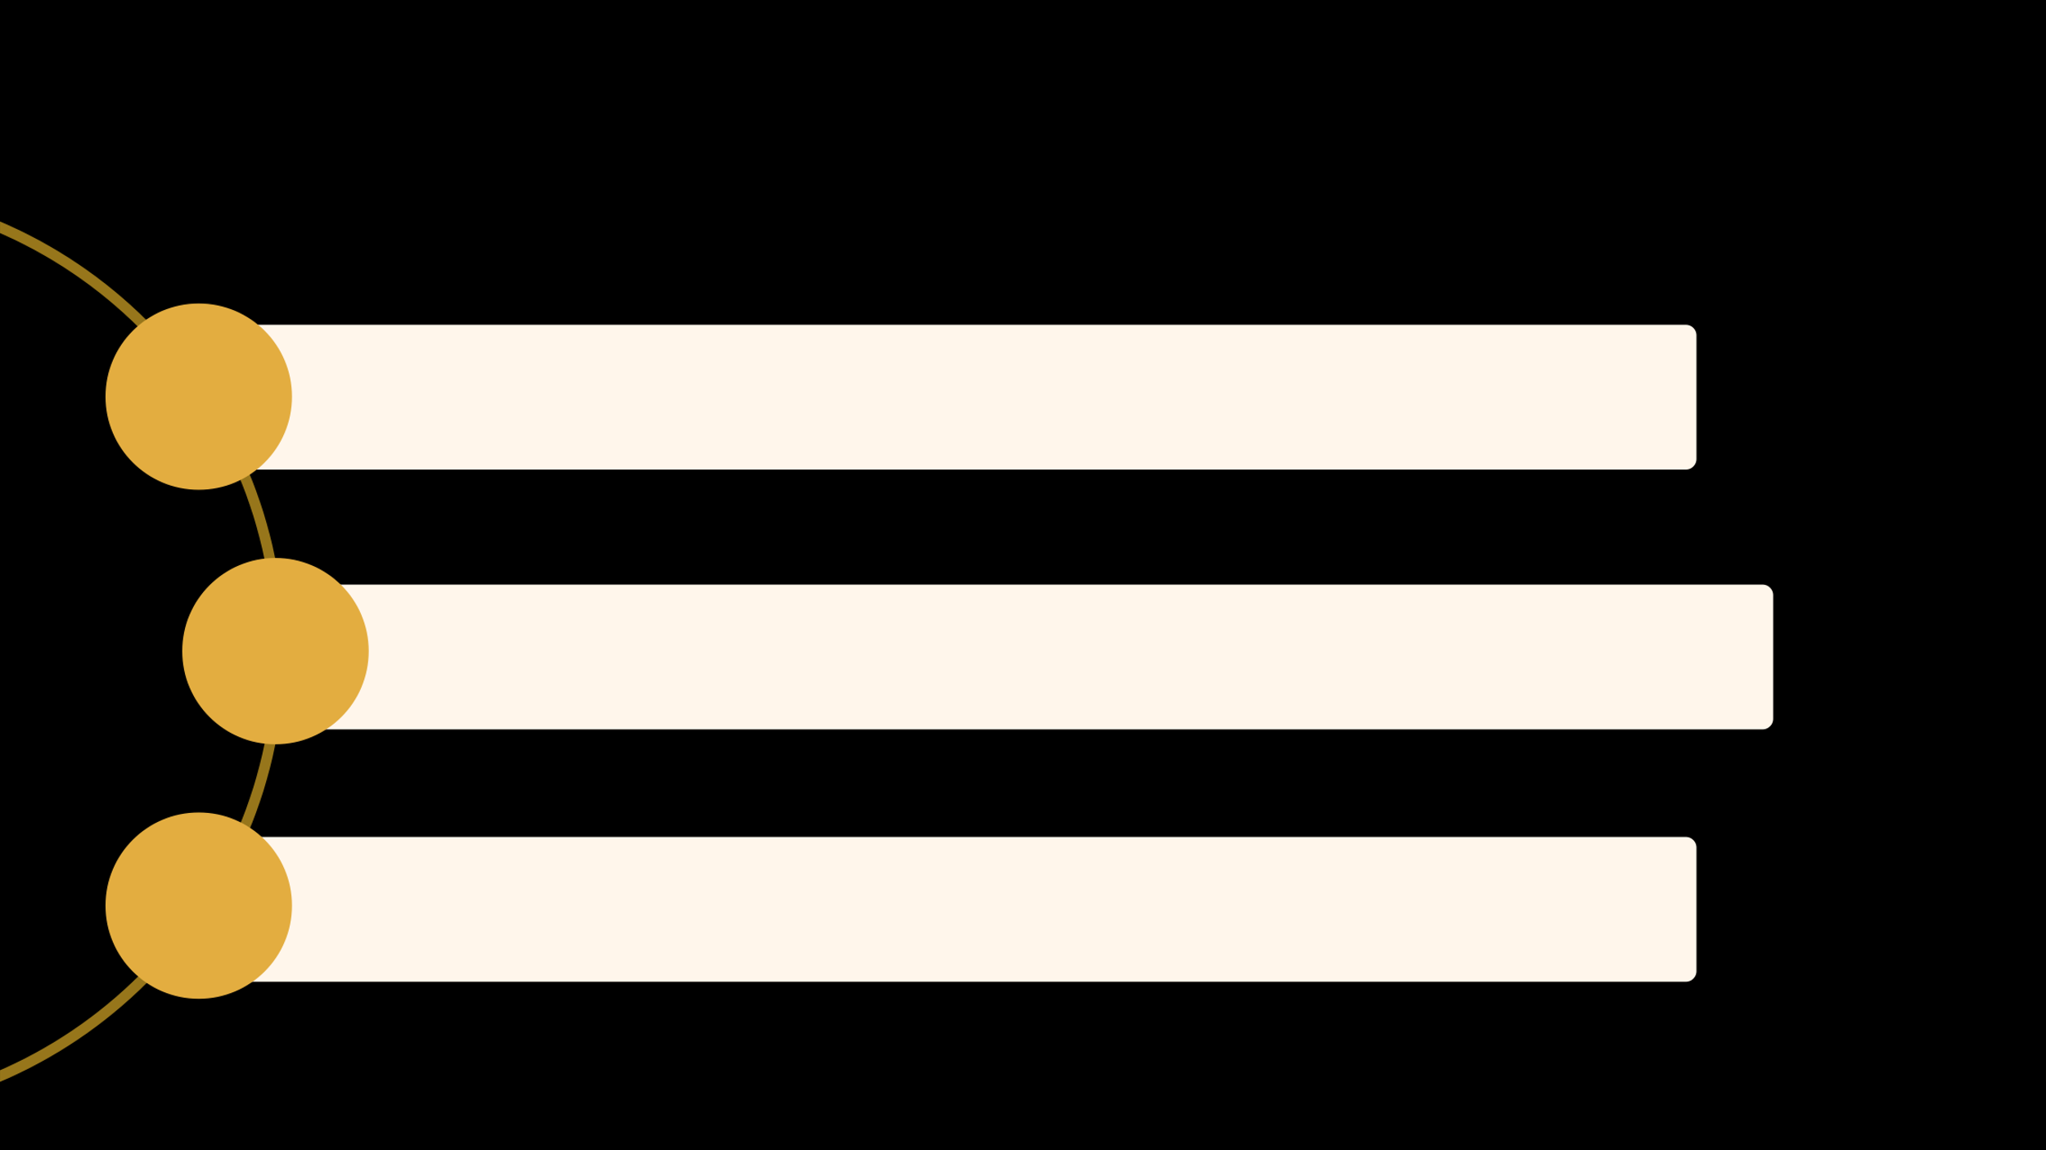
2. Graphs Theory @ Project Management
Project Management as a common task for both of us in our previous jobs
Explore the way to promote Project Management by using Discrete Math
Benefits: Make project Delivery on time, within budget, and with the desired quality

Slide 7
03
3. Questions and Hypothesis

Slide 8

3. Questions and Hypothesis
1. How can Graph Theory be applied to optimize DAG-type projects, especially those time-sensitive ones, in various industries?
2. What is the earliest completion time for the project, and how can it be found?
3. Which activities can be delayed, and by how long, without affecting the minimum completion time?

Slide 9
04
4. Existing Theory (CPM)

Slide 10

4. Existing Theory (CPM)
Core Theory to Apply:
Critical Path Method (CPM)
The critical path and its relation to graph theory
Incorporating graph theory in project management
Finding the longest path
(the critical path)

Slide 11
05
5. Python Based Analysis
Leveraging Directed Acyclic Graphs Analysis in a Promotional Event

Slide 12
5. Python Based Analysis
Step 1: Process input data
Step 2: Represent the graph using NetworkX
Step 3: Find the critical path / the longest path
Step 4: Format and plot using Matplotlib
Step 5: Generate summarized message

Slide 13
06
6. Analysis: Interpretation of the Output

Slide 14

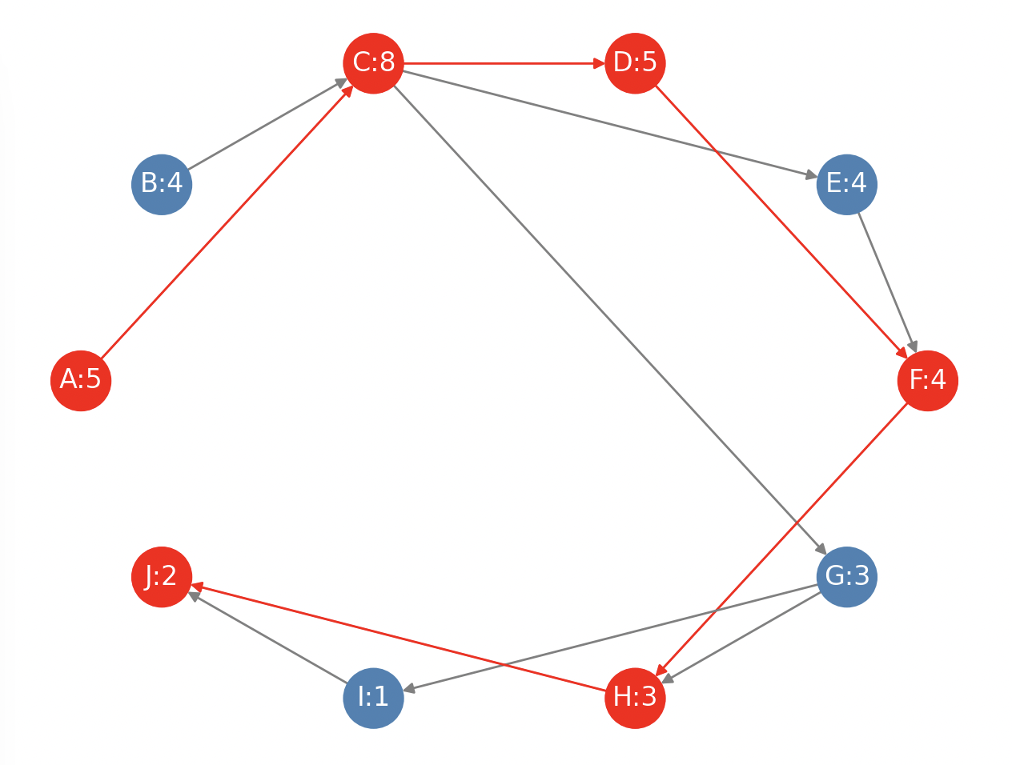
6. Output and Interpretation
SUMMARY
The critical path consists of the following tasks:
1. A: Plan the event (Event Coordinator) (5 days)
2. C: Design promotional materials (Graphic Designer) (8 days)
3. D: Coordinate with suppliers (Purchaser) (5 days)
4. F: Print promotional materials (Printer) (4 days)
5. H: Distribute promotional materials (Retail Staff) (3 days)
6. J: Execute promotional event (Retail Staff) (2 days)
The total duration of the critical path is 27 days.
REFERENCE
The tasks NOT on the critical path are:
B: Select products (Purchaser) (4 days)
E: Prepare email content (Marketing) (4 days)
G: Assemble email campaign (Marketing) (3 days)
I: Launch email campaign (Marketing) (1 days)

Slide 15
6. Output and Interpretation
Project completion possible within 30-day deadline
Non-critical tasks with scheduling flexibility
Inform decisions on resource allocation and task prioritization
Critical path total duration: 27 days

Slide 16
07
7. Conclusion: Reflections and Future Directions

Slide 17
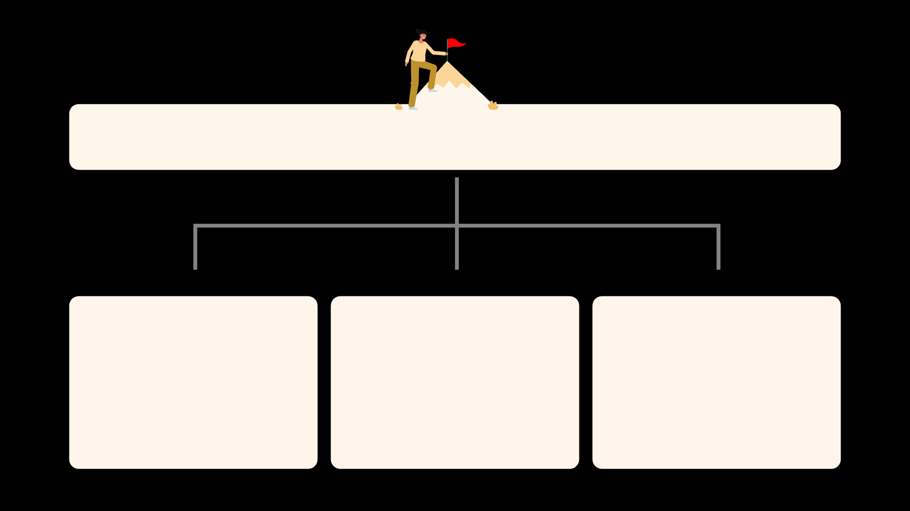
7. Conclusion: Reflections and Future Directions
Benefits for Project Management and beyond
Things to improve
Future Development Directions

Slide 18
08
8. References

Slide 19

8. References
The ABCs of the Critical Path Method from Harvard Business Review
Building DAGs / Directed Acyclic Graphs with Python from MungingData
What is the "critical path" when drawing an activity-on-node network diagram that doesn't converge
Notebook 2.2- Weighted and directed graphs
HiLite.me to insert code snippet in the word document
Customizing NetworkX Graphs by Aren Carpenter

Slide 20
THE END
THANKS
Graph Theory
is so cool ; )

