Slide 1
Optimizing
Project Management Using Graph Theory
CS 5002 Final Project
Qiuying Zhuo & Zhiwei Zhou
2023.04

Slide 2
CONTENT
1. Team Background
2. Graphs Theory @ Project Management
3. Questions and Hypothesis
4. Existing Theory: (CPM)
5. Case Study: Leveraging Directed Acyclic Graphs Analysis in a Promotional Event
6. Analysis: Interpretation of the Output
7. Conclusion: Reflections and Future Directions
8. References

Slide 3
01
1. Team Background

Slide 4



1. Team Background
Drawings, lots of drawings…
Zhiwei's Background:
Architectural Designer
Design Documents Phasing
Building Permits
Construction Administration
Qiuying's Background:
Investment Banker
IPO & MA projects
Cross-team and Cross-company Coordination
…

Slide 5
02
2. Graphs Theory @ Project Management

Slide 6

2. Graphs Theory @ Project Management
Project Management as a common task for both of us in our previous jobs
Explore the way to promote Project Management by using Discrete Math
Benefits: Make project Delivery on time, within budget, and with the desired quality

Slide 7
03
3. Questions and Hypothesis

Slide 8

3. Questions and Hypothesis
1. How can Graph Theory be applied to optimize DAG-type projects, especially those time-sensitive ones, in various industries?
2. What is the earliest completion time for the project, and how can it be found?
3. Which activities can be delayed, and by how long, without affecting the minimum completion time?

Slide 9
04
4. Existing Theory (CPM)

Slide 10

4. Existing Theory (CPM)
Core Theory to Apply:
Critical Path Method (CPM)
The critical path and its relation to graph theory
Incorporating graph theory in project management
Finding the longest path
(the critical path)

Slide 11
05
5. Case Study:
Leveraging Directed Acyclic Graphs Analysis in a Promotional Event

Slide 12

Step 0: Construction of the promotional event scenario
Step 3: Find the critical path / the longest path
5. Case Study:
Leveraging Directed Acyclic Graphs Analysis in a Promotional Event
Step 1: Process input data
Step 4: Format and plot
Step 2: Represent the graph using NetworkX
Step 5: Generate summarized message

Slide 13
06
6. Analysis: Interpretation of the Output

Slide 14
6. Analysis: Interpretation of the Output
Output &amp; Interpretation

Slide 15
07
7. Conclusion: Reflections and Future Directions

Slide 16
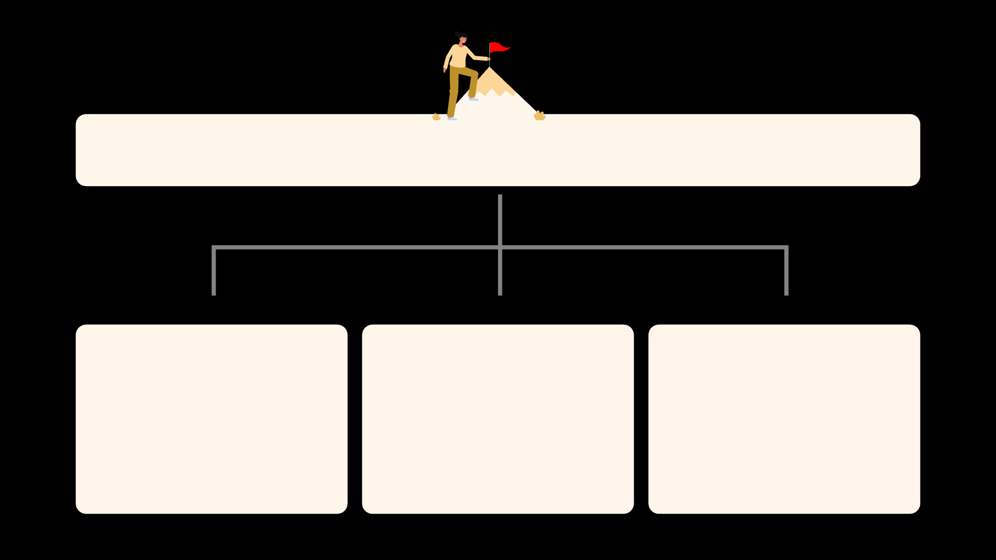
7. Conclusion: Reflections and Future Directions
Benefits for Project Management and beyond
Things to improve
Future Development Directions

Slide 17
08
8. References

Slide 18

8. References
The ABCs of the Critical Path Method from Harvard Business Review
Notebook 2.2- Weighted and directed graphs
Building DAGs / Directed Acyclic Graphs with Python from MungingData
HiLite.me to insert code snippet in the word document
What is the "critical path" when drawing an activity-on-node network diagram that doesn't converge
Customizing NetworkX Graphs by Aren Carpenter

Slide 19
THE END
THANKS
Graph Theory
is so cool ; )

