Slide 1

CSC 450 Real Estate Project
JacksON OLDHAM, Zackary Sprague

Slide 2
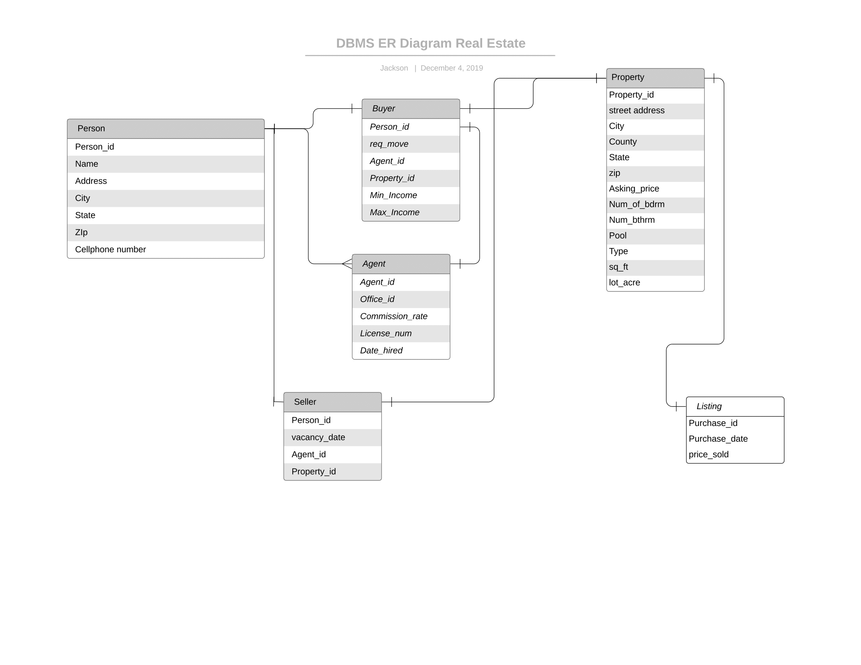
ER DIAGRAM

Slide 3
Queries Needed
1. Find addresses of houses for sale in Campbell County with 4 or more bedrooms and no swimming pool.
2. Show sales trends for various types of properties (condo, single-family house etc.) over the past 3 years, by year, city and buyer income range.
3. For each agent, compute the average selling price of properties they sold in 2019, and the average time the property was on the market.
4. Find the name of the agent(s) who transactioned (as buyer or seller representatives) the most property in the year 2019 by total $ value.
5. Find the top office(s) by unit sales in the past year.
6. In what month(s) do condos sell best?
7. Find the unsold property(ies) that has been on the market for the longest time.

Slide 4
Interfaces
Interfaces for the Buyer, System Admin, and Agent needed to be created.
The Buyer can search for properties through their interface.
The System admin should be able to do anything to the database
Agents can register new properties, change a listings details, and search for properties.

