Slide 1
Self-Introduction
Yichao Zhong

Slide 2
About ME
Yichao Zhong
2021 SJTU ACM Class
APEX Data & Knowledge Management Lab, DRL Group
GPA:
Avg. : 3.72/4.3
Best Semester: 3.84/4.3 (3/33)
Hobbies:
Soccer
Music

Slide 3
What I’ve Done these years
Within Courses
Competitions & Scholarships
Research Experiences

Slide 4
Within Courses
Major Course Projects
Mx* Compiler
A Java-implemented compiler for a Java/C++-like language, Mx*
Total code > 10000 lines
I implemented lots of optimizations and my compiler achieved top performance.
RISC-V CPU
Tomasulo Algorithm Implemented by Verilog
Text-guided Motion Generation
Undergoing
TA Experiences
Programming
Compiler Course Design

Slide 5
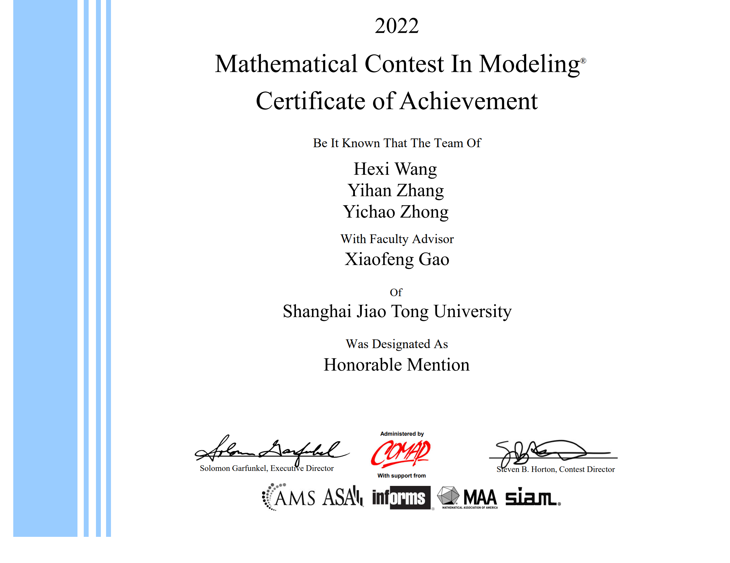
Competitions & Scholarships
I participated in Mathematical Modeling Competitions twice.
COMAP MCM/ICM 2022: Honorable Mention
CUMCM 2022: Second Prize in Shanghai
Scholarships:
Longfor Scholarships (CS only) 2022
Zhiyuan Honor Scholarships 2021,2022,2023

Slide 6
Research Experiences
I entered APEX Lab in August 2023.
Research Topics: RL (Current) & Robotics (Planning)
Publications
Diffusion Models for Reinforcement Learning: A Survey. (released on Arxiv)
Going to be submitted to IJCAI 2024
Recent Works
Retrieval-augmented Diffusion Model-based RL

