Slide 1
Data science HW3
Department of Computer Science
National Tsing Hua University (NTHU)
Hsinchu, Taiwan
Date: April 24th, 2020

Slide 2

Kaggle
A platform of
Machine learning competition
Sharing dataset
https://zh.wikipedia.org/wiki/Kaggle
HW3 will be held on kaggle
https://www.kaggle.com/c/nthuds2020hw3-1/data
Deadline: 2019/5/12 23:59

Slide 3
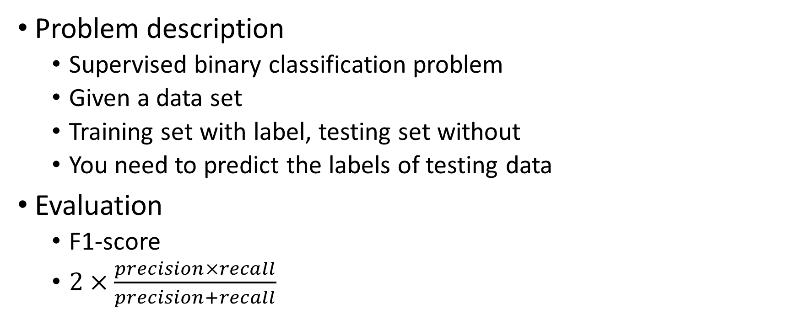
HW3
Problem description
Supervised binary classification problem
Given a data set
Training set with label, testing set without
You need to predict the labels of testing data
Evaluation
F1-score
$2×\frac{precision×recall}{precision+recall}$

Slide 4
Dataset description
The dataset we use is transformed from some real dataset
Numeric feature are nonlinear transformed
10% data become missing value
16 numeric features, 5 nominal features, 1 label
Our label is ‘RainToday’

Slide 5
Baseline method
We provide a simple baseline method for your reference
The steps in baseline are as below
Read training/testing data
Fill missing value with mode/mean
Train a decision tree classifier
Output prediction

Slide 6
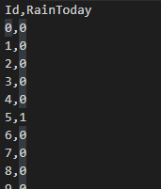
Output format
For each testing instance, there is a unique id
You need to submit you answer to kaggle with the following format 第一行請記得也要output
Id,RainToday
Id1, RainToday1
Id2, RainToday2
…

Slide 7
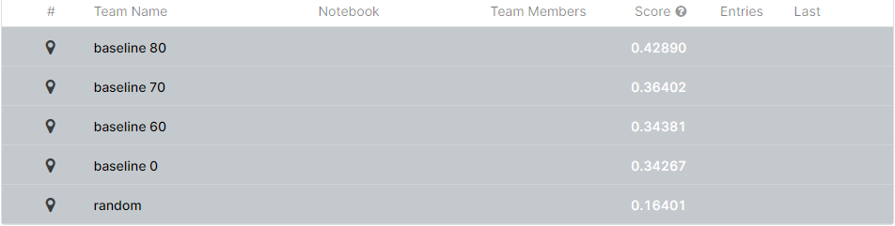
Evaluation
There are two leaderboards in kaggle
Public: can be seen during competition, for reference
Private: used to evaluate, can be seen after competition

Slide 8
Evaluation
You will get 60 points, if your private F1-score is between baseline 60 and baseline 70
You will get 75 points, if your private F1-score is between baseline 70 and baseline 80
For those have scores better than baseline 80
TOP 10% (<=10%): 100
10% ~ 30% (<=30%): 92
30% ~ 60% (<=60%): 86
60% ~ 80% (<=80%): 83
Other: 80

Slide 9
Baseline score in public and private
 | Public | Private
Baseline 80 | 0.38559 | 0.41335
Baseline 70 | 0.33626 | 0.34511
Baseline 60 | 0.28667 | 0.30352
Baseline 0 | 0.26903 | 0.29067

Slide 10
Hints
You can try more techniques for better performance
Feature selection
Dimension reduction (PCA, TSNE)
Try different models
Data augmentation
…
We use private leaderboard as the final score
Use public score to choose your model is dangerous
It’s better to perform validation

Slide 11
Packages you may use
Scikit-learn
https://scikit-learn.org/stable/index.html
Pandas
https://pandas.pydata.org/pandas-docs/stable/
Imbalance learn (for over sampling and down sampling)
https://imbalanced-learn.readthedocs.io/en/stable/

Slide 12
Other rules
You can submit 15 times per day
You can choose 4 predictions for final scoring

