Slide 1





From MVP to first customer
January/February 2023

Slide 2
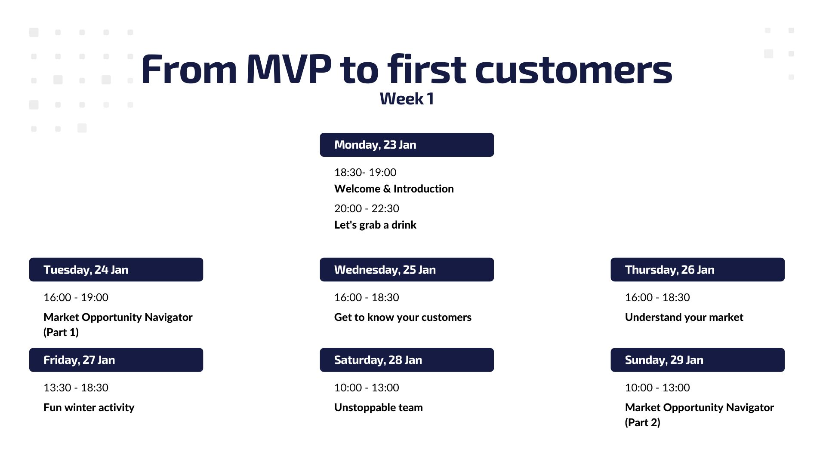


Slide 3
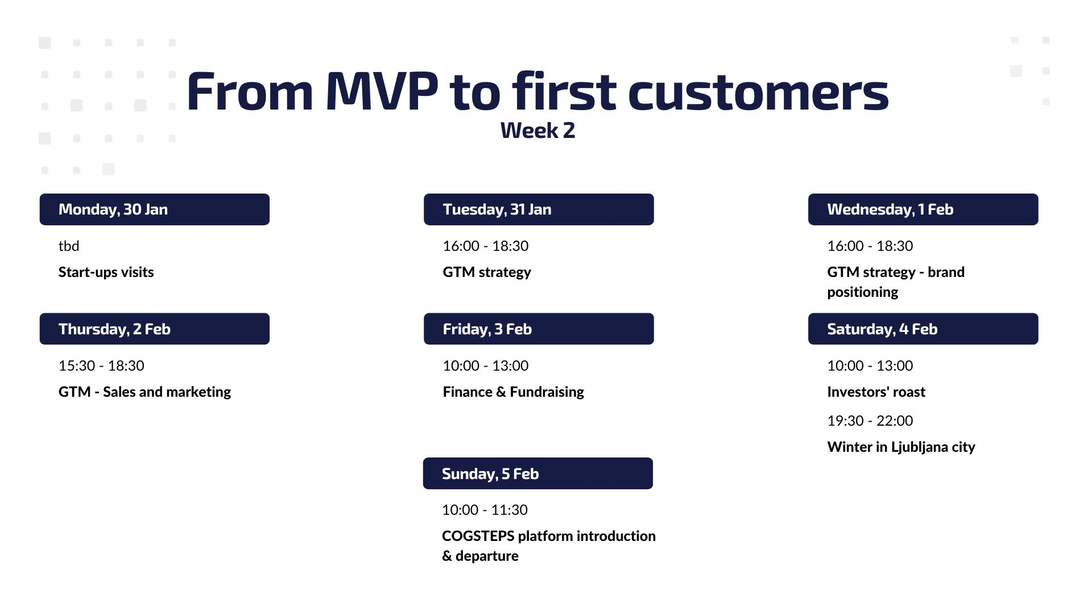

Slide 4
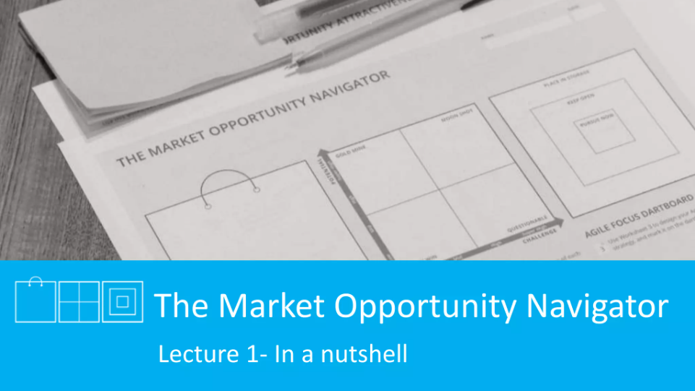

Slide 5
WHO ARE YOU?
IDEA GENERATION
SCALE-UP

Slide 6
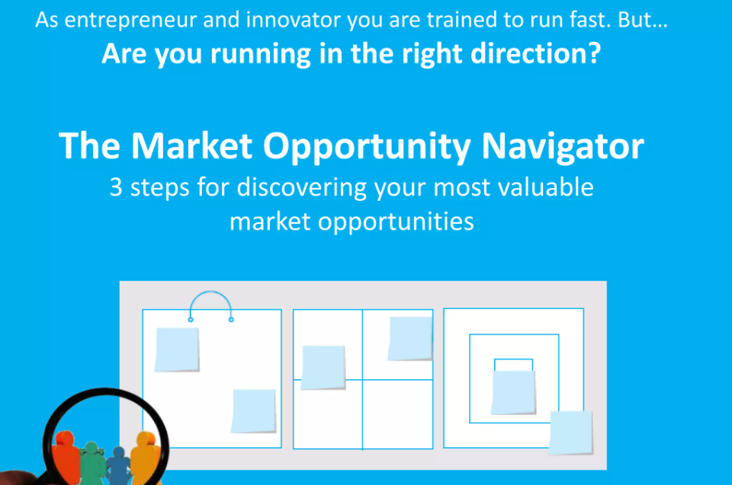

Slide 7
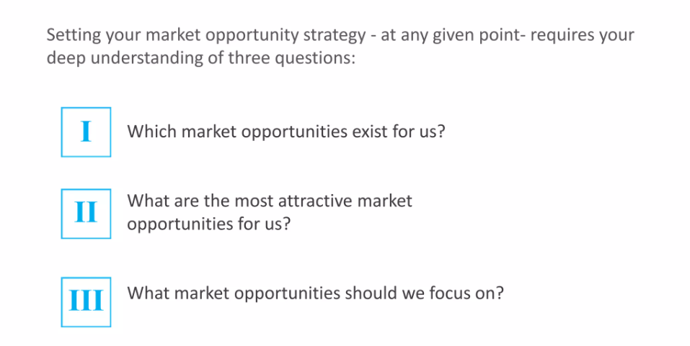
ARE YOU RUNNING IN THE RIGHT DIRECTION?

Slide 8
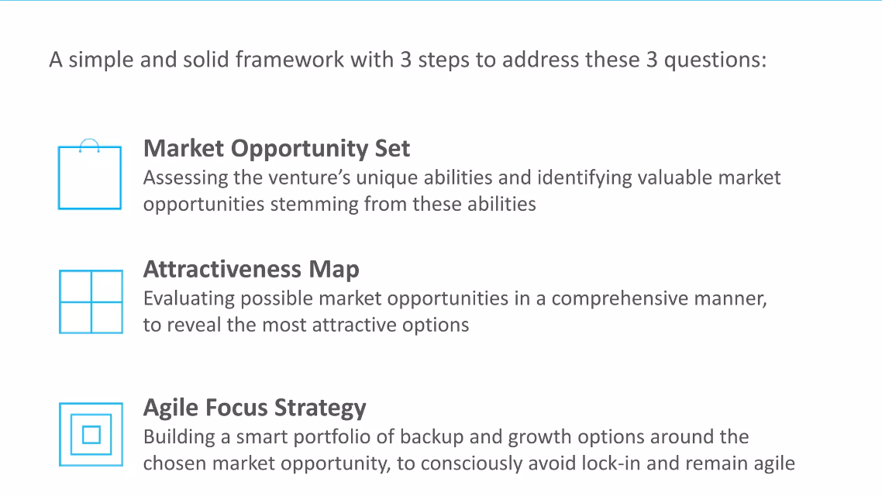
THE MARKET OPPORTUNITY NAVIGATOR

Slide 9
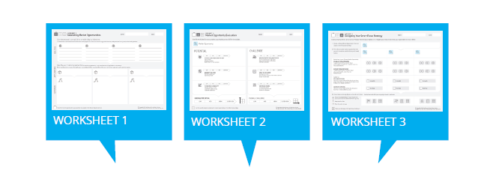
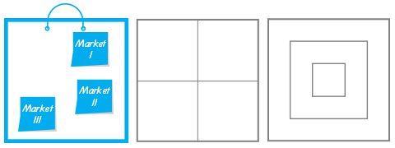
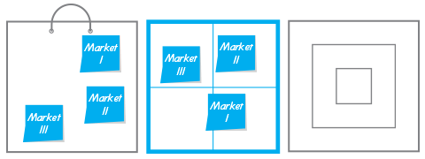
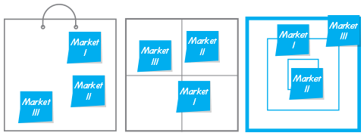
WORKING WITH THE MARKET OPPORTUNITY NAVIGATOR
MARKET OPPORTUNITY SET
ATTRACTIVENESS MAP
AGILE FOCUS DARTBOARD
Copyright 2016 by Sharon Tal and Marc Gruber. All rights reserved. This material may not be reproduced

Slide 10
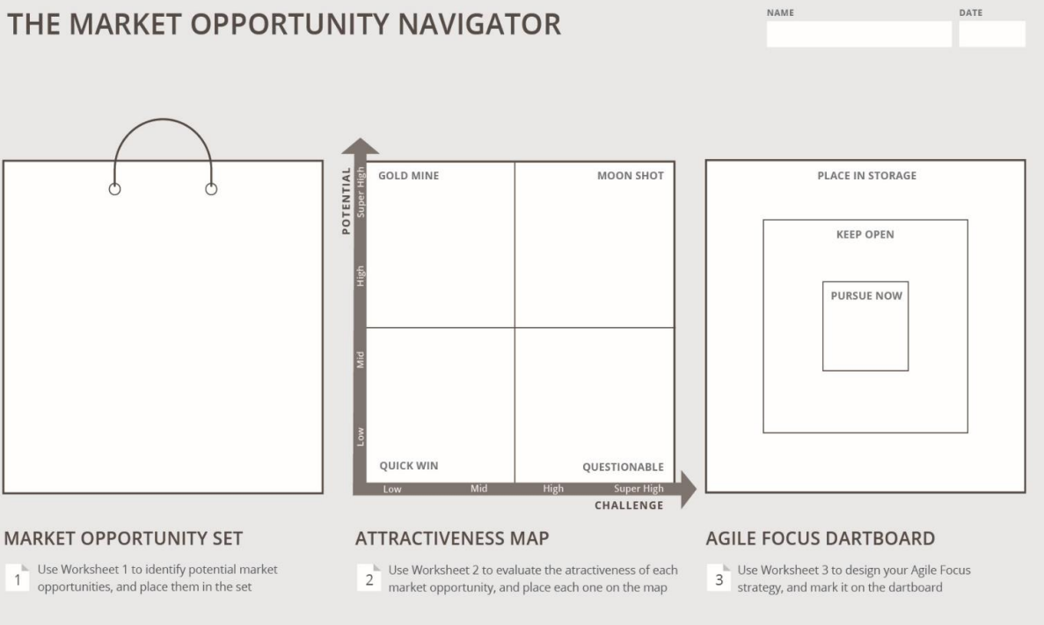

Slide 11
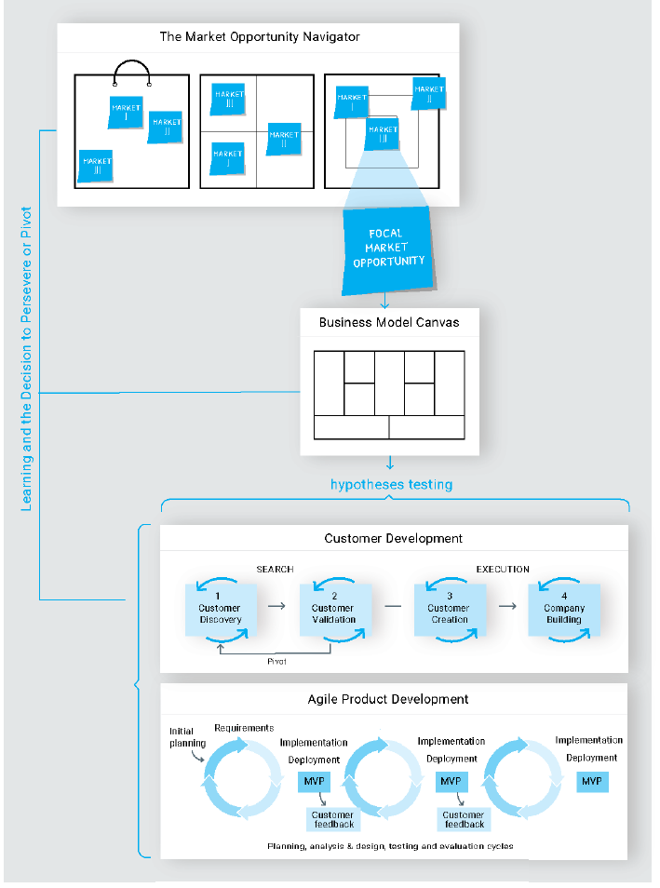

Slide 12
WORKING WITH THE MARKET OPPORTUNITY NAVIGATOR
MARKET OPPORTUNITY SET
ATTRACTIVENESS MAP
AGILE FOCUS DARTBOARD
Copyright 2016 by Sharon Tal and Marc Gruber. All rights reserved. This material may not be reproduced

Slide 13

STEP 1: MARKET OPPORTUNITY SET
DE-LINKING PROCESS
Describe your unique abilities or core technological elements
Elements should be independent of their application in a specific product!

Slide 14
STEP 1: MARKET OPPORTUNITY SET
DE-LINKING PROCESS
Think about the main building blocks of your competences, such as:
Core technology elements
Important know-how about specific process
A rare resource that you own
A special capability
etc.
Describe their main properties as well as the functions they can perform.

Slide 15
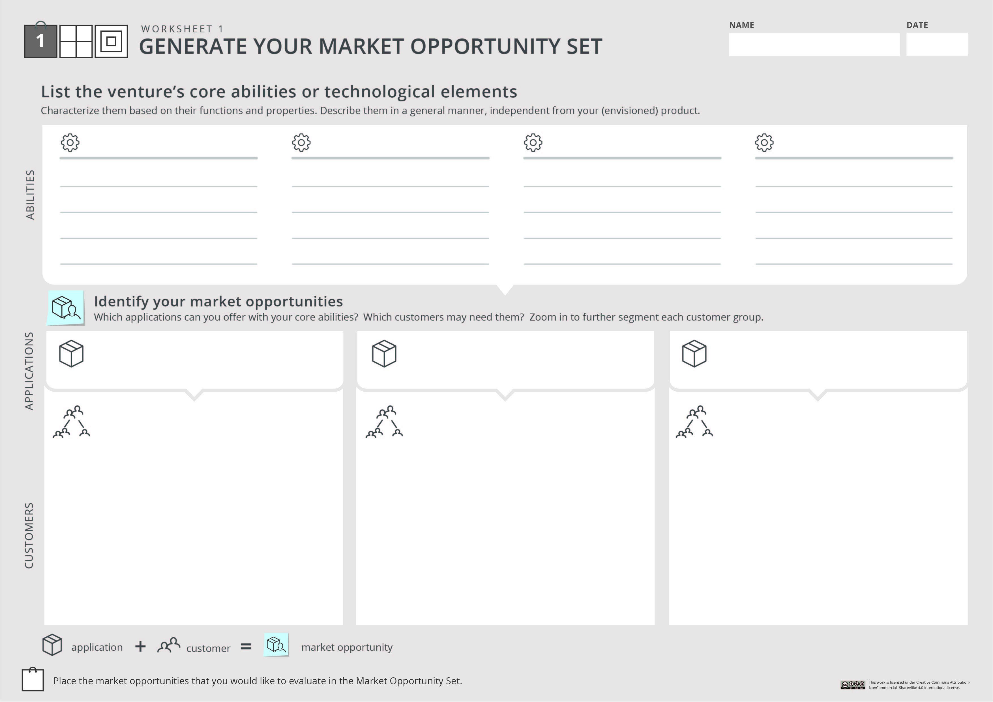
Your project/ startup
Unique ability #1
Unique ability #2
Unique ability #3
Unique ability #4
Functions and properties
Functions and properties
Functions and properties
Functions and properties
Application #1
Application #2
Application #3
Customer segment
Customer segment
Customer segment
Sub segment
Sub segment
….
Sub segment
Sub segment
Sub segment
Sub segment
Customer segment
Sub segment
Sub segment

Slide 16
STEP 2: MARKET OPPORTUNITY SET
RE-LINKING PROCESS
Search for different possible applications that these unique abilities can establish, and who might need this different applications

Slide 17
STEP 2: MARKET OPPORTUNITY SET
RE-LINKING PROCESS
An APLICATION means a specific usage or function created with your core abilities.
As you uncover potential applications, you should also think who might have the need for them → possible sets of CUSTOMERS.

Slide 18
Your project/ startup
Unique ability #1
Unique ability #2
Unique ability #3
Unique ability #4
Functions and properties
Functions and properties
Functions and properties
Functions and properties
Application #1
Application #2
Application #3
Customer segment
Customer segment
Customer segment
Sub segment
Sub segment
….
Sub segment
Sub segment
Sub segment
Sub segment
Customer segment
Sub segment
Sub segment

Slide 19
STEP 3: INITIAL SCREENING OF YOUR OPTIONS
SELECTION OF MOST PROMISSING OPPORTUNITIES
Does you customer need exist?
Can we really satisfy the customer need, and better than existing solutions?
Are there severe restrictions that would hinder us from executing on this market opportunity?
Will this opportunity be in conflict with any of our core values?
etc.

Slide 20
Your project/ startup
Unique ability #1
Unique ability #2
Unique ability #3
Unique ability #4
Functions and properties
Functions and properties
Functions and properties
Functions and properties
Application #1
Application #2
Application #3
Customer segment
Customer segment
Customer segment
Sub segment
Sub segment
….
Sub segment
Sub segment
Sub segment
Sub segment
Customer segment
Sub segment
Sub segment

Slide 21
WORKING WITH THE MARKET OPPORTUNITY NAVIGATOR
MARKET OPPORTUNITY SET
ATTRACTIVENESS MAP
AGILE FOCUS DARTBOARD
Copyright 2016 by Sharon Tal and Marc Gruber. All rights reserved. This material may not be reproduced

Slide 22

EVALUATING YOUR MARKET OPPORTUNITIES
Market opportunities differ on their level of POTENTIAL
and
CHALLENGE.

Slide 23
EVALUATING YOUR MARKET OPPORTUNITIES
POTENTIAL
How big is this opportunity?
Is it at all worth pursuing?
And if so – how much value can we create if we choose this path?

Slide 24
EVALUATING YOUR MARKET OPPORTUNITIES
CHALLENGE
Which obstacles lie ahead of us if we decide to pursue this option?
What are our main challenges and risks?
How difficult will it be to overcome them and conquer this opportunity?

Slide 25
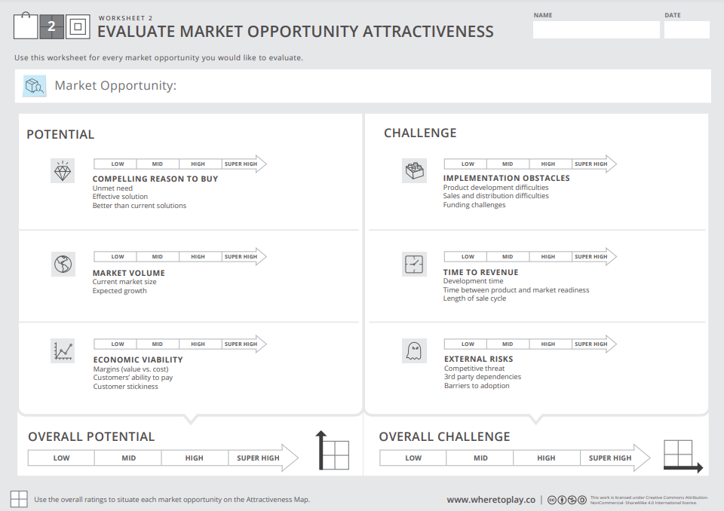

Slide 26
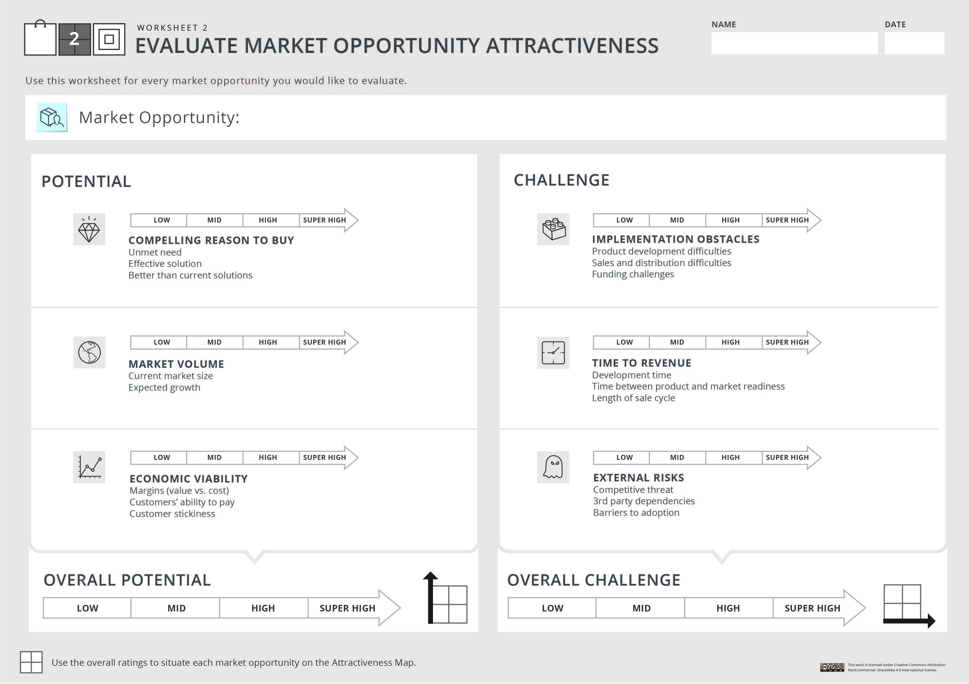
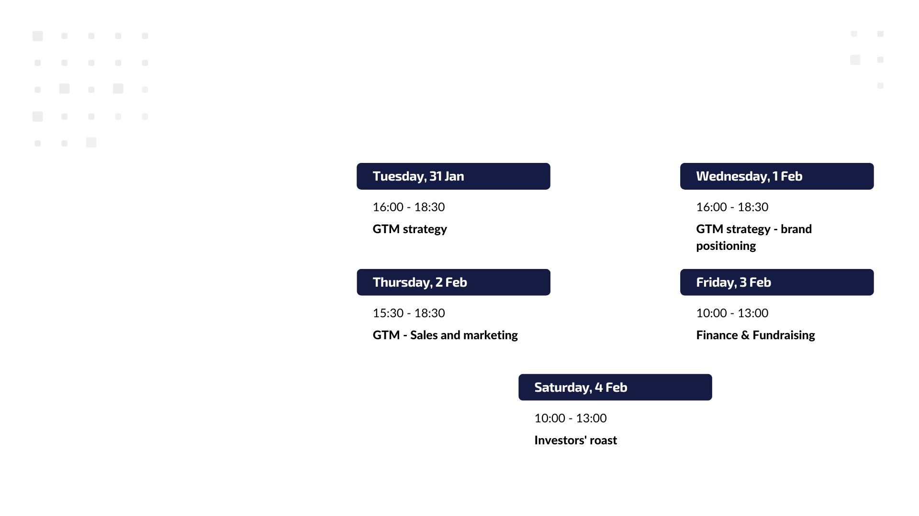

Slide 27
POTENTIAL FOR VALUE CREATION
#1 COMPELLING REASON TO BUY
Will someone really want our offer and be willing to pay for it?
Is there a real unmet need?
Can we provide an effective solution to this need?
Can we address it better than current solutions?
Desk research is not enough!
GET OUT OF THE BUILING AND TALK TO PEOPLE!

Slide 28
POTENTIAL FOR VALUE CREATION
#2 MARKET VOLUME
How big is this market, now and in the near future?
What is the size of the current market?
How much is it expected to grow over time?

Slide 29
POTENTIAL FOR VALUE CREATION
#3 ECONOMIC VIABILITY
Is it worthwhile from a business perspective to pursue this market?
Do you have a sizable margins?
Are the customers well-funded enough to pay the price?
How sticky will customers be?

Slide 30
CHALLENGE IN CAPTURING VALUE
#1 IMPLEMENTATION OBSTACLES
How difficult will it be for you to create and deliver your offer?
How difficult will it be for you to develop the product?
How difficult will it be for you to access the market?
How challenging will it be for you to raise funding for this option?

Slide 31
CHALLENGE IN CAPTURING VALUE
#1 IMPLEMENTATION OBSTACLES
How difficult will it be for you to create and deliver your offer?
How difficult will it be for you to develop the product?
How difficult will it be for you to access the market?
How challenging will it be for sou to raise funding for this option?

Slide 32
CHALLENGE IN CAPTURING VALUE
#2 TIME TO REVENUE
How long will it take until you can generate cash flow through sales?
What is estimated time for development?
Will we need to wait until the market is ready for our offer?
How long is the sale cycle expected to be?

Slide 33
CHALLENGE IN CAPTURING VALUE
#3 EXTERNAL RISKS
What obstacles in your business environment can stand in your way?
How threatend are you by competition?
How dependent are you on other companies or players?
How exposed are you to adoption barriers?

Slide 35
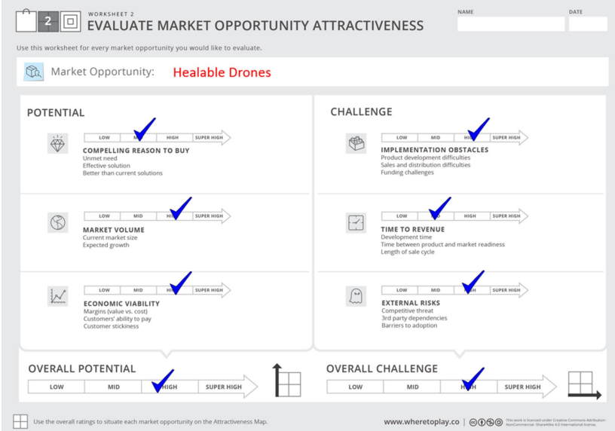


Slide 36
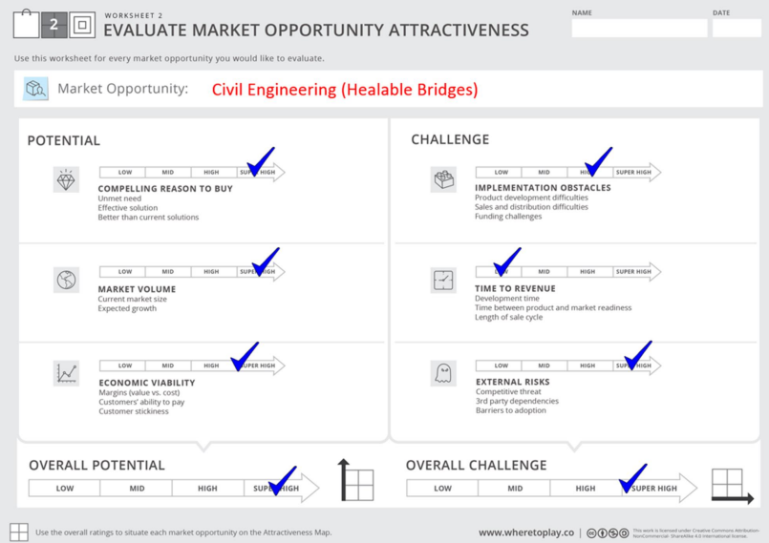

Slide 37
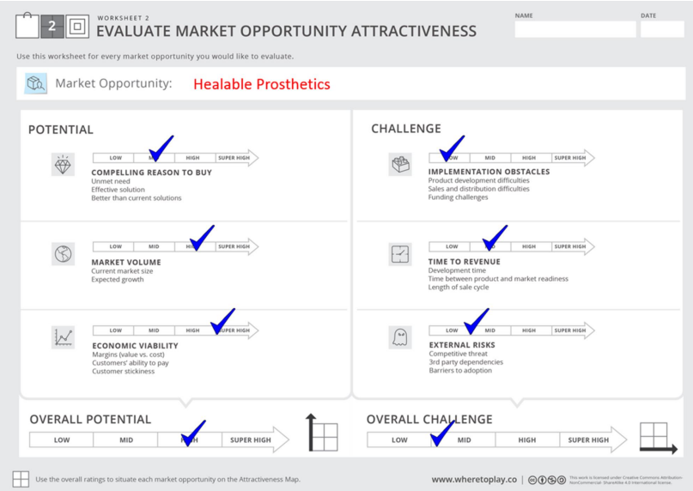

Slide 38
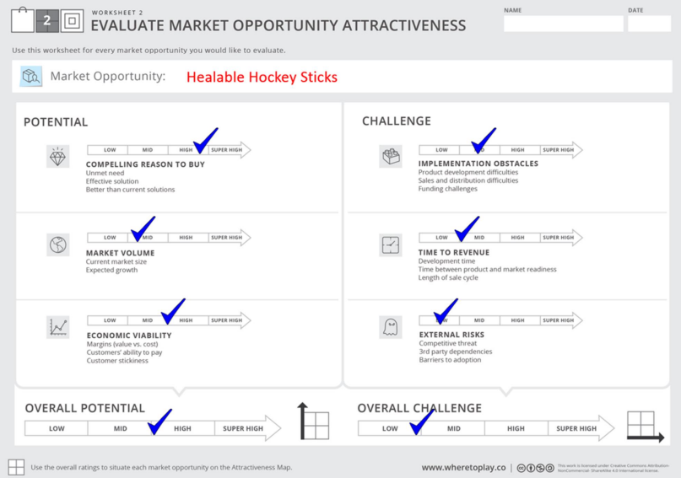

Slide 39
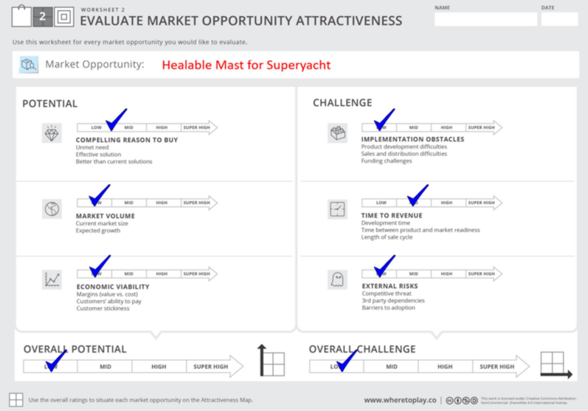

Slide 40
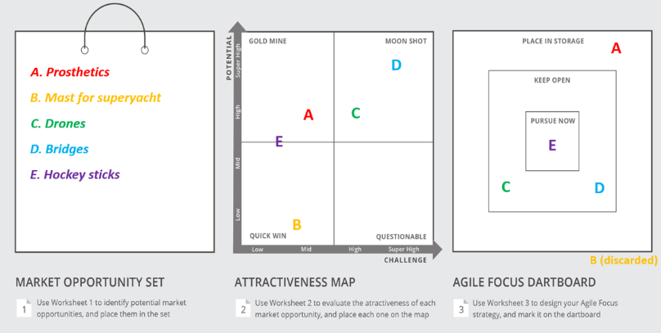

Slide 41

ANALYSING THE ATTRACTIVENESS MAP
GOLD MINE
Market opportunities with relatively high potential and low challenge.
They are ideally located but relatively rare.
A gold-mine option is usually a result of identifying a significant unmet need–one that no one has addressed before. Or, you may possess unique know-how to overcome a challenging hurdle, one that others simply cannot overcome.
If you do have a gold-mine opportunity, it has the features that would make it your primary market opportunity.

Slide 42

ANALYSING THE ATTRACTIVENESS MAP
MOON SHOT
Market opportunities with relatively high potential but also high challenge.
Truly innovative offers are usually located in this quarter of the Attractiveness Map, bearing high risk and high returns simultaneously.
Some investors would argue that these are the most interesting options to invest in, if you believe that the team is qualified to overcome the major challenges that it entails.
Hence, moon-shot options may fit as your primary market opportunity, or as a long-term growth option.

Slide 43

ANALYSING THE ATTRACTIVENESS MAP
QUICK WIN
Market opportunities with relatively low potential and low challenge.
In the risk-return analogy, they represent the low risk - low return alternatives. They offer limited value creation potential that is relatively safe.
These options may offer a great jump-start, and may be combined with other opportunities to enhance the long term potential of the firm.

Slide 44

ANALYSING THE ATTRACTIVENESS MAP
QUESTIONABLE
Market opportunities with relatively low potential and high challenge.
While you will likely be better off finding a target market opportunity that is located in a different quarter, keep these questionable opportunities in mind, as conditions may change over time and questionable options may become more attractive.
Many venture projects fail because they pursue a questionable opportunity, often without even being aware of that.

Slide 45
WORKING WITH THE MARKET OPPORTUNITY NAVIGATOR
MARKET OPPORTUNITY SET
ATTRACTIVENESS MAP
AGILE FOCUS DARTBOARD
Copyright 2016 by Sharon Tal and Marc Gruber. All rights reserved. This material may not be reproduced

Slide 46
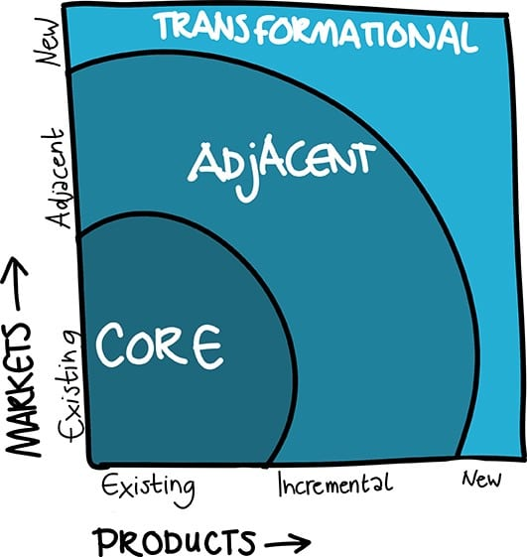
Key benefit: Design a balanced portfolio
Source: Nagji, B., & Tuff, G. (2012). Managing your innovation portfolio. HBR

Slide 47
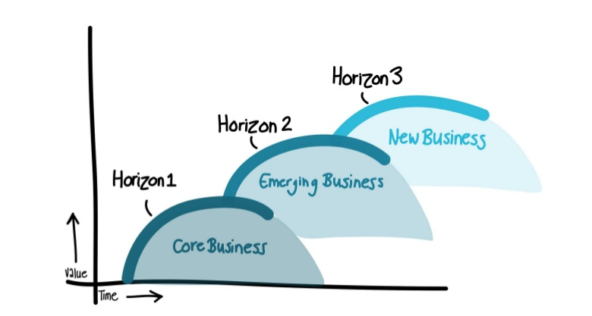
Constantly nourish all 3 Horizons
Source: Bahgai, Coley & White, 1999: The Alchemy of Growth

Slide 48
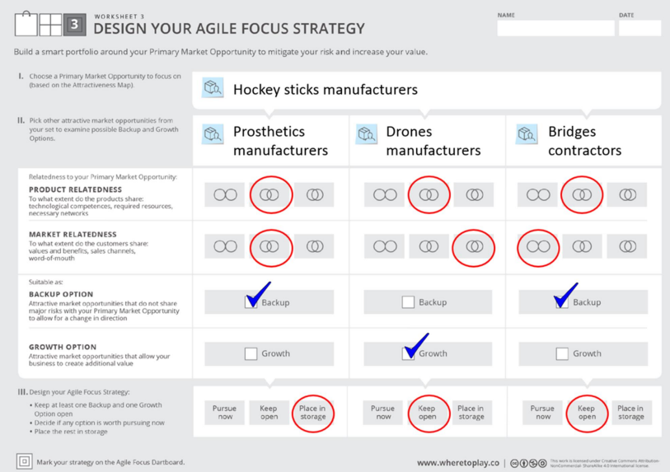

Slide 49
Designing your smart portfolio
A Backup Option
allows you to change direction over time, if necessary.
A Growth Option
allows you to create additional value over time.
It answers the question:
If we are not successful - what shall we do next?
It answers the question:
If we are successful - what shall we do next?
A related opportunity that does not share major risks with the primary market
An attractive opportunity that is tightly related to your primary market

Slide 51

Key benefit: Focus on the most promising opportunity

Slide 52

“The hardest thing when you think about focusing. You think focusing is about saying yes.
No, focusing is about saying no”
Steve Jobs

Slide 53

…and don’t get trapped
Having foresight on your backup and growth options influences the way you:
Develop your technology
File your patents
Recruit your employees
Choose your stakeholders
Build your company culture
Pick your brand name
Design your marketing materials

Slide 54
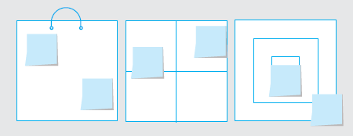
The Market Opportunity Navigator
Discover your most valuable market opportunities
and find out where to play

Slide 55

VALIDATION OF YOUR MARKET OPPORTUNITIES
„Assumption is the mother of all f*ck ups.“
VALIDATE YOUR ASSUMPTIONS – TALK TO PEOPLE!
Then go back and re-do your MON ☺

