Slide 1
ABM for PHDG

Slide 2
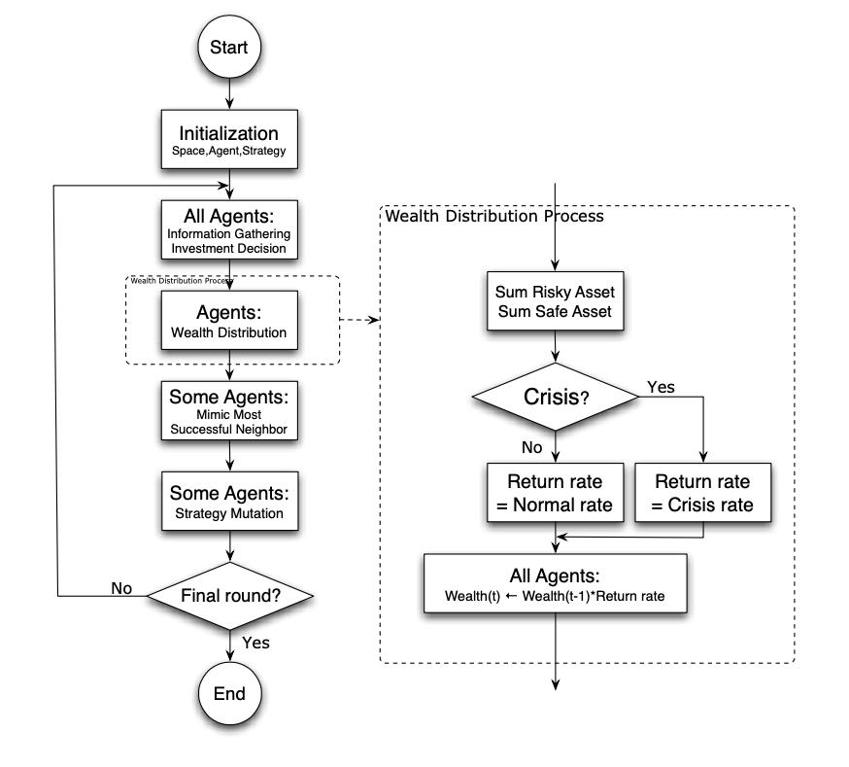
ABM: Flow Chart

