Slide 1
Networking Smartphones for Disaster Recovery
Zongqing Lu, Guohong Cao and Thomas La Porta
Dept. of Computer Science and Engineering
The Pennsylvania State University
Notes:
….......................

Slide 2
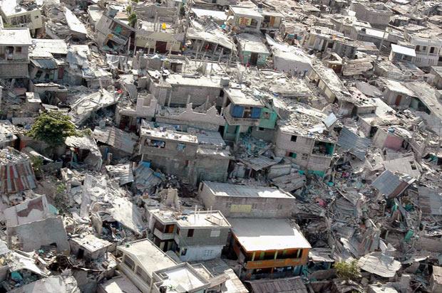
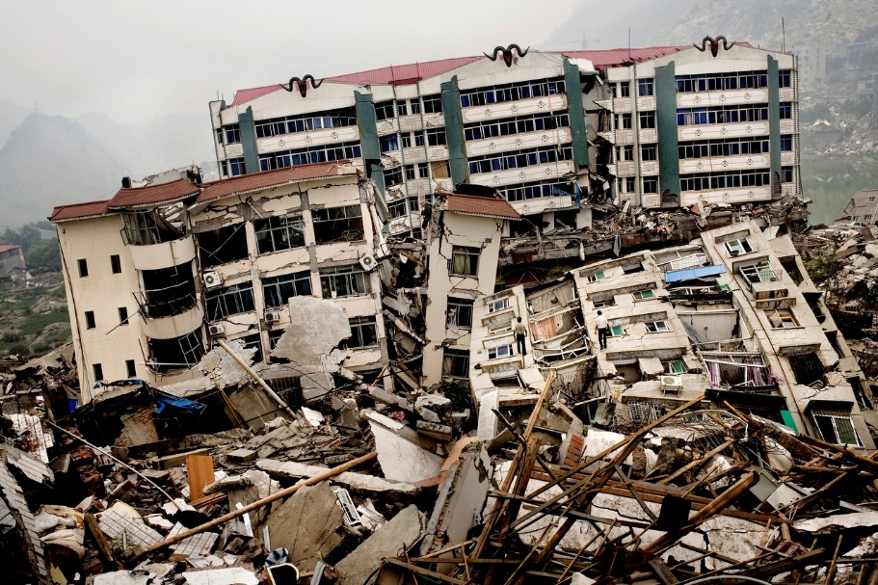
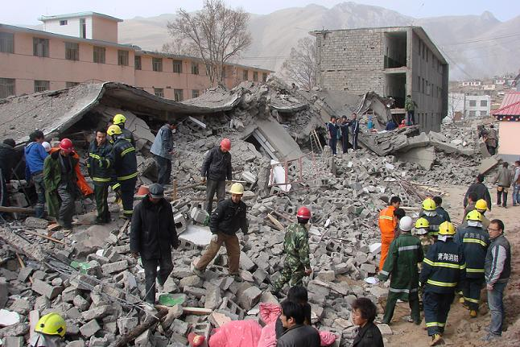
Disasters
B
Notes:
Disasters, such as earthquakes, topple countless homes and kill thousands of people. These are pictures taken after disasters occurred. Look at these pictures, the rescue operation is extremely hard.

Slide 3
Motivation
Power failures and fallen cellular towers
Leave the affected area cut off from the outside and hinder rescue operations
Helpful services in disaster recovery are those that are used daily by everyone*
Learned from the 2011 Great East Japan earthquake
What can be used to help rescue operations?
Smartphones
“TeamPhone”
* A. Fujihara and H. Miwa. Disaster evacuation guidance using opportunistic communication: The potential for opportunity-based service. In Big Data and Internet of Things: A Roadmap for Smart Environments, pages 425–446. 2014.
Notes:
1. Power failures and fallen cellular towers caused by disasters further leave the affected area cut off from the outside and hinder rescue operations.
2. As learned from the 2011 Great East Japan earthquake, the only helpful services in disaster recovery are those that are used daily by everyone. To provide communications in disaster recovery, smartphones, equipped with both cellular and short-range radios (e.g., WiFi, Bluetooth), are the most promising communication tools.

Slide 4
Challenges
Limited communications provided by vehicle carried cellular towers
Frequently changed topology of the network formed by smartphones
Energy-efficiently establish communications between trapped survivors and rescue workers
Notes:
Mobile cellular towers can be deployed fro communications. However, the coverage of the vehicle-carried towers is limited. How to explore smartphones, e.g., using short-range radios, for communications outside the covered area is one of the challenges.
Moreover, the network formed by smartphones is not stable, the topology changes frequently. So, how to handle the dynamics of network is another challenge.
Since rescue operation may last for days, it has to be energy-efficient for trapped survivors to discover nearby rescue workers.

Slide 5
Outline
Network Scenario
TeamPhone Design
TeamPhone Implementation
Evaluations
Summary

Slide 6
Network Scenario

Slide 7
TeamPhone Design
Overview
Messaging system
Self-rescue system

Slide 8
Messaging System
How messages are handled by messaging system
Cellular connections
Within areas covered by mobile cellular tower
Ad hoc communications
Ad hoc network formed by rescue workers and survivors
Smartphones have cellular connection act as gateways
Opportunistic contacts
When destinations cannot be reached by above two.
Static routing
Flood routing

Slide 9
Self-rescue System
Discover rescue crews and sending out emergency message
Rescue operations may last for days
Energy-efficient wake-up schedule
Self-rescue group
Cooperative wake-up

Slide 10
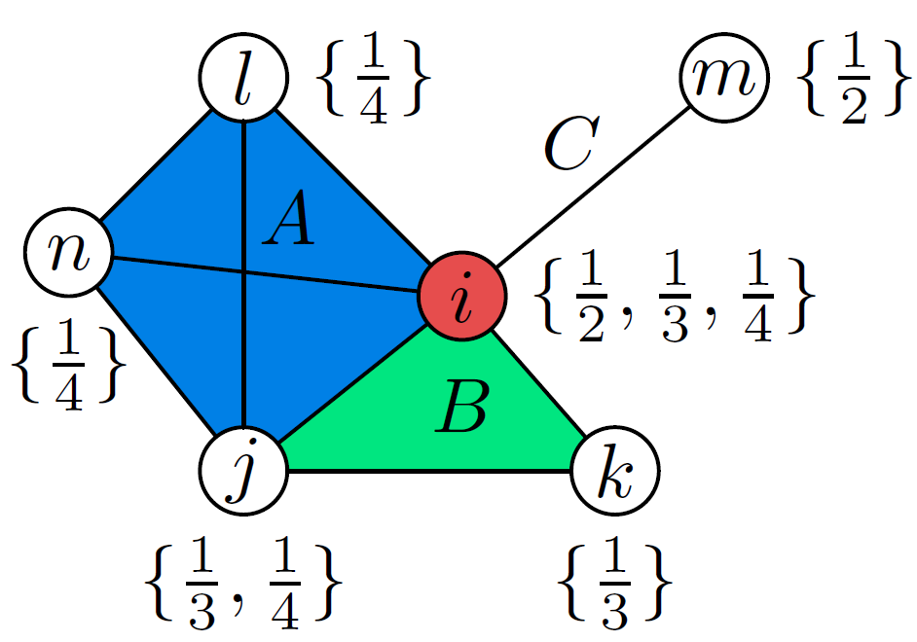
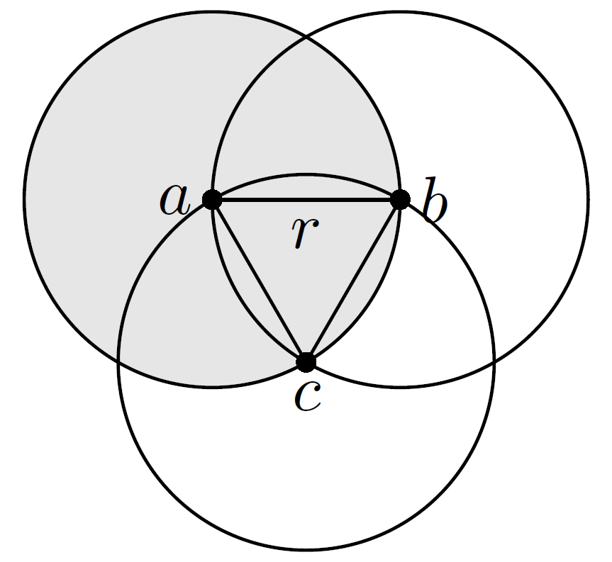
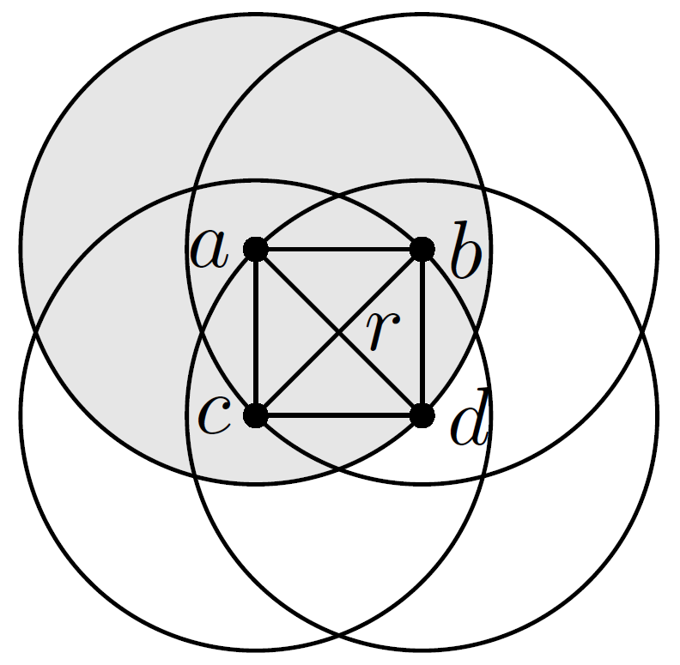
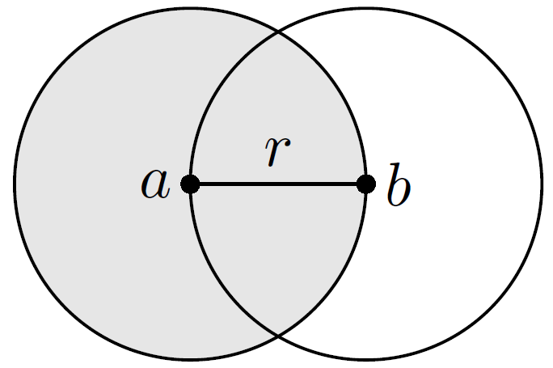
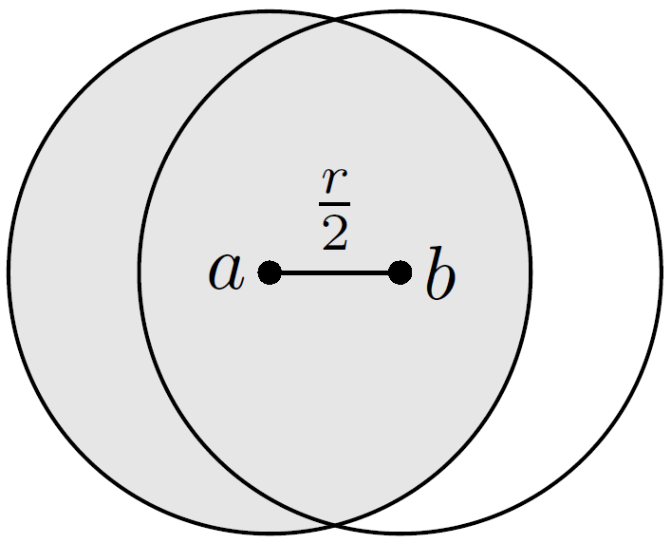
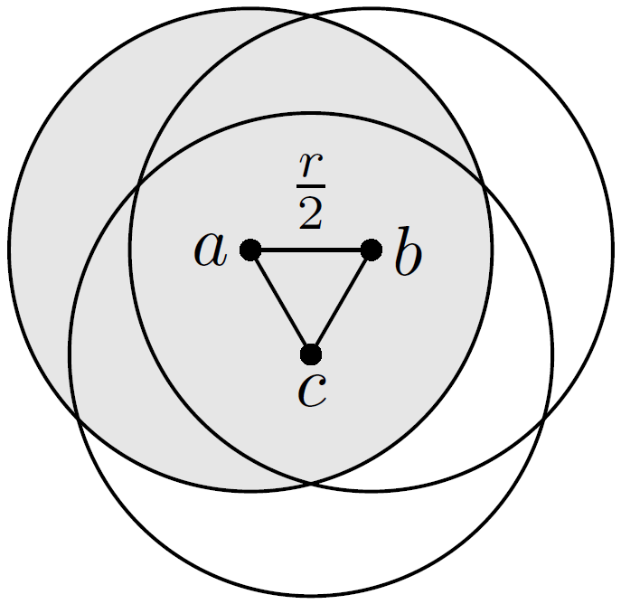
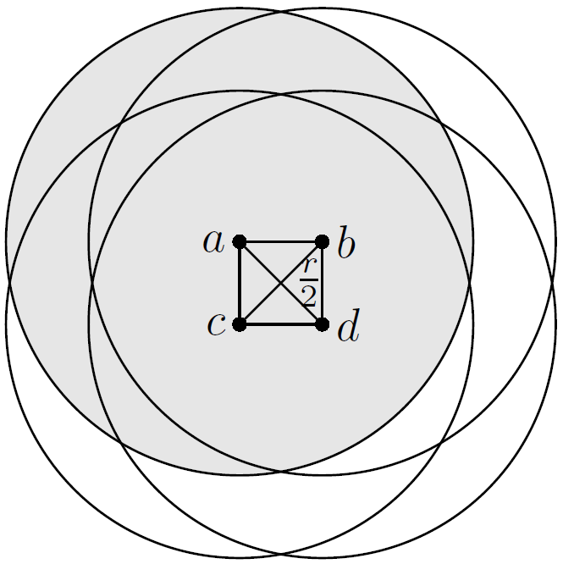
Grouping and Wake-up Scheduling
One-hop network
Consisting of cliques
Within a clique, smartphones wake up alternatively
62.2%
48.8%
48.9%
62.2%
48.8%
48.9%
r transmission radius
Notes:
In a clique there exits an edge between every two nodes, and hence any node in a clique can cover all other nodes. Therefore, in a clique nodes are close to each other, and the area covered by one node can be a large proportion of the area covered by all nodes in the clique.

Slide 11
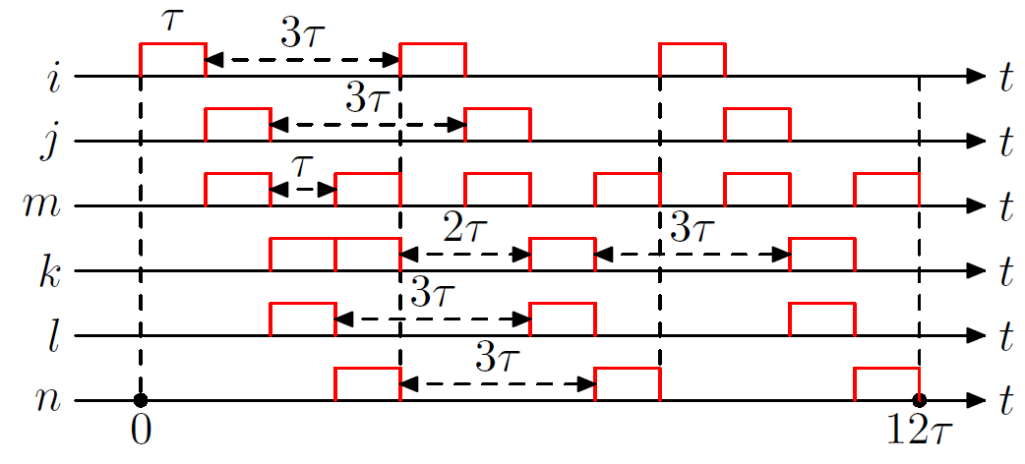
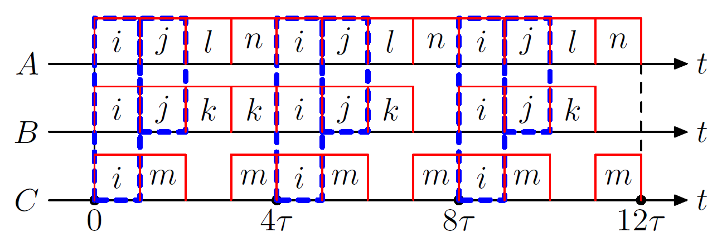
Wake-up Scheduling
3
2
4
1
2
3
Wake-up frequency for each node must be the lowest wake-up fraction.
There is no more than one wake-up node at any time in a clique.
Notes:
The schedule vacancy only slightly affects the overall coverage. But such wake-up scheduling can greatly save energy.

Slide 12
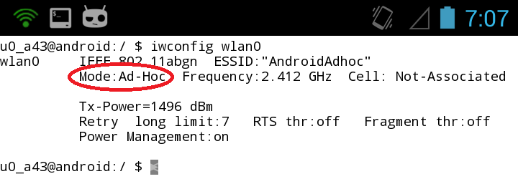
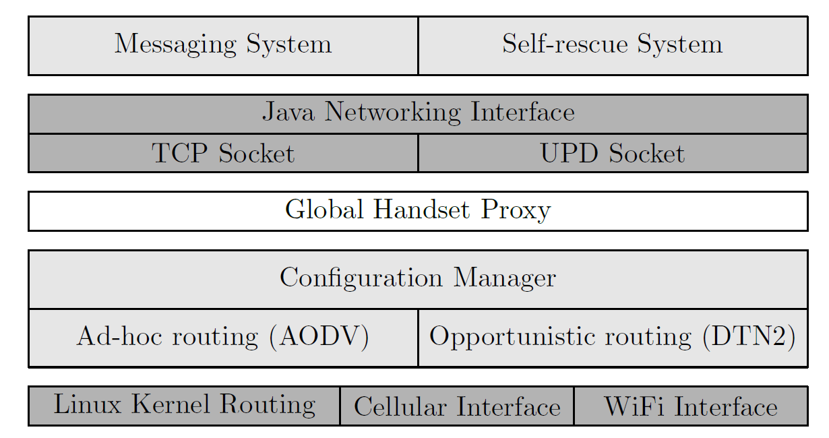
Implementation-interface
Network interfaces
Cellular
WiFi (in ad-hoc mode)

Slide 13
Implementation-routing
AODV (WiFi and cellular interfaces)
A loadable kernel module
capture data packets using netfilter with POSTROUTING,
instruct user-space daemon to issue routing requests,
encapsulate and decapsulate packet when sending over a gateway
A user-space daemon
maintain the kernel routing table
control neighbor discovery, routing request and routing reply
DTN2 (WiFi interface)
A application layer routing, a user-space daemon
Convergence layer, service discovery

Slide 14
Implementation-application
Messaging system, messages are sent in three ways by:
AODV (including through gateways)
AODV-Gateway-Server-Gateway-AODV
DTN2 in static routing mode and flood routing mode
Self-rescue system
Running in background
Scheduling wake-ups using iwconfig
When wake-up, using AODV to detect messaging nodes and send out emergence messages

Slide 15
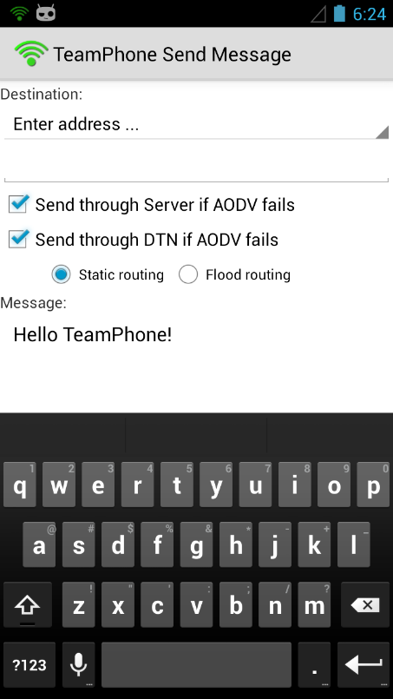
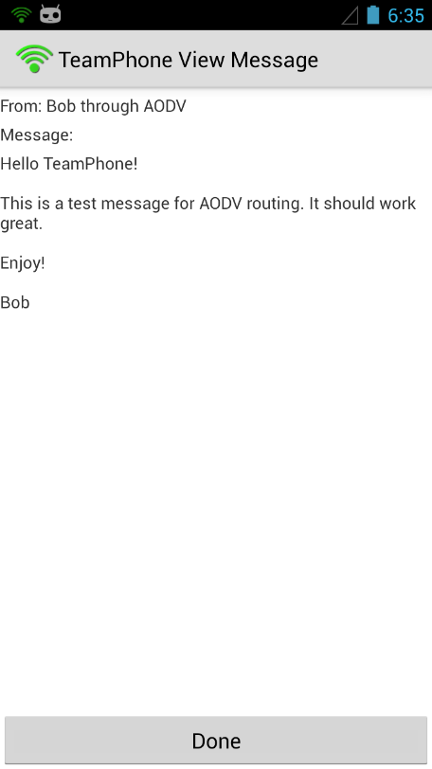
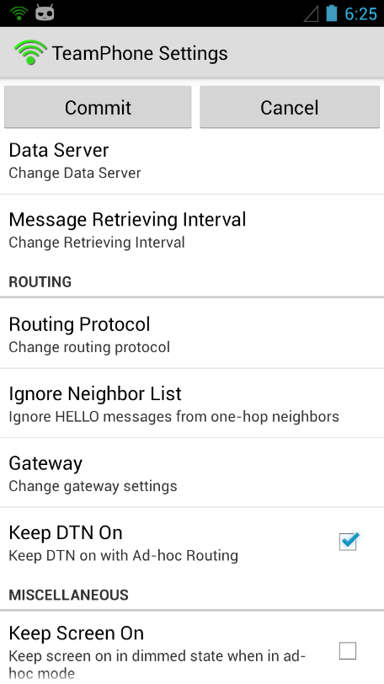
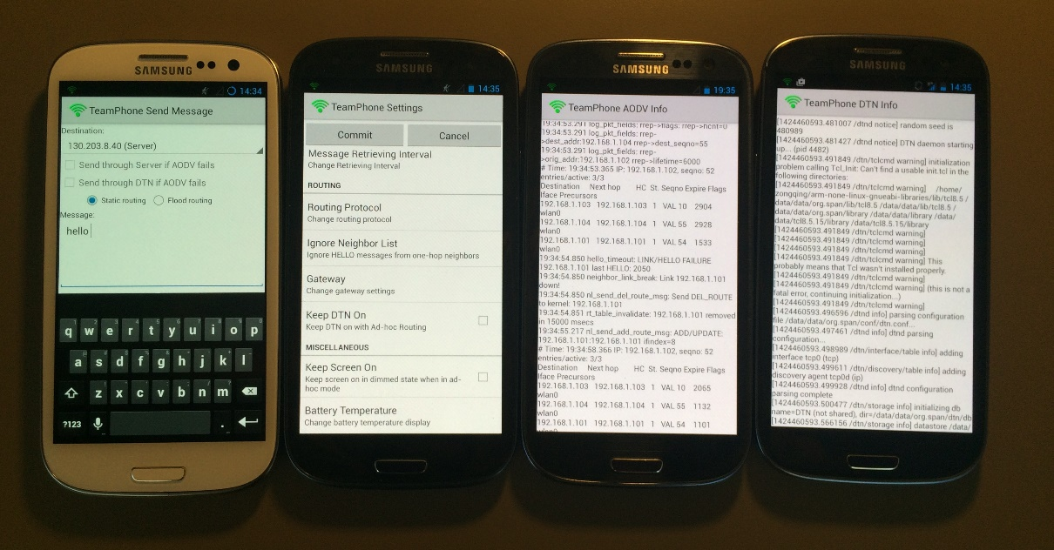
Implementation-application

Slide 16
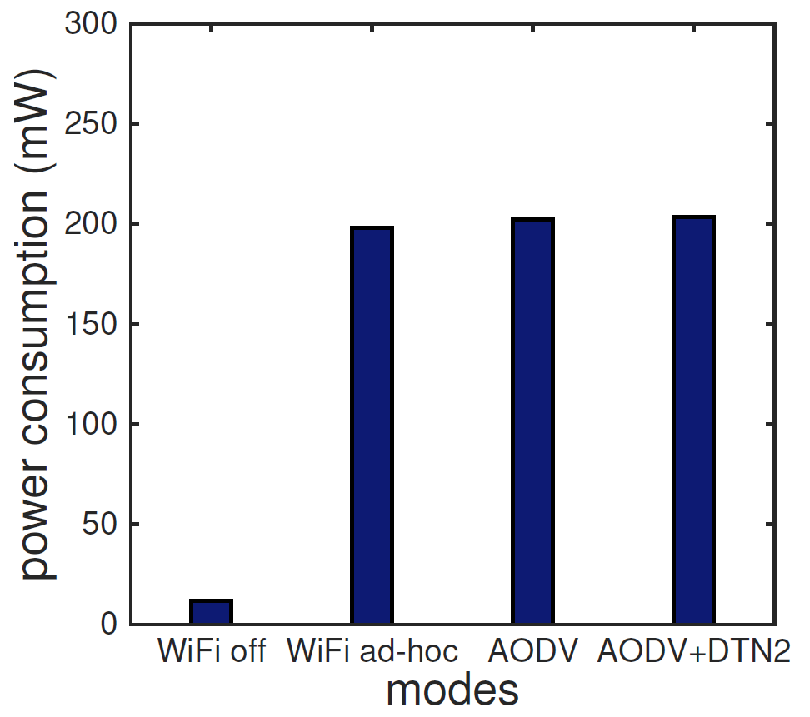
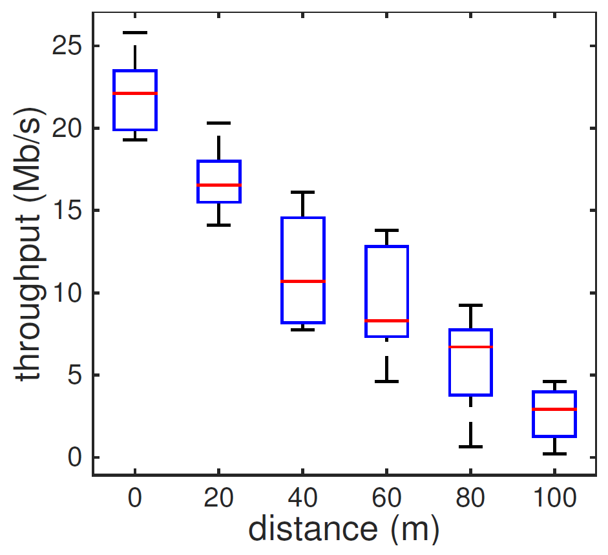
Evaluations
Messaging system

Slide 17
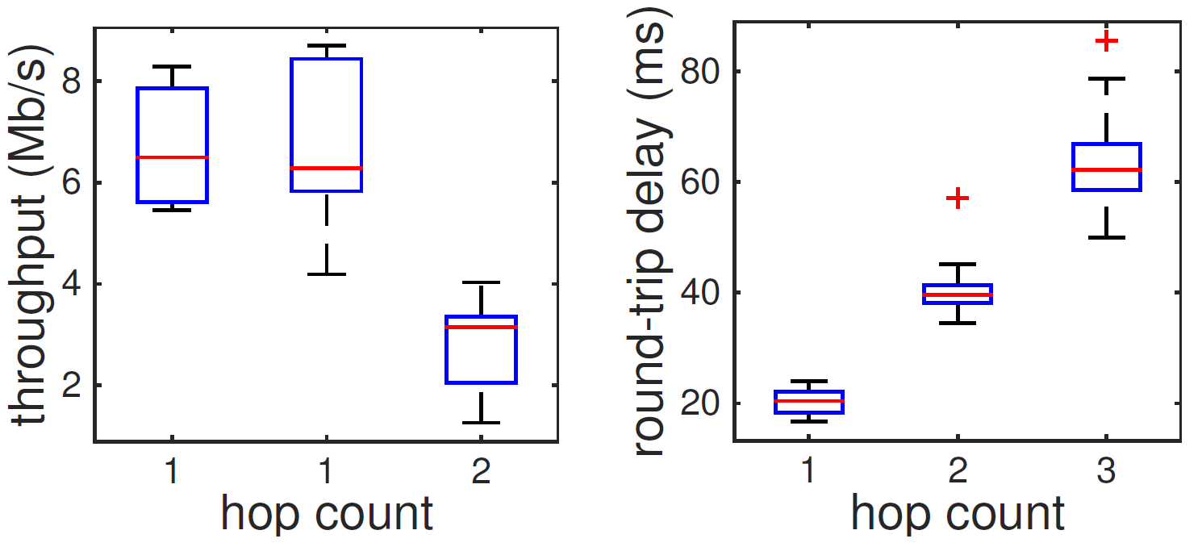
Evaluations (cont’d)
Messaging system

Slide 18
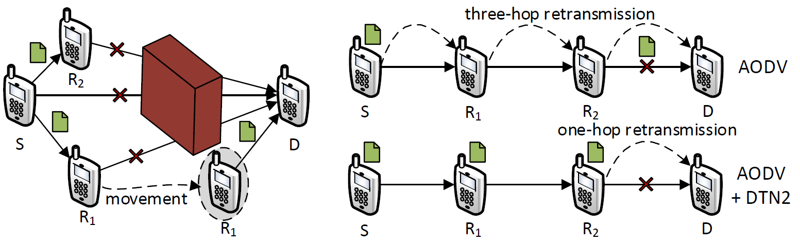
Evaluations (cont’d)
Messaging system

Slide 19
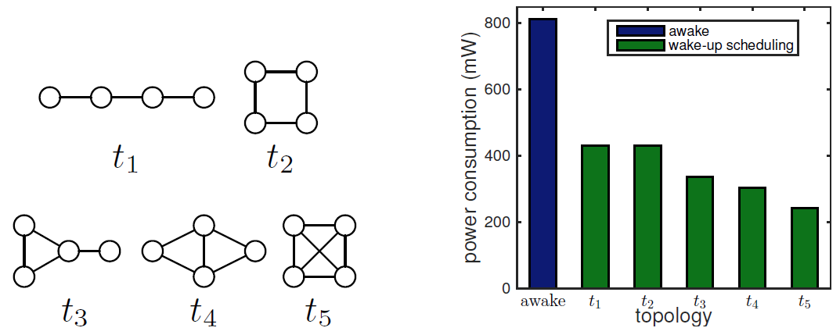
Evaluations (cont’d)
Self-rescue system
 | Power (mW) | Energy (mJ) | Time period (s)
Wake-up | 202.30 | 1011.5 | 5
Sleep | 12.98 | 64.9 | 5

Slide 20
Summary
TeamPhone
Employing cellular, ad hoc, and opportunistic networking
Energy-efficient grouping and wake-up scheduling
Design, implement and evaluate on off-the-shelf smartphones

Slide 21
Thank You
Questions?

