Slide 1


Slide 2
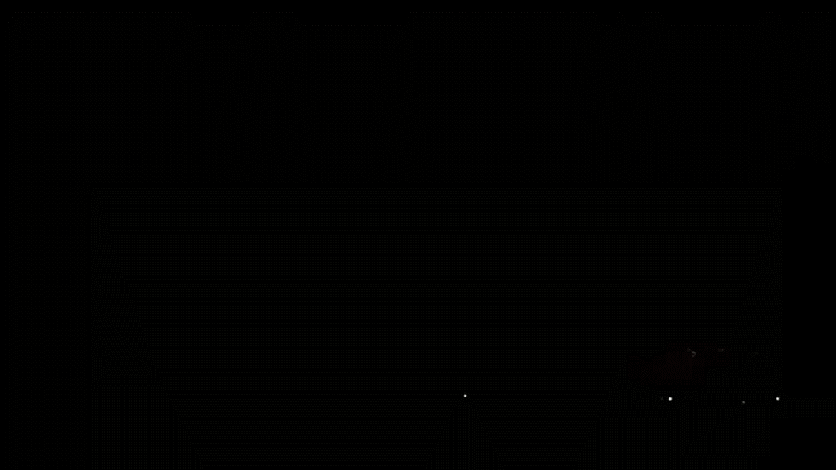
THE MYSTERIES OF
HOLMES

