Slide 1
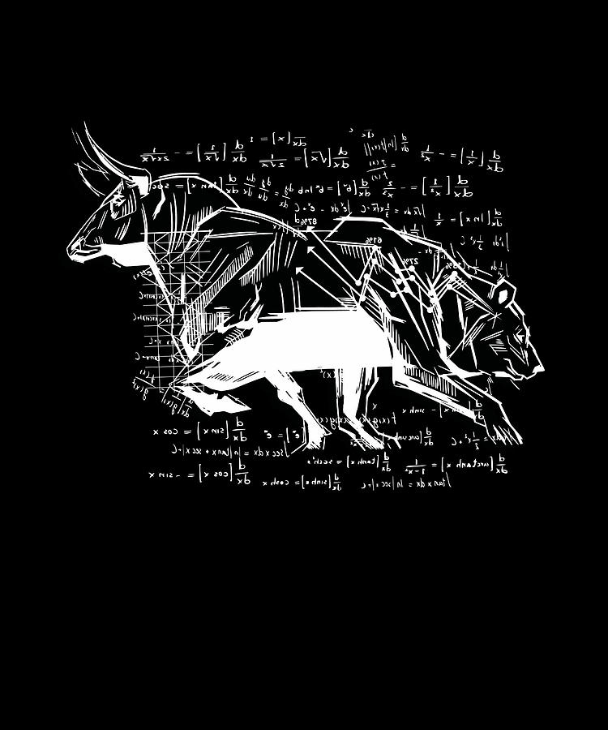
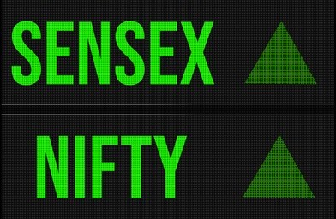




AGENDA
STOCK MARKET Overview
Investing vs Trading
Can we make Money in Stock Market
Presenting my Notes
Topics covered and Strategies
My Portfolio
Mindset needed for Stocks world
Q&A session

