Slide 1
IndoBERT Sentiment Classifier
Findings & Challenges
Summary of notebook results | 25 April 2025
GROUP-2

Slide 2
Objective & Dataset
Goal: Build and evaluate a BERT-based sentiment classifier for Indonesian Instagram comments.
Dataset: 400 comments (200 positive, 200 negative) from Instagram cyberbullying corpus.
Data split: 80% train (320), 20% test (80 samples).

Slide 3
Model & Training Setup
Model: indobenchmark/indobert-base-p1
TrainingArguments:
epochs = 3
lr = 2e-5
batch size = 16/32
weight_decay = 0.01
evaluation = each epoch
metric = F1

Slide 4
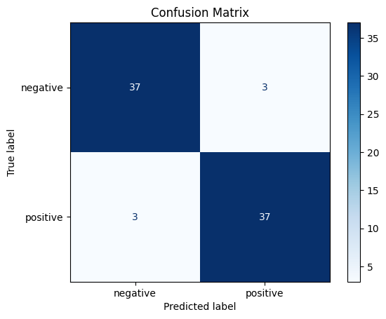
Performance on Test Set
Overall accuracy: 92.5%
Per‑class metrics:
Negative: Precision 0.93, Recall 0.93, F1 0.93 (n=40)
Positive: Precision 0.93, Recall 0.93, F1 0.93 (n=40)
Macro F1: 0.925

Slide 5
Key Challenges Faced
• Library compatibility issues (Transformers 4.x breaking changes)
• Parameter name change: use evaluation_strategy not eval_strategy
• Memory usage – 1.1 GB GPU VRAM per batch on CPU-only environment
• Noisy social‑media text: emojis, slang, code‑switching
• Ambiguous/sarcastic samples still confuse the model → error cases

Slide 6
Insights & Error Analysis
✓ Model achieves high precision & recall on balanced dataset.
✓ Misclassifications often involve sarcasm or mixed‑sentiment comments.
✓ Model more confident on clear sentiment words ("bagus", "jelek").
✓ Slight bias toward short comments due to token truncation.

Slide 7
Recommendations
• Collect more diverse data (sarcasm, neutral, mixed)
• Experiment with larger IndoBERTweet or XLM‑R model
• Hyper‑parameter tuning (lr scheduler, weight decay, epochs)
• Data augmentation: back‑translation, synonym replacement
• Incorporate emoji & slang lexicons to improve context

Slide 8
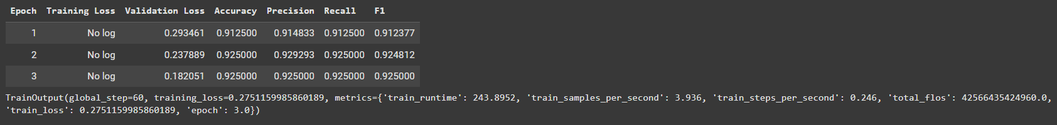
Training Progress per Epoch

Slide 9
Sample Misclassifications
“Gagah kali abang borisq ini.. Klo gk bc nmx bn...” → true: Positive, pred: Negative
“Alah laki‑laki jaman skrng sm aja. Sama sama be...” → true: Negative, pred: Positive
“<USERNAME> ytub apaan ya mba? Aplikasi baru ...” → true: Negative, pred: Positive

