Slide 1
Q1 Sales Report
Regional performance overview for Q1 2025.
North: 320 South: 480 East: 210 West: 390

Slide 2
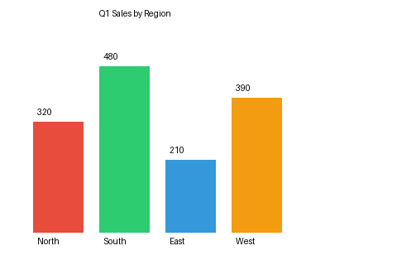
Figure 1: Q1 Sales by Region

Slide 3
Conclusion
South region leads Q1 with 480 units. North and West show steady growth.

