Slide 1
Simple algorithm for partial quantum search
Vladimir E. Korepin and Lov K. Grover
Reporter: Bujiao Wu

Slide 2
Outline
Background
Review of Grover search
Main results
Algorithm
Lower bound
Discussion

Slide 3
Outline
Background
Review of Grover search
Main results
Algorithm
Lower bound
Discussion

Slide 4

Background
Grover search: Find a solution in the given set with time $O(\sqrt{N/M} )$
Alice | Bob | Charli | Richard | Gillian
Search for Charli
How to find the item including the key from $k$blocks?
Notes:
暴力需要搜索所有item。

Slide 5
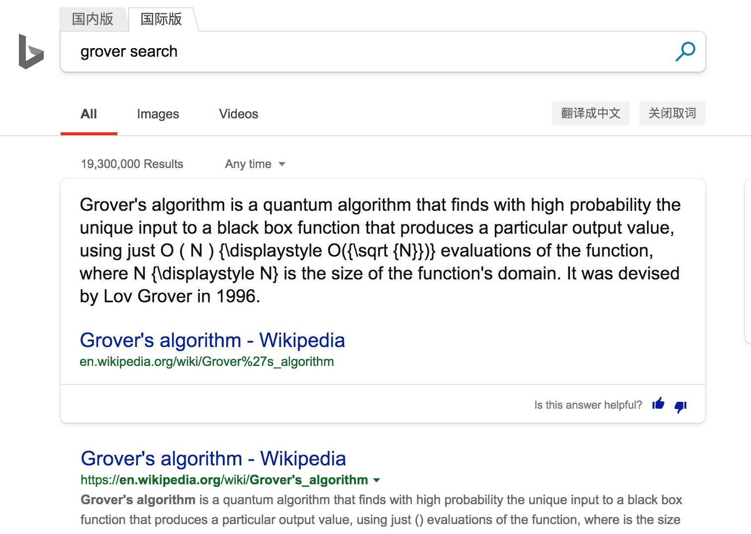
Background
Grover search: Find a solution in the given set with time $O(\sqrt{n} )$
Alice | Bob | Charli | Richard | Gillian
Search for Charli
How to find the item including the key from $k$blocks?

Slide 6
Outline
Background
Review of Grover search
Main results
Algorithm
Lower bound
Discussion

Slide 7
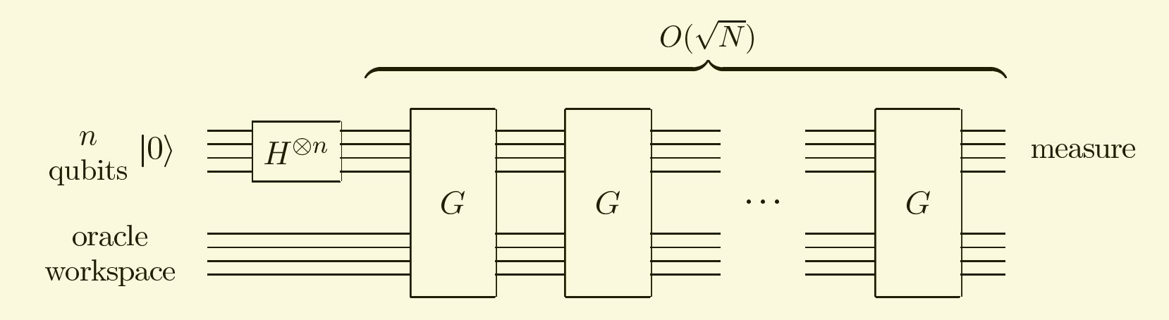
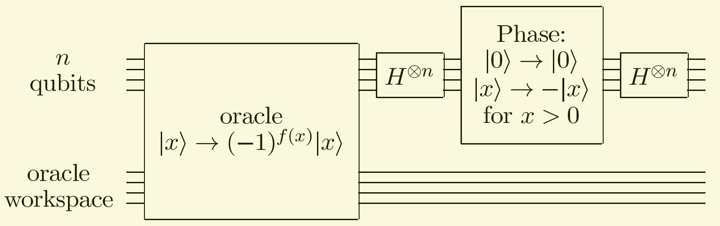
Review of Grover search
Grover Search circuit:
Circuit for the
Grover iteration G:

Slide 8


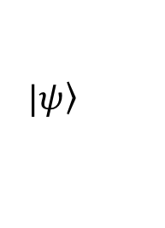


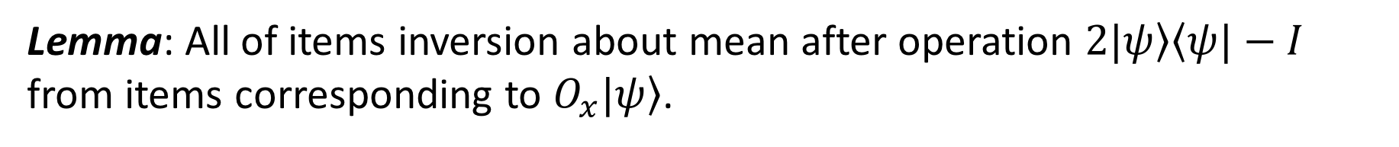

Review of Grover search
G=$(2|\left.ψ\right\rangle \left\langle ψ|−I\right.)O_{x}$, where $\left.\left|\left.ψ\right\rangle =\frac{1}{\sqrt{N}}\sum_{i=0}^{N−1}{|\left.i\right\rangle },O_{x}\right|j\right\rangle =\left\{\begin{aligned}−|\left.j\right\rangle , j ∈S \\ |\left.j\right\rangle , otherwise\end{aligned}\right.$
$$O_{x}$$
$$|\left.ψ\right\rangle$$
Mean: $1$
Mean: $\frac{N−2M}{N}$
Lemma: All of items inversion about mean after operation $2|\left.ψ\right\rangle \left\langle ψ|−I\right.$ from items corresponding to $O_{x}|\left.ψ\right\rangle$.
Notes:
只有1个解：(N-2 * 1)/N

Slide 9
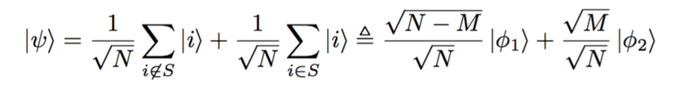
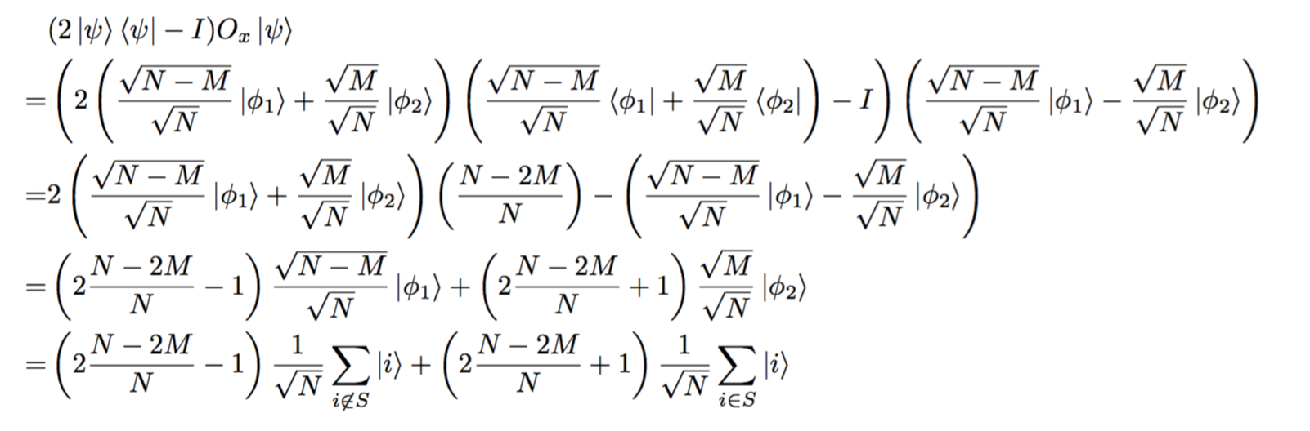

Review of Grover search
Lemma: All of items inversion about mean after operation $2|\left.ψ\right\rangle \left\langle ψ|−I\right.$.

Slide 10
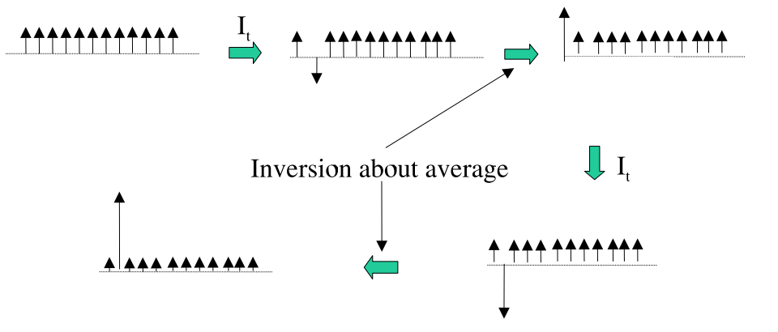


Review of Grover search
Transformations used in quantum search
$$O_{x}$$
$$O_{x}$$

Slide 11
Outline
Background
Review of Grover search
Main results
Algorithm
Lower bound
Discussion

Slide 12
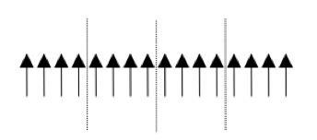
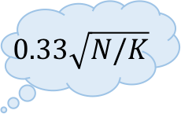
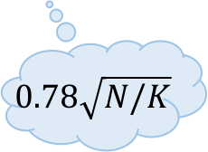
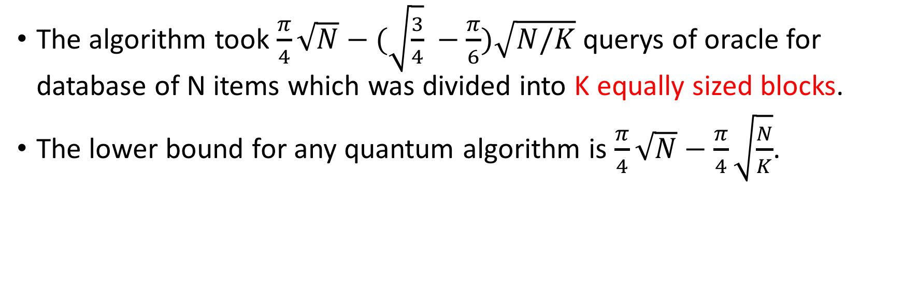
Main results
$$0.33\sqrt{N/K}$$
The algorithm took $\frac{π}{4}\sqrt{N}−(\sqrt{\frac{3}{4}} −\frac{π}{6})\sqrt{N/K}$ querys of oracle for database of N items which was divided into K equally sized blocks.
The lower bound for any quantum algorithm is $\frac{π}{4}\sqrt{N}−\frac{π}{4}\sqrt{\frac{N}{K}}$.
$$0.78\sqrt{N/K}$$

Slide 13
Outline
Background
Review of Grover search
Main results
Algorithm
Lower bound
Discussion

Slide 14
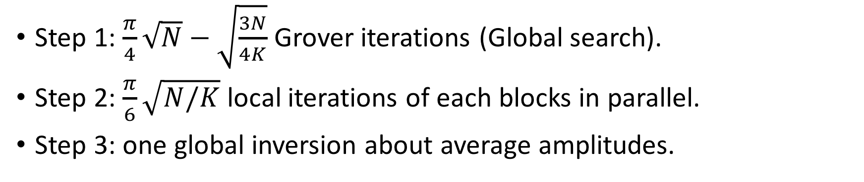
Algorithm
Step 1: $\frac{π}{4}\sqrt{N}−\sqrt{\frac{3N}{4K}}$ Grover iterations (Global search).
Step 2: $\frac{π}{6}\sqrt{N/K}$ local iterations of each blocks in parallel.
Step 3: one global inversion about average amplitudes.

Slide 15
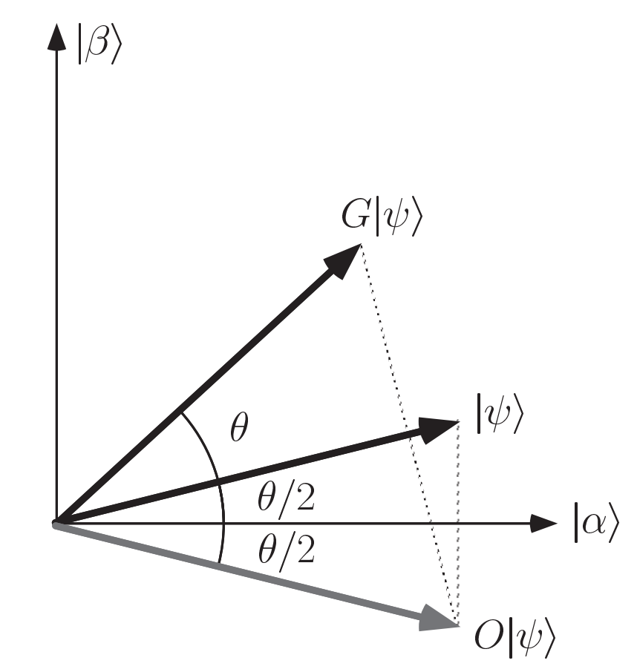
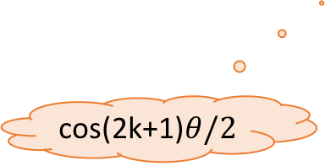
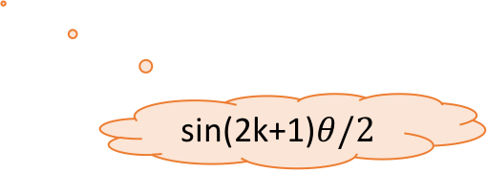
Review of Grover search
Lemma: All of items inversion about mean after operation $2|\left.ψ\right\rangle \left\langle ψ|−I\right.$.
cos(2k+1)$θ/2$
sin(2k+1)$θ/2$

Slide 16
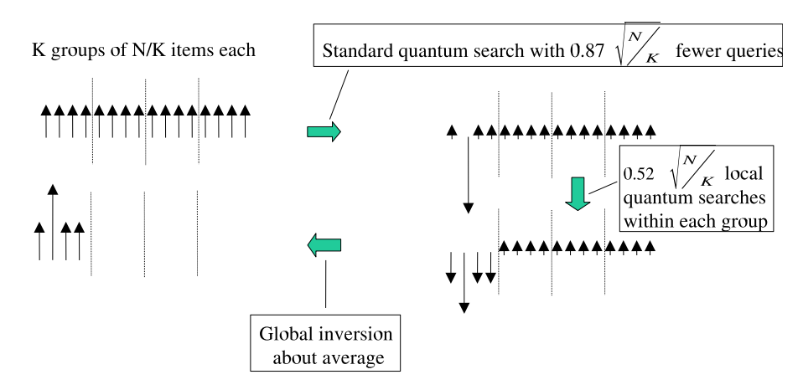


Algorithm
$$ηθ$$
$η$ iterations

Slide 17
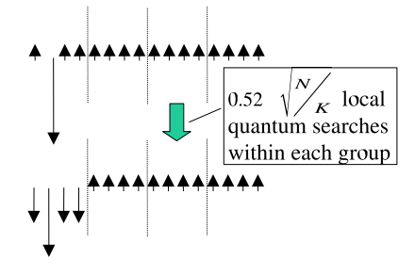



Algorithm analysis
$$θ≈\sin{θ≈2/\sqrt{N/K}}$$
Start with all the amplitude in a single basis state.
Amplitudes for the first block
Non-targets: sin$ηθ\sqrt{\frac{N}{K}}≈\sin\left(2η\sqrt{\frac{K}{N}}\right)/\sqrt{\frac{N}{K}}$
In total:$\sqrt{\frac{N}{K}}sin(2η\sqrt{K/N})$
$$ηθ$$
$η$ iterations
Notes:
考虑第2个阶段 假设第2个阶段经过yeta次Grover迭代

Slide 18
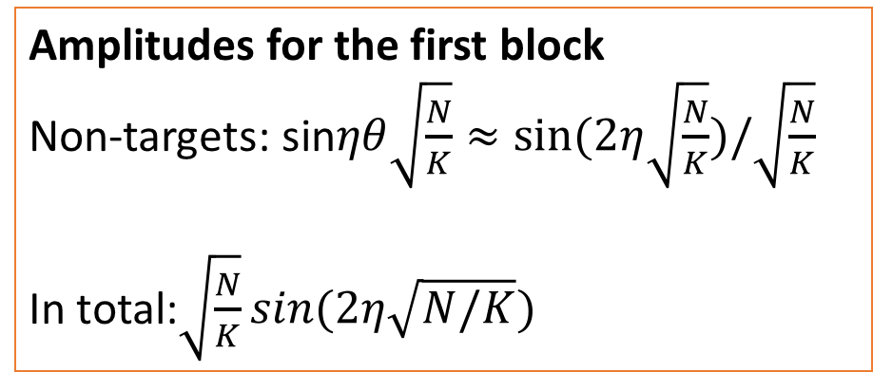
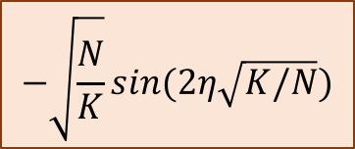
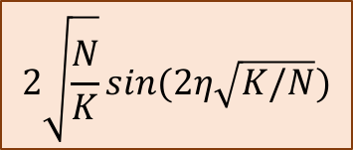
Algorithm analysis
$$θ≈\sin{θ≈2/\sqrt{N/K}}$$
Start with all the amplitude in a single basis state.
Amplitudes for the first block
Non-targets: sin$ηθ\sqrt{\frac{N}{K}}≈sin⁡(2η\sqrt{\frac{N}{K}})/\sqrt{\frac{N}{K}}$
In total:$\sqrt{\frac{N}{K}}sin(2η\sqrt{N/K})$
$$ηθ$$
$η$ iterations
$$2\sqrt{\frac{N}{K}}sin(2η\sqrt{K/N})$$
$$−\sqrt{\frac{N}{K}}sin(2η\sqrt{K/N})$$
Step 2 iterations: 𝜂

Slide 19
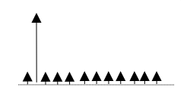
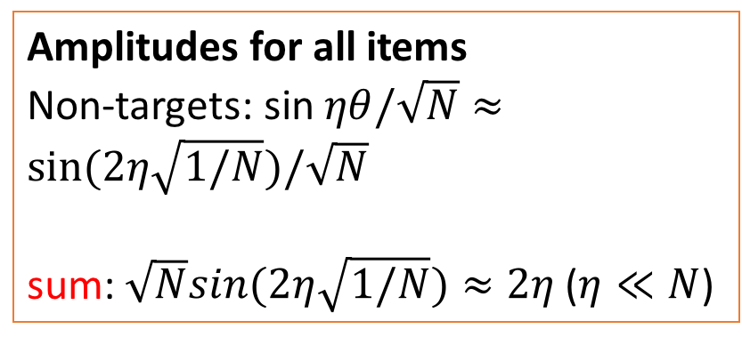

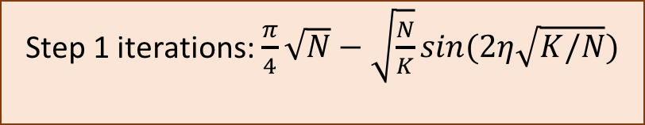

Algorithm analysis
$$θ≈\sin{θ≈2/\sqrt{N}}$$
Stop the search algorithm $η$ iterations before it finds the target.
$η$ iterations
Amplitudes for all items
Non-targets: sin$ηθ/\sqrt{N}≈sin⁡(2η\sqrt{1/N})/\sqrt{N}$
sum: $\sqrt{N}sin(2η\sqrt{1/N})≈2η$ ($η≪N$)
$$2\sqrt{\frac{N}{K}}sin(2η\sqrt{K/N})$$
sum: amplitude in all
$$ηθ$$
Step 1 iterations: $\frac{π}{4}\sqrt{N}−\sqrt{\frac{N}{K}}sin(2η\sqrt{K/N})$
$$−\sqrt{\frac{N}{K}}sin(2η\sqrt{K/N})$$
$η$ iterations

Slide 20

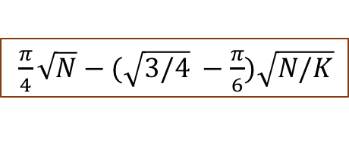

Algorithm analysis
The number of iterations:
Step 1 iterations: $\frac{π}{4}\sqrt{N}−\sqrt{\frac{N}{K}}sin(2η\sqrt{K/N})$
Minimum when 𝜂=$π/6$
Step 2 iterations: 𝜂
$\frac{π}{4}\sqrt{N}−(\sqrt{3/4} −\frac{π}{6})\sqrt{N/K}$
Step 3 iterations: 1

Slide 21
Outline
Background
Review of Grover search
Main results
Algorithm
Lower bound
Discussion

Slide 22
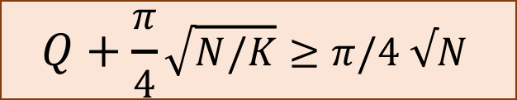

Lower bound
Suppose the query complexity is Q to find a block.
Quantum query lower bound is $\frac{π}{4}\sqrt{N}$ to find an item from N items.
Quantum query lower bound is $\frac{π}{4}\sqrt{N/K}$ to find an item from N/K items.
$$Q+\frac{π}{4}\sqrt{N/K}≥π/4 √N$$
$$Q≥\frac{π}{4}\sqrt{N}−\frac{π}{4}\sqrt{N/K}$$

Slide 23
Outline
Background
Review of Grover search
Main results
Algorithm
Lower bound
Discussion

Slide 24
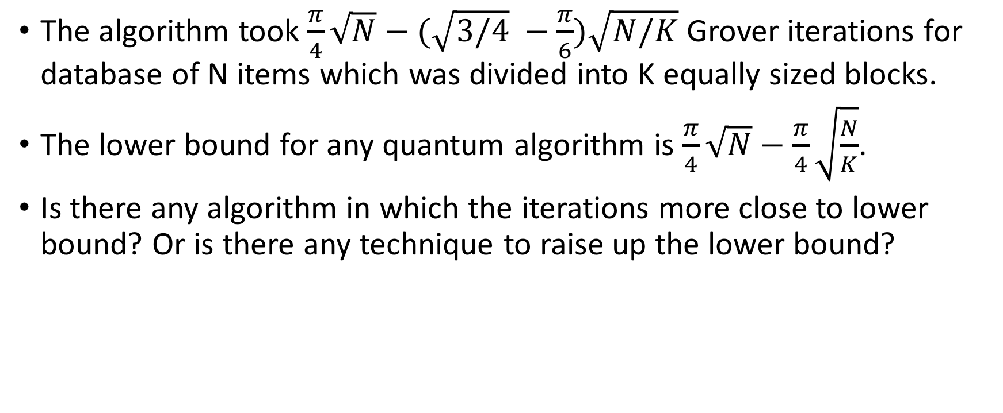
Discussion
The algorithm took $\frac{π}{4}\sqrt{N}−(\sqrt{3/4} −\frac{π}{6})\sqrt{N/K}$ Grover iterations for database of N items which was divided into K equally sized blocks.
The lower bound for any quantum algorithm is $\frac{π}{4}\sqrt{N}−\frac{π}{4}\sqrt{\frac{N}{K}}$.
Is there any algorithm in which the iterations more close to lower bound? Or is there any technique to raise up the lower bound?

Slide 25


