Slide 1
Solution to ITU AI Challenge PS-003:
Multi-environment Automotive QoS Prediction
Qixin Zhang, Wei Ye, Steven Sleder
Advised by Zhi-Li Zhang
2023/10/24

Slide 2

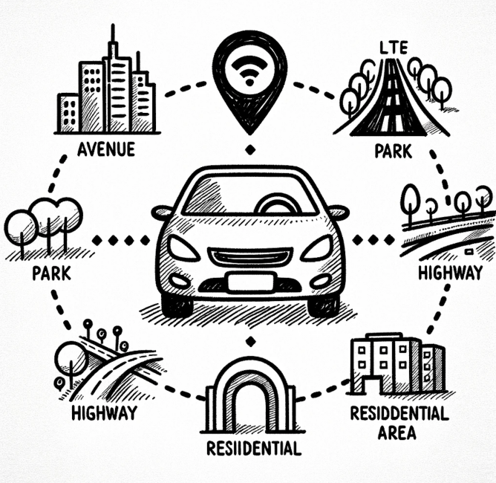
Recall
How can we predict the downlink datarate for different operators by training a Machine Learning model?

Slide 3

Why is This Problem Important?
Growth of connected vehicles and smart transportation
Necessity for real-time, reliable communication
Role of QoS in achieving reliable communication
Varying data distribution

Slide 4
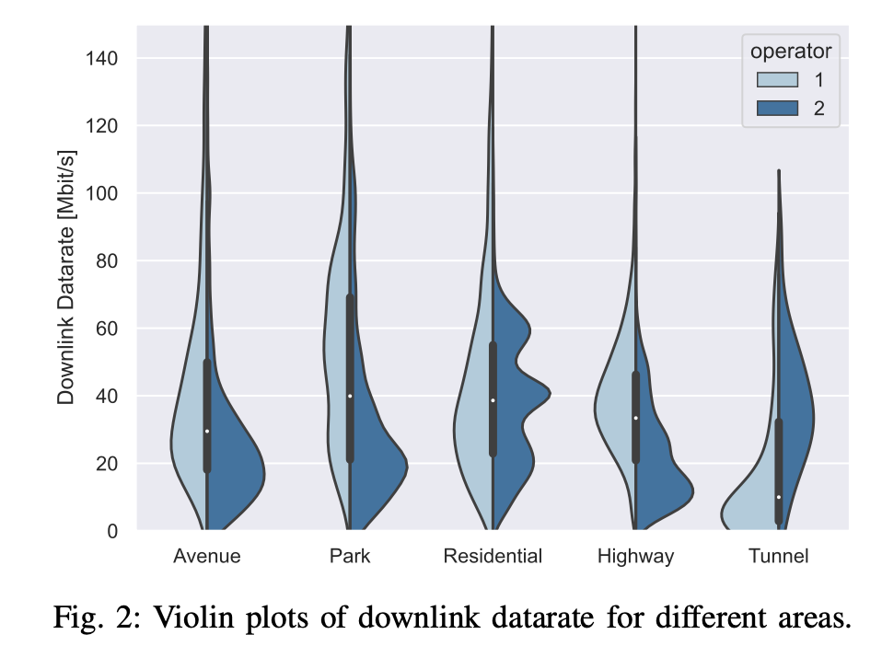
Dataset Exploration
Source: Berlin V2X dataset, rich in diverse urban environments
Data characteristics:
  High-resolution GPS-located wireless measurements
  Cellular and side link radio access technologies
  Physical layer parameters: signal strength and quality
  Wireless Qos metrics:delay, throughput, ...
  Side info: traffic and weather

Slide 5
Domain Adaptation
What is Domain Adaptation?
  Adapting a model's knowledge from a source domain to perform in a different target domain
Why is it Crucial?
  Real-world data often comes from different distributions
  Traditional machine learning models underperform when training and testing distribution differ
Our Scenario
  Different distributions among two operators

Slide 6
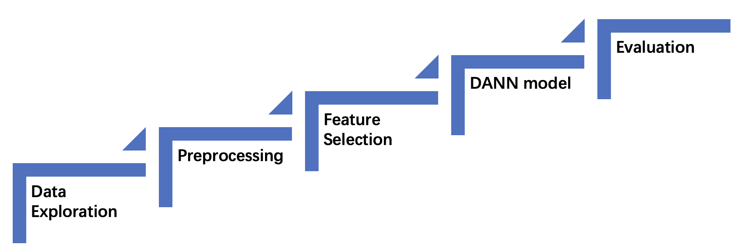
Approach

Slide 7
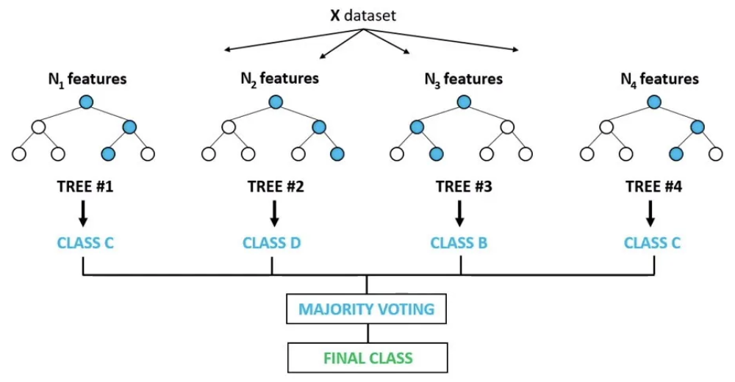
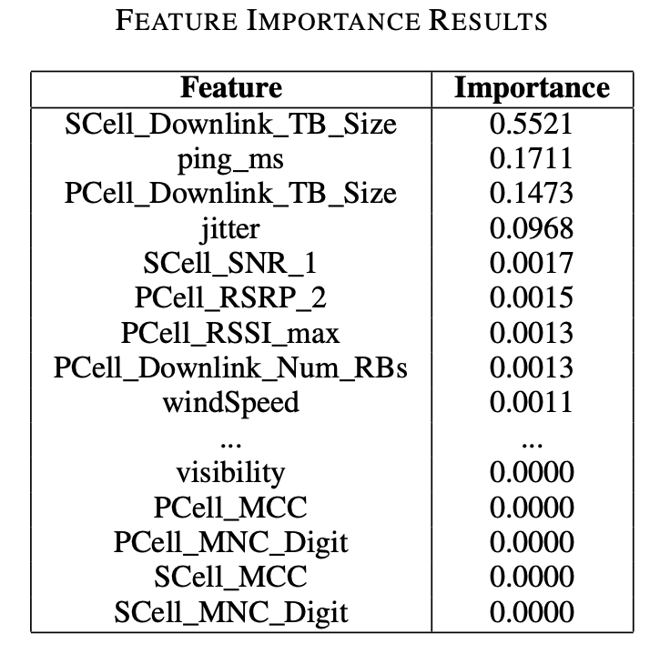
Preprocessing and Feature Selection
Data filtering
  Focused on downlink with measured QoS as data rate
Training&Testing Domains
  by different operators
Feature Selection
  Utilized Random Forest Classifier for importance ranking

Slide 8
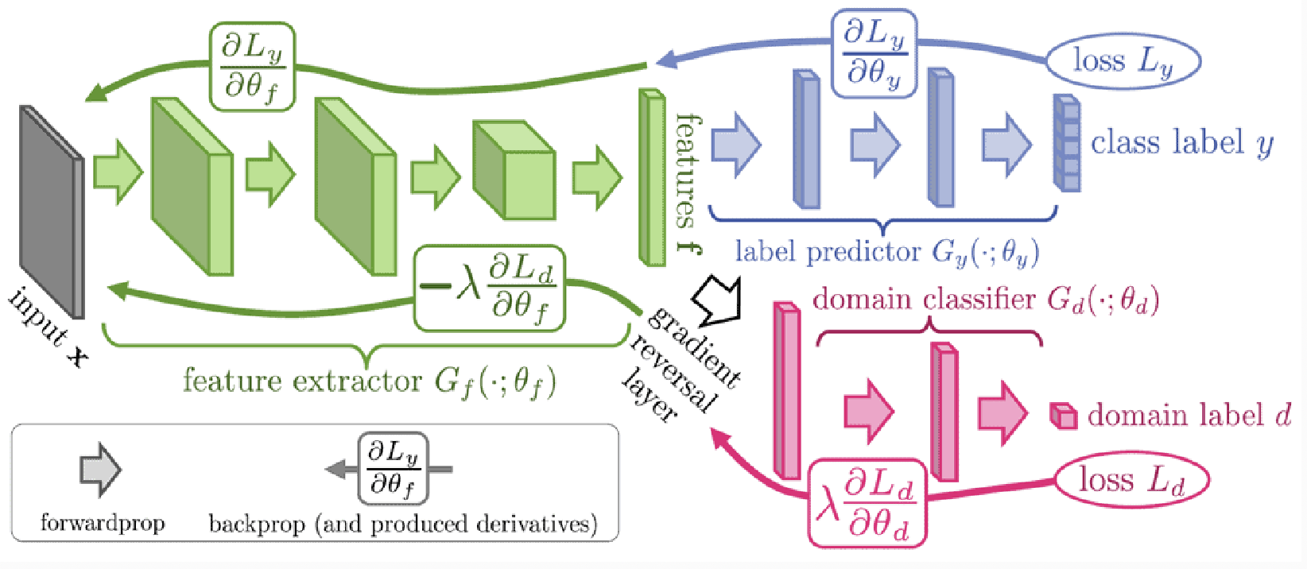
Domain Adaptation with DANN
DANN Architecture
  Feature Extractor: extract crucial patterns from selected features
  Main Task Classifier: Predict QoS based on extracted features
  Domain Classifier: use a gradiant reversal layer & ensure learned features remain domain-agnostic
Objective: joint optimization for QoS prediction & domain classification
Domain Adversarial Neural Network architecture(Figure reproduced from Ganin and Lempitsky)

Slide 9
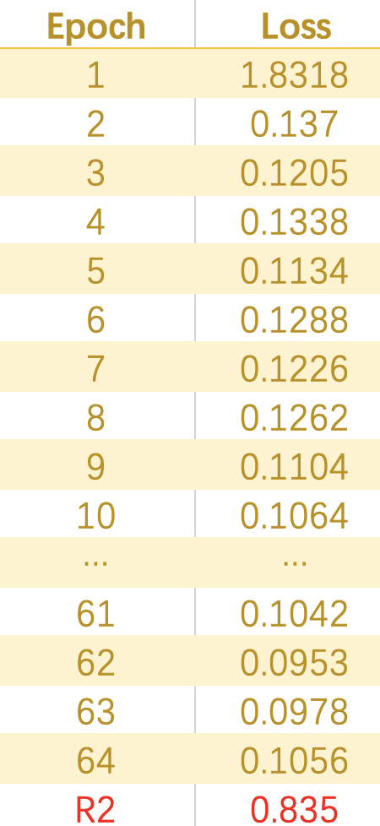
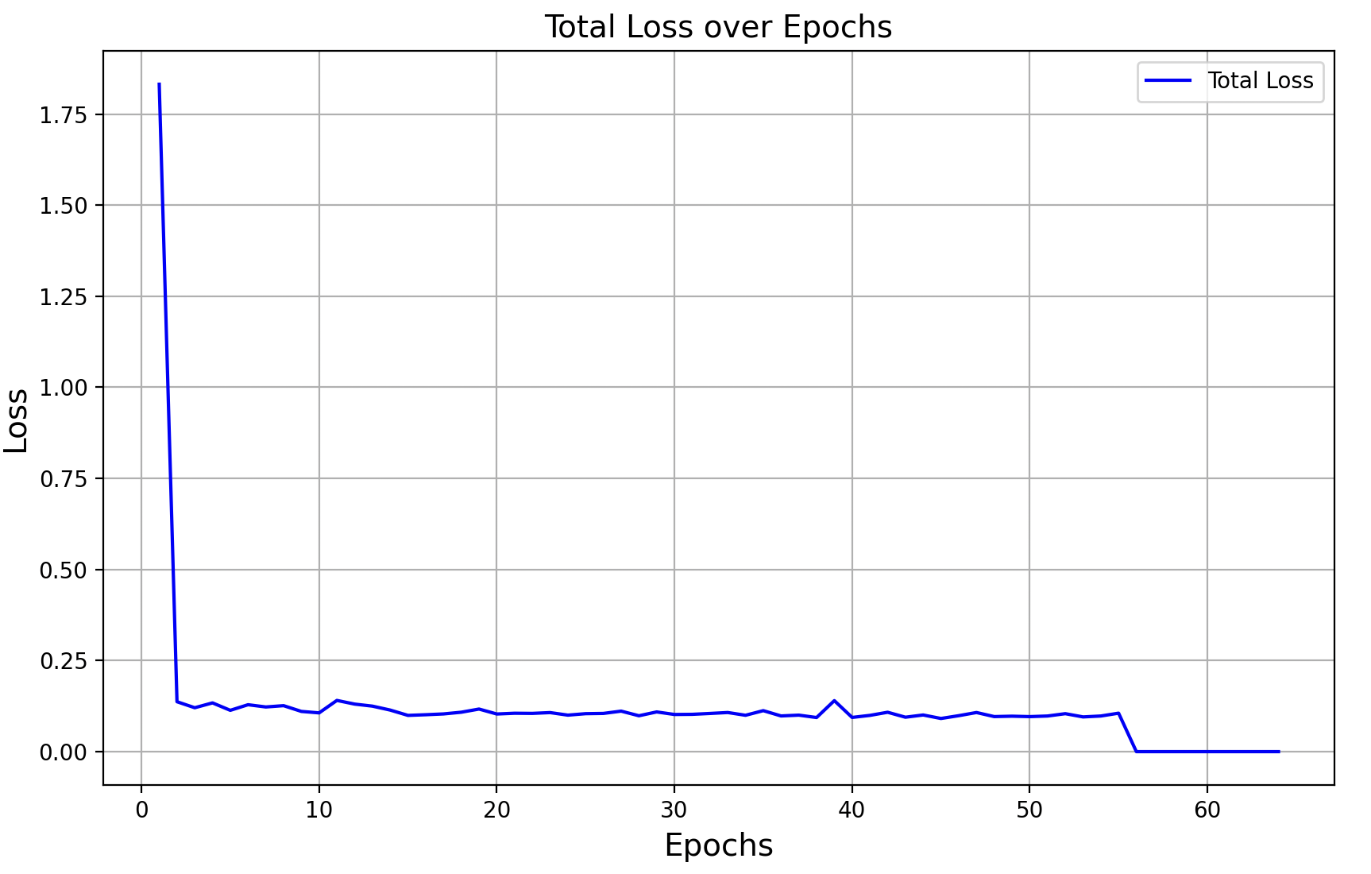
Results
Model performance: R² ~ 0.835

Slide 10
Conclusion
Combination of two algorithms
  Random Forest Classifier
  DANN model
R² score is about 0.835
Effectiveness is achieved

Slide 11
Q
&
A

Slide 12


