Slide 1
E-Sports
We will prove that "playing games" can make money in real world for our hot-blooded youth this time.

Slide 2
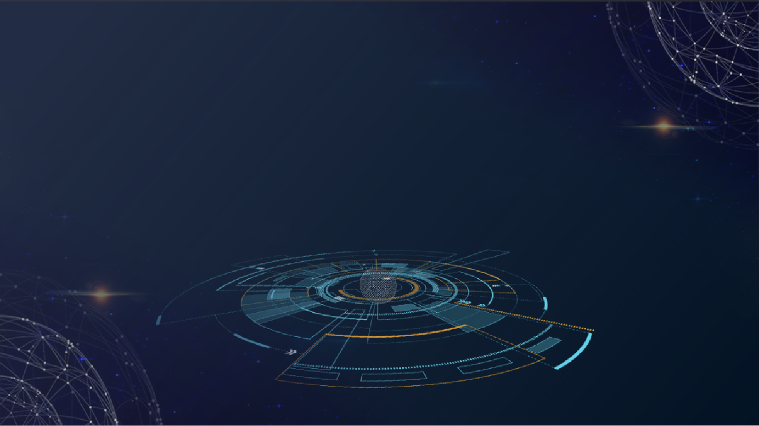
CONTENT
1
2
Features
Application
3
4
Anti-cheating system
Road map

Slide 3
1
Features
The project is focus on thousands of players who love e-sports.

Slide 4

Features
The project is focus on thousands of players who love e-sports. Some of them are youth trainers with dreams or ex-service players who have fought for the e-sports career. Most of them may focus on entertainment but also with passion.
1、Download the ES app
3、record by the system automatically.
2、log in the ES app

Slide 5
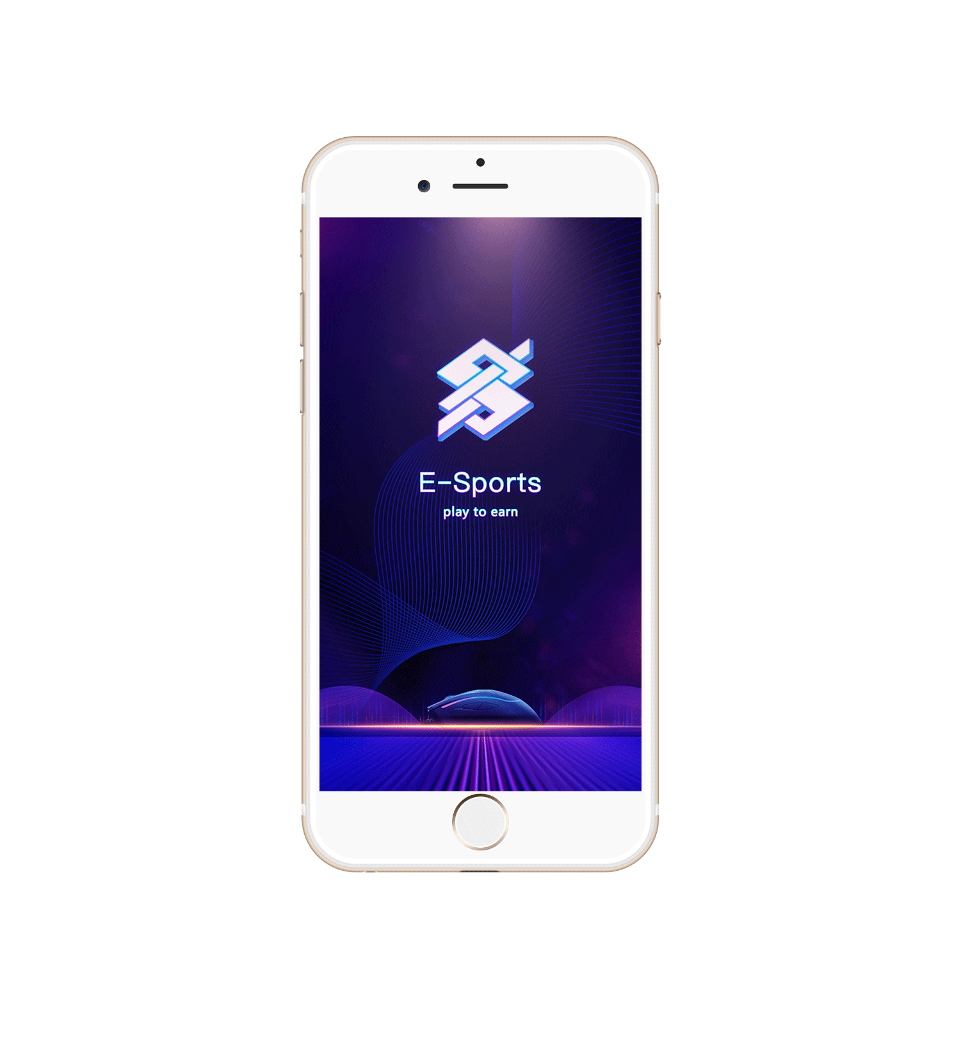
About Team
China and South Korea
In view of the high development of e-sports in the Asia-Pacific region, the project will set up an Asia-Pacific marketing team (focusing on China and South Korea). We will carry out the application promotion of large-scale Internet cafes in Asia-Pacific in the early stage of the project. We will cooperate with major e-sports clubs in the later stage to achieve excellent results. The project will focus on training and delivery talents to clubs and opening new exploration channels for higher and stronger e-sports careers.
ES application is only suit for PC games now. The function for suiting mobile games is under developing.

Slide 6
2
Process

Slide 7
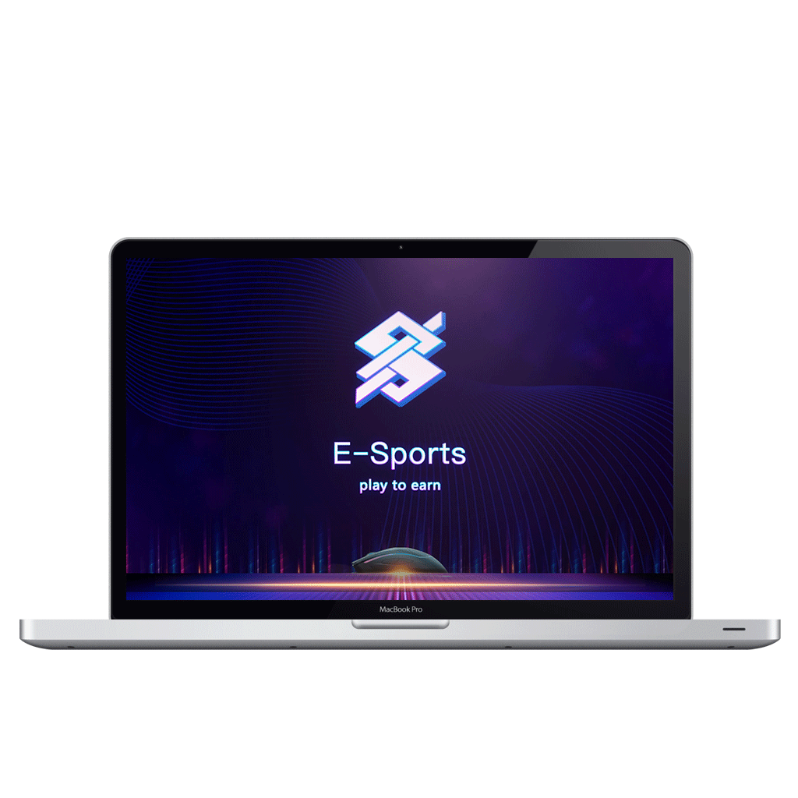
Process
1. Download ES application through official website.
2. Register associated game account.
3. Purchase $ES token through wallet. Please make sure there is enough BNB to mint NFT.
4. Select the corresponding game login. The system will read the corresponding game time and record.
5. ES system will settle and issue rewards after games.

Slide 8
3
Application and NFT

Slide 9

About Games
League of Legend、PUBG、DOTA2、CS:GO
NFT
Attribute
There are levels of each NFT which are bronze, silver, gold, platinum and diamond (which can be upgraded). Each account can only hold one NFT, but each NFT can bind multiple games.
1、LUC point
Corresponding to bronze 5 points, silver 10 points, gold 20 points, platinum 40 points, diamond 80 points.Each upgrade will consume a certain amount of $ES tokens and upgrade 1 point.
2、END point
Corresponding to bronze 5 points, silver 10 points, gold 20 points, platinum 40 points, diamond 80 points
Each upgrade will consume a certain amount of $ES tokens and upgrade 1 point.

Slide 10
About the token
Mint NFT will consuming $ES token with 100usd value.
Silver
Diamond
8% chance
0.1%
Gold
Platinum
1.4%
0.5%

Slide 11
About Upgrade
Each upgrade card consumes the corresponding 5USD 10USD 20USD 30USD 50USD of $ES tokens
Each LUC point corresponds to 0.5USD, and each END point corresponds to 0.5USD
Based on 5 / 5 of the bronze NFT, 5USD reward is give away every day
The basic reward of silver is 10USD
The basic reward of gold is 20USD
The Basic reward of platinum is 40USD
The basic reward of diamond is 80USD
Players can choose to upgrade LUC point or END point (players supposed to upgrade the LUC point first)

Slide 12
About cost back
The players who owns bronze NFT can get their cost back within 20days.
It will cost 50USD to upgrade to silver. In the silver stage, it will takes 15 days to get the capital back, and the players who minted silver NFT can get the capital back within 10days.
Keep upgrade to the Gold NFT will cost 400USD, it will take 25 days to get the capital back, and the players who minted Gold NFT can get the capital back within 5days.
Keep upgrade to the Platinum NFT will cost 1200USD, it will take 30 days to get the capital back, and the players who minted Platinum NFT can get the capital back within 3days.
Keep upgrade to the Diamond NFT will cost 4000USD, it will take 50 days to get the capital back, and the players who minted Diamond NFT can get the capital back within 3days.

Slide 13
Anti-cheating system
Please remember, E-sports is the spirit! It's youth! It's glory!
It is a world that is not understood by others.
There are no strongest heroes and races, but only the operation, consciousness and cooperation of continuous transcendence.
It also embodies the Olympic spirit!
Open multiple games
Plug-in
AFK

Slide 14
Token economics
Total supply 500000000 $ES
Private sale: 10% with price $0.0015
Presale: 20% with price $0.0016
Liquidity:15%( Locked) with price $0.0017 at launch
Locked for application development: 35%
Locked for public relations: 5%
Locked for application maintenance: 3%
Locked for listing in CEX: 12%
Tax per trade: 2% for marketing

Slide 15
About roadmap
Phase 1
Brainstorming
IDO
Website launched
Tokens launched
Phase 3
Marketing of various types of Internet cafes and game portals
Multi-chain cross (ETH, SOL, AVAX)
Sponsoring the Medium-sized esports competitions
Listed in CEX
Phase 4
5% tokens of public relations apply the following parts:
1、Sponsoring large-scale top esports competitions
2、Cooperate with top e-sports clubs
3、Cooperate with top esports players
4、Cooperate with top game manufacturers
5、Listed in top level CEX
Decentralized DAO organization
Roadmap
Phase 2
The 2% transaction tax applies the following parts:
NFT mint
Beta test of application
Marketing

Slide 16

Thanks
WE ARE THE BEST TEAM&VENTURE ENTREPRENEUR

