Slide 1
Acoustics - disease detection
IMBALANCE-AWARE MULTI-DATASET LEARNING
August 13, 2026
NORTHWESTERN ENGINEERING
Notes:
Open: this update concerns controlled encoder screening, not a performance announcement.

Slide 2
Single-dataset learning is structurally long-tailed
ICBHI 2017 • 6,898 cycles
SPRSound inter • 1,429 events
Normal
1040
Normal
3642
Fine crackle
80
Crackle
1864
Coarse crackle
3
Wheeze
886
Wheeze
305
Both
506
Wheeze + crackle
1
Aggregate performance can improve while rare-event learning still fails.
2
NORTHWESTERN ENGINEERING
Notes:
Rare-event support motivates the project but does not establish a solution.
[Sources]
- Source deck; ICBHI 2017 and SPRSound BioCAS2022 release inventories.

Slide 3
Four datasets offer complementary—but non-identical—supervision
ICBHI
SPRSound
HF_Lung
KAUH
920 recordings
2,683 recordings
9,765 recordings
336 recordings
6,898 cycles
9,089 events
81,933 intervals
112 patients
Normal • crackle • wheeze • both
7 event types + record labels
Breath phase + overlapping events
Recording sound type + diagnosis
Partial semantic overlap creates an opportunity for shared supervision
Crackle ↔ fine/coarse crackle • Wheeze ↔ wheeze • Other labels remain dataset-native
Recordings, cycles, events, and intervals are not interchangeable.
3
NORTHWESTERN ENGINEERING
Notes:
Keep prediction units and labels separate. Four datasets do not imply one unified label space.
[Sources]
- docs/pipeline/end_to_end_pipeline_textual_spec_v2.md, four native-lane contracts.

Slide 4
Why naive pooling does not solve the problem
Domain mismatch
Missing ≠ negative
Crackle, DAS, Crep, rhonchi and stridor are not automatically equivalent.
Unlabeled HF background cannot be treated as Normal by default.
↘
↗
NAIVE POOLING
↗
↖
Sample-unit mismatch
Acquisition shortcut
Dual imbalance
Cycle, event, interval and recording labels supervise different targets.
Sampling rate, device, loudness and spectrum reveal dataset identity.
Large datasets and head classes can dominate the same objective.
Paper contribution must be a model / system / training strategy—not dataset aggregation.
4
NORTHWESTERN ENGINEERING
Notes:
Interpretation only: acquisition differences are a control concern, not proof of pathology shortcut use.
[Sources]
- docs/pipeline/end_to_end_pipeline_textual_spec_v2.md, hard claim boundaries.

Slide 5
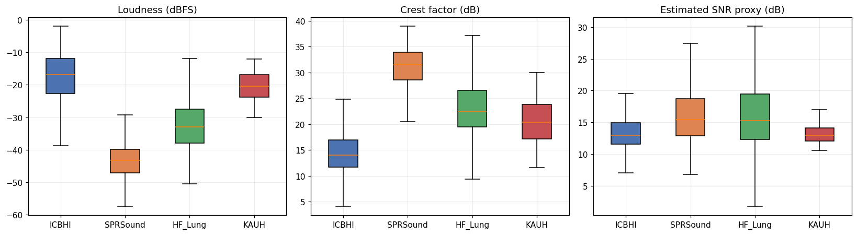
Acquisition fingerprints: loudness differs by ~26 dB
LOUDNESS
SNR PROXY
ICBHI −16.8 dBFS SPRSound −43.2 dBFS
Medians span only 12.9–15.4 dB
5
NORTHWESTERN ENGINEERING
Notes:
dBFS is a recording level; the displayed SNR quantity is a proxy.
[Sources]
- Source deck diagnostic figure; local read-only acoustic probe.

Slide 6
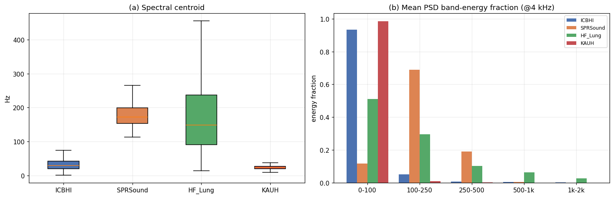
Raw spectral shape is strongly dataset-specific
SPRSound concentrates energy in 100–250 Hz; HF_Lung is broader; ICBHI/KAUH are strongly low-frequency dominated.
These raw differences motivate harmonized preprocessing and dataset/device-stratified evaluation.
6
NORTHWESTERN ENGINEERING
Notes:
Use this as motivation for preprocessing and stratified evaluation, not as a performance result.
[Sources]
- Source deck diagnostic figure; local read-only acoustic probe.

Slide 7
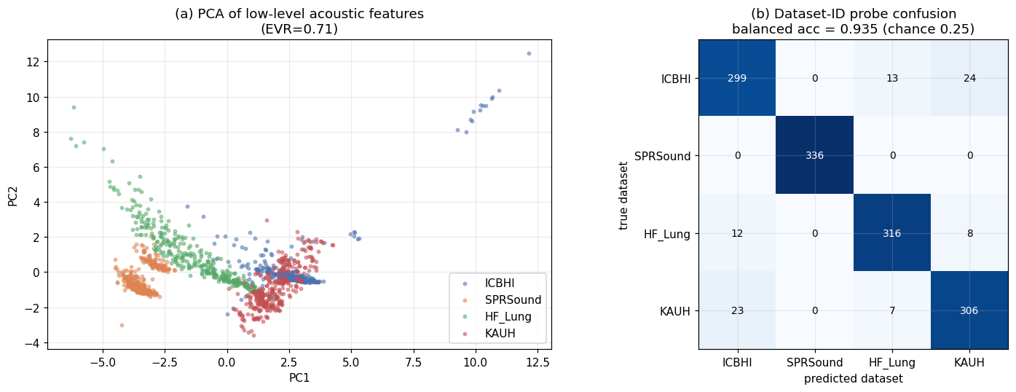
Low-level acoustics identify the dataset with ~0.92–0.94 balanced accuracy
Original plot
Recheck
SPRSound
0.935 recording-level CV
0.924 patient-grouped CV
336 / 336
7
NORTHWESTERN ENGINEERING
Notes:
Dataset-ID accessibility does not demonstrate disease-model shortcut use.
[Sources]
- Source deck diagnostic figure; local read-only dataset-ID probe.

Slide 8
Encoder screening has entered verified native-task evidence
Four native lanes
Shared-window contract
P1/P2 verified • P3 pending
Labels stay native
16 kHz • 2 s / 1 s
Native-task evidence
No label merging
Fixed evaluation contract
No pooled/global score
1
2
3
4
→
→
→
Fixed native contracts
Windowed native units
P1/P2 native evidence
Encoder shortlist
Verified
Verified
GO verified
P3/P4/P5 gates
8
NORTHWESTERN ENGINEERING
Notes:
P1 and P2 have independently verified terminal native-task results. P3 completed full training, validation-only selection, export, and HF threshold selection with outer/test untouched; terminal scoring and independent verification are pending. These states do not yet establish an encoder ranking.
[Sources]
- result/reproduce/sync_20260813T162603Z_c9e531d_P1_P2/.../result_sync_manifest.json.
- P3 run_receipt.json, validation_selection_receipt.json, validation_export_receipt.json and hf_threshold_receipt.json.

Slide 9
P1/P2 verified native-task results; P3 terminal pending
Native-task metrics only — no pooled/global score or encoder ranking
VERIFIED + PENDING
GO • ICBHI .510 • SPR (B/7) .911/.858
P1 — AST
HF F1 .551/.285/.362/.246 • KAUH mF1 .165
GO • ICBHI .514 • SPR (B/7) .908/.827
P2 — BEATs
HF F1 .489/.249/.317/.313 • KAUH mF1 .227
Full 86,250 • val-selected 39,675
P3 — PANNs
Gate A complete • terminal pending • no result
Native-task metrics only. KAUH is fold0 terminal only. P3 outer/test remains untouched.
9
NORTHWESTERN ENGINEERING
Notes:
P1/P2 values are independently verified native-task results: ICBHI and SPRSound values are native scores, HF values are channel F1 in I/E/CAS/DAS order, and KAUH values are macro-F1 from fold0 terminal only. Do not interpret the small P1/P2 differences as an encoder ranking. P3 Gate A is complete: validation export and HF threshold selection finished with outer/test untouched. Terminal scoring is waiting for a safely available GPU, so P3 still has no performance result.
[Sources]
- result/reproduce/sync_20260813T162603Z_c9e531d_P1_P2/files1/Zilong/acoustic_server_results/result_sync_manifests/20260813T162603Z_c9e531d_P1_P2/result_sync_manifest.json.
- /files1/Zilong/Acoustic/result/reproduce/P3_shared_window_seed20260728/full/3b7370c9447340331e7c78168922ca59d5469a93be3e9420dc69250231db4652/run_receipt.json.
- /files1/Zilong/acoustic_server_results/p3_hf_validation_export/20260813T203000Z_8b8ec1d/validation_export_receipt.json and hf_threshold_receipt.json.

Slide 10
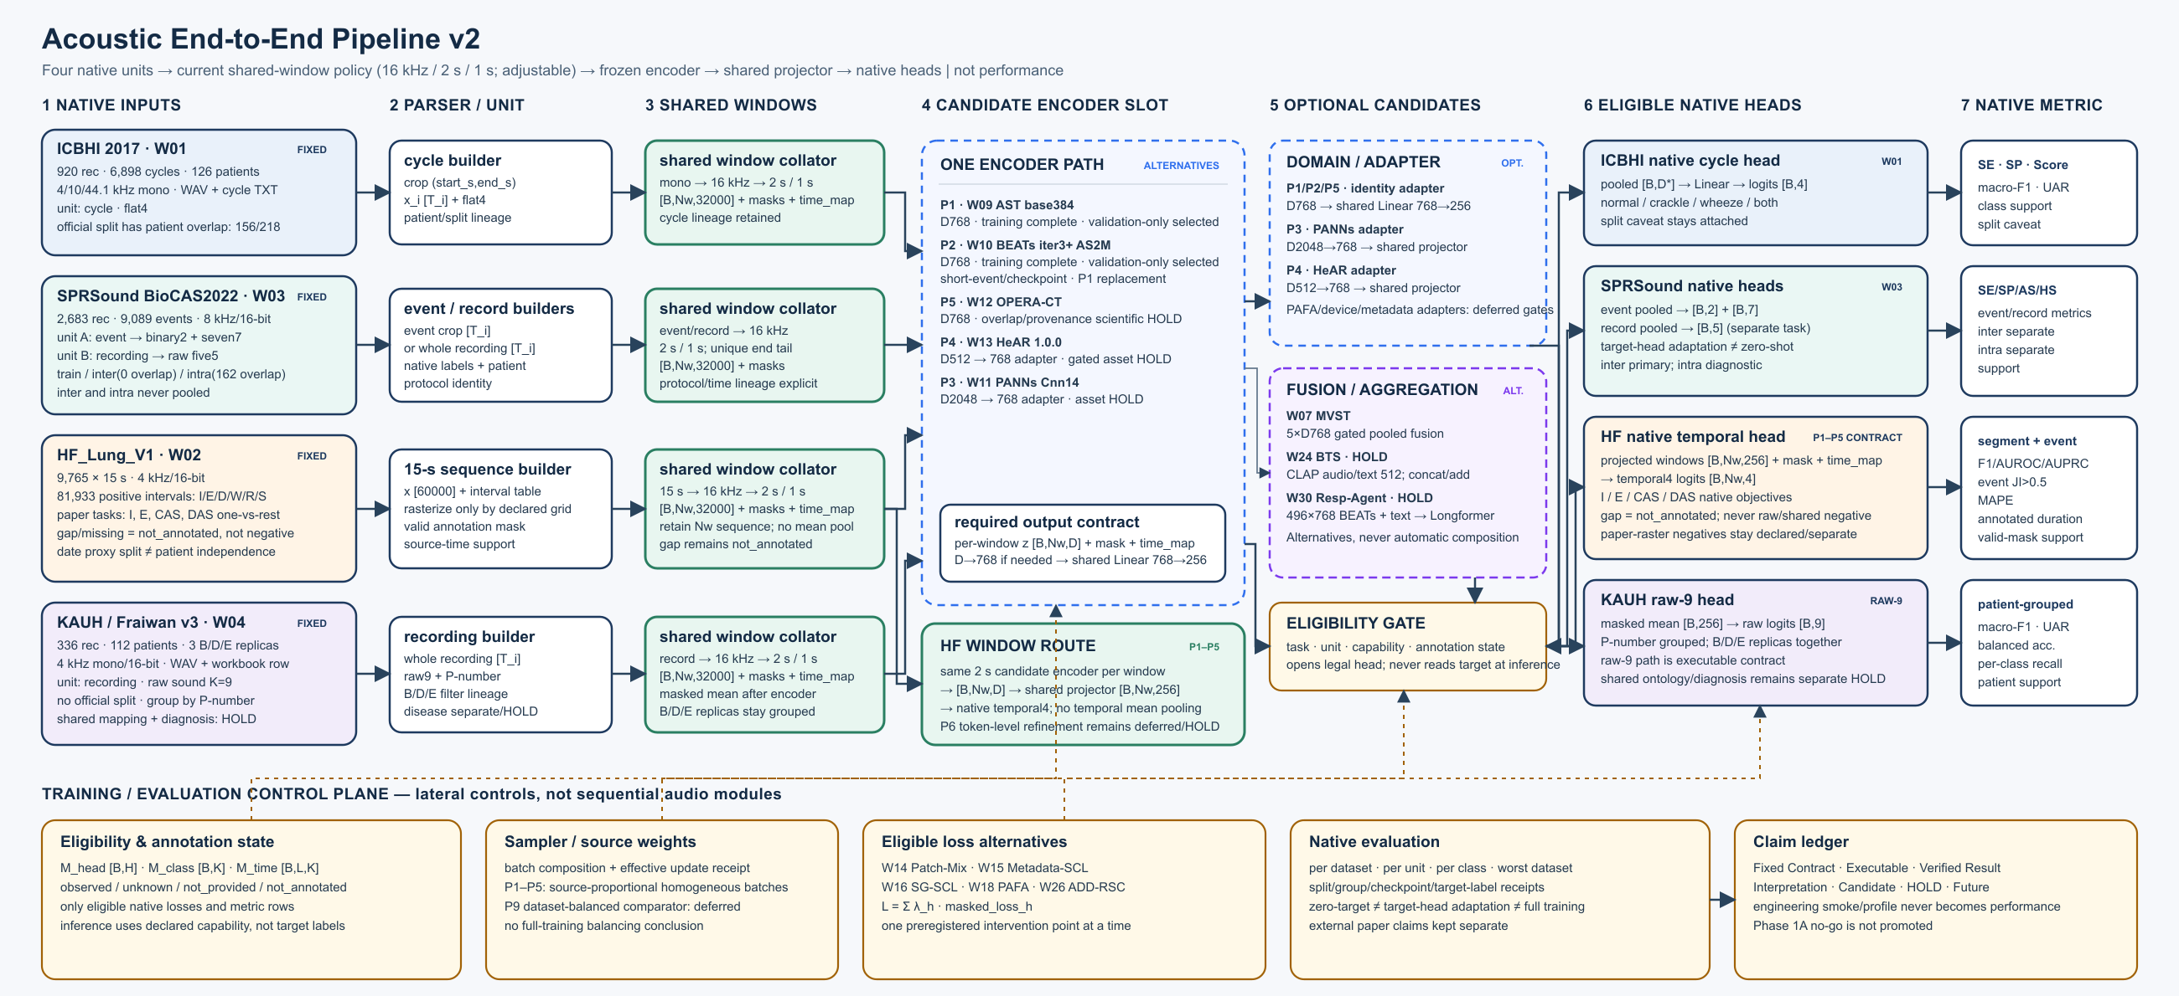
Shared-window architecture reference — current status on Slide 9
10
NORTHWESTERN ENGINEERING
Notes:
Architecture reference only. The unchanged 02:40 CDT image predates the current P1/P2 terminal verification and P3 full-training milestone; slide 9 is the authoritative execution/result update. The lower execution inset is clean-cropped to reduce stale operational detail.
[Sources]
- figures/pipeline/acoustic_end_to_end_pipeline_v2.png, management-accepted 2026-08-13 02:40 CDT architecture snapshot.

Slide 11
Clinical input can sharpen the next protocol
Event definitions
Useful temporal scales
Ambiguous or overlapping events
Meaningful error trade-offs
What counts as
Which durations
Which overlaps are
Which errors are
a meaningful event?
matter for decisions?
clinically distinct?
most consequential?
Boundary rules for clinical review
Windows, intervals, and event context
Do not force unclear
labels into negatives
Prioritize review
criteria, not a score
Clinical input requested; no clinical efficacy claim.
Please help define event boundaries and clinically useful temporal scales.
This input will refine the next protocol—not reinterpret current results.
11
NORTHWESTERN ENGINEERING
Notes:
Clinical question: definitions and useful temporal scales. Ask for protocol guidance, not a claim of efficacy.

Slide 12
Appendix — Historical exploratory diagnostics: source alignment
Patch-Mix
PAFA
SG-SCL
62.1708
64.143
60.984
author: 62.17
paper: 64.84 ± 0.60
paper: 61.71 ± 1.61
1
2
3
4
→
→
→
Source alignment
Direct source-head transfer
Frozen encoder + target head
Rare-event multi-dataset learning
Verified
Verified
Verified
Historical exploratory diagnostic
12
NORTHWESTERN ENGINEERING
Notes:
Historical exploratory diagnostic. It does not select the present P1/P2 screen.
[Sources]
- Source deck; local historical alignment receipts.

Slide 13
Appendix — Historical exploratory diagnostic: direct source-head transfer
Same 1,429 SPRSound inter events
HISTORICAL • ZERO-TARGET-TUNING
Binary AS
Narrow-four diagnostic
Patch-Mix
59.38
51.15
PAFA
55.82
51.19
SG-SCL
59.98
50.08
Better than random guess☺
Historical protocol only; not current P1/P2 evidence.
13
NORTHWESTERN ENGINEERING
Notes:
Protocol-specific historical direct transfer: same 1,429 SPRSound inter events and no target tuning. It is not current shared-window evidence.
[Sources]
- Source deck; historical SPRSound inter transfer receipt.

Slide 14
Appendix — Historical target-supervised adaptation
Historical protocol — target labels were used
ENCODER FROZEN
0
50
100
direct head 59.38
Patch-Mix
target head 87.68
direct head 55.82
PAFA
target head 84.29
direct head 59.98
SG-SCL
target head 90.65
Target-supervised adaptation only; not zero-shot or shared-window training evidence.
14
NORTHWESTERN ENGINEERING
Notes:
Target labels were used for the target head. This is adaptation, not zero-shot and not a joint-training conclusion.
[Sources]
- Source deck; historical target-head adaptation receipt.

Slide 15
Appendix — Historical exploratory diagnostic: minority failure
Historical aggregate metrics
SPRSound inter support
Patch-Mix
Official Score
Macro-F1
UAR
Normal
1040
82.37
0.362
0.351
Wheeze
305
PAFA
Official Score
Macro-F1
UAR
Fine crackle
80
75.77
0.387
0.279
Coarse crackle
3
SG-SCL
Official Score
Macro-F1
UAR
84.41
0.372
0.351
Wheeze + crackle
1
Historical tail-failure observation; not a current method conclusion.
15
NORTHWESTERN ENGINEERING
Notes:
Historical diagnostic only. Preserve the tail-failure caveat and do not promote it to a current method conclusion.
[Sources]
- Source deck; historical SPRSound inter diagnostic receipt.

