Slide 1
Acoustics - disease detection
IMBALANCE-AWARE MULTI-DATASET LEARNING
July 23, 2026
NORTHWESTERN ENGINEERING

Slide 2
Single-dataset learning is structurally long-tailed
ICBHI 2017 • 6,898 cycles
SPRSound inter • 1,429 events
Normal
1040
Normal
3642
Fine crackle
80
Crackle
1864
Coarse crackle
3
Wheeze
886
Wheeze
305
Both
506
Wheeze + crackle
1
Aggregate performance can improve while rare-event learning still fails.
2
NORTHWESTERN ENGINEERING

Slide 3
Four datasets offer complementary—but non-identical—supervision
ICBHI
SPRSound
HF_Lung
KAUH
920 recordings
2,683 recordings
9,765 recordings
336 recordings
6,898 cycles
9,089 events
81,933 intervals
112 patients
Normal • crackle • wheeze • both
7 event types + record labels
Breath phase + overlapping events
Recording sound type + diagnosis
Partial semantic overlap creates an opportunity for shared supervision
Crackle ↔ fine/coarse crackle • Wheeze ↔ wheeze • Other labels remain dataset-native
Recordings, cycles, events, and intervals are not interchangeable.
3
NORTHWESTERN ENGINEERING

Slide 4
Why naive pooling does not solve the problem
Domain mismatch
Missing ≠ negative
Crackle, DAS, Crep, rhonchi and stridor are not automatically equivalent.
Unlabeled HF background cannot be treated as Normal by default.
↘
↗
NAIVE POOLING
↗
↖
Sample-unit mismatch
Acquisition shortcut
Dual imbalance
Cycle, event, interval and recording labels supervise different targets.
Sampling rate, device, loudness and spectrum reveal dataset identity.
Large datasets and head classes can dominate the same objective.
Paper contribution mut be a model / system / training strategy—not dataset aggregation.
4
NORTHWESTERN ENGINEERING

Slide 5
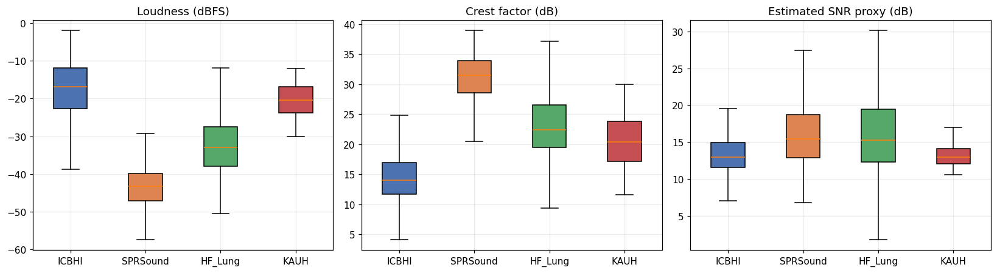
Acquisition fingerprints: loudness differs by ~26 dB
LOUDNESS
SNR PROXY
ICBHI −16.8 dBFS SPRSound −43.2 dBFS
Medians span only 12.9–15.4 dB
5
NORTHWESTERN ENGINEERING

Slide 6
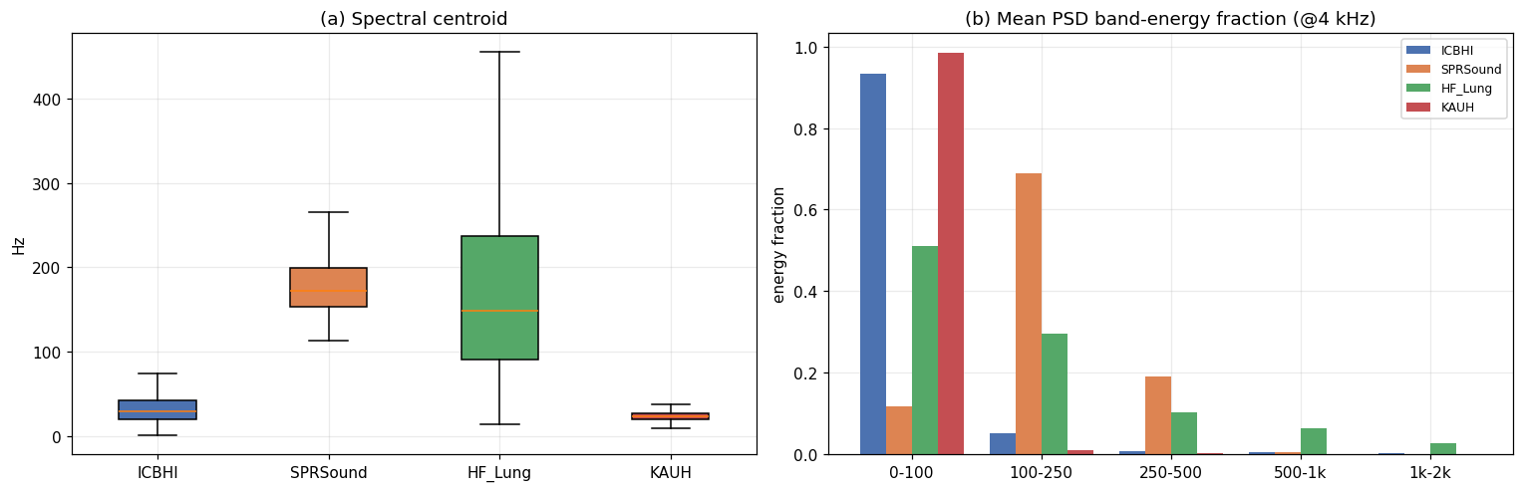
Raw spectral shape is strongly dataset-specific
SPRSound concentrates energy in 100–250 Hz; HF_Lung is broader; ICBHI/KAUH are strongly low-frequency dominated.
These raw differences motivate harmonized preprocessing and dataset/device-stratified evaluation.
6
NORTHWESTERN ENGINEERING

Slide 7
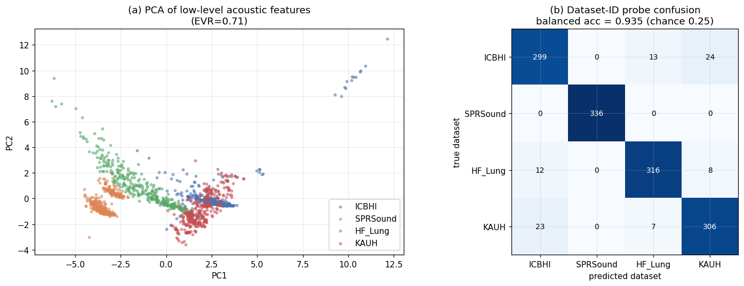
Low-level acoustics identify the dataset with ~0.92–0.94 balanced accuracy
Original plot
Recheck
SPRSound
0.935 recording-level CV
0.924 patient-grouped CV
336 / 336
7
NORTHWESTERN ENGINEERING

Slide 8
From source alignment to the open research question
Patch-Mix
PAFA
SG-SCL
62.1708
64.143
60.984
author: 62.17
paper: 64.84 ± 0.60
paper: 61.71 ± 1.61
1
2
3
4
→
→
→
Source alignment
Direct source-head transfer
Frozen encoder + target head
Rare-event multi-dataset learning
Verified
Verified
Verified
Proposed
8
NORTHWESTERN ENGINEERING

Slide 9
Direct source decision layers do not transfer
Same 1,429 SPRSound inter events
ZERO-TARGET-TUNING
Binary AS
Narrow-four diagnostic
Patch-Mix
59.38
51.15
PAFA
55.82
51.19
SG-SCL
59.98
50.08
Better than random guess☺
Source features may be useful; the source classifier is not.
9
NORTHWESTERN ENGINEERING

Slide 10
Frozen representations retain target-linear accessibility
Binary AS on the same SPRSound inter set
ENCODER FROZEN
0
50
100
direct head 59.38
Patch-Mix
target head 87.68
direct head 55.82
PAFA
target head 84.29
direct head 59.98
SG-SCL
target head 90.65
the representation is reusable under target supervision.
10
NORTHWESTERN ENGINEERING

Slide 11
Aggregate recovery and minority failure coexist
Seven-class aggregate metrics
SPRSound inter support
Patch-Mix
Official Score
Macro-F1
UAR
Normal
1040
82.37
0.362
0.351
Wheeze
305
PAFA
Official Score
Macro-F1
UAR
Fine crackle
80
75.77
0.387
0.279
Coarse crackle
3
SG-SCL
Official Score
Macro-F1
UAR
84.41
0.372
0.351
Wheeze + crackle
1
Wheeze + crackle recall = 0 for all three models
11
NORTHWESTERN ENGINEERING

Slide 12
Proposed system: share only acoustically compatible supervision
ICBHI
→
SHARED HEADS
crackle families • wheeze normal & abnormal
SPRSound
→
OPTIONAL DATASET ADAPTERS
SHARED ACOUSTIC ENCODER
→
→
HF_Lung
→
DATASET-NATIVE HEADS
quality / diagnosis / interval heads
KAUH
→
dataset balancing × class balancing
12
NORTHWESTERN ENGINEERING

