Slide 1
Mastering Git
A Git Workshop by Pablo Rodríguez for Z1 Digital Studio

Slide 2

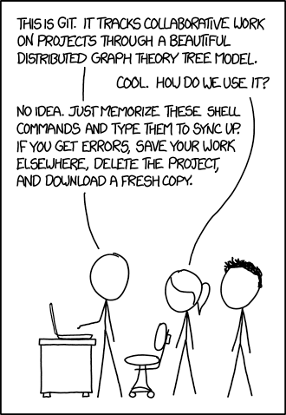

Slide 3
La demo app
https://github.com/z1digitalstudio/git-workshop-demo-app
gh repo clone z1digitalstudio/git-workshop-demo-app

Slide 4
Aquí se viene aprendido de casa

Slide 5
¿Qué es un commit?

Slide 6
¿Qué es una rama?

Slide 7
Commits are snapshots, not diffs
https://github.blog/2020-12-17-commits-are-snapshots-not-diffs/

Slide 8
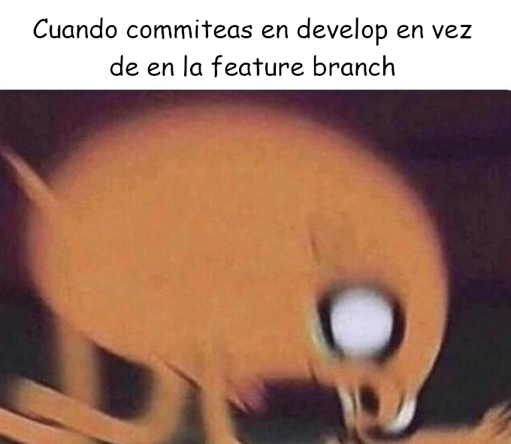

Slide 9
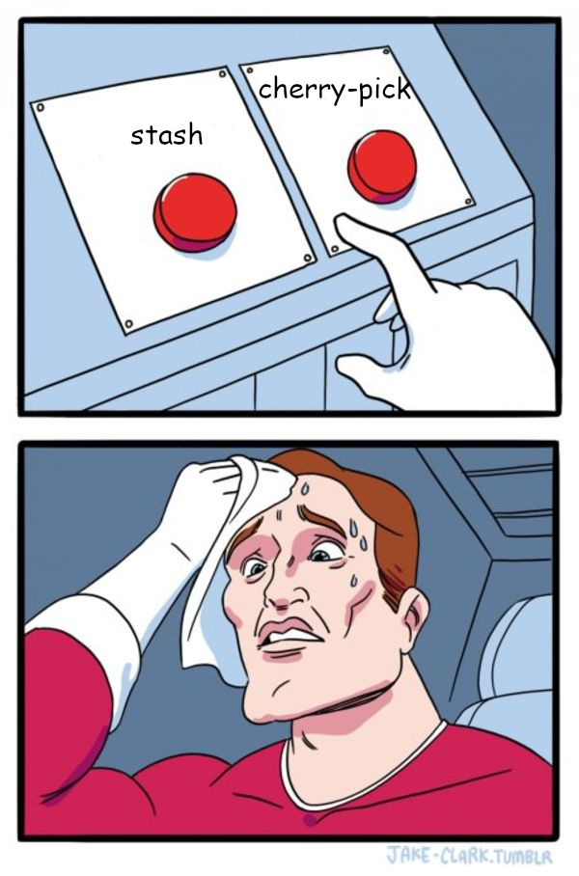

Slide 10
git stash

Slide 11

git stash
Stash the changes in a dirty working directory away

Slide 12
git cherry-pick

Slide 13
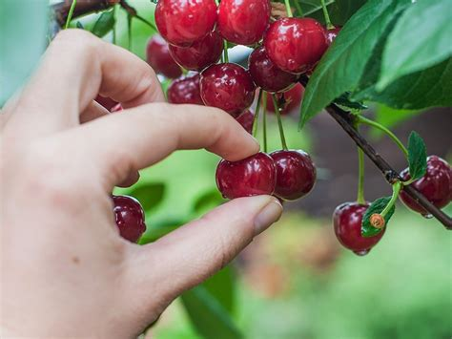
git cherry-pick
Apply the changes introduced by some existing commits

Slide 14
A
B
C
D
HEAD
develop
ω
ψ
C’
HEAD
HEAD
feature
$ git switch feature
$ git cherry-pick C

Slide 15
Moviendo commits entre ramas
Caso práctico

Slide 16


Slide 17


Slide 18
git commit --amend

Slide 19

git commit —amend
Replace the tip of the current branch by creating a new commit.

Slide 20
Modificando un commit existente
Caso práctico

Slide 21
¿Qué pasa si hacemos un amend a un commit pusheado?

Slide 22
git push —force

Slide 23
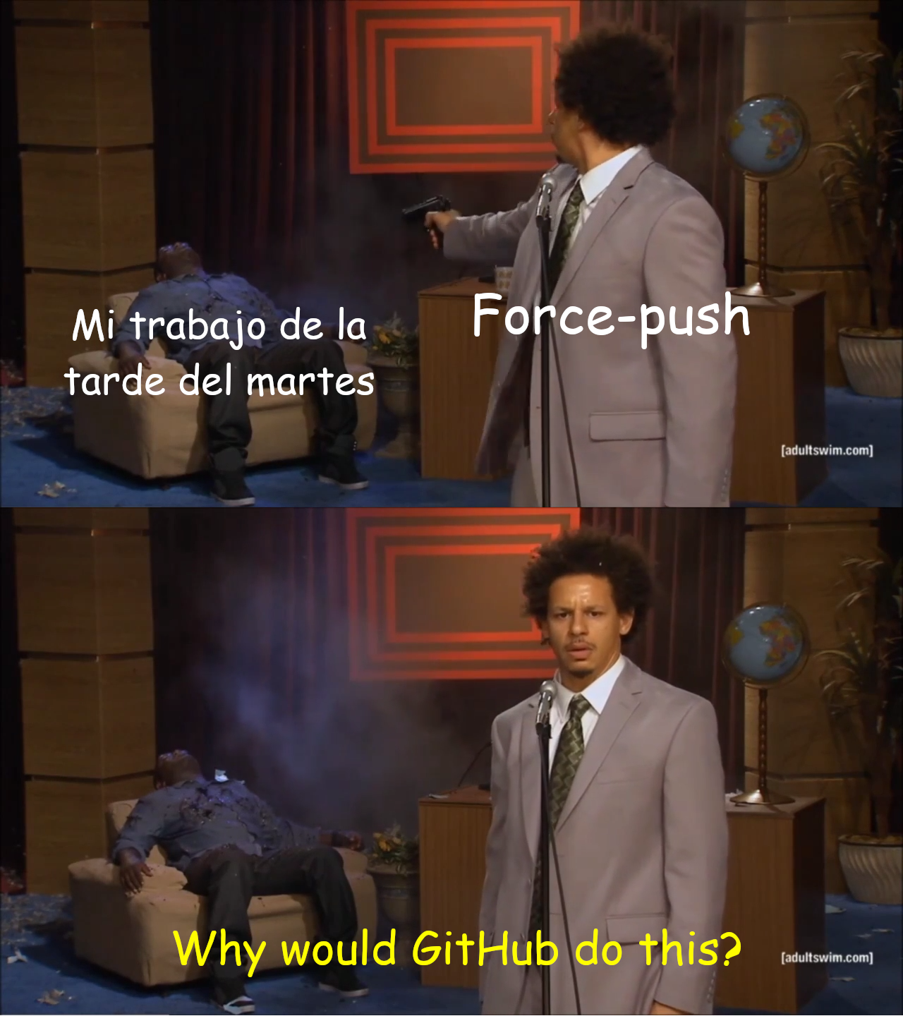
git push —force
Usually, the command refuses to update a remote ref that is not an ancestor of the local ref used to overwrite it. [...] This flag disables these checks, and can cause the remote repository to lose commits; use it with care.

Slide 24
A
B
C
D
D’
feature
A
B
C
D
D’
origin/feature
$ git push
$ git commit —amend -m “Nuevo mensaje”
$ git push —force

Slide 25
git push —force-with-lease

Slide 26
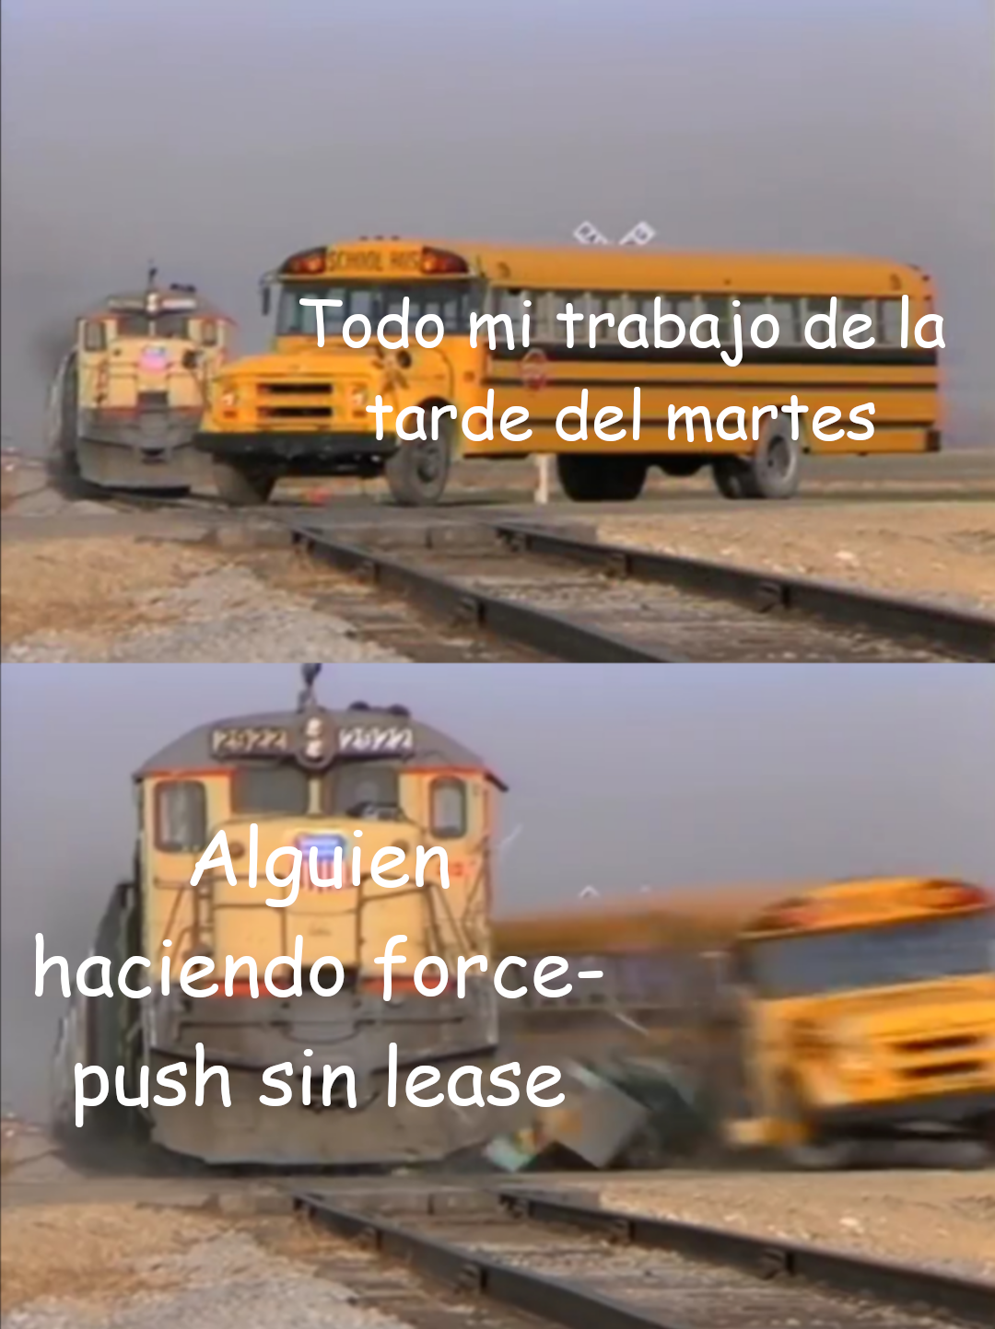
git push —force-with-lease
https://git-scm.com/docs/git-push#Documentation/git-push.txt---force-with-leaseltrefnamegt

Slide 27
A
B
C
D
D’
feature
A
B
C
D
E
origin/feature
$ git commit —amend -m “Nuevo mensaje”
$ git push —force-with-lease

Slide 28
¿Qué podemos hacer para evitar force-pushes accidentales a master y a develop?

Slide 29
Configurando ramas protegidas en GitHub
Caso práctico

Slide 30


Slide 31
git commit --fixup

Slide 32

git commit –fixup
Create a new commit which "fixes up" <commit> when applied with git rebase --autosquash

Slide 33
ω
ψ
χ
f! ψ
feature
$ git commit –fixup ψ

Slide 34
git rebase

Slide 35
A
B
C
develop
ω
ψ
χ
f! ψ
HEAD
feature
ω
ψ
χ
f! ψ
$ git rebase develop

Slide 36
¿A qué nos recuerda todo esto?

Slide 37


Slide 38
A
B
C
develop
ω
ψ
χ
f! ψ
f! ψ
feature
$ git rebase -i –autosquash develop

Slide 39
A
B
C
develop
ω
ψ
χ
feature
Rebase
vs
Merge
A
B
C
develop
ω
ψ
χ
feature

Slide 40


Entonces, ¿rebase o merge?

Slide 41
Torvalds sobre los rebases
https://www.kernel.org/doc/html/latest/maintainer/rebasing-and-merging.html

Slide 42

Fossil: “Rebase considered harmful”
https://fossil-scm.org/home/doc/trunk/www/rebaseharm.md

Slide 43
Mejorando una PR con rebase interactivo
Caso práctico

Slide 44
¿En qué se diferencia un merge commit de un commit normal?

Slide 45
Torvalds sobre los “octopus merge”
https://marc.info/?t=138540142500001&r=1&w=2

Slide 46
¿No os recuerda a algo eso de los “octopus”?

Slide 47


Slide 48


Slide 49
git bisect

Slide 50
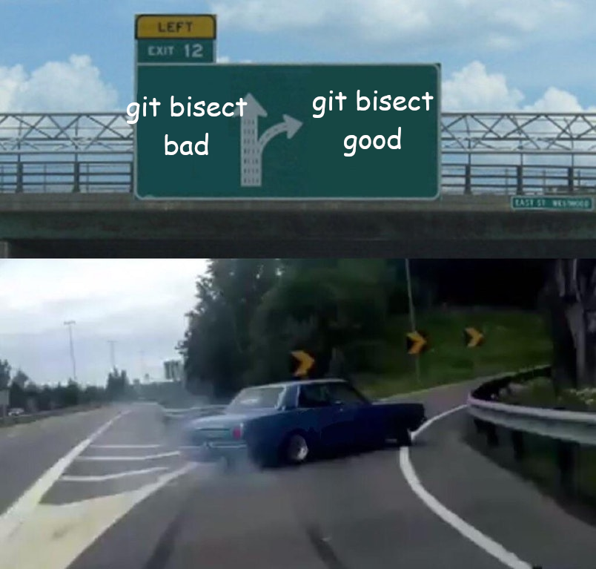
git bisect
Use binary search to find the commit that introduced a bug

Slide 51
Encontrando cuándo se introdujo un bug con bisect
Caso práctico

Slide 52


Slide 53
git revert

Slide 54

git revert
Given one or more existing commits, revert the changes that the related patches introduce, and record some new commits that record them.

Slide 55
Revirtiendo el commit que introdujo el bug
Caso práctico

Slide 56
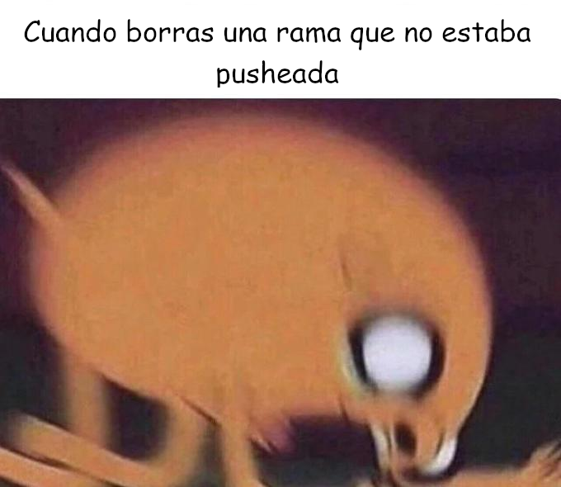

Slide 57
git reflog

Slide 58

git reflog
Reference logs, or "reflogs", record when the tips of branches and other references were updated in the local repository

Slide 59
Recuperando un commit perdido
Caso práctico

Slide 60
gh

Slide 61


