Slide 1



To Tweet of Become Extinct?:
Why Surgeons Need to Understand Social Networking (PS233)
aka #ACS2010
This is a CESTE Sponsored Panel for #ACSCC10
@amcollsurgeons and @OpPatientAccess
Philip L. Glick, MD MBA FACS
(aka @glicklab)
Vice Chairman, Department of Surgery
Professor of Surgery, Pediatrics, Obstetrics & Gynecology, SUNY @ Buffalo

Slide 3
Panel’s Agenda (#ACS2010)
Introduction “To Tweet or Become Extinct?: Why Surgeons Need to Understand Social Networking and Social Media” (@glicklab)
“To Twitter or Die: The ABC’s of Safe Surgical Social Networking” (@z1g1)
“Can Tweeting Make You Smarter of “Dumber”: Using Social Networking for GME, CME, and Patient Care” (@sani2012)
“The E-Patient is In: How Social Networking Can Make You a Better Surgeon” (@susannahfox)
“Oper @ ting Safely on Social Networks: Legal Do’s and Don’ts” (@razmonson)
Live/Online Panel Q & A and “Concluding Remarks” (@dscottlind)
Our Live Twitter Audience Ombudsman (@theartofeyes)

Slide 4
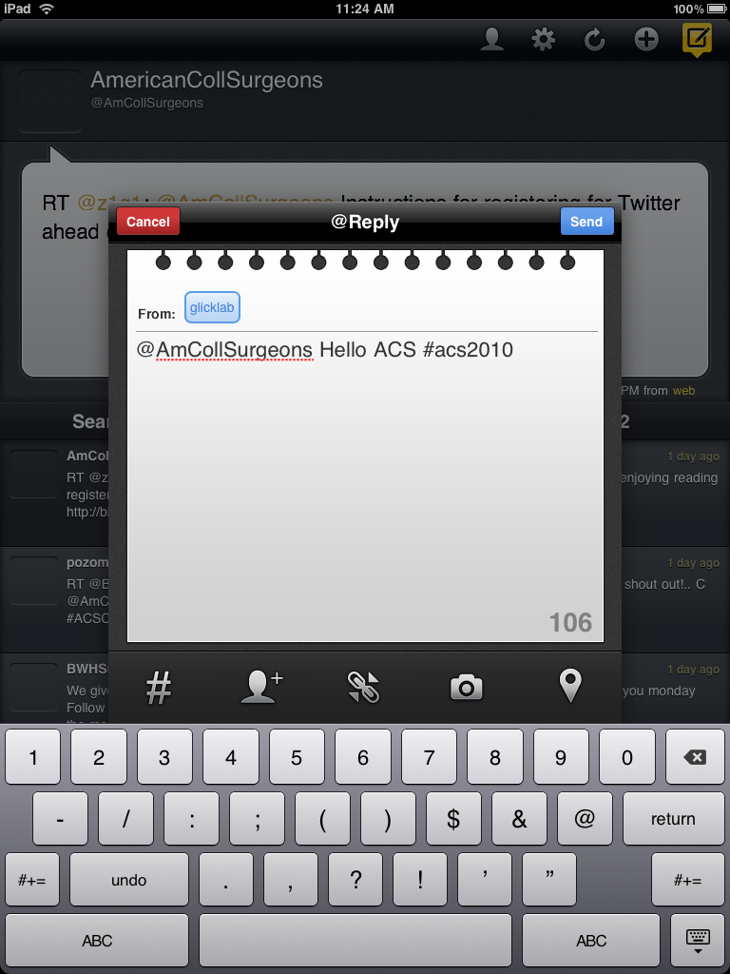
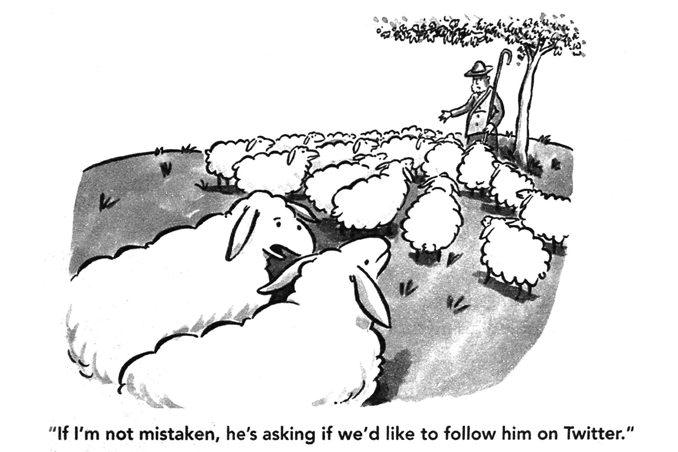
Yes, Please! @glicklab, #ACS2010

Slide 5
Guidelines for a Live Twitter Comments and
Q and A (The Back Channel)
#ACS2010 or @THEARTOFEYES
Our Live Twitter Audience Ombudsman is @theartofeyes
Please be courteous to our Front Channel Speakers, they can’t see the Twitter Feeds or the Audience
Real Time Comments are Encouraged
Multitasking Obviously is Encouraged
The Ombudsman May Interrupt the Speaker for Timely Comments or Questions or Save Them for the Q &A
The Back Channel Activity Should be Constructive, Synergistic, & Value Added!
Any Comments or Questions We Can’t Get to During PS233 Will be Responded to shortly After the Session
Fellows or others not able to attend PS233 are encourage to comment or ask questions (#ACS2010)
If You Have a Different Interest or Agenda than PS233 share it somewhere else

Slide 6
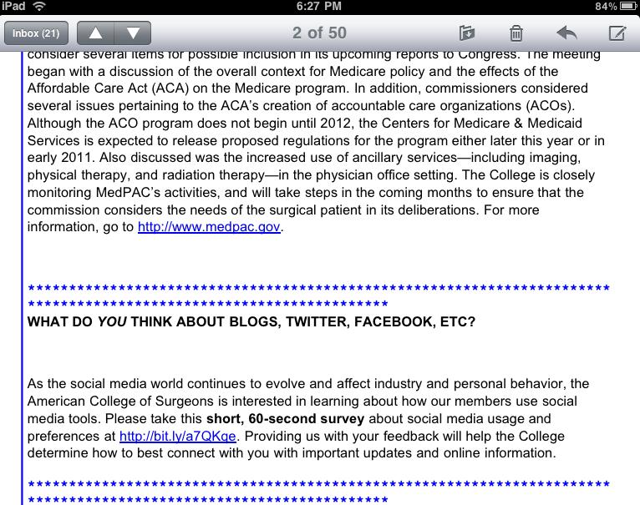
ACS Weber Shandwick Survey*
(ACS Newscope 9/18/2010)

Slide 7
ACS Weber Shandwick Survey*
(N=294-312, September 2010)
1. How often do you engage in the following social media sites?
 | answered question |  |  |  |  |  |  | 315
 | skipped question |  |  |  |  |  |  | 0
 | Daily | Weekly | Monthly | Rarely | Never | Never heard of it |  | Response Count
Twitter** | 5.6% (17) | 3.0% (9) | 1.3% (4) | 10.5% (32) | 79.0% (241) | 0.7% (2) |  | 305
Facebook*** | 23.4% (73) | 13.1% (41) | 3.2% (10) | 15.1% (47) | 44.9% (140) | 0.3% (1) |  | 312
YouTube | 7.4% (23) | 22.3% (69) | 19.4% (60) | 32.4% (100) | 17.8% (55) | 0.6% (2) |  | 309
Flickr | 0.0% (0) | 3.0% (9) | 2.6% (8) | 14.9% (45) | 65.9% (199) | 13.6% (41) |  | 302
LinkedIn | 1.6% (5) | 5.9% (18) | 5.3% (16) | 19.4% (59) | 52.3% (159) | 15.5% (47) |  | 304
Sermo | 1.4% (4) | 5.8% (17) | 2.4% (7) | 8.5% (25) | 41.2% (121) | 40.8% (120) |  | 294
 |  |  |  |  |  |  |  | 13
- US Population on Twitter* = 7% (v ACS ~ 20%), on Facebook** = 41% (v ACS ~64%)
*http://www.surveymonkey.com/sr.aspx?sm=K1FaI2kH861MhqHLl5WbVcuC2xCZAOz6PgpLBiB6hWA_3d
**http://www.convinceandconvert.com/twitter/7-surprising-statistics-about-twitter-in-america/
***http://www.socialmediatoday.com/roywells1/158020/416-us-population-has-facebook-account

Slide 8
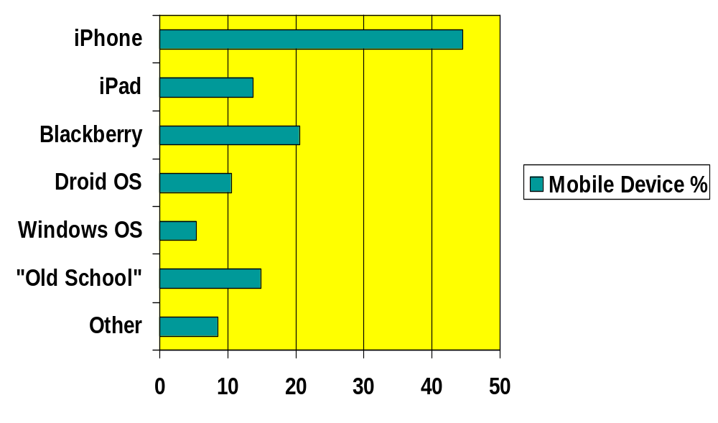
ACS Weber Shandwick Survey*
(N=256, September 2010)
****US Population with Mobile “Apps” = 35% (v ACS ~ 70%)
*http://www.surveymonkey.com/sr.aspx?sm=K1FaI2kH861MhqHLl5WbVcuC2xCZAOz6PgpLBiB6hWA_3d
**** http://pewinternet.org/Reports/2010/The-Rise-of-Apps-Culture.aspx

Slide 9
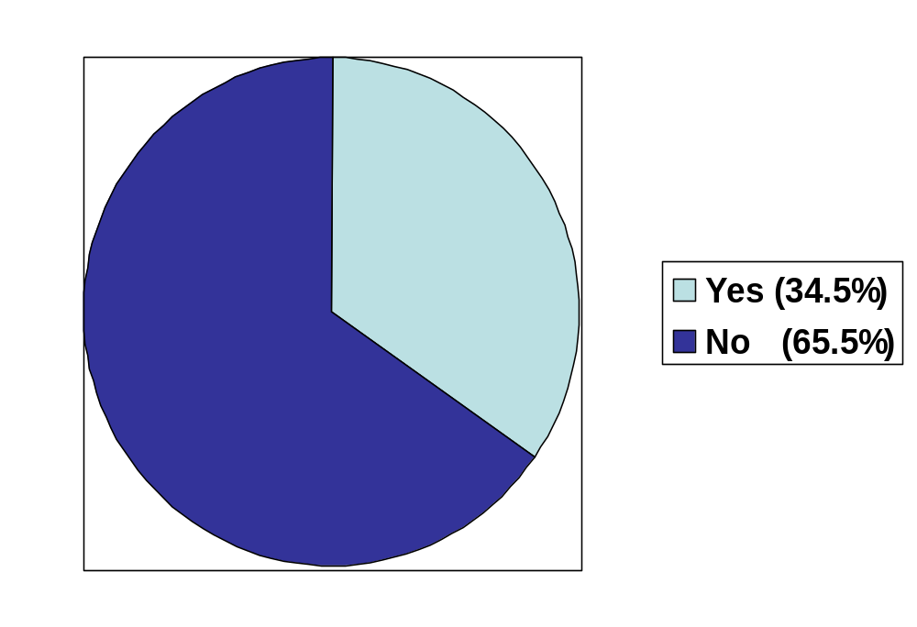
ACS Weber Shandwick Survey*
(N=312, September 2010)
Do you Participate in On-Line Forums or Read on-Line Health Blogs?
* http://www.surveymonkey.com/sr.aspx?sm=K1FaI2kH861MhqHLl5WbVcuC2xCZAOz6PgpLBiB6hWA_3d

Slide 10
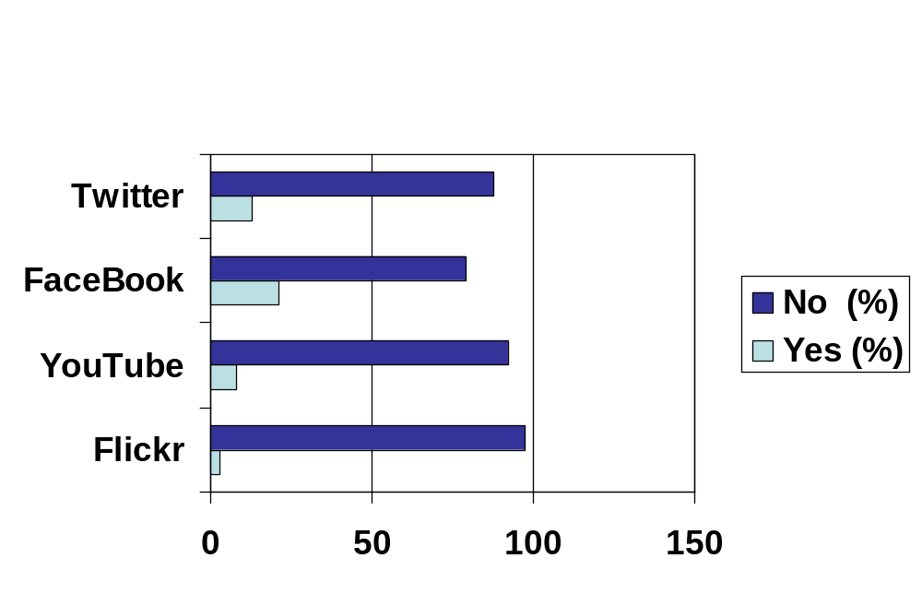
ACS Weber Shandwick Survey*
(N=307-313, September 2010)
Did You Know ACS Has an On-Line Presence for:?
* http://www.surveymonkey.com/sr.aspx?sm=K1FaI2kH861MhqHLl5WbVcuC2xCZAOz6PgpLBiB6hWA_3d

Slide 11
What is Social Network(ing)?
The interaction between a group(s) of people who share a common interest(s)
The use of the Internet (sites/communities/media) to communicate between people sharing common interests, related skills, or geographical locations
Social networking – Wiktionary (http://en.wiktionary.org/wiki/social_networking)
Social network Definition from PC Magazine Encyclopedia (http://www.pcmag.com/encyclopedia_term/0,2542,t=social+network&i=55313,00.asp)

Slide 12
What is Social Networking
For Surgeons?
The interaction between a group(s) of people (surgeons, healthcare teams, patients, families, etc) who share common interests (pt care, quality, GME, CME, advocacy, etc)*
* ”The American College of Surgeons (ACS) was established in 1913, at the initiative of Franklin Martin, MD, FACS, Chicago, IL, as a surgical society dedicated to promoting the highest standards of surgical care through education of, and advocacy, for its Fellows and their patients, and to safeguarding standards of care in an optimal and ethical practice environment.”
(ACS Archives http://www.facs.org/archives/index.html)

Slide 13

Where is Social Networking
For Surgeons?
On the Internet

Slide 14
What is Social Media / Social Network(ing)?
Six Common Sites 4 Surgeons
  Twitter* (friends, colleagues, & patients; all in format) http://www.twitter.com
  Facebook* (friends, colleagues, & patients; opt in format) http://www.facebook.com
  Flickr * (photo sharing)
  http://www.flickr.com/
  YouTube* (a place to share video clips)
  http://www.youtube.com/
  Sermo (MD/DO only, req last 4 SS#’s to verify)
  http://www.sermo.com
  LinkedIn (business & professional networking)
  http://www.linkedin.com
  * See ACS Bookmark You Received at Registration

Slide 15
Why Surgeons Need to Understand Social
Networking and Social Media?
Who’s there: Your Colleagues, Your Trainees (at every level), Your Patients, Their Families, Your Potential New Patients, Your Payors, Your Hospitals, Your Universities, Your Professional Organizations, Your State Medical Licensing Boards, etc
It is a Time Efficient, Low Cost, Geographically Borderless (Flat) Way to:
  Share “Interesting cases” with Colleagues
  Share knowledge for GME to greater numbers of trainees
  Obtain CME
  “Market” New Programs
  “Recruit” New Patients
  Provide Patient Education Materials
  Put the World at Your Finger Tips
  Prevent burnout or Rejuvenate the mid-career “Blues”
  Provide “Second Career” Opportunities
  …

Slide 16

What is Social Media / Social Networking?
By @equalman http://www.youtube.com/watch?v=oalBUgzKaLw

Slide 17
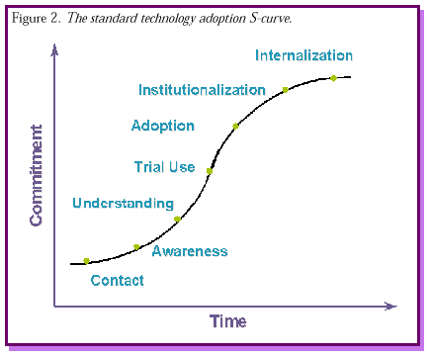
ACS Social Networking Adoption Curve
http://www.stsc.hill.af.mil/crosstalk/1999/11/paulk.asp

Slide 18
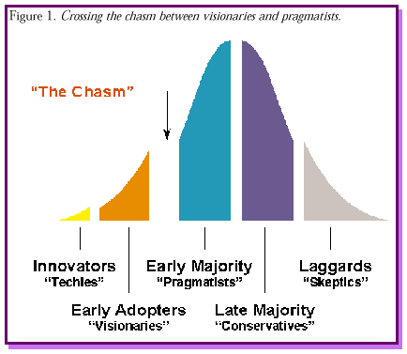

Crossing “The Chasm” Between
“Visionaries” → “Pragmatists”
FACS Home
FACS FaceBook
FACS Twitter
FACS Flickr
FACS Youtube
http://www.stsc.hill.af.mil/crosstalk/1999/11/paulk.asp

Slide 19

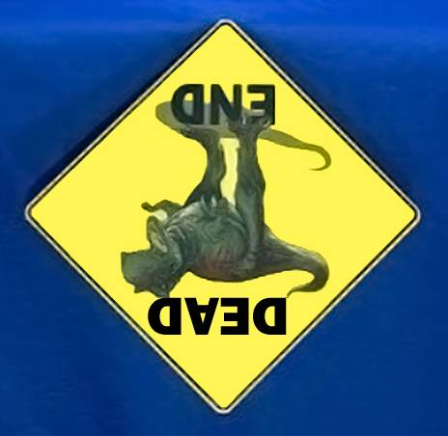
Twitter:
@glicklab, #ACS2010
Voice:
(716) 878-7449
Fax:
(716) 877-7998
E-mail:
glicklab@aol.edu
Internet:
www.smbs.buffalo.edu/sur/ped/

