Slide 1
To Tweet or Become Extinct?: Why Surgeons Need to Understand Social Networking
Zack Glick MS
Website Administrator
Syracuse City School District
@z1g1
z1g1.net
mail@zackglick.com

Slide 2
Twitter ABCs
  A connected network that allows for the sharing of short messages, with over 145 Million Users.
  Because of its simple interface it is a flexible tool that can be used for communication
  Consequently knowing what to do and what not to do are critical for a surgeon to successfully utilize this technology
  Twitter Registration cheat sheet http://bit.ly/aFk9oe
Notes:
With so many users online you are able to harness the power of crowd sourcing if you curate the propper community
conversations are the esence of Social Networking
Understadning the cocktail party nature of Social Networking, you observe and listen at a cocktail party before joining a conversation and start hanging out buisness cards
A simple interface provides that tools that non technical users can employ to harnes a very high tech system
Understand that Twitter and all Social Networking sites are public forums and accessable via Search engines (Google, Bing, ect) and that propper configurations and awarness are critical for anyone to utilize these technoloogies effectively

Slide 3
Security Considerations
  Controlling your identity
    If your desired name is taken try a variation by adding Dr to the front or MD to the back
    Your username is how people will see you on Twitter, choose it like a professional email
  Controlling your account
    Anyone with your password can broadcast to all of followers
    Beware of sites or applications asking for your password, you should only ever enter your password on https://twitter.com
  Maintaining Privacy
    Protected accounts allow you to control who can see your updates
Notes:
Controling your online identity requires the same awareness that contorling you physical identity requires: Caution, Location Awareness and Common Sense
Your Username is used to find and communicate with you on Twitter, if this is going to be a personal account make sure it is professional but also keep is short to allow for @ replys and RT's
Twitter Oauth Announcement http://bit.ly/9zKFgn
By default your updates are public and can be viewsd by anyone, anyone can become your follower without your consent and you will recive an email whenever something happens regarding your accont on Twitter. Propper configuration is key

Slide 4
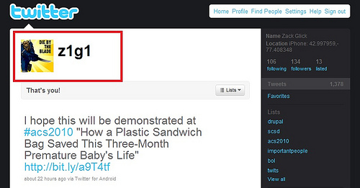
Twitter Nomenclature
  Username: a person or group's "handle"

Slide 5
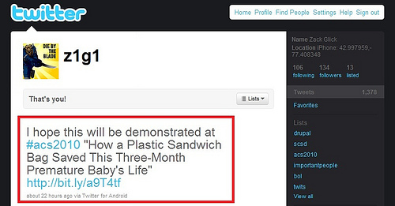
Twitter Nomenclature
  Update aka "tweet": a posting that is made to a User's profile it can include links to stories, photos, videos, or messages to other Users. Limited to 140 characters

Slide 6
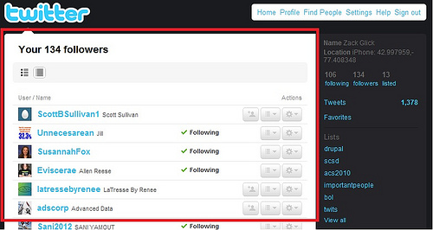
Twitter Nomenclature
  Follower: a Twitter user who has subscribed to another user's updates

Slide 7
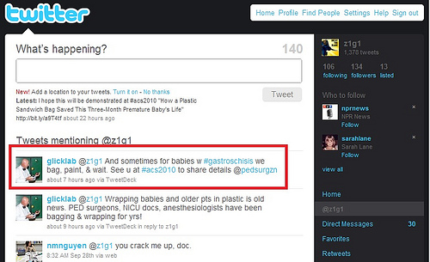
Twitter Nomenclature
  @ reply: placing an @ sign in front of a username will send a publicly viewable message to the specific user

Slide 8
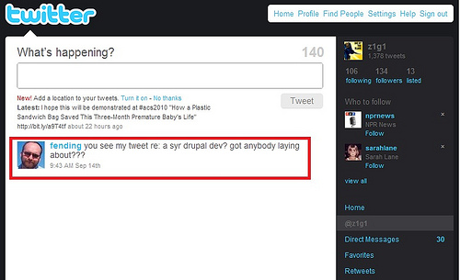
Twitter Nomenclature
  Direct Message aka "dm":This is a way to send a private message to a Twitter user

Slide 9
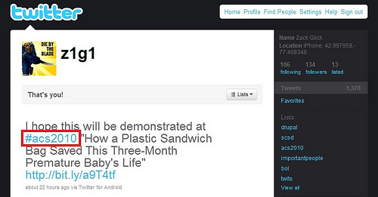
Twitter Nomenclature
  Hashtag: placing a # in front of a word helps you categorize the updates that you send. Example #ACS2010

Slide 10
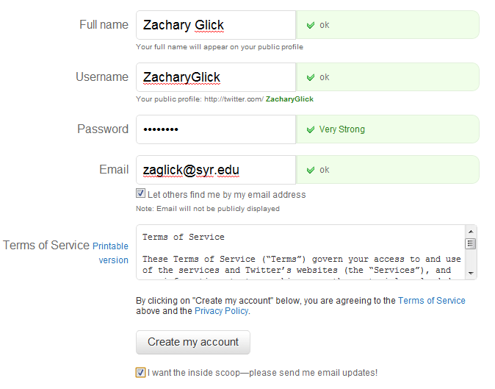
Setting Up an Account
  Information Required for registration
Notes:
Using your real name allows your account to be located easier, and can help distinguish you from others with a simlar name, it also can allow you to add spaces, periods and other characters not allowed in the Username
Passwords need to be strong including upper and lowercase letters, numerals and special characters, remmebering these passwords can be dificult and a password manager can help
beware saving paswords to your browser sicne they are stored in plaintext
I use Last Pass premium to remember all of my passwords
Only ever enter you password on HTTPS://www.twitter.com
Your email is used to recover your password if you loose it so use an email that you can access and turn off email notifications in the settings
Terms of service http://twitter.com/tos
you are at the mercey of Twitter when it comes to TOS, if you don't agree you are can not play in thier pool
The TOS can changes at anytime without notification and your relatioship with Twitter can change
Using a service like Backupify can allow you to archive you updates outside of Twitter
Uncheck the inside scoop

Slide 11
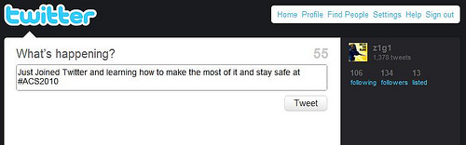
Hello World ! !
Notes:
your first message, that you get a computer to send when you are learning a language
A tradition in the programming world

Slide 12
Ok now what?
  Finding People
    Twitter Suggested Users feature lets your browse more well known users
    Search for people via your webmail account or LinkedIn profile
    www.Twitter.com/%username get you to the desired users page and you can follow specific people
    A Twitter list will allow you to follow multiple people at once
  Post Something
    Participate in #musicmonday or #followfriday
    Share a link to an article or photo
    Send a "Hello World!" message
Notes:
remember our cocktail party metaphor, observe, listen and then get invovled
Twitter and other Social Networks are an open community and remember that in any open communmity you will get all types participatting, follow the positive comments and block the spammers and negitive users

Slide 13
More Information and Resources
  Twitter Registration cheat sheet http://bit.ly/aFk9oe
  Please contact me with any questions
    Twitter: @z1g1
    Online: http://www.z1g1.net `

