Slide 1
Can Tweeting Make You Smarter of Dumber?
Using social networking for GME, CME,
and patient care
#acs2010
Sani Z Yamout, MD
@sani2012/@pedsurgzn
Fellow
Division of Pediatric Surgery
Department of Surgery
SUNY at Buffalo
Notes:
My name is Sani Yamout
I’m a pediatric surgery fellow at WCHOB
now that we got a introduction to the use of twitter, let’s look at how it can be applied, in conjunction with other forms of social media, in the surgical education and patient care

Slide 2



Notes:
Twitter's initial purpose was for it to be a tool that helps people keep up with their friends and their day to day activities.
This has caused many to brand it as gimmick that is just another way for teenagers to waste their time
I see this consistently in the responses I get from colleagues any time I mention using twitter in the field of surgery
The typical response would be: SO you’ll send out messages like: ” coming out of OR", 'did a sweet pull through”
What many people do not realize is that Twitter has had a substantial change in direction purpose

Slide 3
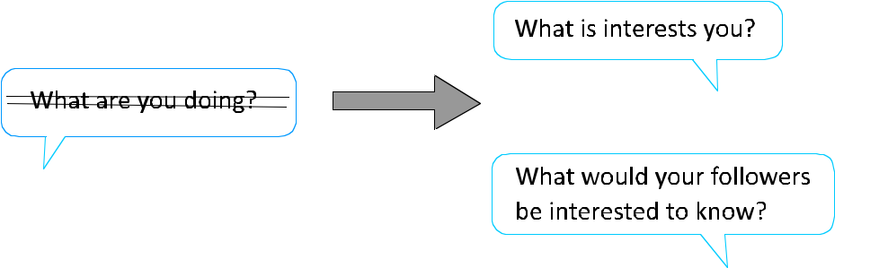
Notes:
Many of the Twitter users have moved from mostly talking about what they are doing on a daily basis, to sharing thoughts, findings, and news that interests them and people who are following them.
This is what we are interested in. Basically using twitter to help with surgeon education and patient care
Additionally the almost universal availability of smart phones, which allows for an "anytime-anywhere" mobile access to the internet, has made Twitter a one-point source for obtaining and sharing information on the go

Slide 4
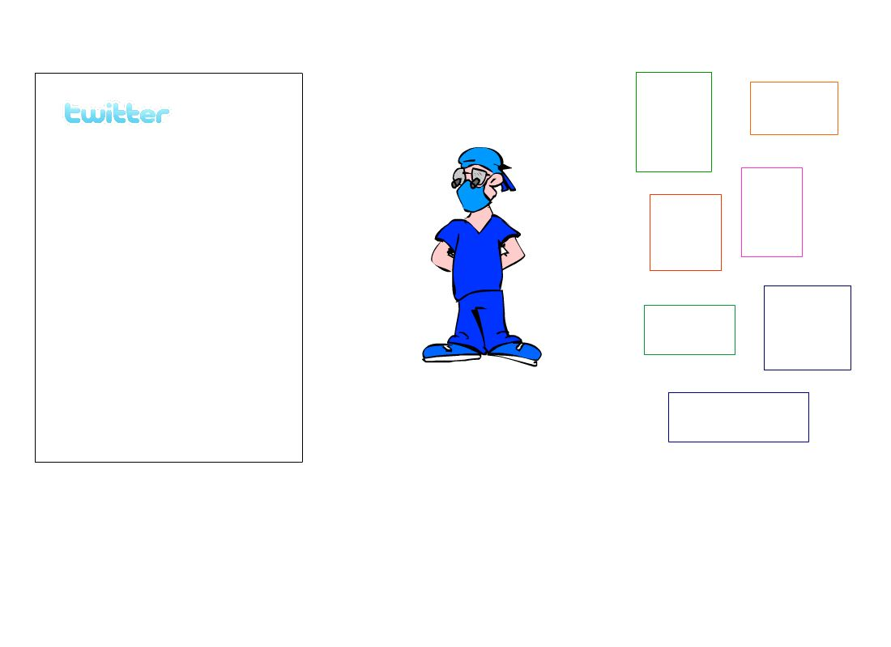

Blog
Website
Great new trick
You tube video of
pyloro-myotomy
Deadline for ACS meeting registration
CME credits website
Job opportunity
Website
Blog
Website
Blog
Website
Personal Learning Network
Internet Sources
Notes:
For example. As a ped surg fellow.
I spend a substantial amount of my time online looking up articles and other sources of information to help my care for my patients.
Whenever I find a paper, website, Youtube video, or blog that interests me, I send out a tweet with a link to that site.
So, effectively, I'm sifting through the internet and gathering and sharing information useful to me at my level of training and interest
Now other people following me, including other pediatric surgery fellows, also have access to this information thru twitter
They can browse through the brief 140 character message, and decide if they are interested enough in the content to hit the URL link and get more info
Now imagine 10, 20, or 30 other surgeons with similar interest doing the same and exchanging the information they find

Slide 5
Twitter is a tool that can help surgeons with similar interests work together to organize web contents within a personal learning network
Notes:
When used in this manner, Twitter can be a way for surgeons with similar interests and levels of training to work together to organize the web contents to suit their needs within what could be described as a personal learning network
This can be a substantial tool that compliments didactic learning.

Slide 6
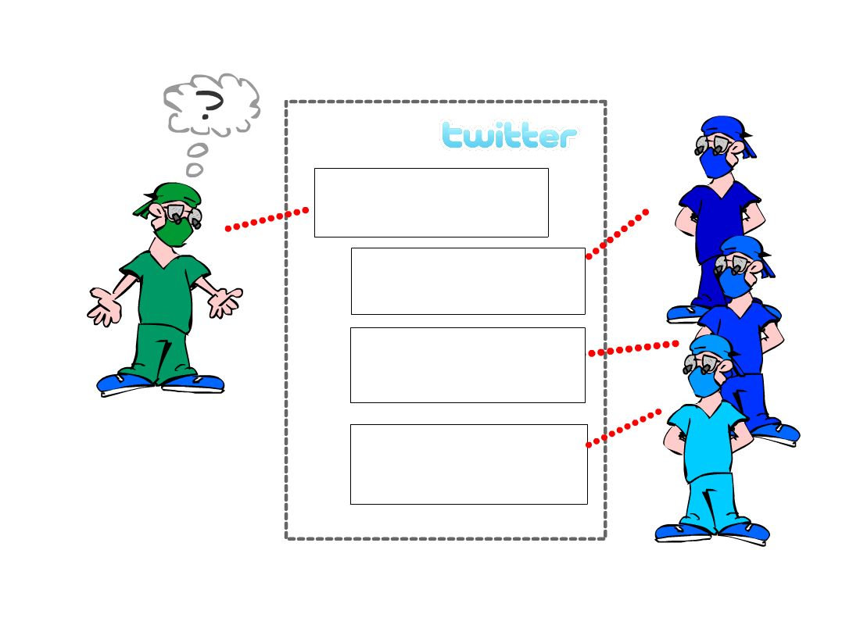
What r u using for lap pylorus instead of knife?
Insulated bovie. Cutting to 8
Good paper http://ARw4
Bovie. see youtube video
http://RTW-9Aj
Went nack to doing them
open!
Notes:
In addition to using Twitter to spread information, Surgeons can use it to contact and interact with each other instantaneously, regardless of geographic location
The ability to imbed links to references within messages makes twitter particularly appealing for such communications

Slide 7
How can Twitter be used in surgical education?
Notes:
So, how can Twitter be used in surgical education

Slide 8
How can Twitter be used in surgical education?
Announcements
Biliary trct injuries panel session PS111 starting in 30 minutes #ACSCC10
#hepatobil
Notes:
ANNOUNCEMENTS:
For example, The ACS meeting is a huge conference. One way to make the most efficient use of it would be for surgeons of similar interests to tweet out information regarding talks, posters, and exhibitions relevant to their field of interest to help direct each other to these events
As you can see here, the tweet is reminding surgeons who are interested in HB surgery about the Panel session.
It is marked by two hashtags to help followers keep track
It can also be used to make announcements that simply make the conference experience more pleasant

Slide 9
How can Twitter be used in surgical education?
Announcements
Free food at the #SurgTechno booth!!

Slide 10
How can Twitter be used in surgical education?
Helping residents study
What is the pre-op workup for Wilm’s? #PSITE http://WzrA23x
Notes:
Twitter can be used to help residents prepare for exams.
For example, I have in a mind a system where, once a week, I would tweet out a board type question then link it to a discussion in my blog.
This way I benefit from researching the subject, and other fellows following me benefit from reading and contributing to my post.

Slide 11
How can Twitter be used in surgical education?
Gathering and sharing resources
Great discussion on management of perf’d appys in kids http://Wrx103
Notes:
Again, one of the main uses for twitter

Slide 12
How can Twitter be used in surgical education?
Directing surgeons to sources of CME
1 hour of CME credits online at http/:WXrT/Ao #CMESurg
Notes:
DIRECTING TO CME SOURCES
As you all probably know, the ABS MOS program now requires 50 CME credit hours in 3 year cycles.
Twitter can potentially be used as tool that can direct surgeons to sources of CME credits relevant to their interest and field of training.

Slide 13
What’s happening?
140
Twitterer
Glicklab how often is bilious emesis due to surgical cause in a neonate? #PedSurg #Surg
http://ArO-Wx
Hashtag
Shortened URL
Notes:
Here are a few examples, Let's say you are following Glicklab (handle for our twitterer), who posted a tweet about the issue of bilious emesis in newborns.
He also attached a URL that can direct you to the source of info. Additionally, he added a couple of hashtags in order to help people interested in pedsurg or surgery to locate his tweet
now if you are a ped surgeon following glicklab, you would probably be interested in this subject, so you click on the URL link...

Slide 14
What’s happening?
140
Glicklab how often is bilious emesis due to surgical cause in a neonate #PedSurg
http://ArO-Wx

Slide 15
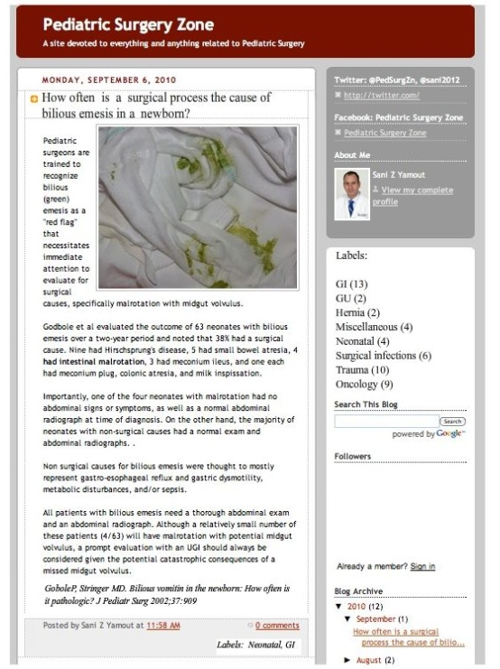
Blog name
Date of post
Title of post
Blogger profile
Index of posts
by subject
Reference
Notes:
For those who are not familiar with the term, a blog is an online personal journal that discusses thoughts and ideas, frequently with links to other sources
So if we look at this structure of this blog post...
Discuss content
mention how subjects can be easily archived, indexed and searched
if you notice at the bottom, I labeled the post. The post is then automatically indexed for EZ retrieval at any time
Blogs are being increasingly used by healthcare workers because of the ease of use and powerful capacity for the spread and exchange of information
Blogs can be created by a person or a group and accessed by followers, who can discuss and comment on the subject online.
By being interactive and engaging, blogs can attract a large group of followers
They are very easy to incorporate into an educational environment and can compliment more traditional didactic teaching methods.
One of the nice things about blogs, is that each has their own URL, which makes linking the blog through other sites, as we saw in the case of the prior tweet, very easy

Slide 16
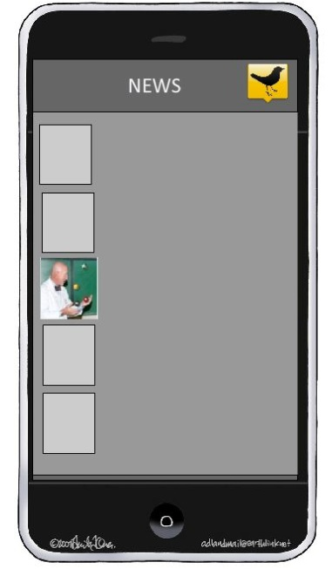

Sani2012: Lap pylorus using a bovie
http:Aor3 #pedsurg
Notes:
Here’s another example. If you are following me on twitter and decided they want to know more about this post related to using the bovie instead of the arthrotomy knife for lap pyloromyotomies
hit the URL and it seamlessly directs you to...

Slide 17

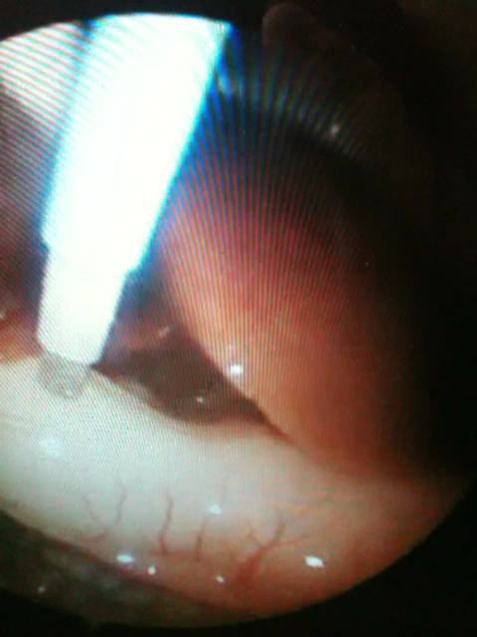
Sani2012: Lap pylorus using a bovie
http:Aor3 #pedsurg
Notes:
a Youtube VIdeo of the procedure
You tube is another example of an online resource that is of huge educational benefit.
PAUSE
If you search laparoscopic surgery on the youtube site, you get over 4000 hits. Unfortunately, much of this is basically junk.
In this situation, surgeons within a network who come across useful videos can share them on Twitter and thus combine their efforts so others do not have to duplicate the work of sifting through useless information
As you can imagine, the potential applications Twitter are limitless

Slide 18
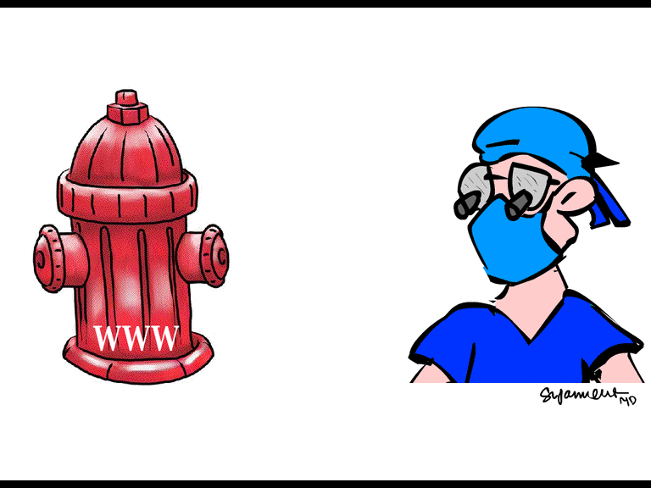
Notes:
In conclusion, someone once compared trying to get information from the web to trying to drink from a fire hydrant
Twitter, in conjunction with other forms of social media such as blogs, can help communities of surgeons with similar interest and levels of training sift through this mass of online information, share what’s relevant, and enrich it with their own thoughts and experiences

Slide 19
Can Twitter make you smarter or dumber?
Notes:
SO can twitter, and other forms of social media, make you smarter or dumber?

Slide 20
Depends on how you use it!
Great paper on the effect of the 80-hour work-week on patient
Outcome http//aWol/jjap #GenSurg
Just finished a sweet lap colectomy. Now time for happy hour!
Notes:
It All depends on how you use them

