Slide 2
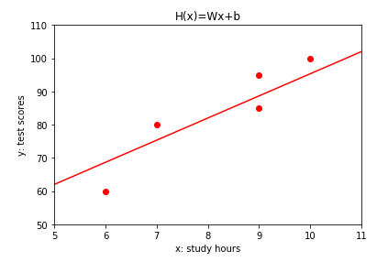








$$d_{5}$$
$$d_{3}$$
$$d_{4}$$
$$d_{2}$$
$${ {\hat{y}}^{(i)}= h(x}^{(1)})=Wx^{(1)}+b$$
$$d_{1}$$
$$y^{(1)}$$
$$x^{(1)}$$

