Slide 1

SANTADER PRODUCT RECOMMENDATION
Zeinab Shahraki
Nov 2021

Slide 2

Problem Statement
Santander: a banking company in Spain that offers an array of financial products.
A small number of their customers would receive many recommendations while many others would not see any at all.
The goal of competition is to accurately predict what their existing customers would use in the next month.

Slide 3
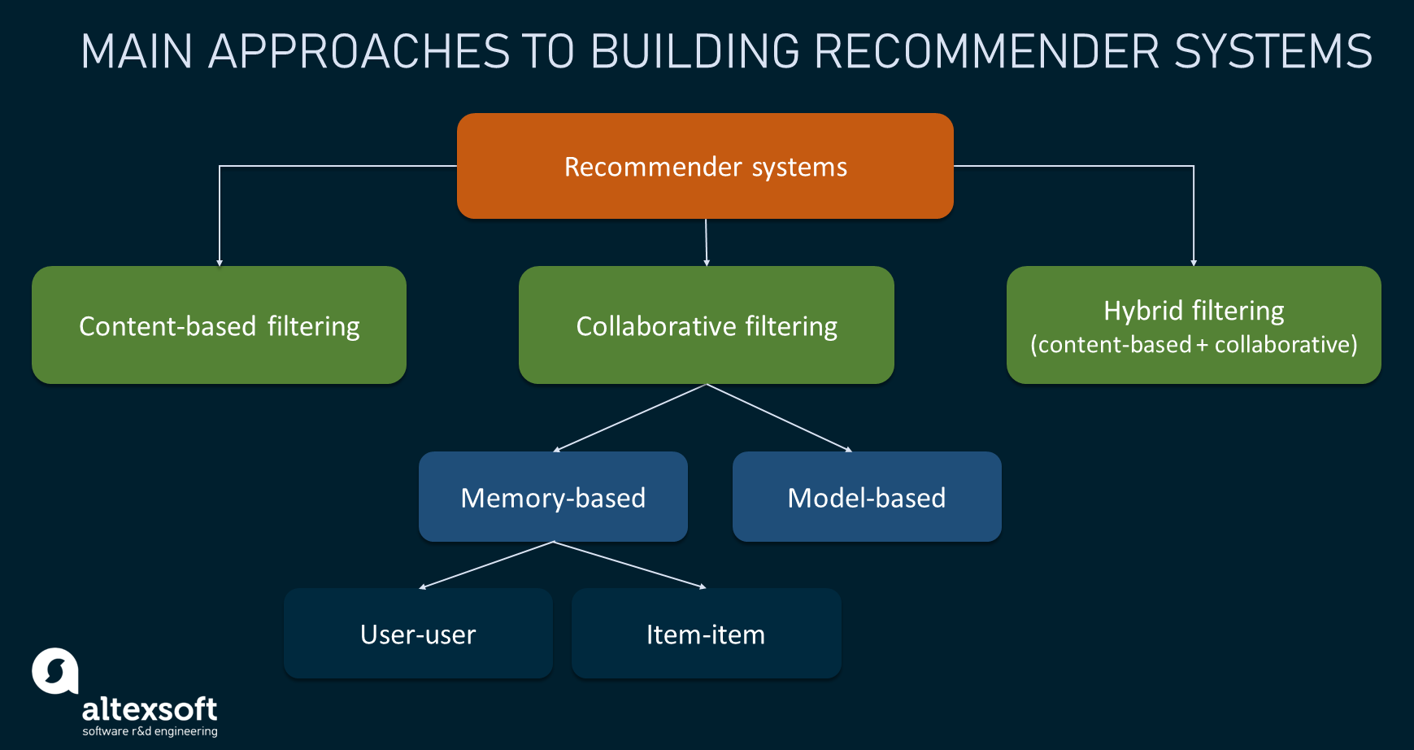
Types of Recommendation Systems

Slide 4
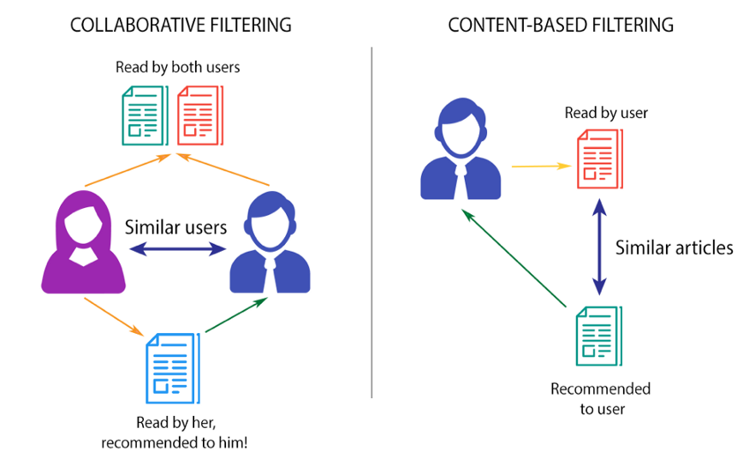
Types of Recommendation Systems
Content Based Filtering: items/products which are like the item/product that a person has already purchased.
Collaborative Filtering: user-item interaction.
Memory-Based Approach: user-item filtering, and item-item filtering. In the user-item approach, we identify clusters of similar users and utilize the interaction of a particular user in that cluster to predict the interaction of the whole cluster.
Model-Based Approach: we use machine learning models to predict the rating for an item that could have been given by a user and hence, provide recommendations. (Matrix factorization, SVD, ALS, and SVD++)

Slide 5
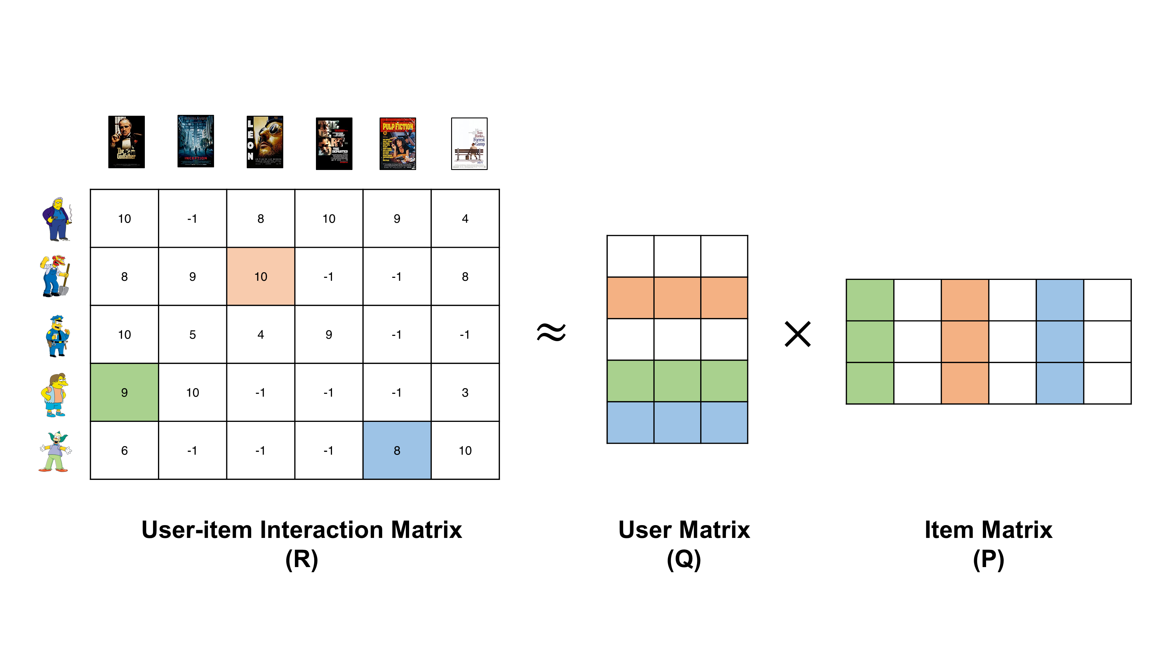
Types of Recommendation Systems
Matrix Factorization: The goal is to complete the matrix and fill in the null values in the rating matrix.
Hybrid Models:
Using Matrix factorization (collaborative filtering) on ratings matrix to match similar users and predict a rating for the user-item pair.
Using Pearson correlation (content-based filtering) to find similarity between users who provide explicit filters and the hotels with feature vectors.

Slide 6

Santander Product Recommendation
Spanish bank, who wanted to recommend products to their customers.
Solutions like: SVD and Matrix decomposition!
Summary of Dataset:
13MM records containing information about 950,000 customers.
17 months of data from Jan 2015 to May 2016.
Goal is recommending products for customers in June 2016
First set of 24 columns denote customers features.
The second set of 24 columns are the products.

Slide 7
Dataset description:
Train dataset: more than 13MM records containing information about 950,000 customers.
1.5 years (17 month) of customers behavior data beginning from Jan 2015 to May 2016.
Objective is to recommend products for customers in June 2016.
Train dataset contains 48 columns:
The first set of 24 columns: customer’s features such as when the customer joined, whether the customer’s spouse is working for the bank, customer’s age, where he lives etc.
The second set of 24 columns: products features such as current_account, savings_account, payroll_account, that the customer holds as of that date.

Slide 8

Dataset Description:
Customer Features:
Customer’s income, customer seniority, whether the customer’s spouse is working for the bank, customer’s age, where customer lives etc.
Product Columns:
current_account, savings_account, payroll_account etc, that the customer holds as of that date.
Project objective:
To predict what new products customers will purchase in June 2016.
Target Variables: list of products

Slide 9
Exploratory Data Analysis:
Categorical Features:
canal_entrada : Channel used by the customer to join
indext : Foreigner index
indresi : Residence index
indrel : primary customer at beginning but not end of month
indrel_1mes : Customer type at the beginning of the month
indfall : Deceased index.
ind_nuevo : is the customer new?
ind_actividad_cliente : customer active?
pais_residencia : Customer's Country residence
sexo: gender
segmento : segmentation
tiprel_1mes : Customer relation type at the beginning of the month
tipodom : Addres type. 1, primary address
Encoding Categorical Data
Numerical Features:
age : age in years
antiguedad : seniority in months
renta : gross income by province
Replacing missing values with mean
Drop two product columns with dominant null values
Handling outliers
Binning
Log transform

Slide 10

Insights:
Most of the customers have either 17 or 11 months of data. It could also mean that new customers are less.
Equal number of males and females.
Equal numbers of Active and Inactive customers.
Most are primary customers.
Most of them are residing in the same country as they bank.
Most the customers do not have their spouse working in the bank.
Most of the customers are non-foreigners.

Slide 11
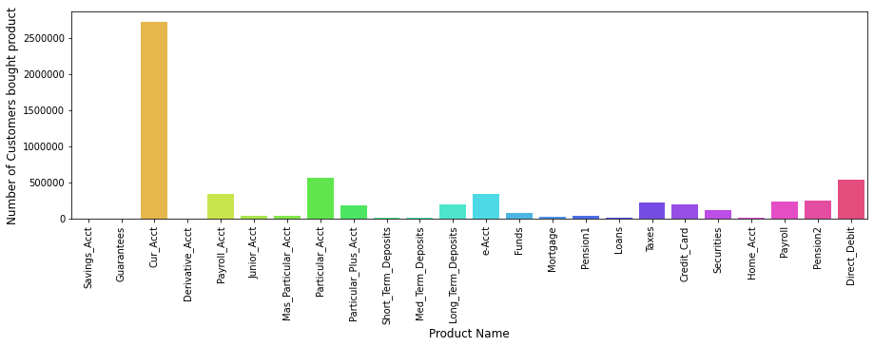
Exploratory Data Analysis:
The most bought product is the current account followed by Particular Account.
The least bought is the Guarantees.

Slide 12
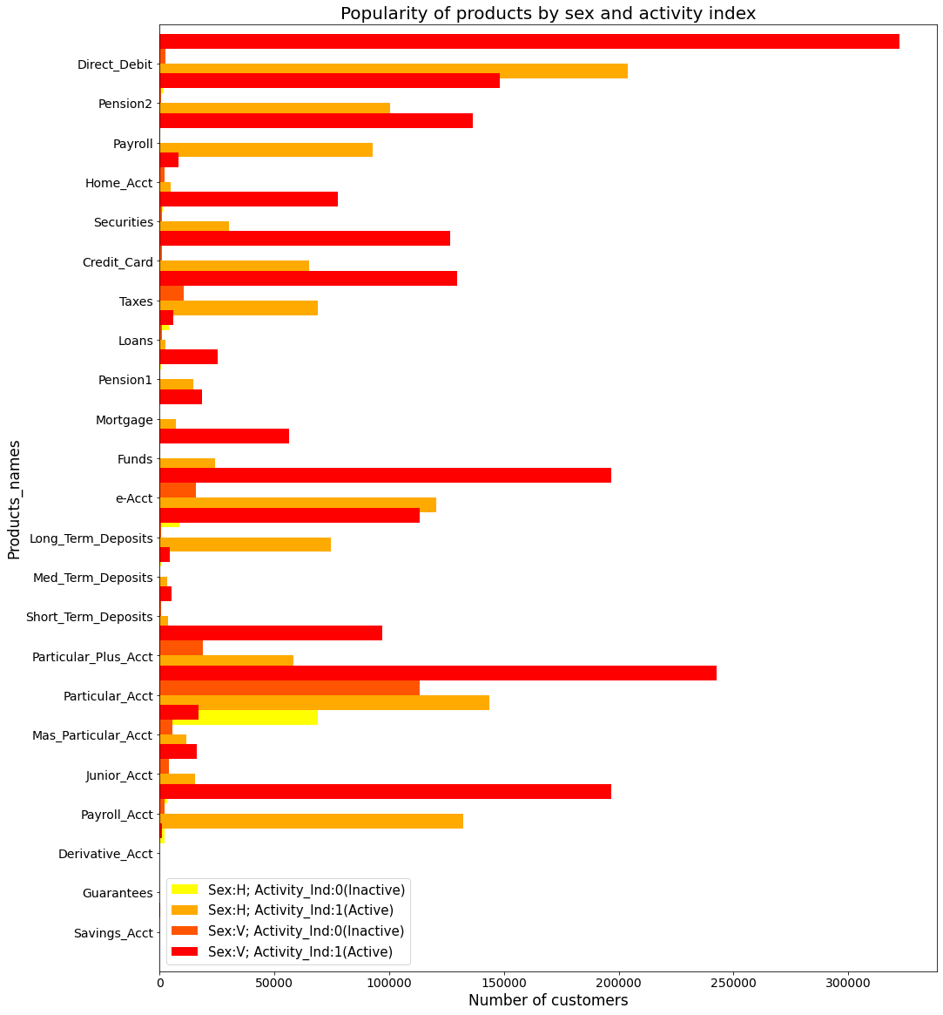
Exploratory Data Analysis:
The most popular product is Cur_Acct which is excluded to analyze others.
Most of the products are bought by Active customers.
Savings_Acct and Guarantees are owned by very less people (we can remove these 2 products).

Slide 13
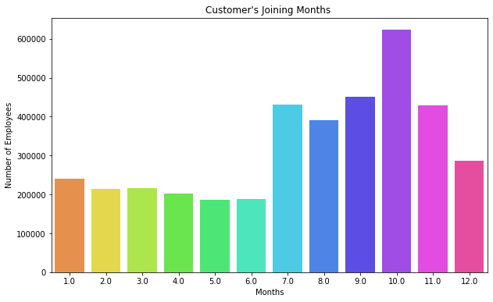
Exploratory Data Analysis:
Most customer's have joined in the month of October.
Join Day's seems to be evenly distributed.
The earliest customer is from Jan of 1995 and the latest customer is from May of 2016. In
the 2nd half of the year there are more people becoming customers of the bank.

Slide 14

Solution:
A Multiclass classification problem: Gradient boosting algorithm of XGBoost.
A single XGBoost model is trained using a target variable which denote the product that is added.
For customers that added multiple products, a single one is chosen at random as the target.
The target variable is the product that is added.
The feature engineering files are calculated using different lags.

Slide 15
Solution:
New product records in June 2015 can be the best indicator of new products in June 2016.
The models trained on June 2015 for example are trained on features based on all 22 (24-2) user data predictors up till and including June 2015 and product information before June 2015.
This approach mimics the test data which also contains user data for June 2016.
The test features were generated using the most recent months and were based on lag data in order to have similar feature interpretations.
Consequently, the model trained on June 2015 which uses 5 lag months is evaluated on the test features calculated on only the lag data starting in January 2016.

Slide 16
Solution:
There are many parameters need to be tuned.
Using GridSearchCV function in Scikit Learn can generate multiple values of each parameter at the same time.
It's useful for hyperparameters tuning to get the best models since we can compare each other.
Some important parameters can affect the performance of model and reduce overfitting.

Slide 17
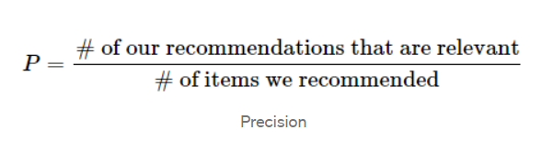
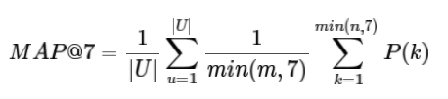
Summary of Results
Results are evaluated according to the Mean Average Precision @ 7 (MAP@7).
To recommend the top 7 products to each customer. The scoring is evaluated using mean average precision at 7 (MAP@7).
Final Result: 0.03016 on Private Score
How relevant is the list of recommended items

Slide 18
Other candidate solutions:
The goal is the prediction of the products that the customer will purchase in the next month (June 2016). Since the types of our products are discrete, the time series problem transforms to a multi-class classification problem.
Neural Networks such as LSTM:
Due to the high number of customers and products, the possibility of making an integrated model for each user for all products or one product for all users is a time-consuming process.
Further, in terms of actual modeling for the end user, this work has a high computational cost. Indeed, changing the model, even by adding a new product, is a high-computational process.
They’re some unbalanced features in a dataset which can make modeling in neural networks more challenging.
Collaborative filtering:
We seek to find customers with similar interests. Hence, we can categorize them in the same groups. With more users and more features that users need to compare them with each other, the possibility of finding the optimum solution is more complex.
In addition, the problem of imbalance dataset makes it more difficult.

Slide 19
Other candidate solutions:
Using PySpark

