Slide 1
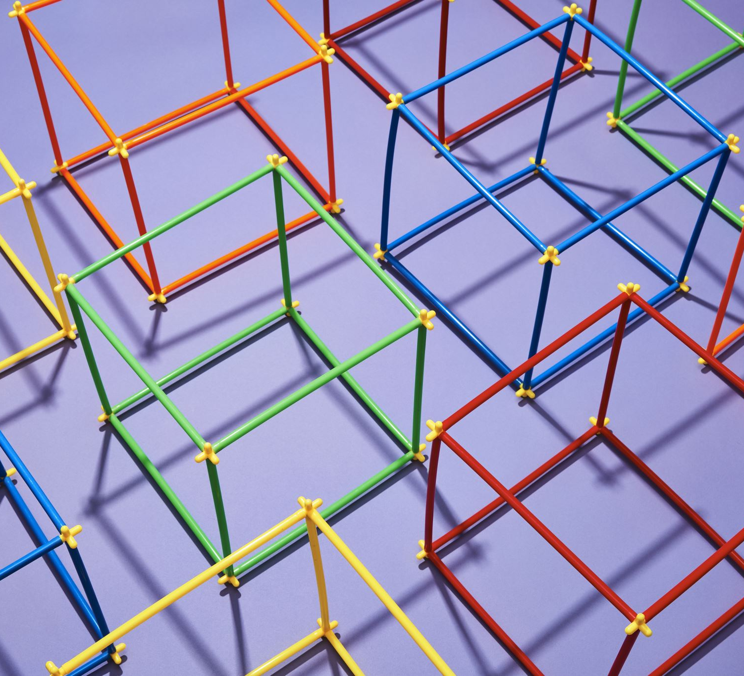
KLONDLIKE SOLITAIRE
Autonomous agents
Autonomous AGENTS
Christos ziskas

Slide 2
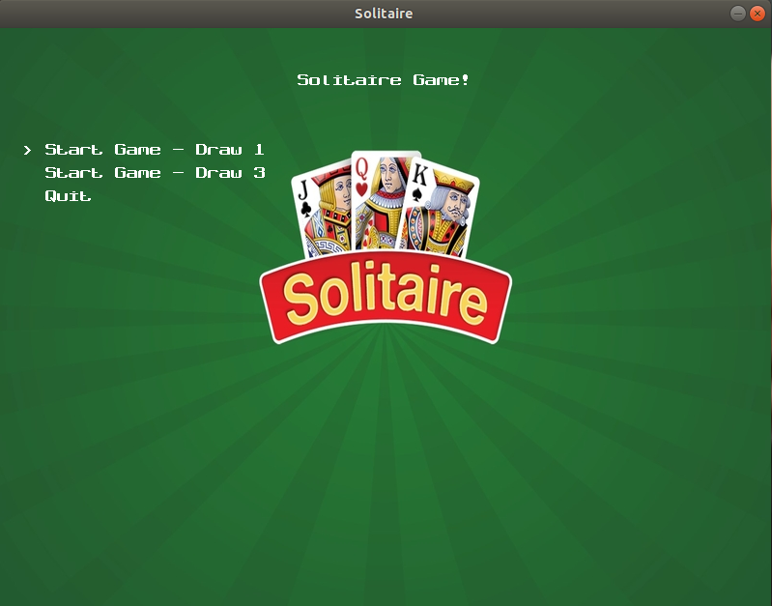
SOLITAIRE

Slide 3
Features
Scenes
Graphic representation of cards, table
Moving Cards
Score , number of moves, Game time
Button Functionality
Sound Company

Slide 4
scenes
Main Menu
Game option scene
Preparation Scene
Intermediate stage from main menu to game scene
Game Scene
Play the game
Result Scene
Winning or Losing state with results

Slide 5
Game table
Cards representing as rects(rectangles)
Hidden or overt
Back place of a card as background
Front face of a real card
Height, width, position x, position y
The cards are stacked in succession at different heights
The piles are located at their respective points on the board
Initialization at the beginning of the game

Slide 6
Moving cards
Rects of cards are saved, accompanied by height, name of card and position of mouse on the screen
Representation while moving
Decrease stack height for successful drop
Successful drop to new heap
Failure drop to previous heap

Slide 7
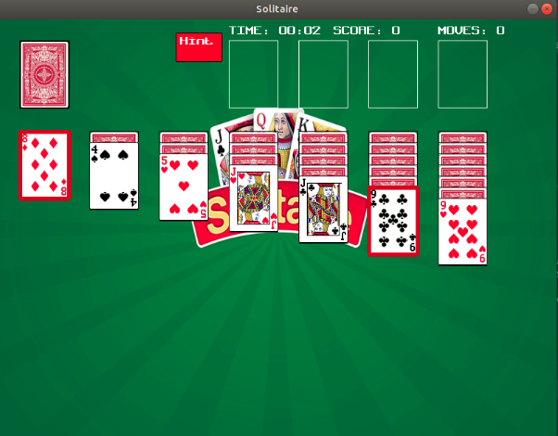
Moving cards

Slide 8
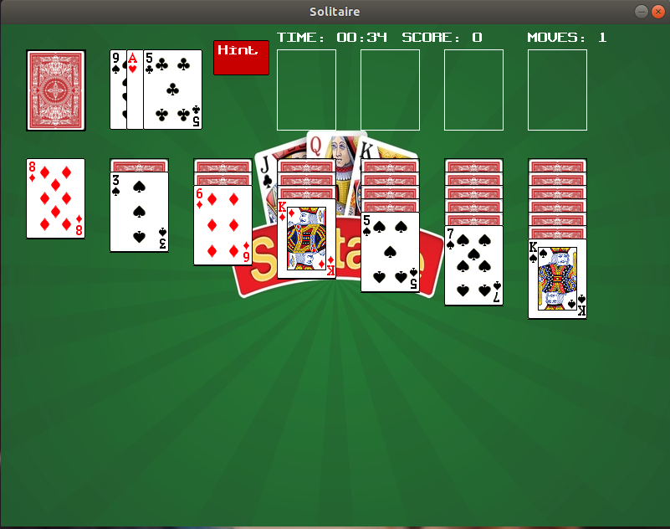
SCORE , MOVES NUMBER, GAME TIME

Slide 9
buttons
Hint Button
Red Rect on the cards indicated by hint algorithm
Solve Button
Moving to winning game state when the solve algorithm indicates
Quit Button
Moving to losing game state when the available hint algorithm indicates

Slide 10
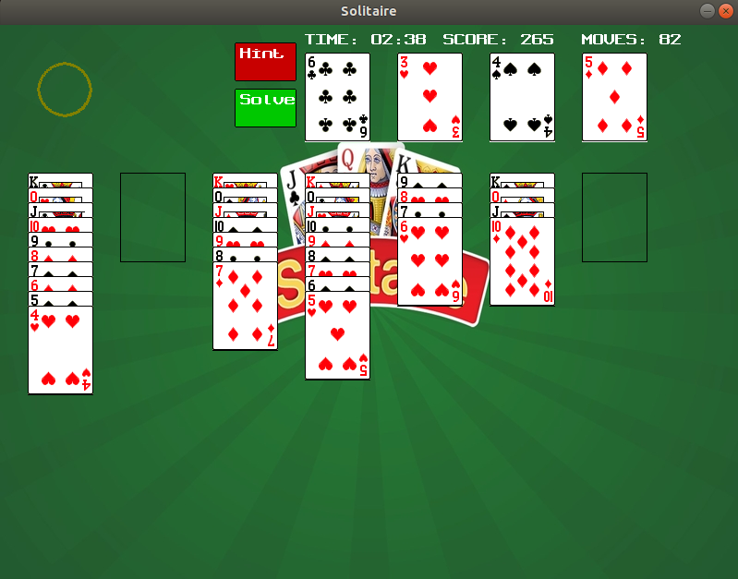
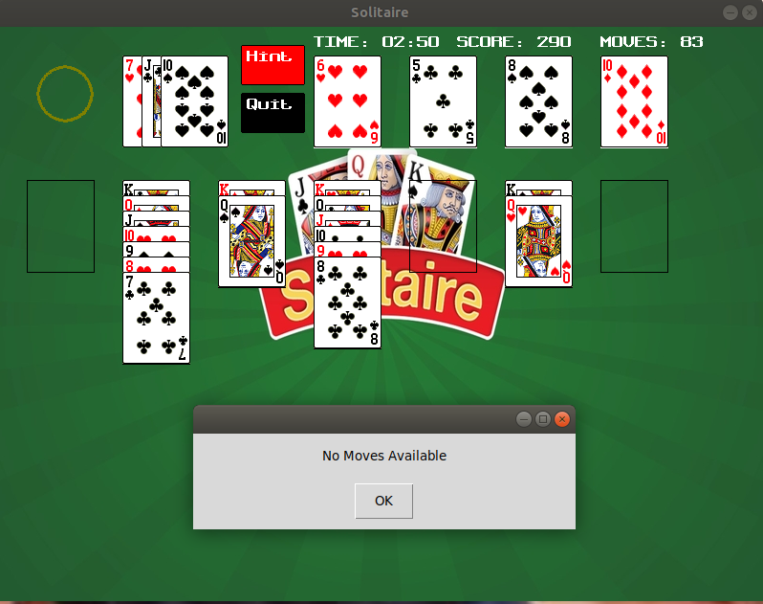
Buttons

Slide 11
Future add-on
Undo action
Update hints after multiple presses of hint button
Different score calculation & time penalty
Optimization of finding hint

