Slide 1
How to choose to invest in a film based on the investment budget and language type
GROUP22: Ziyue Zhang and Qige Pang

Slide 2
CONTENTS
Datasets and working with datasets
Analysis
Data app demo
Conclusion

Slide 3
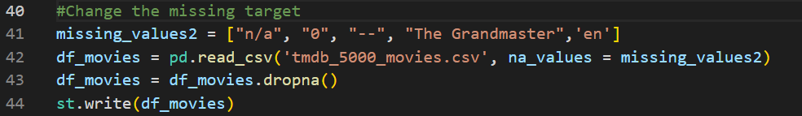

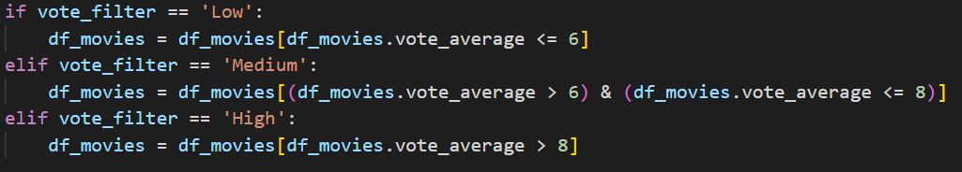
1. Datasets and working with datasets
Delete en and invalid data
Call the data

Slide 4
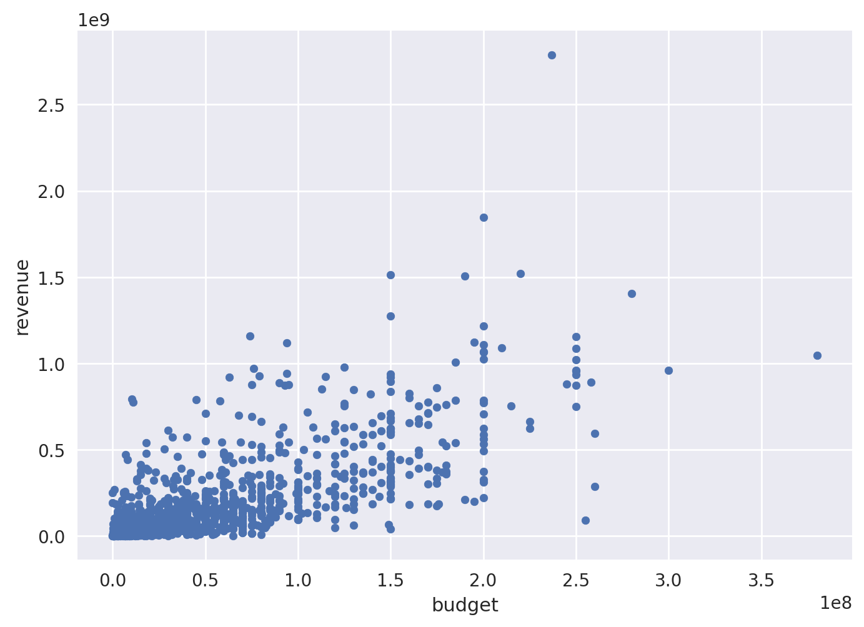
Part 1. Analysis

Slide 5
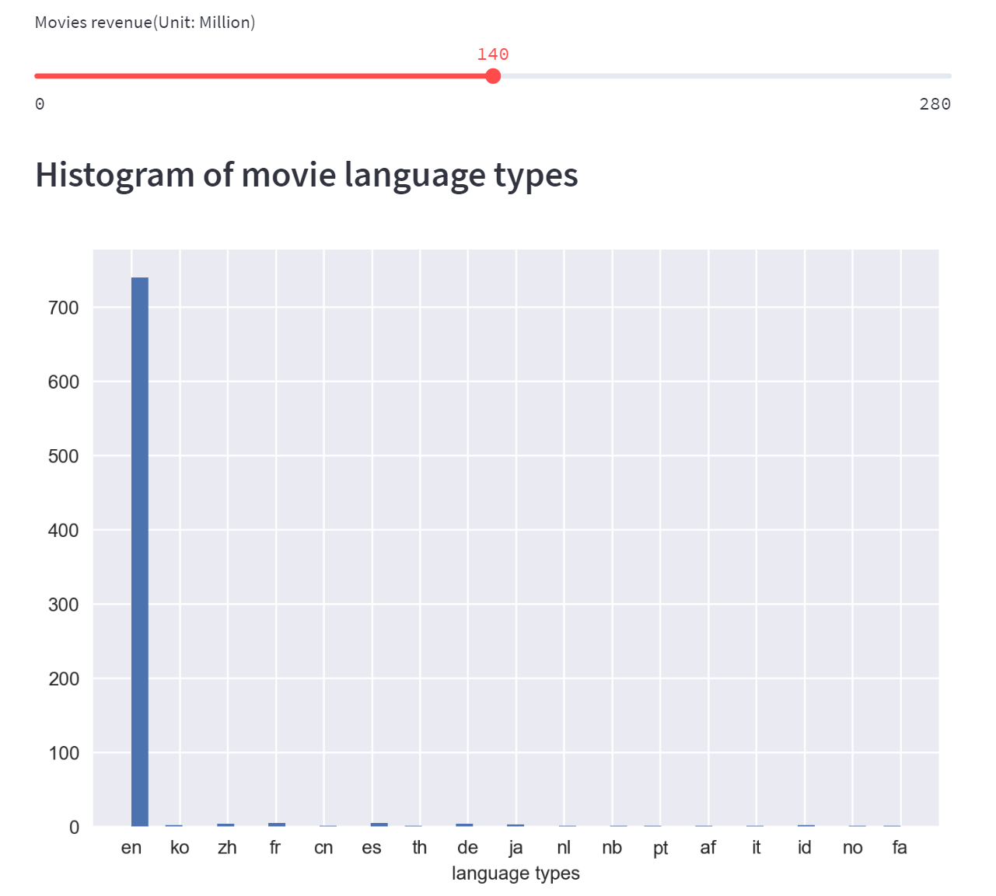
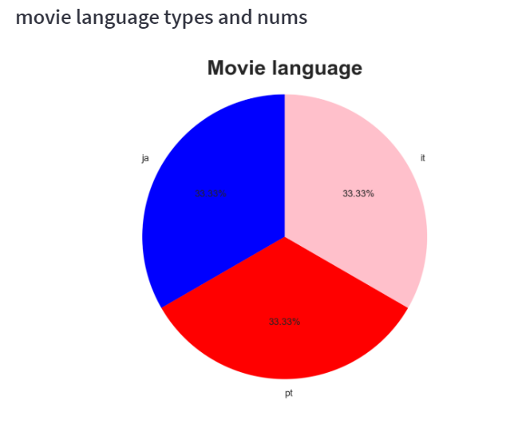
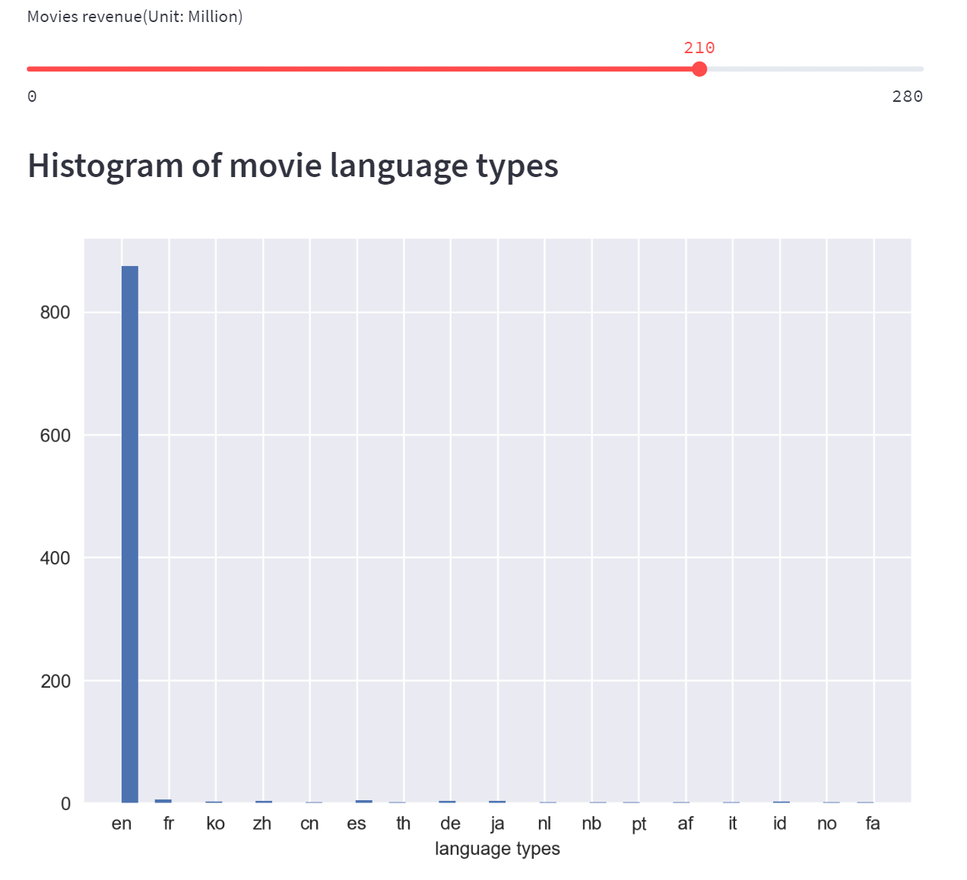
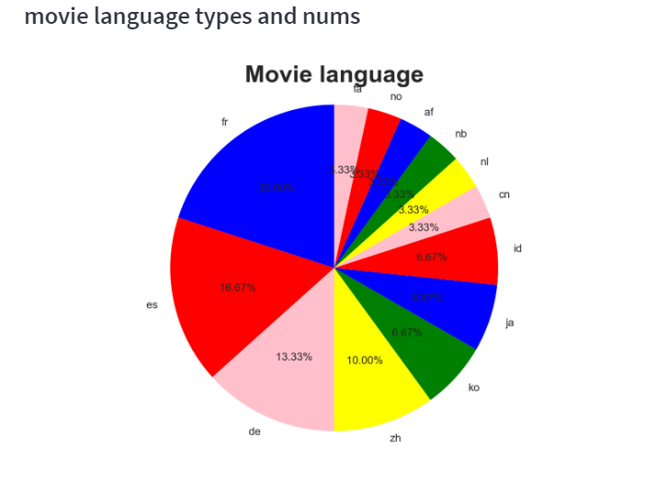
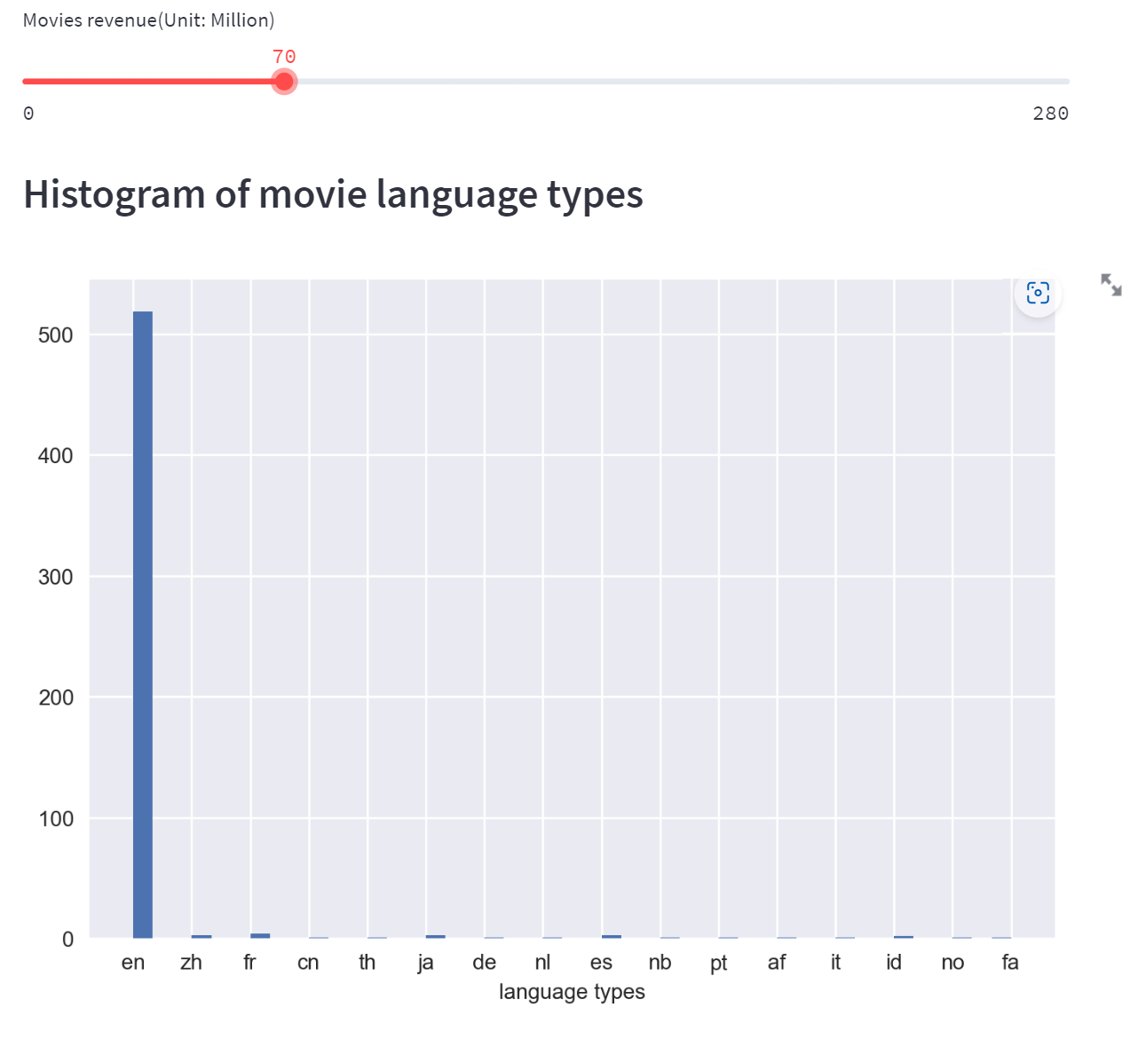
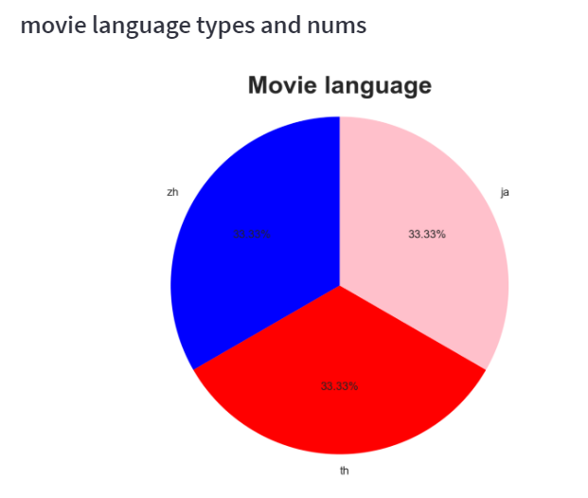
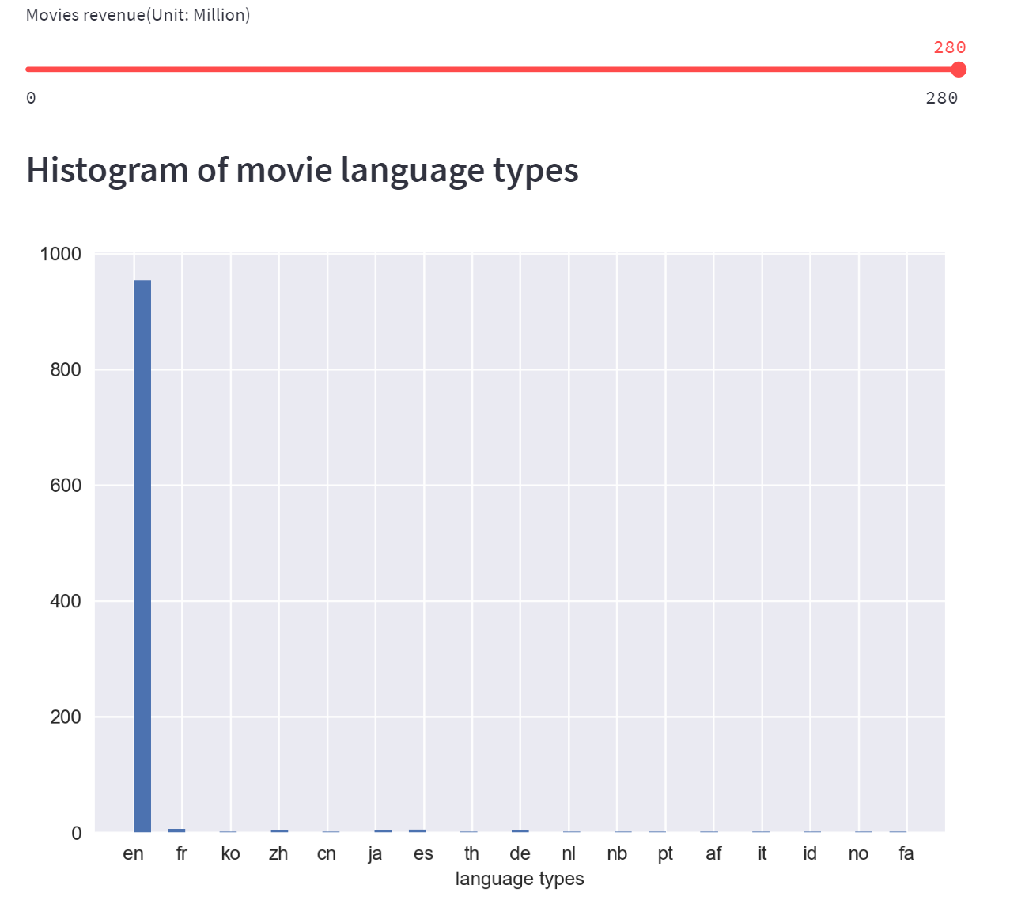
Part 2. Analysis
The film language type of each revenue segment
High revenue
zh：Chinese
ja：Japanese
th: Thai
en: English
fr: French
it: Italian
pt: Portuguese
High(vote average>8)
Low（vote average≤8）
Medium(vote average>6&vote average≤8)

Slide 6
Conclusion
We believe that budget and revenue is high positive correlation.
English language films account for a high proportion of the market.
French films with medium ratings have the highest proportion of the market. Japanese, Italian and Portuguese films have the highest proportion of the market under the high rating (Except the en. high revenue)

Slide 7
Thanks.

