Slide 1
Serial Optimisation of
Conway's Game of Life
COSC7502 Milestone 1
A controlled, evidence-based optimisation of a serial C++ implementation
UQ-inspired academic styling · no official logo or template used
Notes:
[Sources]
- presentation/COSC7502_Milestone1_Draft_Presentation.pptx
- OPTIMISATION_LOG.md

Slide 2
Eight neighbours determine every cell's next state
B3 / S23 rule
Reference
behaviour
• Birth: exactly 3 neighbours → alive
• Survival: exactly 2 neighbours → keep the current state
• Otherwise: any other count → dead
• All cells update synchronously.
• Edges wrap to form a toroidal world.
• The NetLogo reference world is 101 × 101.
• The optimised program remains serial.
cell
Moore neighbourhood
The eight surrounding cells are counted.
Performance changes must preserve this exact model.
COSC7502 · Milestone 1
2
Notes:
[Sources]
- User-provided presentation specification (reference model and 101 x 101 NetLogo world)
- src/life.cpp (rule, synchronous update, toroidal lookup implementation)

Slide 3
V0 prioritised traceability and correctness
Readable serial baseline
Correctness oracle
• C++17 with vector<vector<uint8_t>> storage
• current_ is read; next_ is written, then swapped
• generic 3 × 3 neighbour loops skip the centre
• wrapped coordinates are calculated in the hot path
• mt19937 seed reproduces the initial state
• block still life
• blinker oscillator
• glider movement
• horizontal and vertical wrapping
• deterministic seeded setup
V0 neighbour loop (simplified)
for (dy = -1; dy <= 1; ++dy) {
for (dx = -1; dx <= 1; ++dx) {
if (dx == 0 && dy == 0) continue;
nx = wrap(x + dx);
ny = wrap(y + dy);
count += current_[ny][nx];
}
}
6 / 6
deterministic tests passed locally and on Rangpur
Every version must match both live-cell count and checksum.
COSC7502 · Milestone 1
3
Notes:
[Sources]
- Git tag v0_baseline: src/life.h and src/life.cpp
- tests/test_life.cpp
- OPTIMISATION_LOG.md — V0 correctness

Slide 4
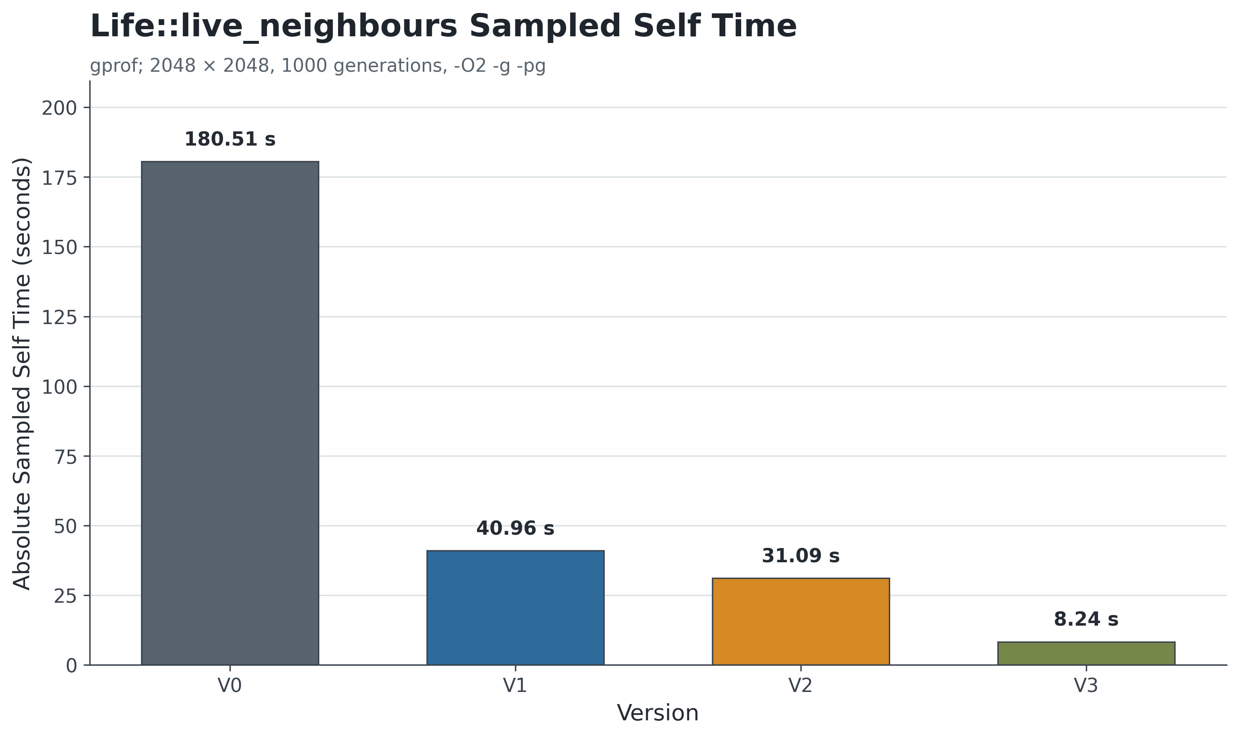
Profiling made neighbour calculation the first target
≈ 96.61%
of V0 sampled self time was inside Life::live_neighbours
Controlled sequence
V0 → V1 → V2 → V3
precompute wrap
→ contiguous grid
→ explicit neighbours
Measure the hotspot, change one thing, then test again.
Diagnostic profile: 2048 × 2048, 1000 generations, -O2 -g -pg
COSC7502 · Milestone 1
4
Notes:
[Sources]
- results/v0_baseline/profile.txt (96.61% and 180.51 sampled self seconds)
- analysis/plots/live_neighbours_profile.png
- OPTIMISATION_LOG.md — V0 to V3 optimisation sequence

Slide 5
V1 removed repeated wrapping from the hot path
V0 — calculate repeatedly
V1 — precompute once
wrap(x - 1)
wrap(x + 1)
wrap(y - 1)
wrap(y + 1)
x_prev[x] x_next[x]
y_prev[y] y_next[y]
→
Same 2D grid · same rule · same double buffering · same benchmark
90.85 s
→
20.35 s
≈ 4.46×
V0 median at 2048 × 2048
V1 median at 2048 × 2048
largest single optimisation gain
COSC7502 · Milestone 1
5
Notes:
[Sources]
- Git tags v0_baseline and v1_precomputed_wrap: src/life.cpp
- results/v0_baseline/summary.csv
- results/v1_precomputed_wrap/summary.csv
- OPTIMISATION_LOG.md — V1 controlled change and interpretation

Slide 6
Later changes added smaller gains
V2 — contiguous row-major grid
V3 — explicit eight-neighbour sum
vector<vector<uint8_t>>
↓
vector<uint8_t>
generic 3 × 3 loops
+ centre-skip branch
↓
8 explicit reads
Index: y × width + x
One allocation removes row indirection and creates better locality opportunities.
The fixed Moore neighbourhood removes loop and branch overhead without changing the rule.
20.35 → 16.92 s
16.92 → 16.07 s
≈ 1.20× incremental speedup
≈ 1.05× incremental speedup
COSC7502 · Milestone 1
6
Notes:
[Sources]
- Git tags v1_precomputed_wrap, v2_contiguous_grid, and v3_explicit_neighbours
- results/v1_precomputed_wrap/summary.csv
- results/v2_contiguous_grid/summary.csv
- results/v3_explicit_neighbours/summary.csv
- OPTIMISATION_LOG.md — V2 and V3 controlled changes

Slide 7
The benchmark isolated each serial change
Environment
Workload
Measurement
• UQ Rangpur · a100-0
• 1 node · 1 task · 1 CPU
• GCC 8.5.0
• -O3 -DNDEBUG
• 512² · 1024² · 2048²
• 800 generations
• 35% initial density
• seed 12345 · 5 repetitions
• median runtime
• CV records variability
• generation updates timed only
• live count + checksum checked
All 15 formal rows per version produced matching live-cell counts and checksums.
COSC7502 · Milestone 1
7
Notes:
[Sources]
- Makefile (benchmark flags and timed executable)
- results/v0_baseline/environment.txt
- results/v0_baseline/summary.csv
- results/v1_precomputed_wrap/summary.csv
- results/v2_contiguous_grid/summary.csv
- results/v3_explicit_neighbours/summary.csv

Slide 8
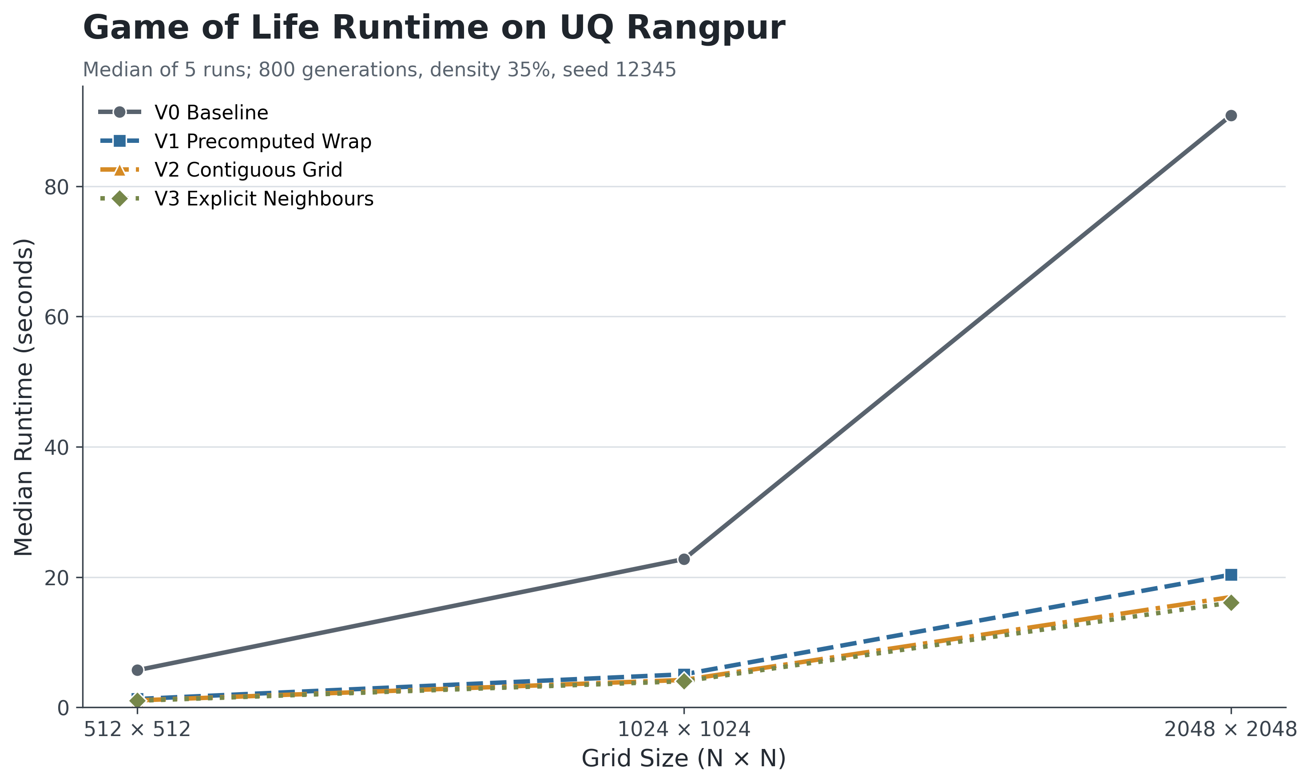
V3 was about 5.65× faster than the baseline
≈ 5.65×
speedup at 2048 × 2048
≈ 82.3%
runtime reduction at 2048 × 2048
The reduction was about 82.3% at all three tested sizes, and each gain was larger than observed run-to-run variation.
COSC7502 · Milestone 1
8
Notes:
[Sources]
- analysis/plots/runtime_vs_grid_size.png
- results/v0_baseline/summary.csv
- results/v1_precomputed_wrap/summary.csv
- results/v2_contiguous_grid/summary.csv
- results/v3_explicit_neighbours/summary.csv
- analysis/plot_results.py (validation and speedup calculation)

Slide 9
Measure first, then optimise and verify
≈ 5.65×
• The profiler identified the highest-value target.
• V1 produced the largest gain by removing repeated wrapping work.
• V2 and V3 still improved runtime, but the returns became smaller.
• Correctness checks were repeated after every controlled change.
• The implementation remained serial throughout the milestone.
final serial speedup over V0
Faster code only counts when it still produces the same result.
COSC7502 · Milestone 1
9
Notes:
[Sources]
- OPTIMISATION_LOG.md — V0 to V3 interpretation and decisions
- results/v3_explicit_neighbours/summary.csv
- results/v3_explicit_neighbours/validation.txt

