Slide 1
Discrete Mathematics
CSE 2353
Fall 2007
Margaret H. Dunham
Department of Computer Science and Engineering
Southern Methodist University
Some slides provided by Dr. Eric Gossett; Bethel University; St. Paul, Minnesota
Some slides are companion slides for Discrete Mathematical Structures: Theory and Applications by D.S. Malik and M.K. Sen

Slide 2
Outline
Introduction
Introduction
Sets
Logic & Boolean Algebra
Proof Techniques
Counting Principles
Combinatorics
Relations,Functions
Graphs/Trees
Boolean Functions, Circuits

Slide 3
Introduction to Discrete Mathematics
What Is Discrete Mathematics?
An example: The Stable Marriage Problem

Slide 4

The Stable Marriage Problem
The Problem
A Solution:
    The Deferred Acceptance Algorithm
In the future we will:
  Prove that the assignment is stable (reading tonight).
  Prove that the assignment is optimal for suitors.
  Count the number of possible assignments.
  Calculate the complexity of the algorithm.

Slide 5

Stable
Marriage partners should be assigned in such a manner that no one will be able to find someone (whom they prefer to their assigned mate) that is willing to elope with them.

Slide 6
What Is Discrete Mathematics?
What it isn’t: continuous
Discrete: consisting of distinct or unconnected elements
Countably Infinite
Definition Discrete Mathematics
  Discrete Mathematics is a collection of mathematical topics that examine and use finite or countably infinite mathematical objects.

Slide 7
Outline
Introduction
Sets
Logic & Boolean Algebra
Proof Techniques
Counting Principles
Combinatorics
Relations,Functions
Graphs/Trees
Boolean Functions, Circuits
Sets

Slide 8
It is assumed that you have studied set theory before.
The remaining slides in this section are for your review. They will not all be covered in class.
If you need extra help in this area, a special help session will be scheduled.

Slide 9
Sets: Learning Objectives
Learn about sets
Explore various operations on sets
Become familiar with Venn diagrams
CS:
  Learn how to represent sets in computer memory
  Learn how to implement set operations in programs

Slide 10
Sets
Definition: Well-defined collection of distinct objects
Members or Elements: part of the collection
Roster Method: Description of a set by listing the elements, enclosed with braces
  Examples:
    Vowels = {a,e,i,o,u}
    Primary colors = {red, blue, yellow}
Membership examples
  “a belongs to the set of Vowels” is written as:
    a ∈ Vowels
  “j does not belong to the set of Vowels:
    j ∉ Vowels

Slide 11
Sets
Set-builder method
  A = { x | x ∈ S, P(x) } or A = { x ∈ S | P(x) }
    A is the set of all elements x of S, such that x satisfies the property P
    Example:
      If X = {2,4,6,8,10}, then in set-builder notation, X can be described as
      X = {n ∈ Z | n is even and 2 ≤ n ≤ 10}

Slide 12
Sets
Standard Symbols which denote sets of numbers
  N : The set of all natural numbers (i.e.,all positive integers)
  Z : The set of all integers
  Z⁺ : The set of all positive integers
  Z* : The set of all nonzero integers
  E : The set of all even integers
  Q : The set of all rational numbers
  Q* : The set of all nonzero rational numbers
  Q⁺ : The set of all positive rational numbers
  R : The set of all real numbers
  R* : The set of all nonzero real numbers
  R⁺ : The set of all positive real numbers
  C : The set of all complex numbers
  C* : The set of all nonzero complex numbers

Slide 13
Sets
Subsets
  “X is a subset of Y” is written as X ⊆ Y
  “X is not a subset of Y” is written as X Y
  Example:
    X = {a,e,i,o,u}, Y = {a, i, u} and
      Z= {b,c,d,f,g}
      Y ⊆ X, since every element of Y is an element of X
      Y Z, since a ∈ Y, but a ∉ Z

Slide 14
Sets
Superset
  X and Y are sets. If X ⊆ Y, then “X is contained in Y” or “Y contains X” or Y is a superset of X, written Y ⊇ X
Proper Subset
  X and Y are sets. X is a proper subset of Y if X ⊆ Y and there exists at least one element in Y that is not in X. This is written X ⊂ Y.
  Example:
    X = {a,e,i,o,u}, Y = {a,e,i,o,u,y}
      X ⊂ Y , since y ∈ Y, but y ∉ X

Slide 15
Sets
Set Equality
  X and Y are sets. They are said to be equal if every element of X is an element of Y and every element of Y is an element of X, i.e. X ⊆ Y and Y ⊆ X
  Examples:
    {1,2,3} = {2,3,1}
    X = {red, blue, yellow} and Y = {c | c is a primary color} Therefore, X=Y
Empty (Null) Set
  A Set is Empty (Null) if it contains no elements.
  The Empty Set is written as ∅
  The Empty Set is a subset of every set

Slide 16
Sets
Finite and Infinite Sets
  X is a set. If there exists a nonnegative integer n such that X has n elements, then X is called a finite set with n elements.
  If a set is not finite, then it is an infinite set.
  Examples:
    Y = {1,2,3} is a finite set
    P = {red, blue, yellow} is a finite set
    E , the set of all even integers, is an infinite set
    ∅ , the Empty Set, is a finite set with 0 elements

Slide 17
Sets
Cardinality of Sets
  Let S be a finite set with n distinct elements, where n ≥ 0. Then |S| = n , where the cardinality (number of elements) of S is n
  Example:
    If P = {red, blue, yellow}, then |P| = 3
  Singleton
    A set with only one element is a singleton
    Example:
      H = { 4 }, |H| = 1, H is a singleton

Slide 18
Sets
Power Set
  For any set X ,the power set of X ,written P(X),is the set of all subsets of X
  Example:
    If X = {red, blue, yellow}, then P(X) = { ∅ , {red}, {blue}, {yellow}, {red,blue}, {red, yellow}, {blue, yellow}, {red, blue, yellow} }
Universal Set
  An arbitrarily chosen, but fixed set

Slide 19
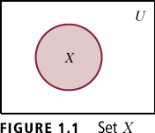
Sets
Venn Diagrams
  Abstract visualization of a Universal set, U as a rectangle, with all subsets of U shown as circles.
  Shaded portion represents the corresponding set
  Example:
    In Figure 1, Set X, shaded, is a subset of the Universal set, U

Slide 20

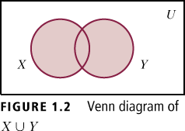
Set Operations and Venn Diagrams
Union of Sets
  Example: If X = {1,2,3,4,5} and Y = {5,6,7,8,9}, then
    XUY = {1,2,3,4,5,6,7,8,9}

Slide 21

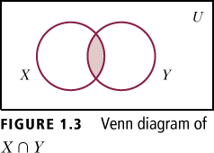
Sets
Intersection of Sets
  Example: If X = {1,2,3,4,5} and Y = {5,6,7,8,9}, then X ∩ Y = {5}

Slide 22
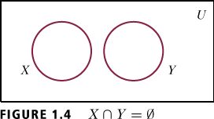
Sets
Disjoint Sets
  Example: If X = {1,2,3,4,} and Y = {6,7,8,9}, then X ∩ Y = ∅

Slide 23

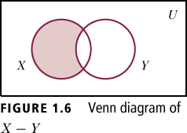
Sets
Difference
  Example: If X = {a,b,c,d} and Y = {c,d,e,f}, then X – Y = {a,b} and Y – X = {e,f}

Slide 24

Sets
Complement
The complement of a set X with respect to a universal set U, denoted by , is defined to be = {x |x ∈ U, but x ∉ X}
  Example: If U = {a,b,c,d,e,f} and X = {c,d,e,f}, then = {a,b}

Slide 25
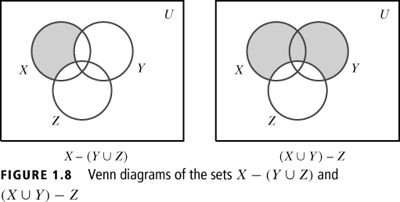
Sets

Slide 26
Sets
Ordered Pair
  X and Y are sets. If x ∈ X and y ∈ Y, then an ordered pair is written (x,y)
  Order of elements is important. (x,y) is not necessarily equal to (y,x)
Cartesian Product
  The Cartesian product of two sets X and Y ,written X × Y ,is the set
  X × Y ={(x,y)|x ∈ X , y ∈ Y}
    For any set X, X × ∅ = ∅ = ∅ × X
  Example:
    X = {a,b}, Y = {c,d}
      X × Y = {(a,c), (a,d), (b,c), (b,d)}
      Y × X = {(c,a), (d,a), (c,b), (d,b)}

Slide 27
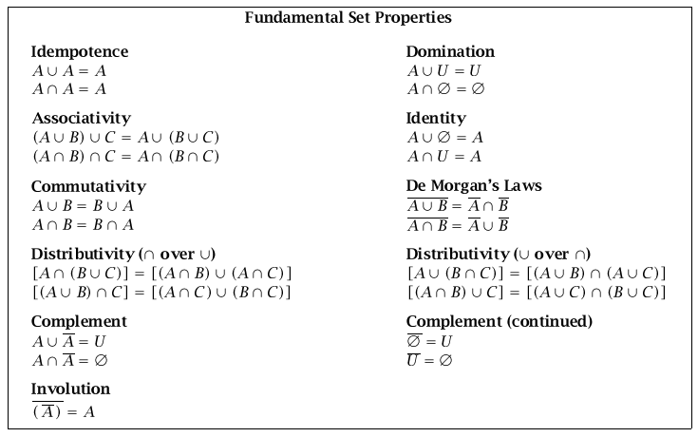

Slide 28
Computer Representation of Sets
A Set may be stored in a computer in an array as an unordered list
  Problem: Difficult to perform operations on the set.
Linked List
Solution: use Bit Strings (Bit Map)
  A Bit String is a sequence of 0s and 1s
  Length of a Bit String is the number of digits in the string
  Elements appear in order in the bit string
    A 0 indicates an element is absent, a 1 indicates that the element is present
A set may be implemented as a file

Slide 29
Computer Implementation of Set Operations
Bit Map
File
Operations
  Intersection
  Union
  Element of
  Difference
  Complement
  Power Set

Slide 30
Special “Sets” in CS
Multiset
Ordered Set

Slide 31
Outline
Introduction
Sets
Logic & Boolean Algebra
Proof Techniques
Counting Principles
Combinatorics
Relations,Functions
Graphs/Trees
Boolean Functions, Circuits
Logic & Boolean Algebra

Slide 32
Logic: Learning Objectives
Learn about statements (propositions)
Learn how to use logical connectives to combine statements
Explore how to draw conclusions using various argument forms
Become familiar with quantifiers and predicates
CS
  Boolean data type
  If statement
  Impact of negations
  Implementation of quantifiers

Slide 33
Mathematical Logic
Definition: Methods of reasoning, provides rules and techniques to determine whether an argument is valid
Theorem: a statement that can be shown to be true (under certain conditions)
  Example: If x is an even integer, then x + 1 is an odd integer
    This statement is true under the condition that x is an integer is true

Slide 34
Mathematical Logic
A statement, or a proposition, is a declarative sentence that is either true or false, but not both
Uppercase letters denote propositions
  Examples:
    P: 2 is an even number (true)
    Q: 7 is an even number (false)
    R: A is a vowel (true)
  The following are not propositions:
    P: My cat is beautiful
    Q: My house is big

Slide 35

Mathematical Logic
Truth value
  One of the values “truth” (T) or “falsity” (F) assigned to a statement
Negation
  The negation of P, written , is the statement obtained by negating statement P
    Example:
      P: A is a consonant
      : it is the case that A is not a consonant
Truth Table
P
T F
F T

Slide 36
Mathematical Logic
Conjunction
  Let P and Q be statements.The conjunction of P and Q, written P ^ Q , is the statement formed by joining statements P and Q using the word “and”
  The statement P ^ Q is true if both p and q are true; otherwise P ^ Q is false
  Truth Table for Conjunction:

Slide 37
Mathematical Logic
Disjunction
  Let P and Q be statements. The disjunction of P and Q, written P v Q , is the statement formed by joining statements P and Q using the word “or”
  The statement P v Q is true if at least one of the statements P and Q is true; otherwise P v Q is false
  The symbol v is read “or”
  Truth Table for Disjunction:

Slide 38
Mathematical Logic
Implication
  Let P and Q be statements.The statement “if P then Q” is called an implication or condition.
  The implication “if P then Q” is written P → Q
  P is called the hypothesis, Q is called the conclusion
Truth Table for Implication:

Slide 39


Mathematical Logic
Implication
  Let P: Today is Sunday and Q: I will wash the car.
  P → Q :
  If today is Sunday, then I will wash the car
  The converse of this implication is written Q → P
    If I wash the car, then today is Sunday
  The inverse of this implication is
    If today is not Sunday, then I will not wash the car
  The contrapositive of this implication is
    If I do not wash the car, then today is not Sunday

Slide 40
Mathematical Logic
Biimplication
  Let P and Q be statements. The statement “P if and only if Q” is called the biimplication or biconditional of P and Q
  The biconditional “P if and only if Q” is written P ↔ Q
  “P if and only if Q”
  Truth Table for the Biconditional:

Slide 41

Mathematical Logic
Precedence of logical connectives is:
  highest
  ^ second highest
  v third highest
  → fourth highest
  ↔ fifth highest

Slide 42
Mathematical Logic
Tautology
  A statement formula A is said to be a tautology if the truth value of A is T for any assignment of the truth values T and F to the statement variables occurring in A
Contradiction
  A statement formula A is said to be a contradiction if the truth value of A is F for any assignment of the truth values T and F to the statement variables occurring in A

Slide 43

Mathematical Logic
Logically Implies
  A statement formula A is said to logically imply a statement formula B if the statement formula A → B is a tautology. If A logically implies B, then symbolically we write A → B
Logically Equivalent
  A statement formula A is said to be logically equivalent to a statement formula B if the statement formula
    A ↔ B is a tautology. If A is logically equivalent to B , then symbolically we write A B

Slide 44
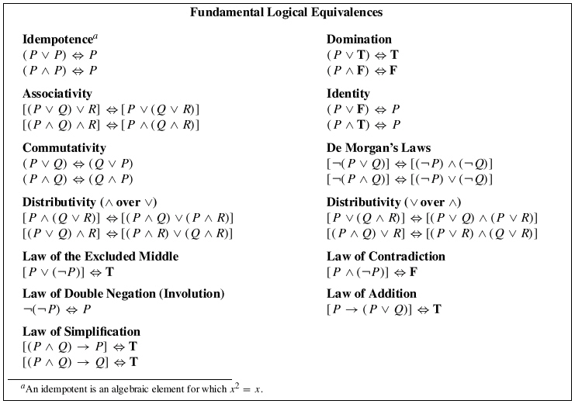

Slide 45
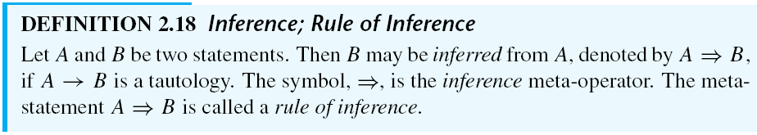
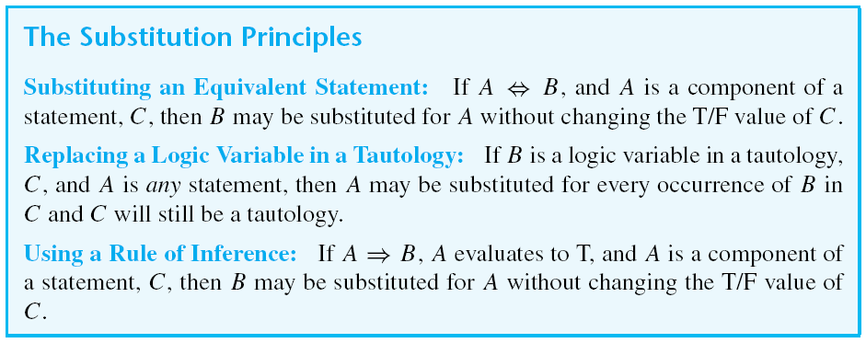
Inference and Substitution

Slide 46
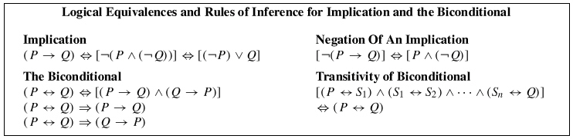
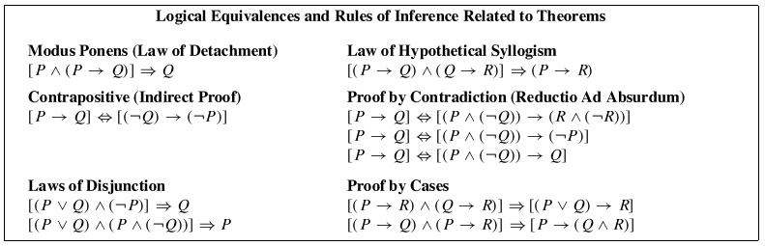

Slide 47
Quantifiers and First Order Logic
Predicate or Propositional Function
  Let x be a variable and D be a set; P(x) is a sentence
  Then P(x) is called a predicate or propositional function with respect to the set D if for each value of x in D, P(x) is a statement; i.e., P(x) is true or false
  Moreover, D is called the domain (universe) of discourse and x is called the free variable

Slide 48

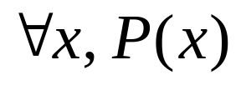

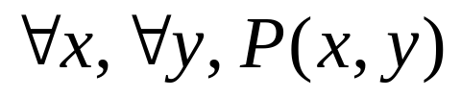
Quantifiers and First Order Logic
Universal Quantifier
  Let P(x) be a predicate and let D be the domain of the discourse. The universal quantification of P(x) is the statement:
    For all x, P(x) or
    For every x, P(x)
    The symbol is read as “for all and every”
    or
    Two-place predicate:

Slide 49

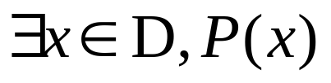

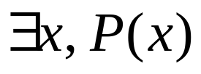
Quantifiers and First Order Logic
Existential Quantifier
  Let P(x) be a predicate and let D be the universe of discourse. The existential quantification of P(x) is the statement:
    There exists x, P(x)
    The symbol is read as “there exists”
    or
    Bound Variable
      The variable appearing in: or

Slide 50
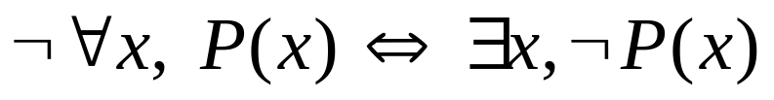



Quantifiers and First Order Logic
Negation of Predicates (DeMorgan’s Laws)
  Example:
    If P(x) is the statement “x has won a race” where the domain of discourse is all runners, then the universal quantification of P(x) is , i.e., every runner has won a race. The negation of this statement is “it is not the case that every runner has won a race. Therefore there exists at least one runner who has not won a race. Therefore:

Slide 51
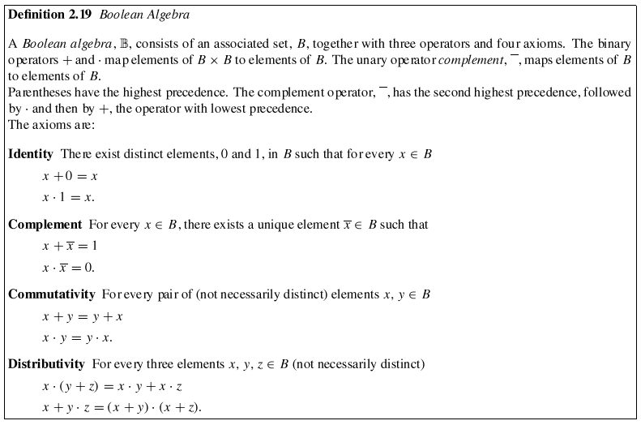

Slide 52
Two-Element Boolean Algebra
The Boolean Algebra on B= {0, 1} is defined as follows:
+ 0 1 · 0 1 ¯
0 0 1 0 0 0 0 1
1 1 1 1 0 1 1 0

Slide 53
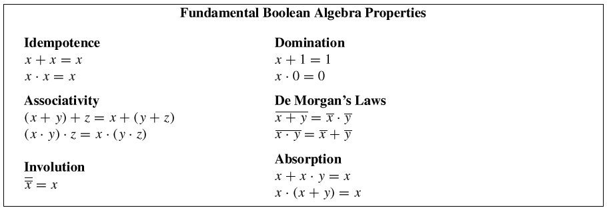
Duality and the Fundamental
Boolean Algebra Properties
Duality
  The dual of any Boolean theorem is also a theorem.
    Parentheses must be used to preserve operator precedence.

Slide 54
Logic and CS
Logic is basis of ALU (Boolean Algebra)
Logic is crucial to IF statements
  AND
  OR
  NOT
Implementation of quantifiers
  Looping
Database Query Languages
  Relational Algebra
  Relational Calculus
  SQL

