Slide 1
ConCare: Personalized Clinical Feature Embedding via Capturing the Healthcare Context
By: bbath2, satta2

Slide 2
General Problems
Extracting personal health context
EHR is extremely diverse, different values of clinical features (eg: blood glucose) may have different significances for different patients based on their static baseline info, thus the static info is important health context for the patient. The issue, however, is that the dynamic clinical features of the patient can also be treated as the health context. As such, in ConCare, we not only look at both the static baseline and dynamic features as the health context, but we also explore any interdependencies between them.

Slide 3
General Problems (cont)
Capturing the impact of Time Interval
Patients tend to go to the hospital only when they are feeling sick, and physicians only prescribe lab examinations when necessary. Therefore, medical records are produced irregularly. It is also perceived by many existing studies that more recent clinical records are more significant than older records in general when it comes to healthcare prediction. However, in certain circumstances, those historical records may contain valuable information that was not revealed in the latest examinations. ConCare implements a more adaptive, time-aware mechanism to flexibly learn the impact of time interval for each clinical feature.

Slide 4
Specific Approach
The multi-channel GRU with time-aware attention is used to separately learn the representation of each dynamic feature
A feature encoder is adopted to combine all the static information and dynamic records based on self-attention
A cross-head decorrelation module is used to minimize the cross-covariance of hidden activations across different heads for the self-attention
The prediction is obtained from all the regenerated feature embeddings with an attention queried by static baseline information

Slide 5
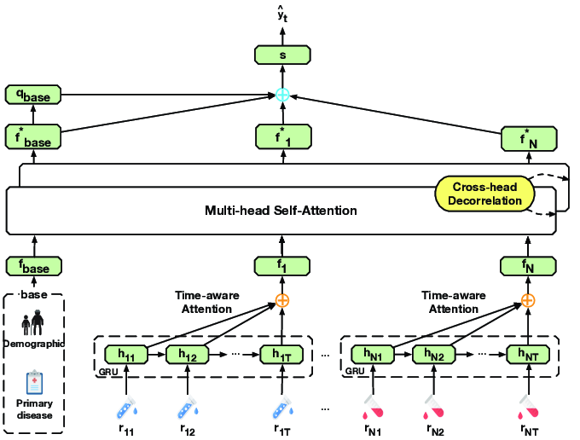

Slide 6
Reproduction Attempts
Databases:
MIMIC-III
Real-World ESRD Dataset (never received permission)
Baselines:
GRU
T-LSTM
RETAIN
Unfortunately, we were unable to replicate any of the other baseline models

Slide 7
Prediction Results
Method | AUROC | AUPRC | Min(Se, P+)
GRU | .8628(.011) | .4989(.022) | .5026 (.028)
RETAIN | .8313(0.14) | .4790(.020) | .4721 (.022)
MCA_RNN | .8587(.013) | .5003(.028) | .4932 (.024)
T-LSTM | .8617(.014) | .4964 (.022) | .4977 (.029)
Transformer | .8535(.014) | .4917 (.022) | .5000 (.019)
SAnD | .8382(.007) | .4545 (.018) | .4885 (.017)
ConCare | .8702(.008) | .5317 (.027) | .5082 (.021)
Method | AUROC | AUPRC | Min(Se, P+)
GRU | 0.8568 | 0.5493 | 0.5092
T-LSTM | 0.8625 | 0.5599 | 0.5
RETAIN | 0.8479 | 0.5077 | 0.5092
Regression | 0.8485 | 0.4744 | 0.4601
ConCare (28 Epochs) | 0.8566 | 0.4985 | 0.5183
ConCare (100 Epochs) | 0.8669 | 0.5736 | 0.5481

