Slide 1


Slide 2

The Problem
Smoke Detectors are hopelessly outdated tech

Slide 3

The Product
An IoT integrated Smoke Detector
Detects air quality information throughout house or workplace and stores it in database for many possible uses

Slide 4
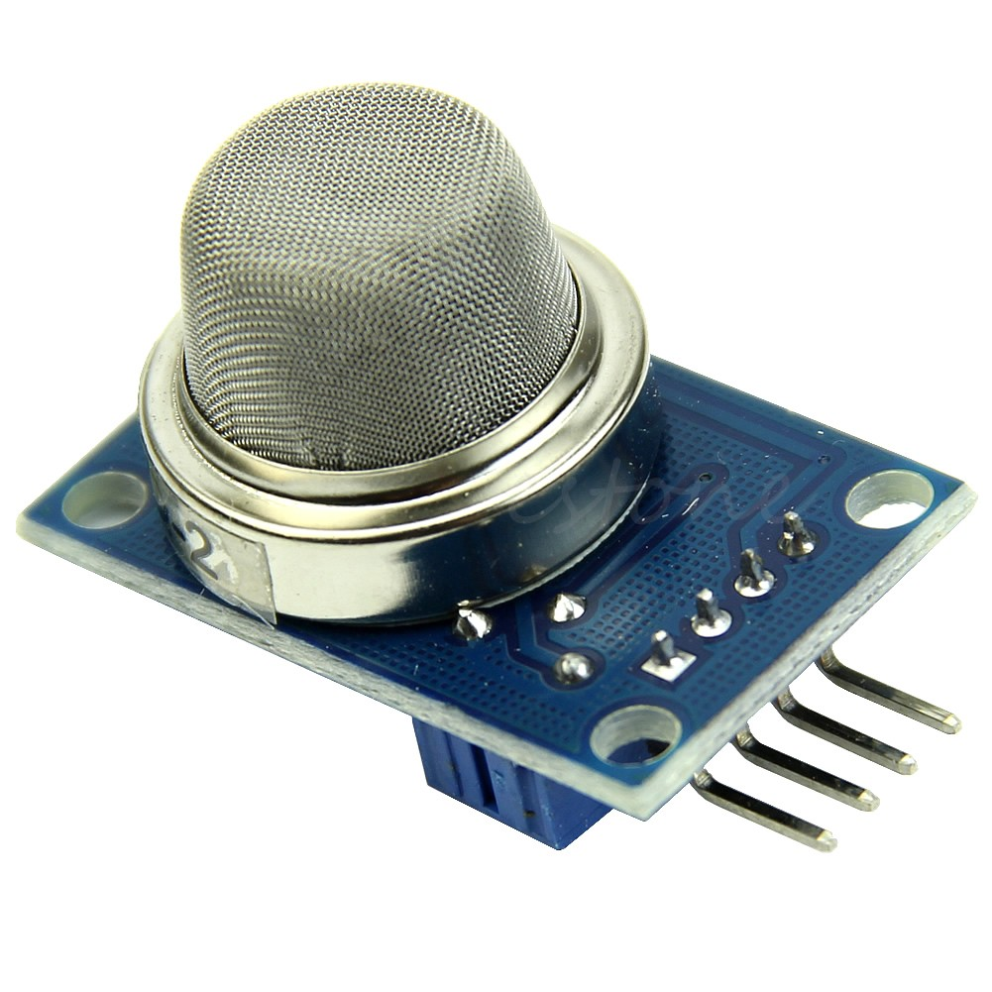
The Sensor
MQ2 Sensor
Detects Smoke, Carbon Monoxide, Flammable Gas
Very Cheap (<$3 for crappy ones)

Slide 5
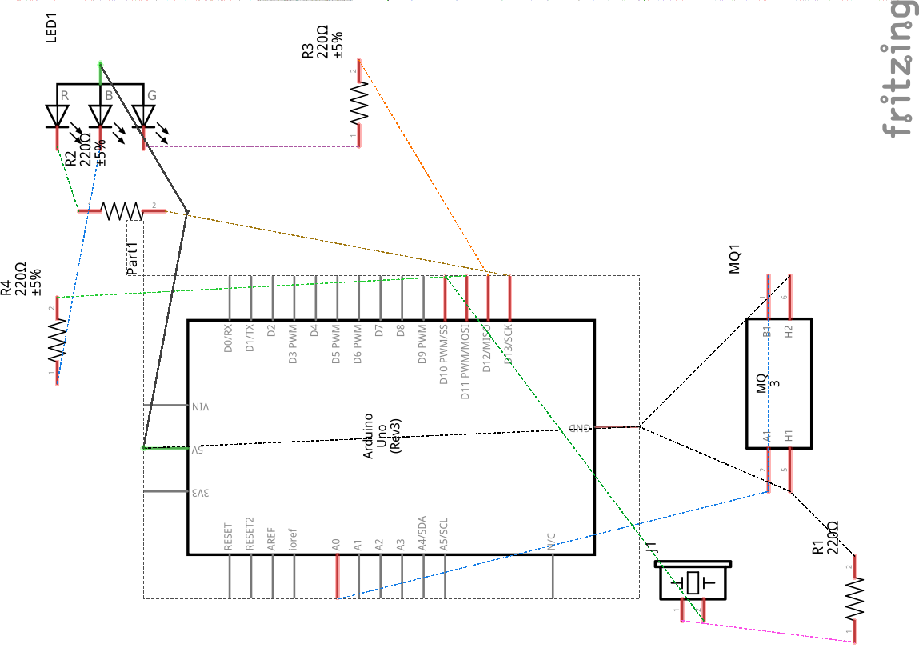
The Circuit
Consists of Sensor, RGB Led, Piezo Speaker

Slide 6
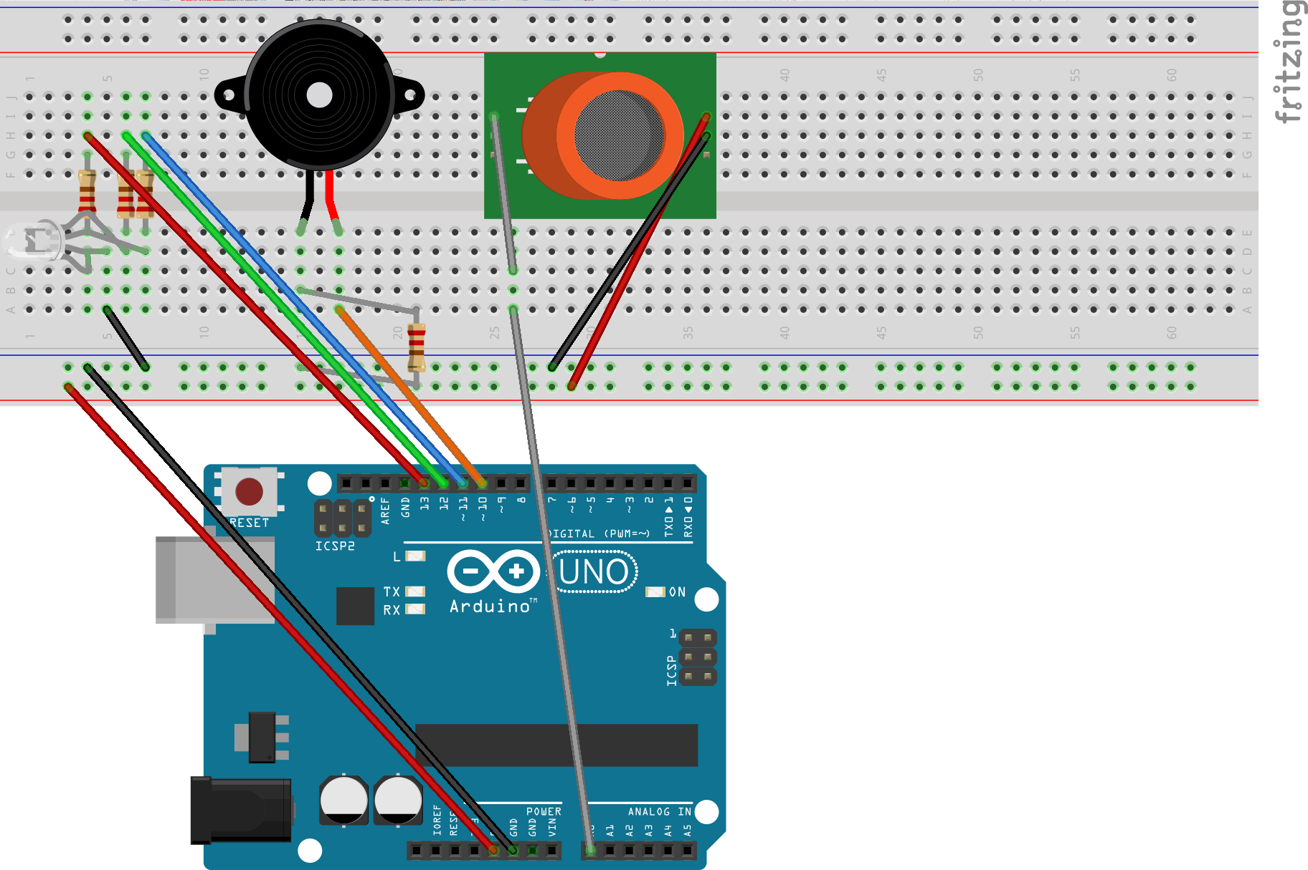
Arduino
The Arduino compiles data on the air quality and sends it over serial to the connected computer.

Slide 7
Raspberry Pi + Python
The connected Pi (or whatever computer you choose with USB shields) will relay the data to the cloud service
Spawns a multi-threaded process wherein read are simultaneously taken in from every connected Arduino circuit
Recalibrates every 40 reads (blue light)

Slide 8

Foggy Factor
The Python on the SBC can also relay signals from one Arduino to all the others (like a multi-cast)
This will set off all the connected alarms in a house if one circuit is triggered.

Slide 9

API / Cloud Storage Service
Logs are sent live to the sto API
Open source alternative to many paid IoT platforms (IFTTT, Zapier, etc.)
Requires technical know-how and some Javascript chops to set up
I wrote it.

Slide 10
Data Storage
Data is currently populating in a free mLab instance
Calculated to consume 30-50MB per year per sensor
Can also be stored locally on internal server for further fog effects
Customizable in the python code how often you want to relay data to servers

Slide 11


Mobile App
Prototype currently built in Facebook’s ReactJS + Framework7
Data is being fetched and displayed
Can try to show it but it’s causing trouble
Can be converted to React Native and ported to Android + iOS

Slide 12
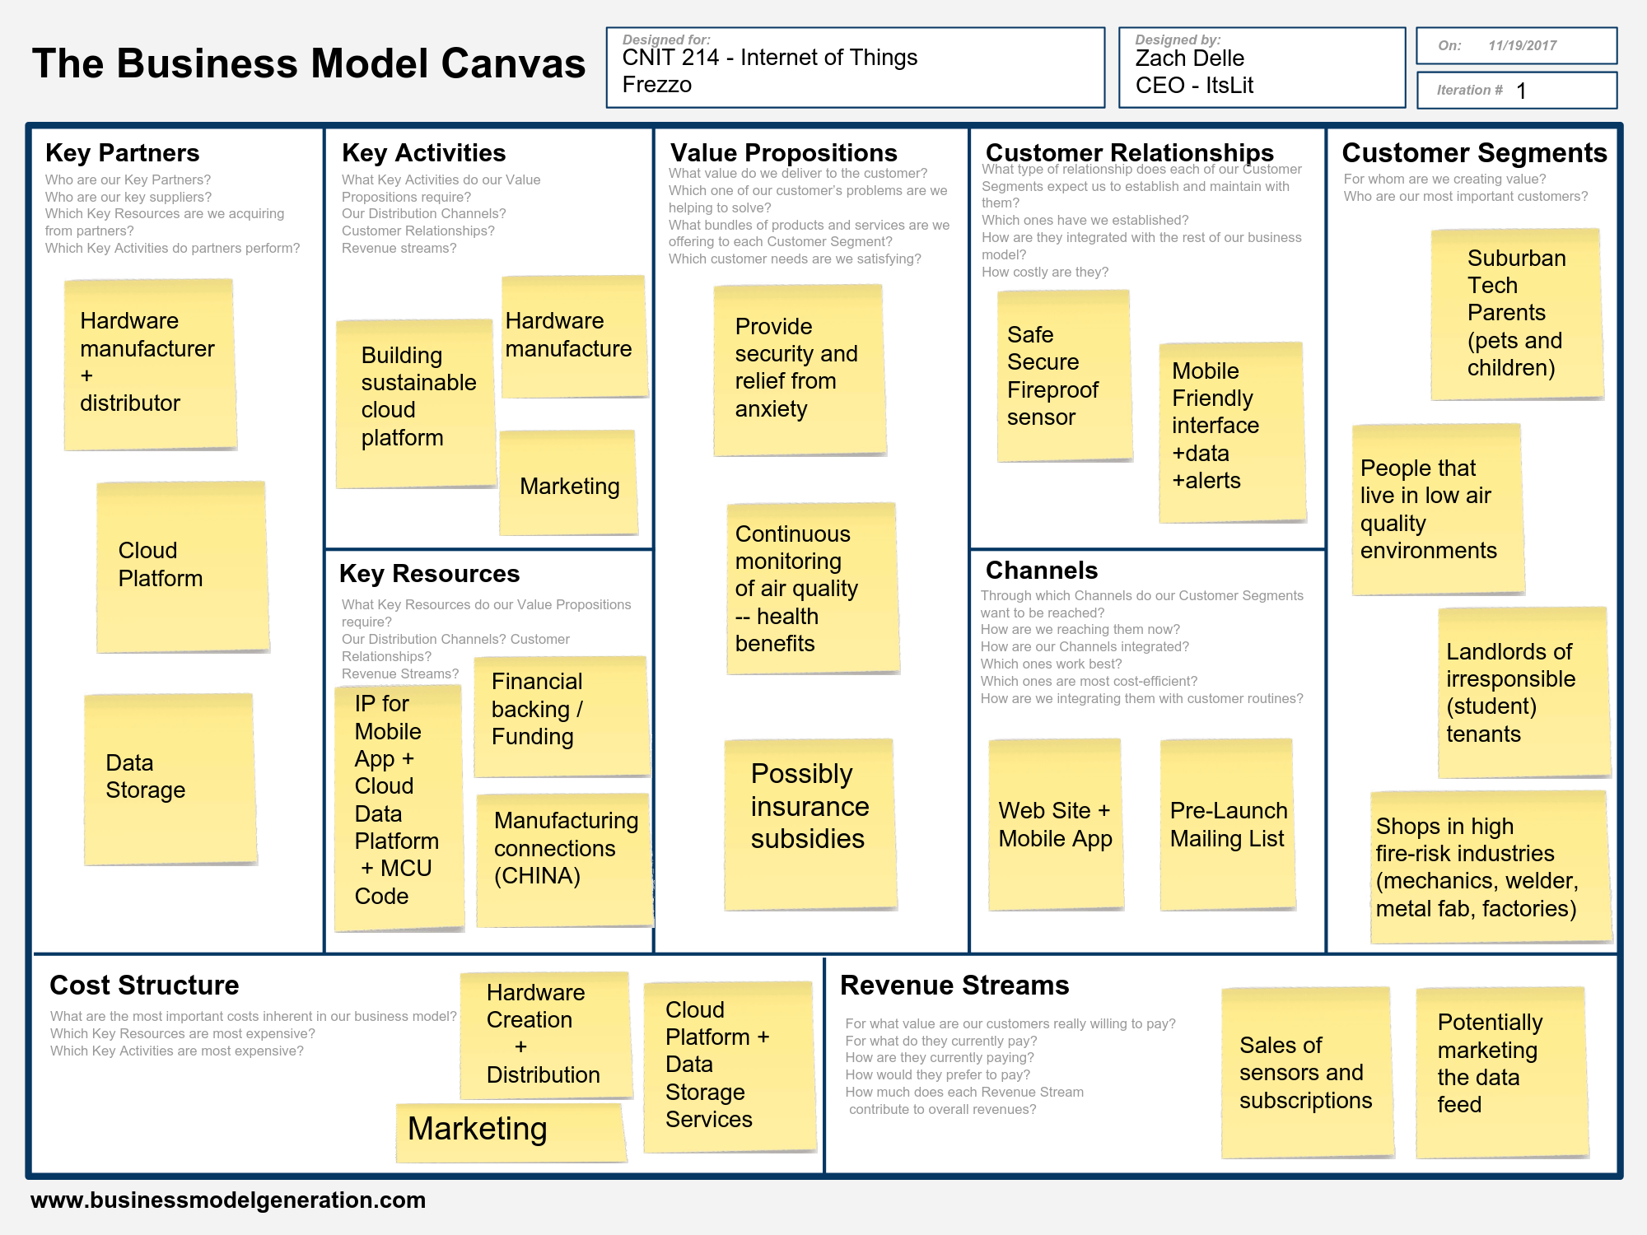
Business Case

Slide 13

Potential Improvements
Circuit could be built for PoE for data transfer and power – great use case very low power
Onboard SBC for processing at individual sensor
Fireproof acrylic or fiberglass (kevlar) casing could make it very useful for forensics

Slide 14
Source Code
Source Code: http://github.com/z3dtech/ItsLit
Sto API: http://github.com/z3dtech/sto
API wrapper http://github.com/z3dtech/StoPy
All MIT Licensed – feel free to repurpose

